Slide 1

The genome assembly is simply the genome sequence produced after chromosomes have been fragmented, those fragments have been sequenced, and the resulting sequences have been put back together. A genome assembly is updated when DNA has been sequenced that allows gaps to be filled. It may also be updated when a new assembling algorithm is released.

Slide 2
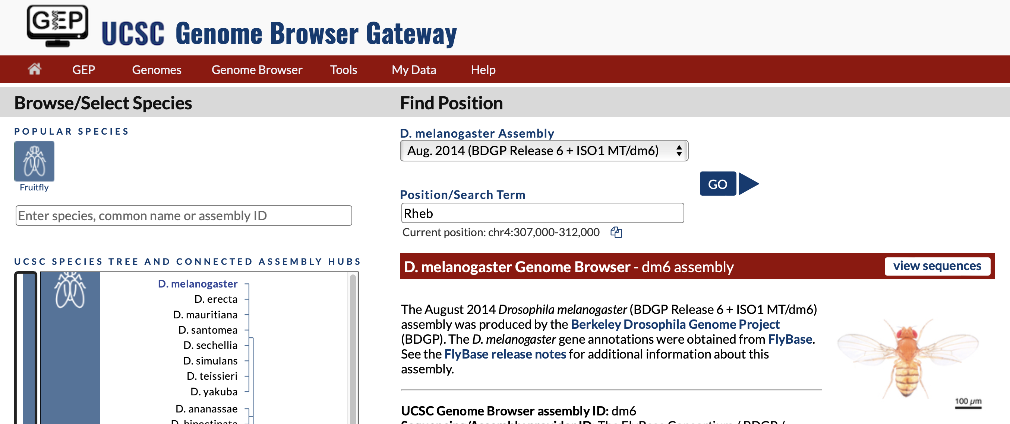

Slide 3
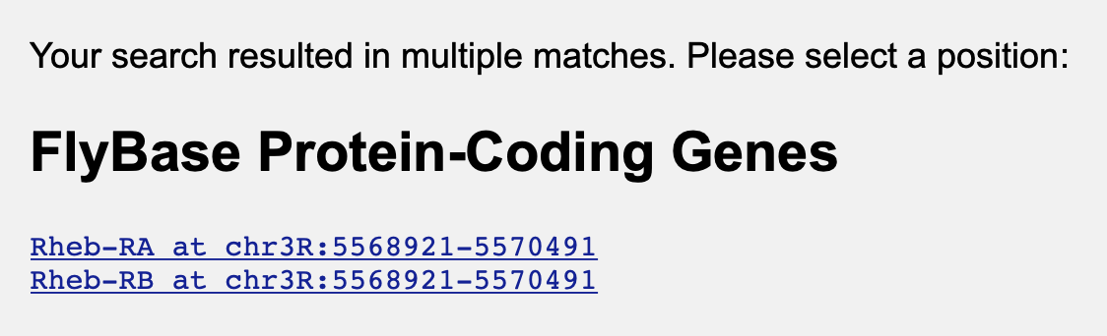

Slide 4

If the coordinates weren’t identical, we would have chosen the one that covers the largest region for this step.

Slide 5
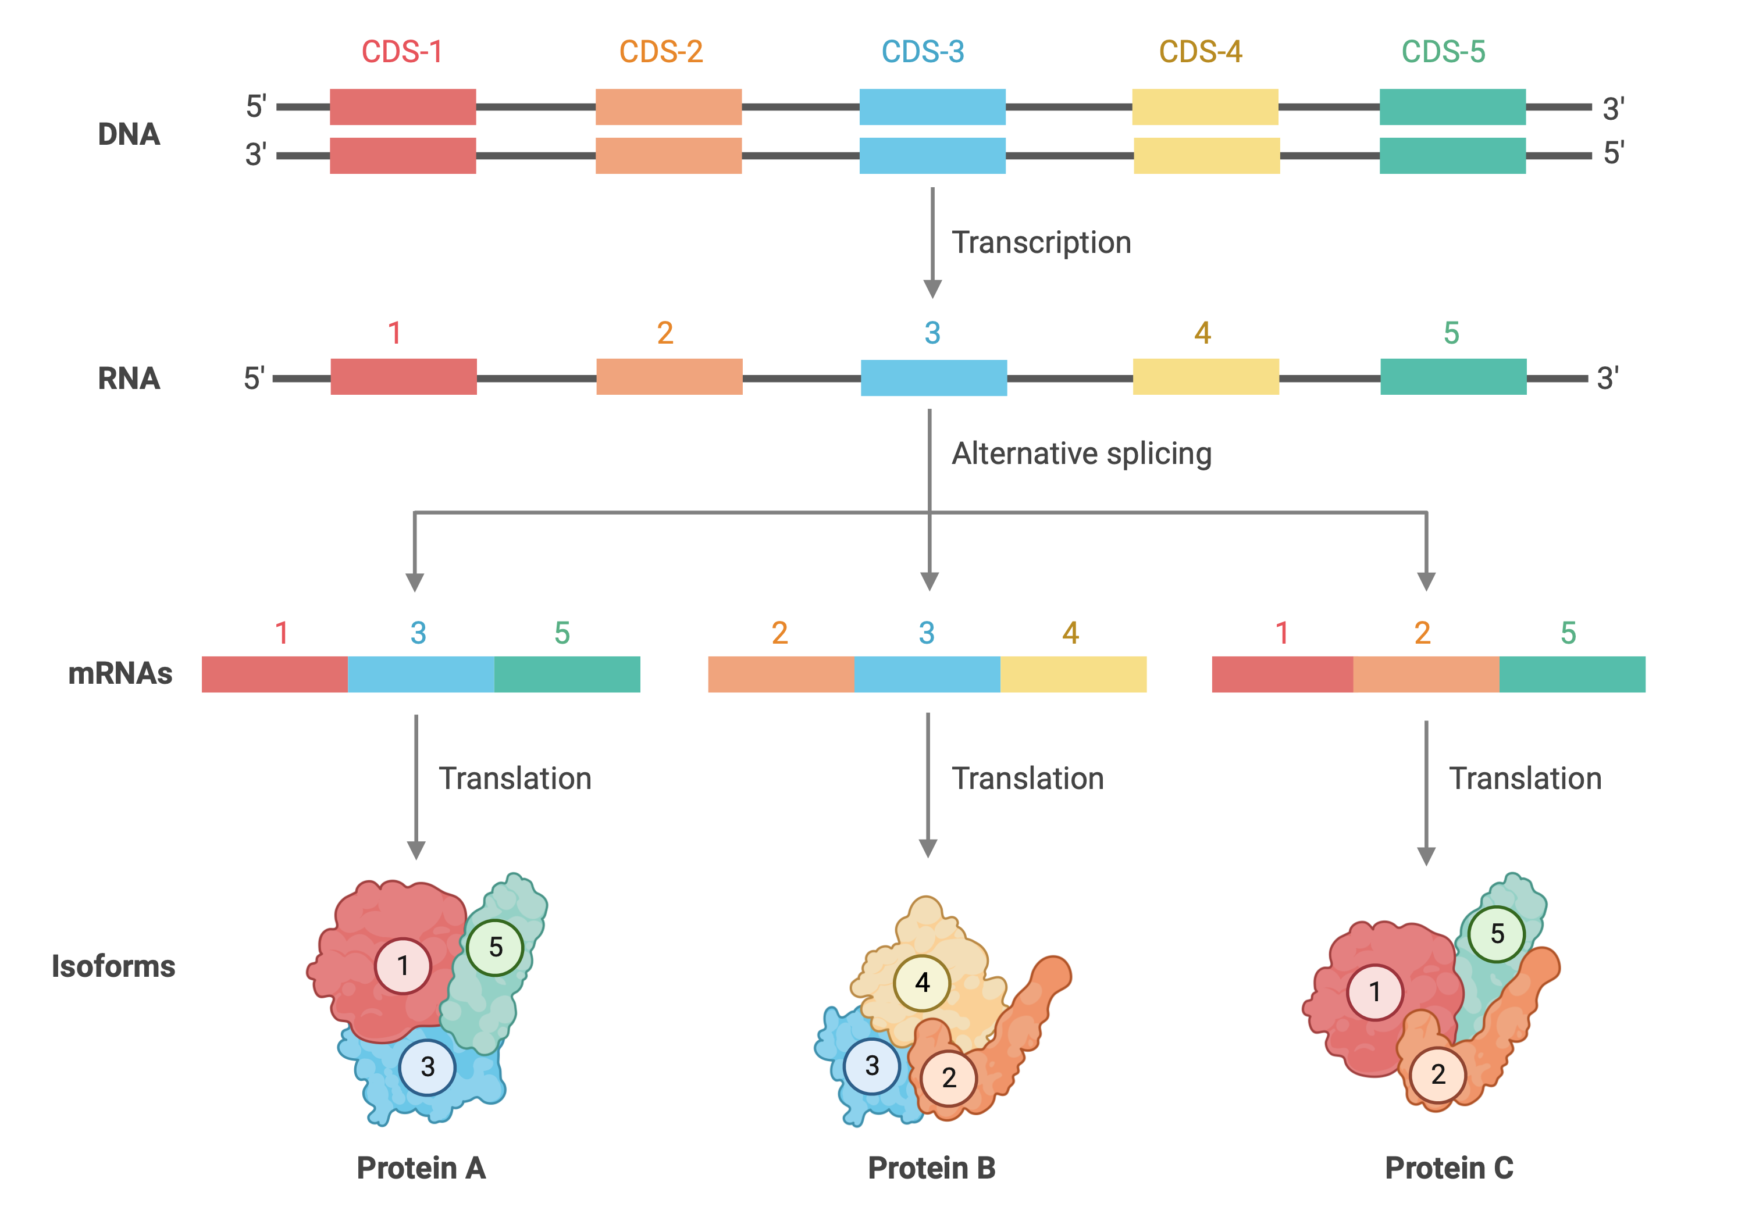
Isoforms are potentially different versions of a protein encoded by a single gene. Isoforms result from alternative splicing of a particular pre-mRNA, and/or the use of a different transcription start site (TSS).
Proteins A, B, & C are isoforms encoded from the same gene through alternative splicing.
Adapted from “Gene Splicing” by BioRender.com (2022). Retrieved from https://app.biorender.com/biorender-templates
Notes:
____________
Alt Text
Isoforms are potentially different versions of a protein encoded by a single gene. Isoforms result from alternative splicing of a particular pre-mRNA, and or the use of a different transcription start site or TSS.
In this figure we start with a double stranded DNA molecule composed of five coding DNA sequences, or CDS, blocks. Each block undergoes transcription to create a single stranded RNA molecule. Then, alternative splicing jumbles up the blocks so instead of all five being included in the mRNA only three undergo translation. For example, CDS 1, 3, and 5 undergo translation to create protein A. CDS 2, 3, and 4 undergo translation to create protein B, and CDS 1, 2, and 5 undergo translation to produce protein C. Proteins A, B, and C are isoforms encoded from the same gene through alternative splicing.

Slide 7
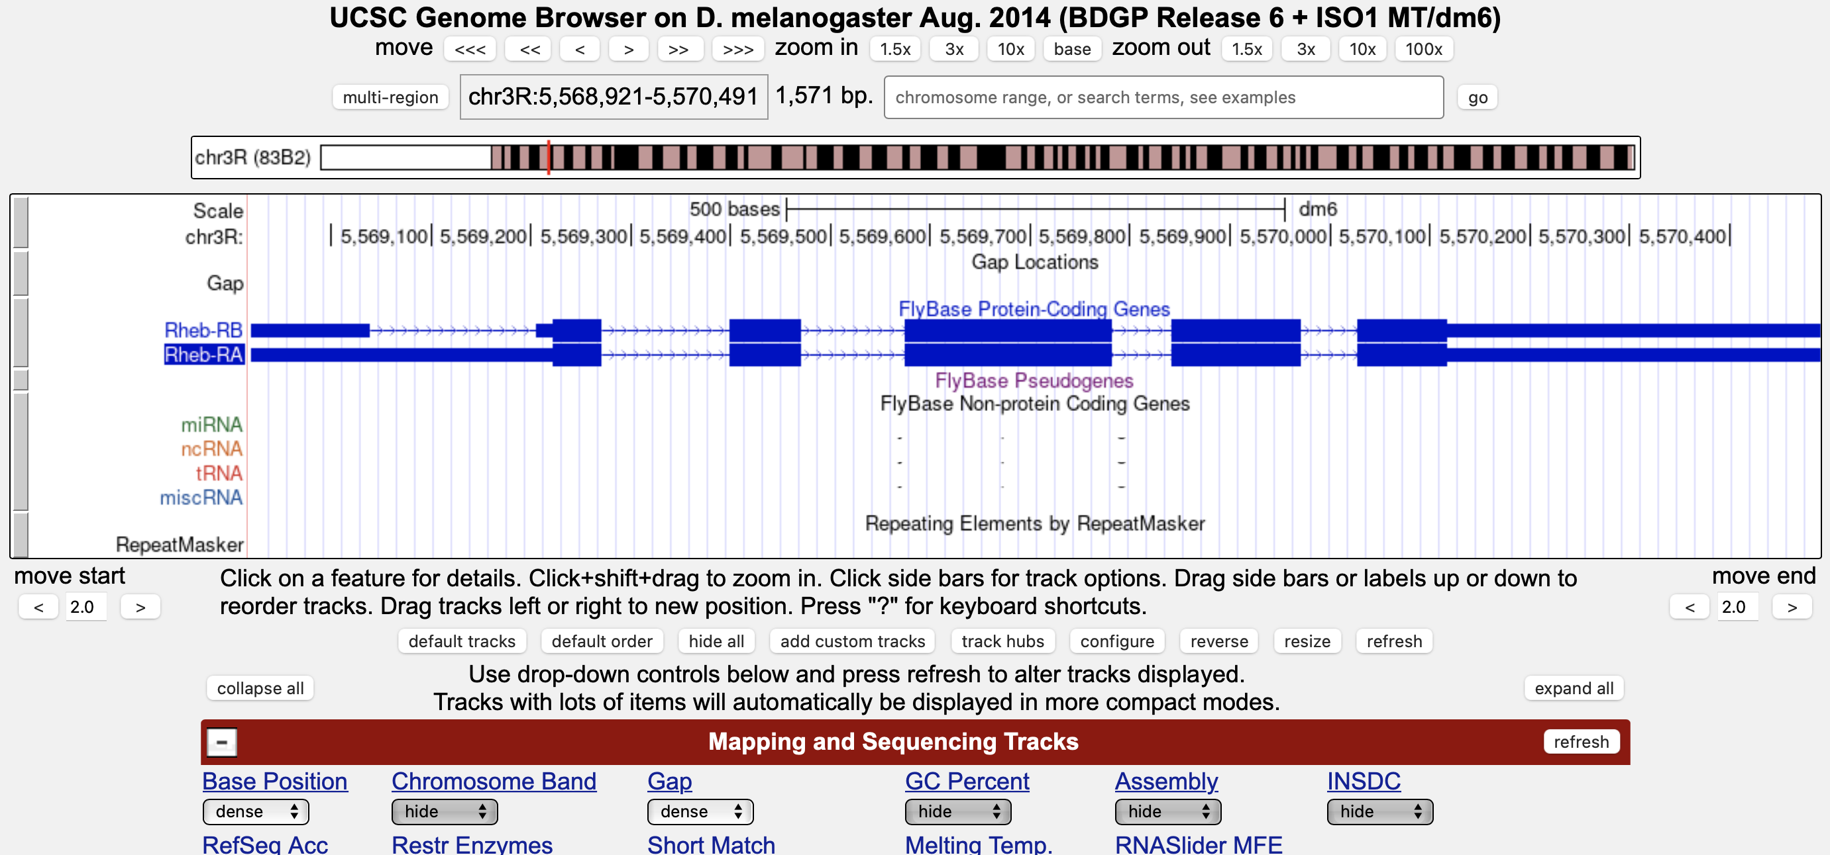
Genomic region shown in the Browser image
Total size in base pairs (bp) of the genomic region being viewed
Navigation Controls
Genome Browser Image (Genomic Features Panel)
Display Controls

Slide 8
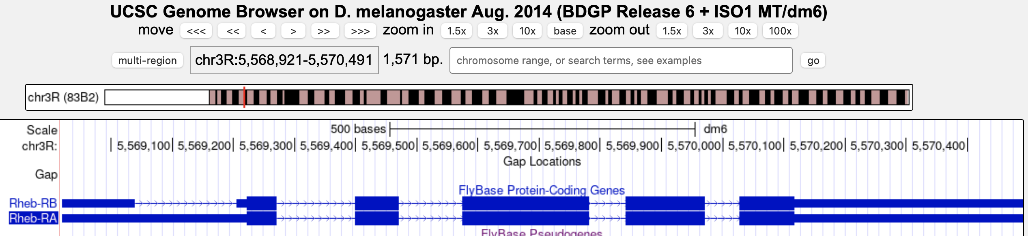
Species
Assembly
Scaffold

Slide 9
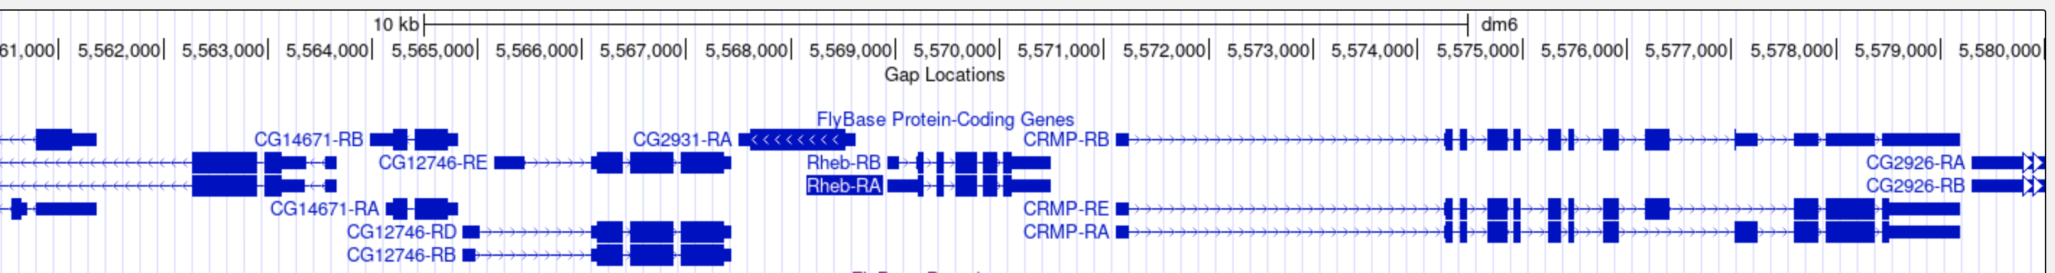
CG12746
CG2931
Rheb
CRMP
CG2926

Slide 10
Each protein-coding gene annotated by FlyBase in D. melanogaster has an annotation symbol that begins with the prefix “CG” for Computed Gene. Unless genes are characterized experimentally and formally named, they are referred to by this symbol. For example, in the figure above, three of the five genes—CG2931, CG12746, and CG2926—have not been named since they haven’t yet been characterized experimentally. However, the Ras homolog enriched in brain and Collapsin Response Mediator Protein genes have been characterized by past scientific studies, and thus are referred to by their gene symbols Rheb and CRMP, respectively.

Slide 11
D. melanogaster (chr3R scaffold)
5’ 3’
CG12746
CG2931
Rheb
CRMP
CG2926
Target Gene
on + strand
Upstream
Downstream

Slide 12
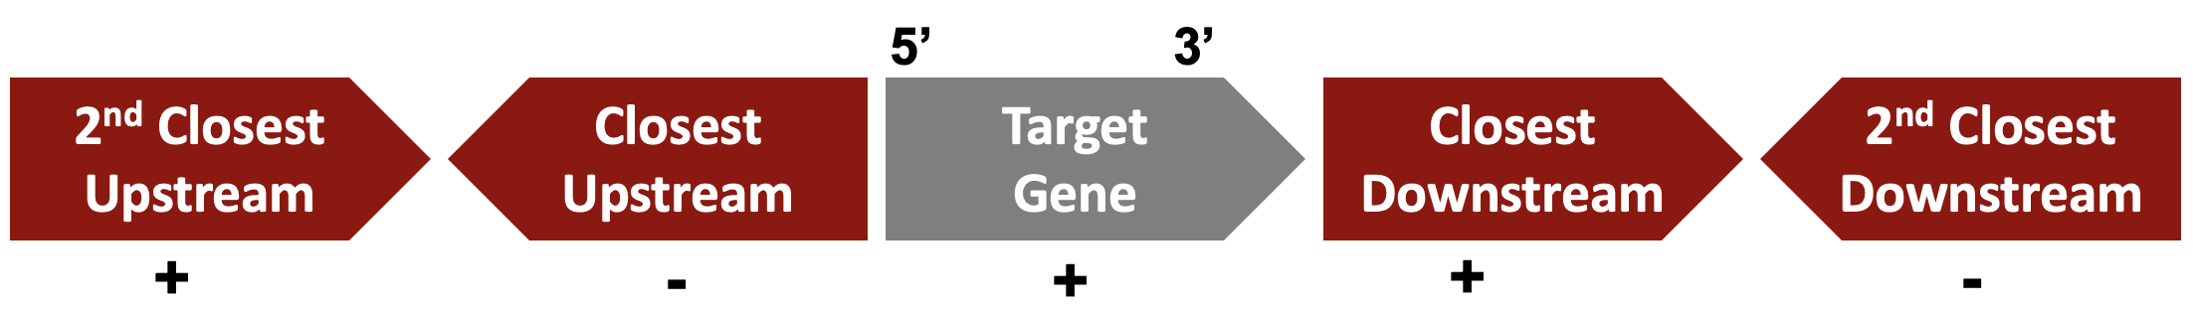
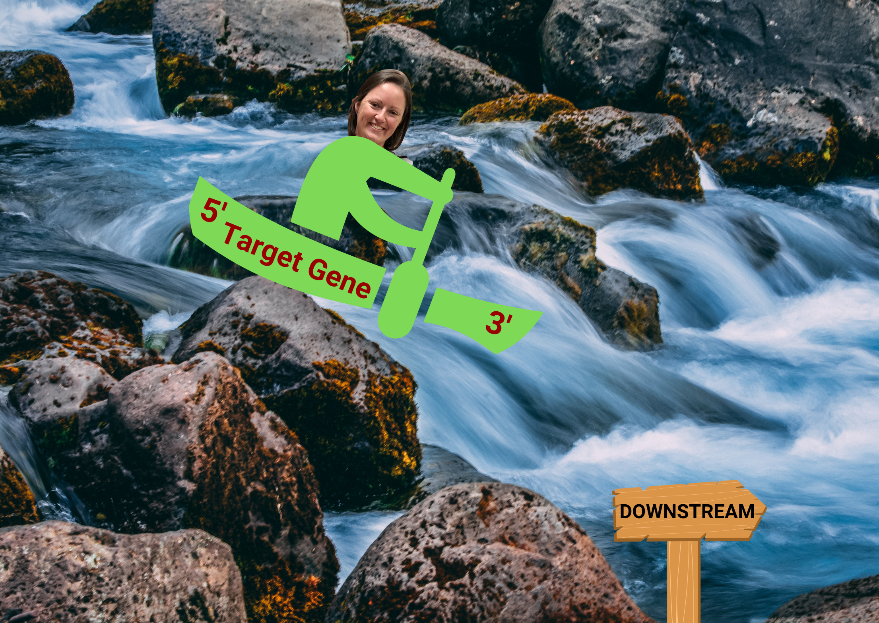
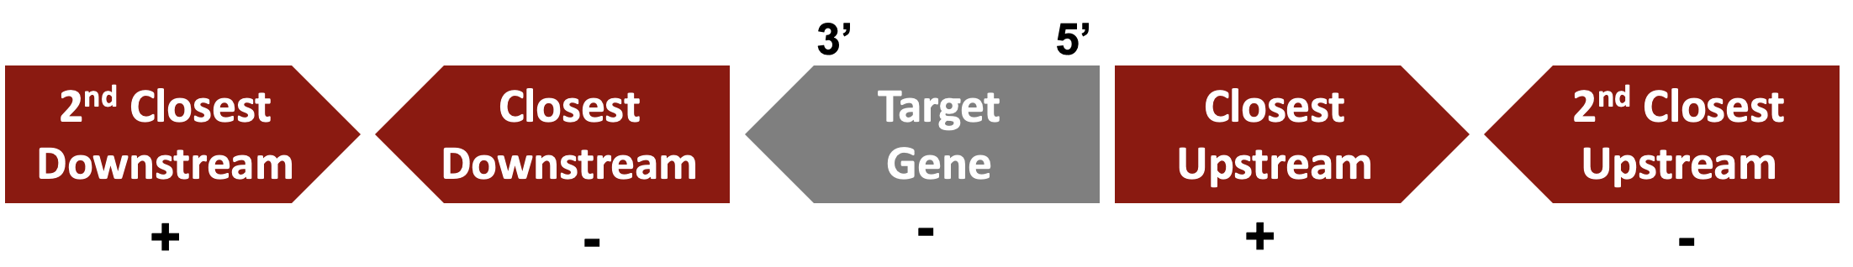
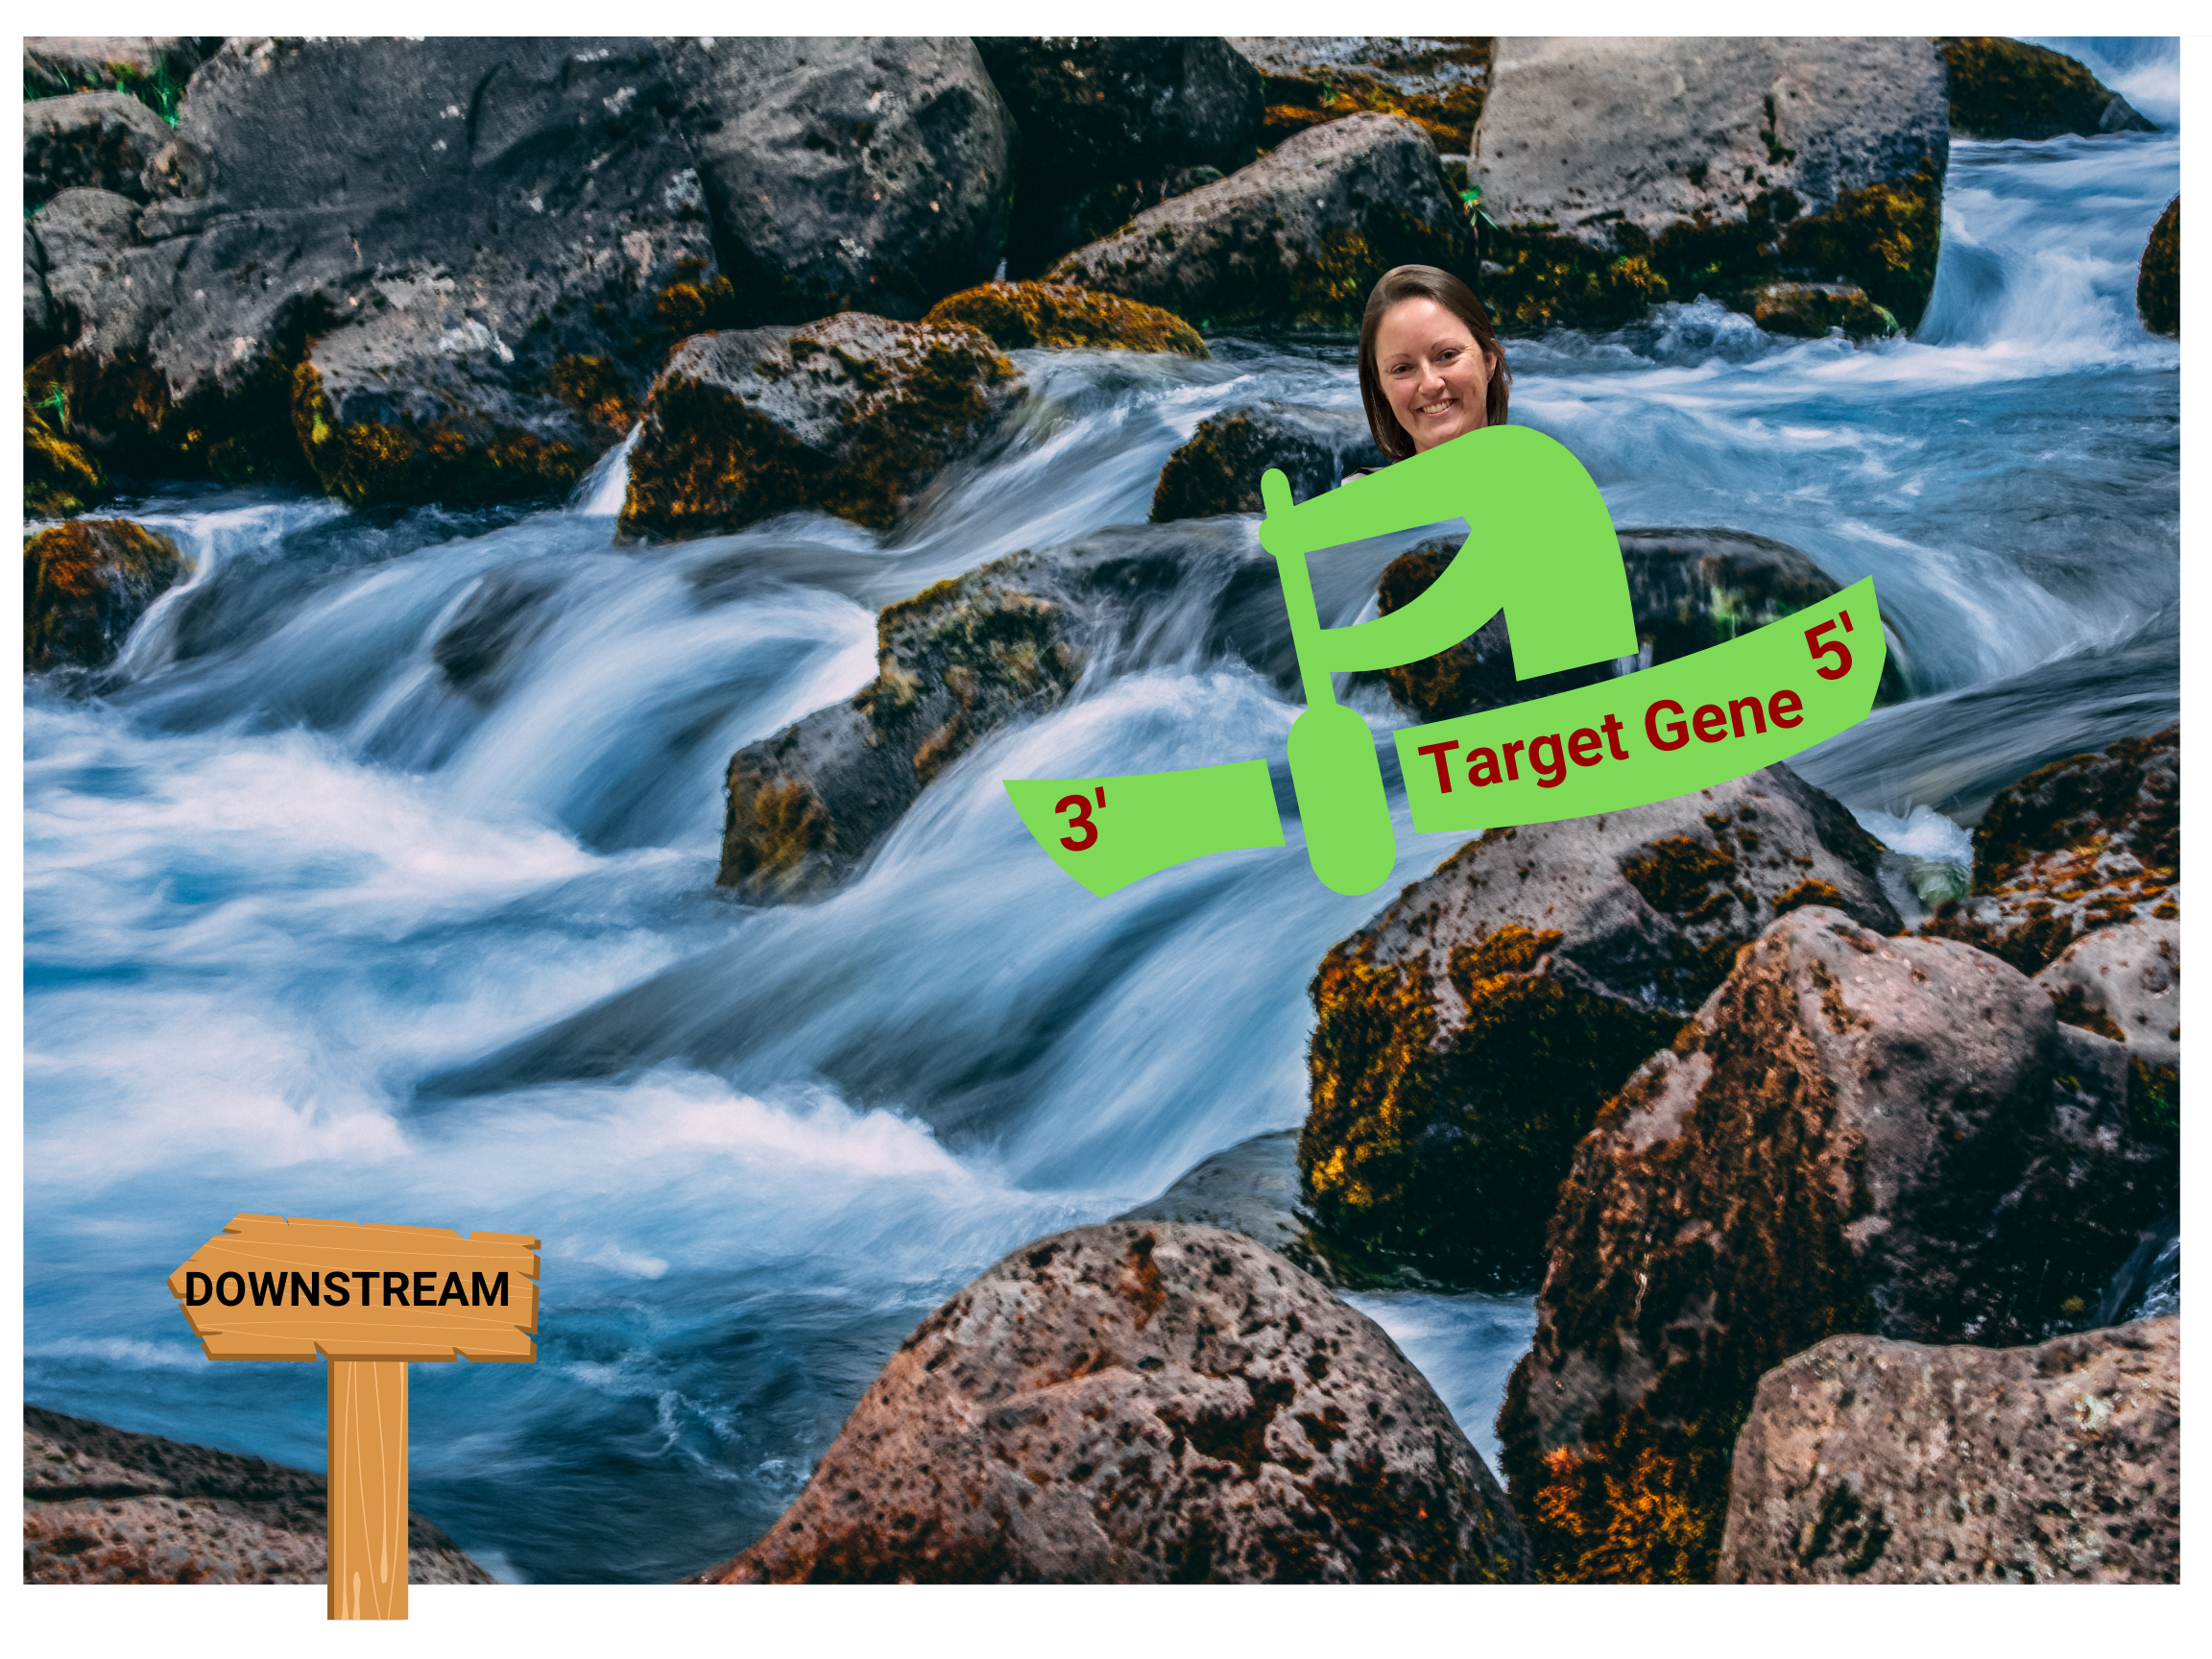
Upstream: located on the 5’ side of the target gene
Downstream: located on the 3’ side of the target gene
Genomic Neighborhood of Target Gene on Positive Strand of DNA
As we learned in Understanding Eukaryotic Genes: Module 1, genes on the same DNA molecule may be transcribed in opposite directions (i.e., genes on the positive strand of DNA are transcribed from left to right and genes on the negative strand of DNA are transcribed from right to left). Since genes have directionality, the areas of DNA we call upstream and downstream change depending on the orientation of the target gene (i.e., upstream and downstream is determined in relation to the directionality of your target gene).
+
Since river streams have directionality (i.e., flow in only one direction), to help you orient yourself, think of your target gene as a raft floating down a stream. Wherever the raft just floated from is “upstream” of its current location and wherever the raft is floating to is “downstream” of its current location. Notice how the areas of DNA we call upstream and downstream to the target gene change depending upon whether the target gene is on the positive or negative strand of DNA.
-
Genomic Neighborhood of Target Gene on Negative Strand of DNA

Slide 13
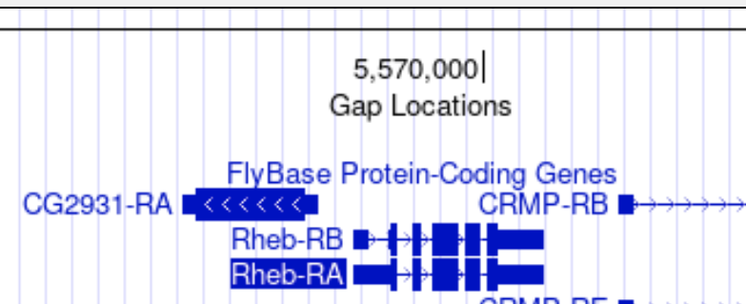

Slide 14
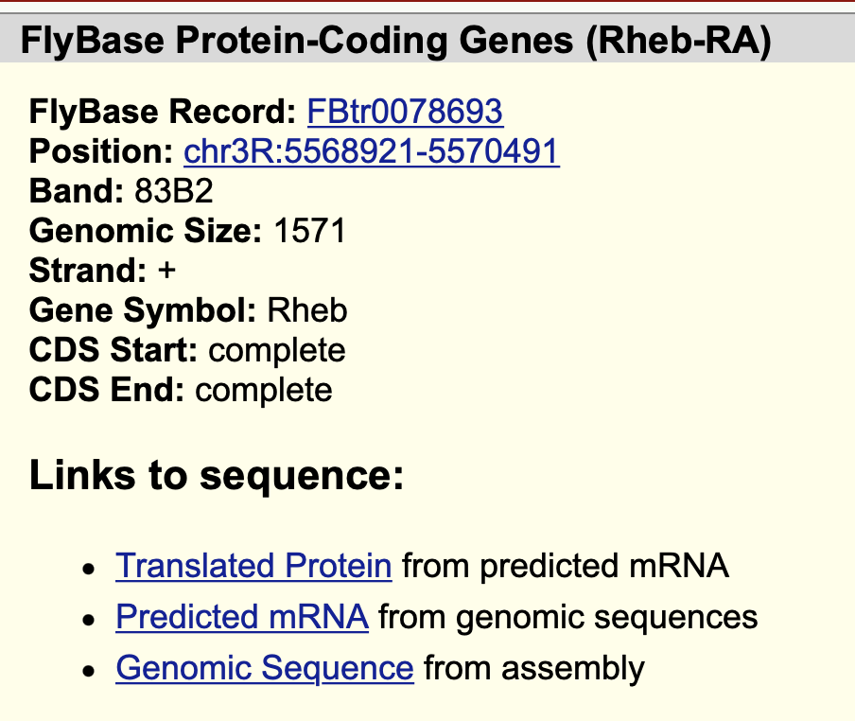
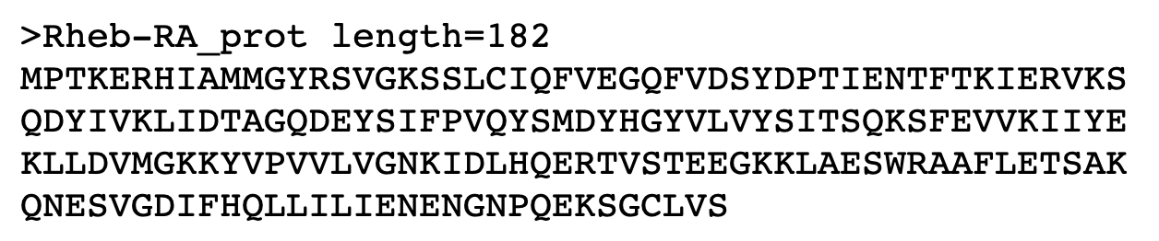
Rheb-PA

Slide 15
What is the difference between Rheb-RA and Rheb-PA?
The prefix “Rheb" corresponds to the gene symbol. The ‘R’ or ‘P’ in the suffix designates the associated transcript (mRNA) or protein-product of the gene, respectively. The ‘A’ in the suffix refers to the A isoform of the gene.
Gene symbols (e.g., Rheb) are italicized while their mRNA and protein products are not (e.g., Rheb-RA and Rheb-PA).

Slide 16
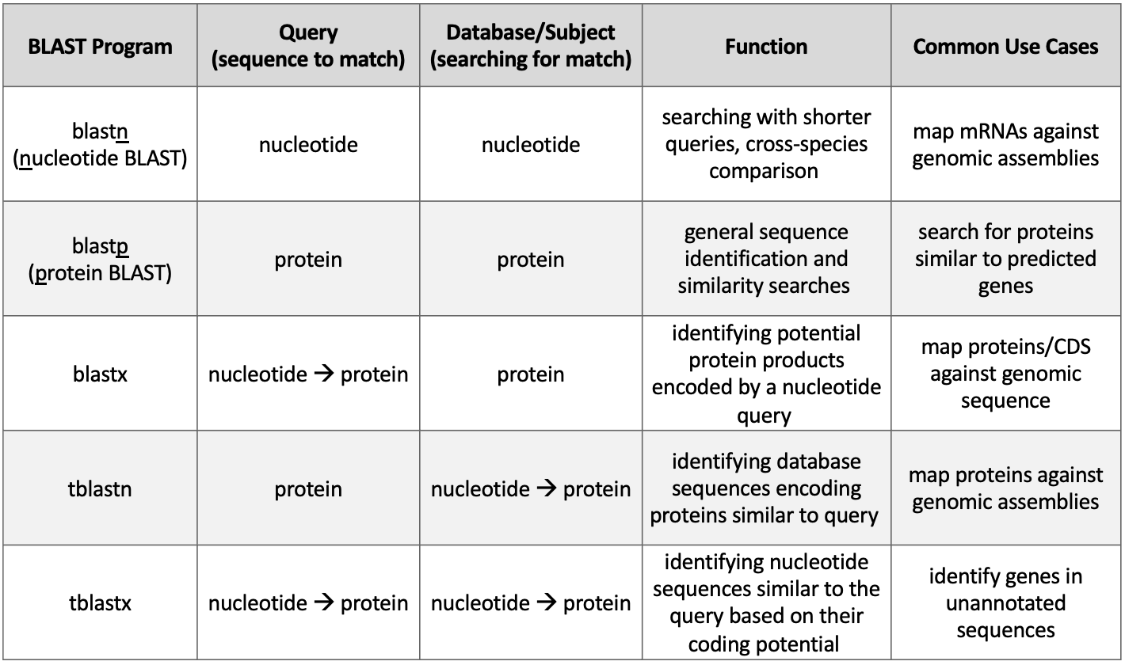
The Basic Local Alignment Search Tool (BLAST) finds regions of local similarity between nucleotide or protein sequences by comparing nucleotide or protein sequences to sequence databases (or to an individual nucleotide or protein sequence) and calculates the statistical significance of each match. The statistical values we will focus on are:
Expect Value (E-value): describes the expected number of BLAST hits with this alignment score or better due to chance
  The lower the E-value (i.e., the closer it is to zero), the more significant the match.
Percent Identity (Identities): describes how similar the query sequence is to the database (or subject) sequence (i.e., how many characters in each sequence are identical)
  The higher the Percent Identity (i.e., the closer it is to 100), the more significant the match.
The five traditional BLAST programs:
blastn program searches nucleotide databases using a nucleotide query
blastp program searches protein databases using a protein query
blastx program searches protein databases using a translated nucleotide query
tblastn program searches translated nucleotide databases using a protein query
tblastx program searches translated nucleotide databases using a translated nucleotide query
Arrows indicate the BLAST program translates the
nucleotide sequence before performing the search.

Slide 17
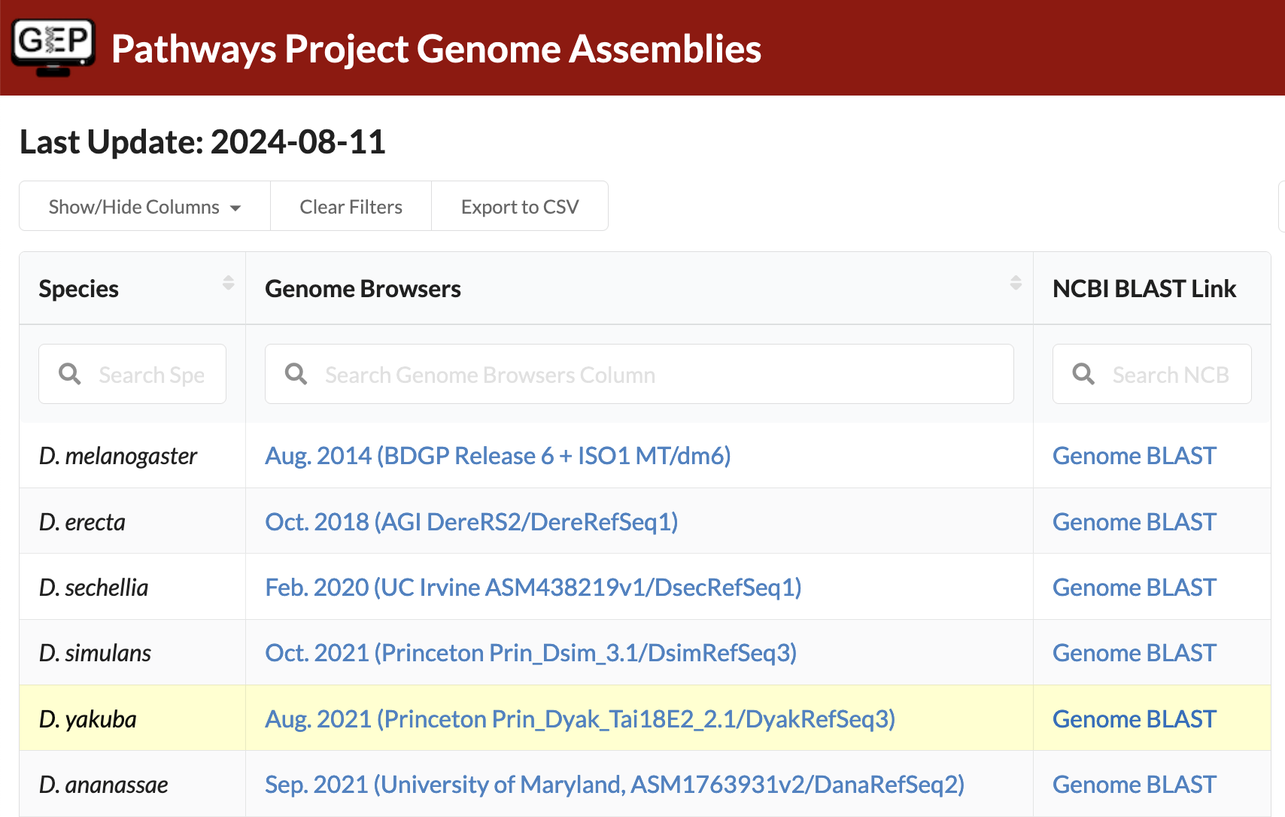

Slide 18
The National Center for Biotechnology Information (NCBI) periodically updates the genome assemblies used for BLAST searches that can cause bookkeeping issues when they occur in the middle of a semester.
Using the “Genome BLAST” links on the ”Pathways Project Genome Assemblies” page ensures student annotators are navigating to the correct genome assembly database when performing their BLAST search against the entire genome of their target species. However, this circumvention will only be needed in Part 2 of the Pathways Project protocol. In Parts 3 and 5, we will navigate directly to the NCBI BLAST home page.
Notes:
The National Center for Biotechnology Information (NCBI) periodically updates the genome assemblies used for BLAST searches that can cause bookkeeping issues when they occur in the middle of a semester. Using the “Genome BLAST” links on the ”Pathways Project Genome Assemblies” page ensures student annotators are navigating to the correct genome assembly database when performing their BLAST search against the entire genome of their target species. However, this circumvention will only be needed in Part 2 of the Pathways Project protocol. In Parts 3 and 5, we will navigate directly to the NCBI BLAST home page.

Slide 19
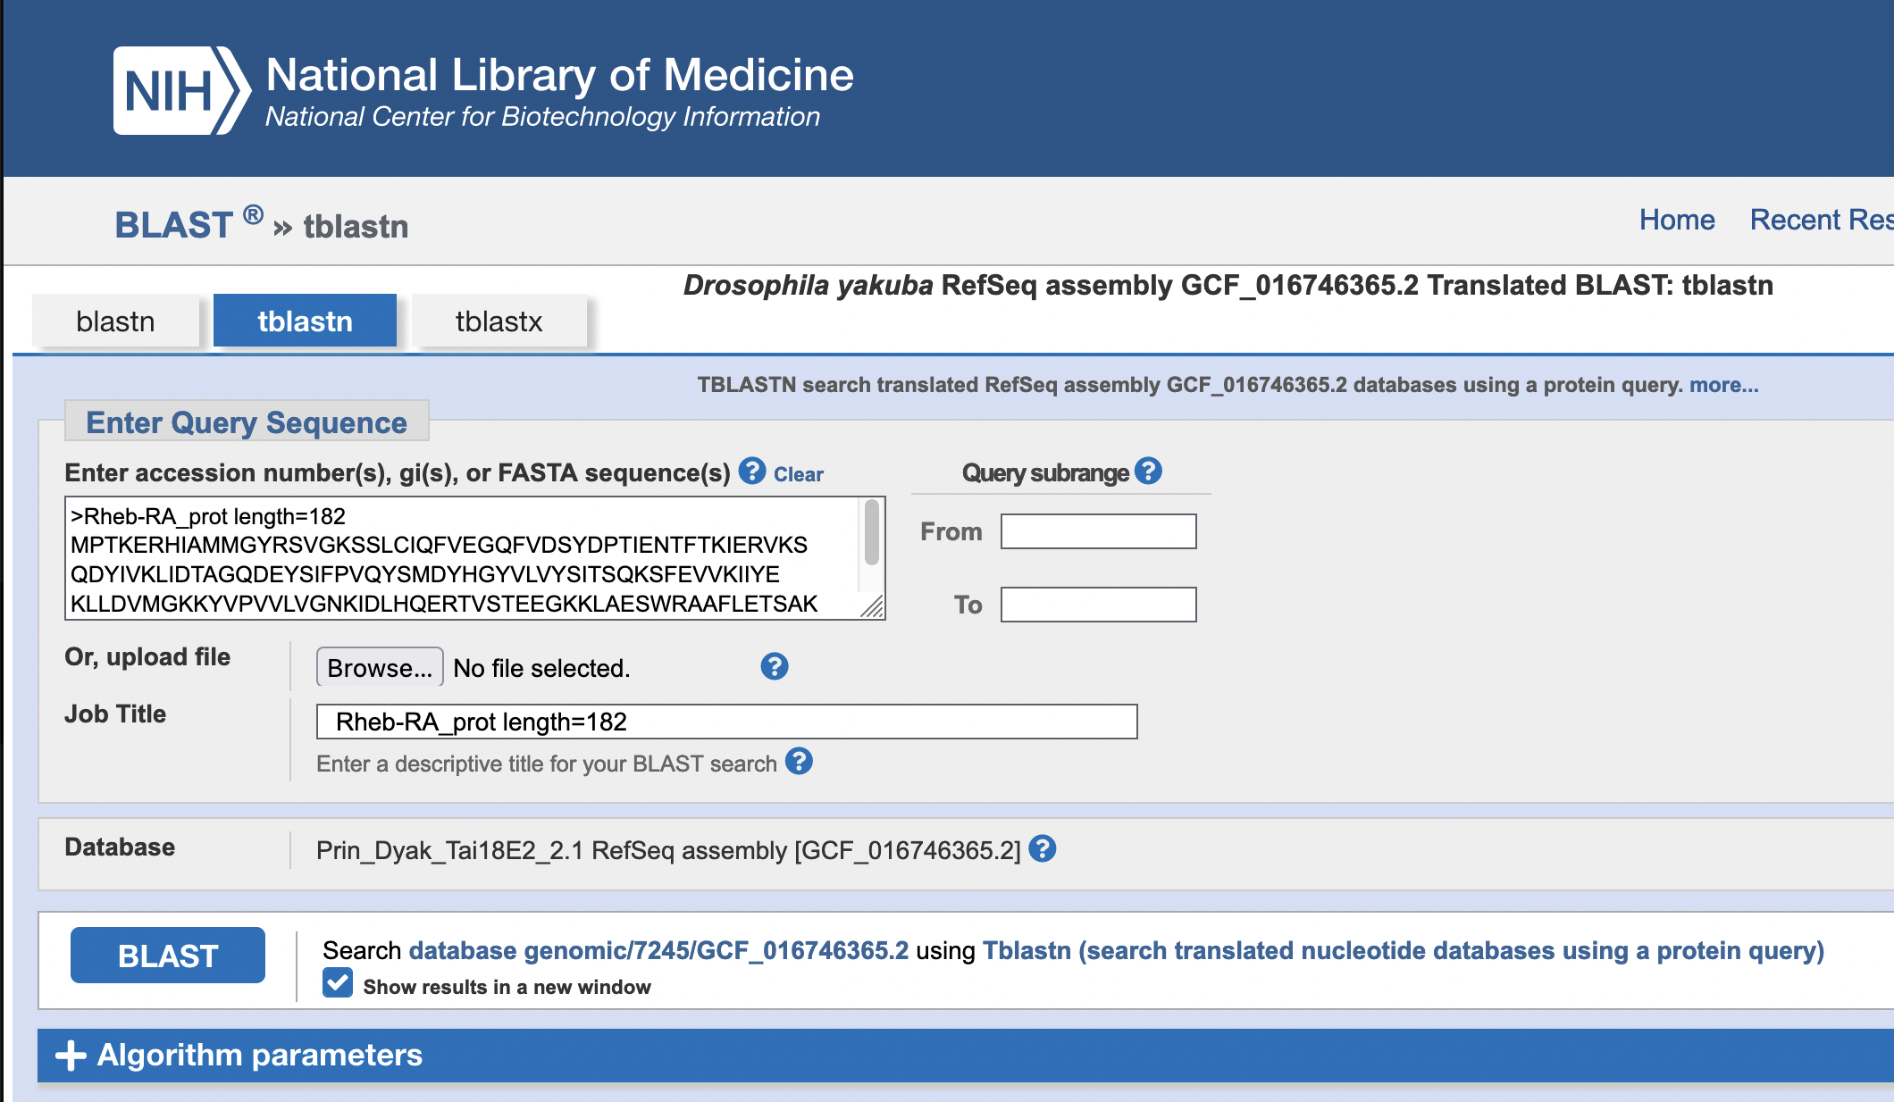
tblastn searches translated nucleotide database
using a protein query
D. melanogaster Rheb-PA
(protein query)
Prin_Dyak_Tai18E2_2.1 RefSeq assembly [GCF_016746365.2]
nucleotide database containing the entire D. yakuba genome assembly
(
)

Slide 20
Similar to how humans have unique
fingerprints that can be used to identify them at crime scenes, each nucleotide and amino acid sequence is assigned a unique accession number to
allow scientists to identify it from the millions of other sequences stored in a database.

Slide 21
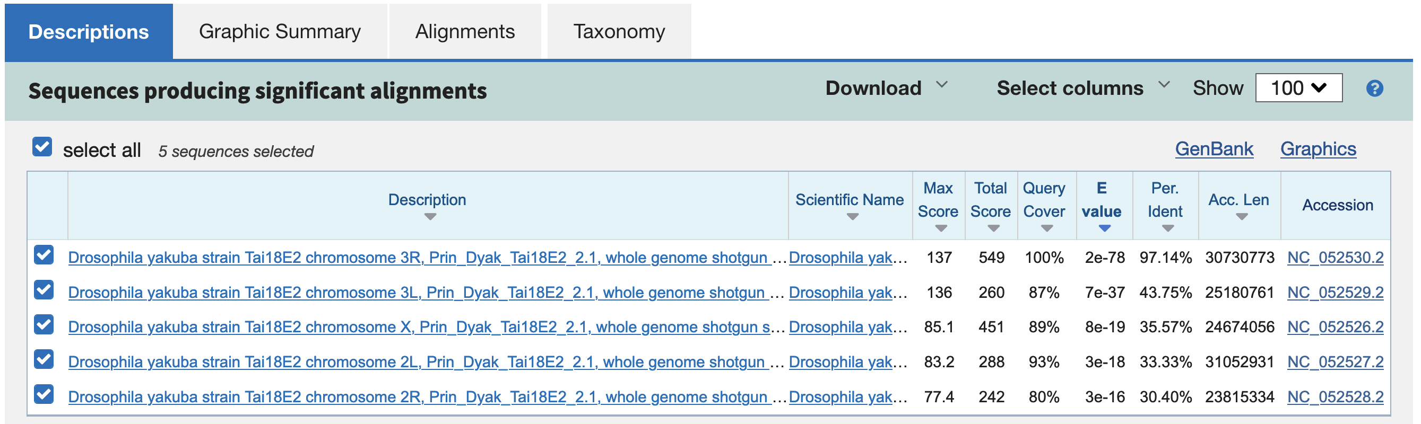

Slide 22

Each sequence record in the NCBI database has a sequence version number consisting of an accession
number followed by a dot and a version suffix (e.g., NC_052530.2). The accession number is used by NCBI to identify the sequence record, and the version suffix is used to identify revisions to the sequence record. By convention, an accession number without the version suffix refers to the latest version of the sequence record. Student annotators should only use the accession number and ignore the version number when navigating in the Genome Browser. Student annotators will use the accession number (e.g., NC_052530) to navigate to a genomic region in the Genome Browser. For example, entering “NC_052530:100-200” in the search terms of the D. yakuba Genome Browser would show us coordinates 100-200 of the chromosome 3R scaffold (NC_052530) in the Genome Browser image.
NC_052530.2
Accession Number
Version
The accession number for the chromosome 3R scaffold of D. yakuba is NC_052530.

Slide 23
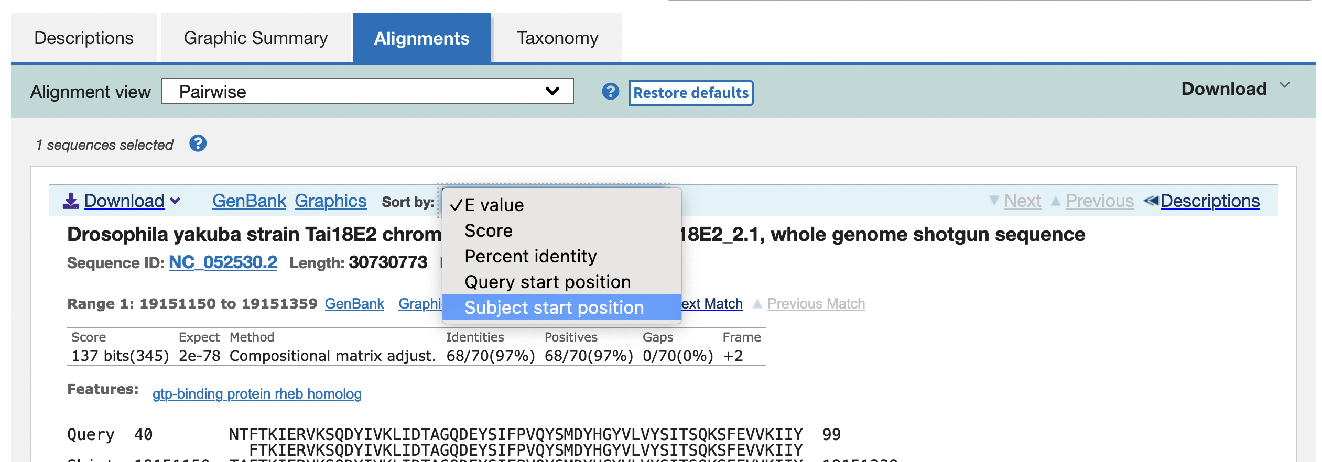

Slide 24
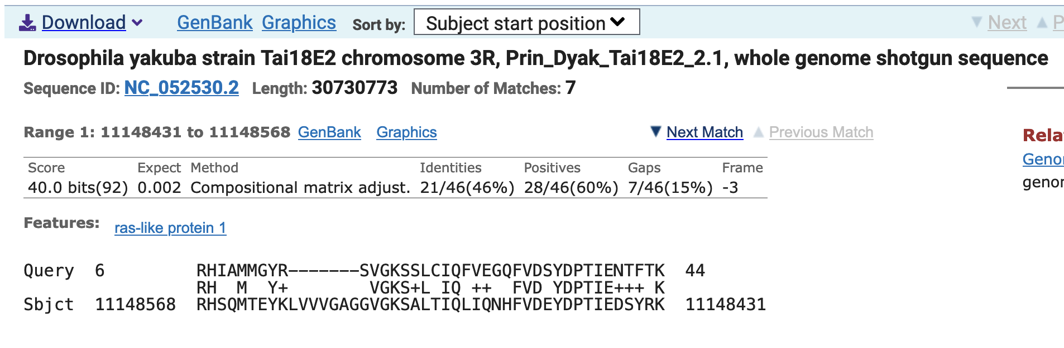

Slide 25
Range | D. melanogaster |  | Target Species |  | E-Value | Identities (%) | Subject Frame
 | Query Start | Query End | Subject Start | Subject End
1 | 6 | 44 | 11,148,568 | 11,148,431 | 0.002 | 46 | -3
2 | 18 | 108 | 11,418,759 | 11,419,094 | 5e-06 | 28 | +3
3 | 1 | 20 | 19,150,809 | 19,150,868 | 2e-78 | 90 | +3
4 | 16 | 45 | 19,150,981 | 19,151,070 | 2e-78 | 83 | +1
5 | 40 | 109 | 19,151,150 | 19,151,359 | 2e-78 | 97 | +2
6 | 111 | 153 | 19,151,422 | 19,151,550 | 2e-78 | 93 | +1
7 | 153 | 182 | 19,151,610 | 19,151,699 | 2e-78 | 93 | +3
best collinear
set of alignments to Rheb-PA

Slide 26
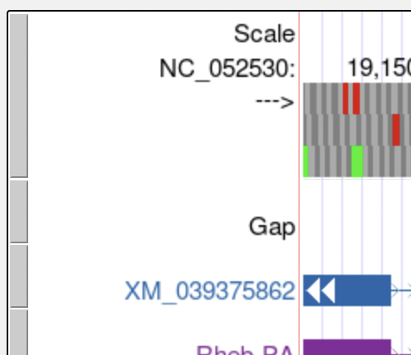
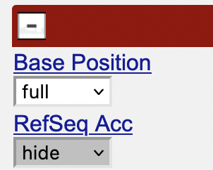
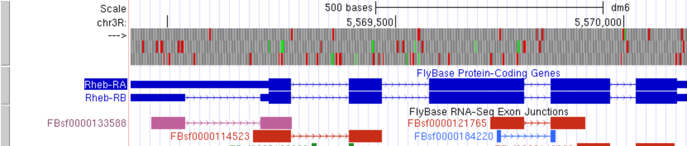
Each evidence track in the Genome Browser has an associated description page that contains a discussion of the track, the methods used to create the track, and, in some cases, filter and configuration options to fine-tune the information displayed in the track (e.g., RNA-Seq tracks). To view the description page, click on the gray mini-button to the left of a displayed track (left) or on the label for the track in the display controls section (right).
View description page of an evidence track
Click or drag in the base position track to zoom in
Drag tracks left or right to a new position
Drag gray mini-button up or down to reorder tracks
Type "?" for keyboard shortcuts
ZOOM IN HERE
BASE POSITION TRACK
DRAG HERE TO MOVE LEFT OR RIGHT
REORDER TRACKS HERE

Slide 27
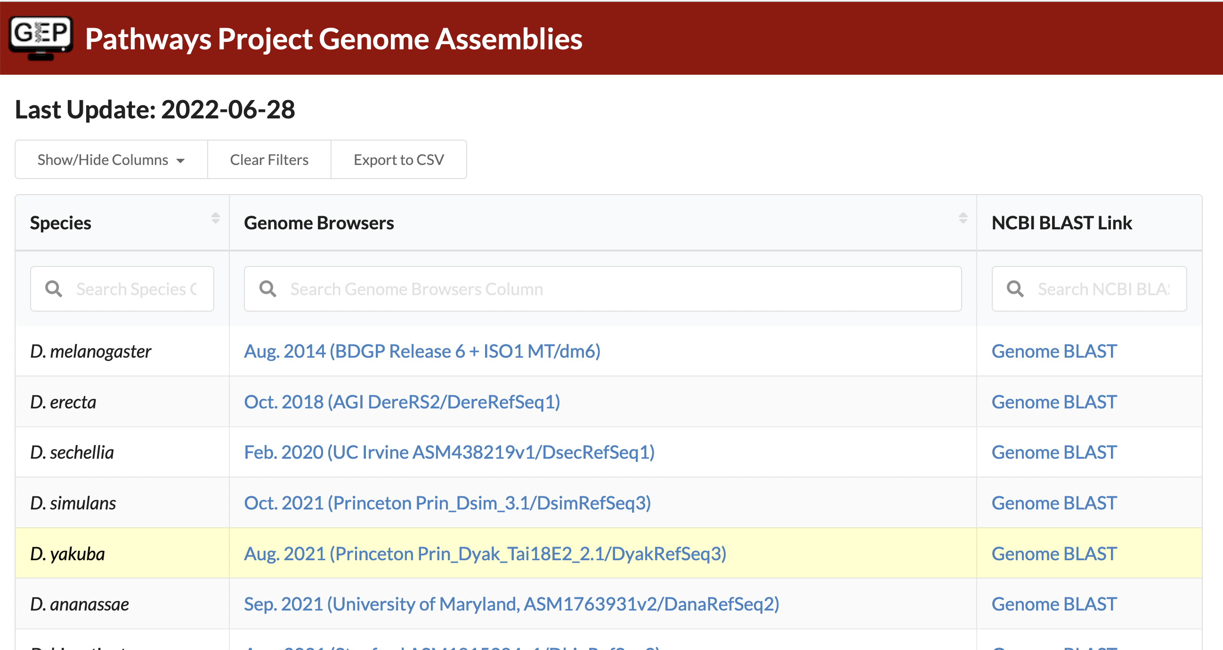
The Genome Browser Gateway should default to the correct assembly once you click on the
Drosophila species in the left-hand table. To double check, you are using the correct one, you can see which assembly you should be using via the "Genome Browsers" column of the Pathways Project Genome Assemblies web page. For example, D. yakuba has three assembly options to choose from and according to the Genome Assemblies page, we should use the "Aug. 2021 (Princeton Prin_Dyak_Tai18E2_2.1/ DyakRefSeq3)" assembly when annotating D. yakuba.

Slide 28
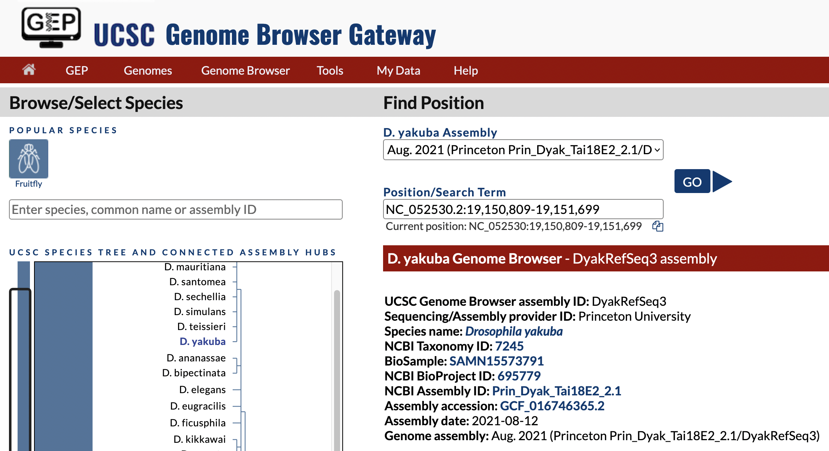
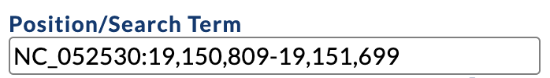
You will be asked for these four items in the Annotation Form

Slide 29
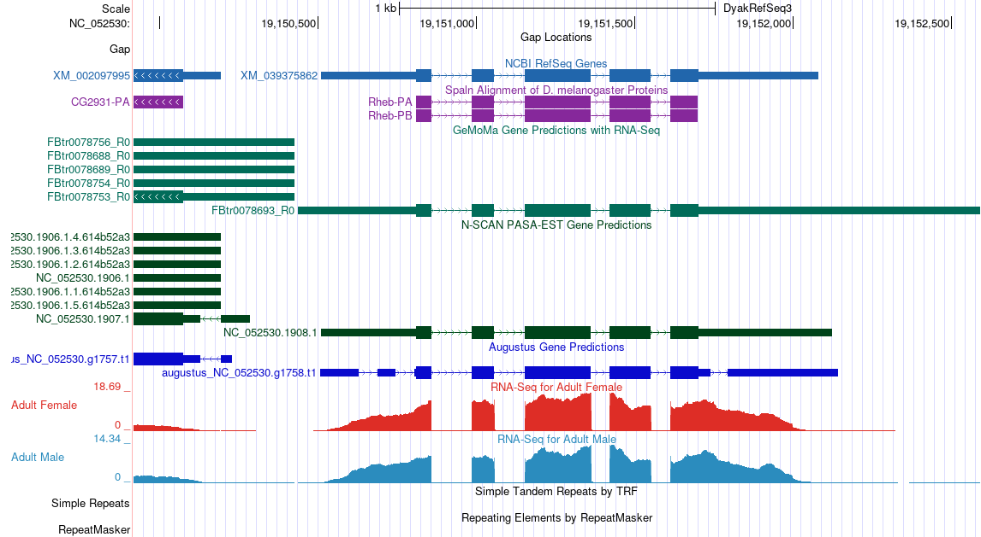
coding sequence (CDS): part of the DNA sequence of a gene that is translated into protein (i.e., protein coding portion of the gene)
Transcript
Spaln is similar to tblastn
Gene Predictions
RNA-Seq

Slide 30
We cannot always trust that what we see in the Genome Browser is accurate, particularly for Drosophila species that are more distantly related to D. melanogaster. The gene prediction tracks, like their name implies, are predictions; thus, your role, as a researcher in the Pathways Project, is to help scientists studying these genes
be confident in the specific model for the gene. Your brain is far superior to a computer algorithm in weighing conflicting evidence, thus your model will be more reliable than what a computer can produce alone. For example, in your own project, there might be a situation where a gene predictor(s) doesn’t show a gene in an area that has an alignment to D. melanogaster proteins (or vice versa); therefore, you’d need to investigate that further.

Slide 31
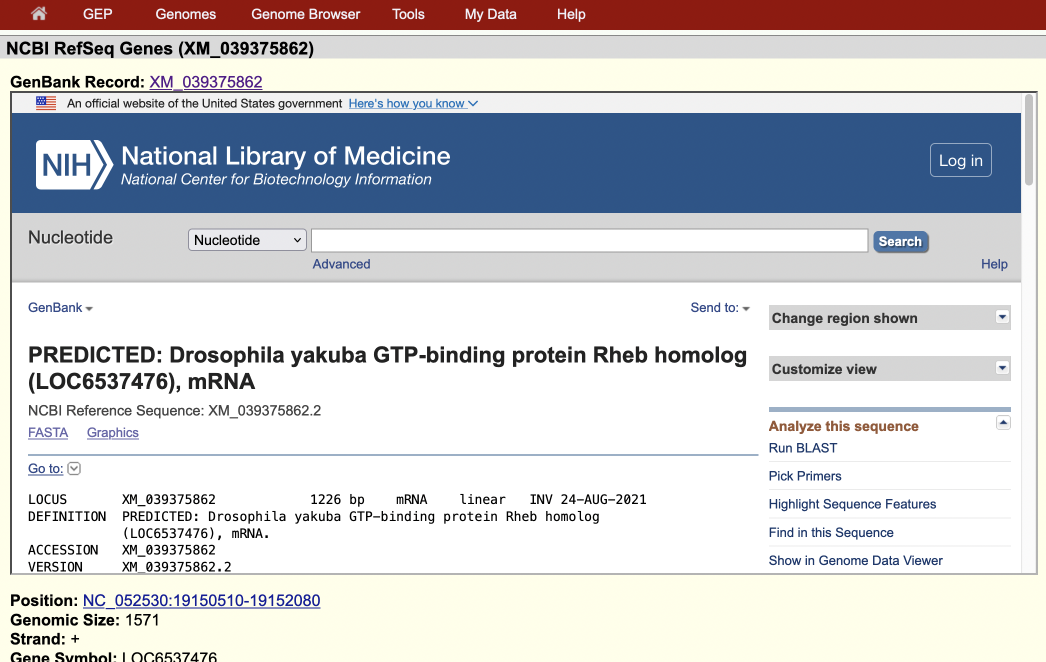
Scroll to the bottom of the GenBank Record window to view sequence of translated protein from predicted mRNA

Slide 32
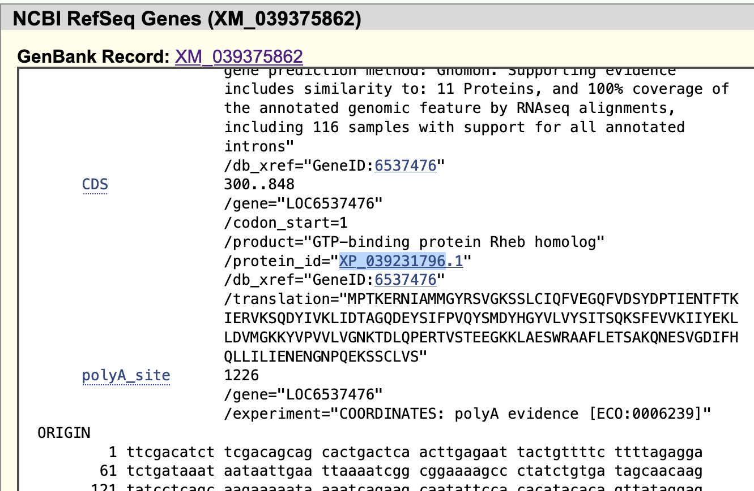
Sequence of translated protein from predicted mRNA

Slide 33
The NCBI database of reference sequences (RefSeq) is a curated, non-redundant
Accession Prefix | Description
XM_ | mRNA (predicted model)
XP_ | protein (predicted model)
NP_ | protein (known)
collection of naturally occurring DNA, RNA, and protein sequences. The RefSeq database includes both known (manually reviewed by NCBI staff or collaborators) and computationally predicted sequences.
The two-letter prefix (followed by an underscore) of RefSeq accession numbers has an implied meaning with respect to the type of molecule it represents (e.g., known or predicted model, genomic scaffold, mRNA).

Slide 34

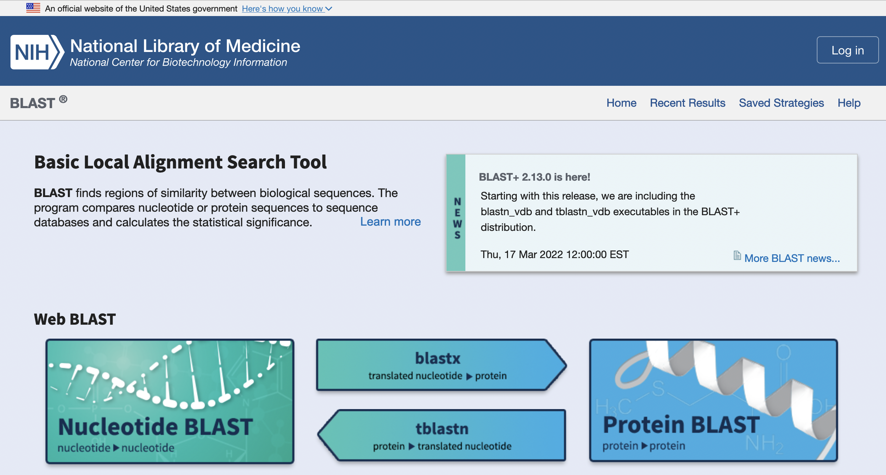
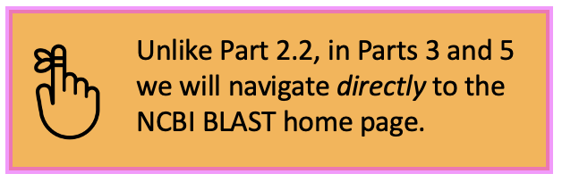
Unlike Part 2.2, in Parts 3 and 5 we will navigate directly to the NCBI BLAST home page.
blastn
blastp

Slide 35
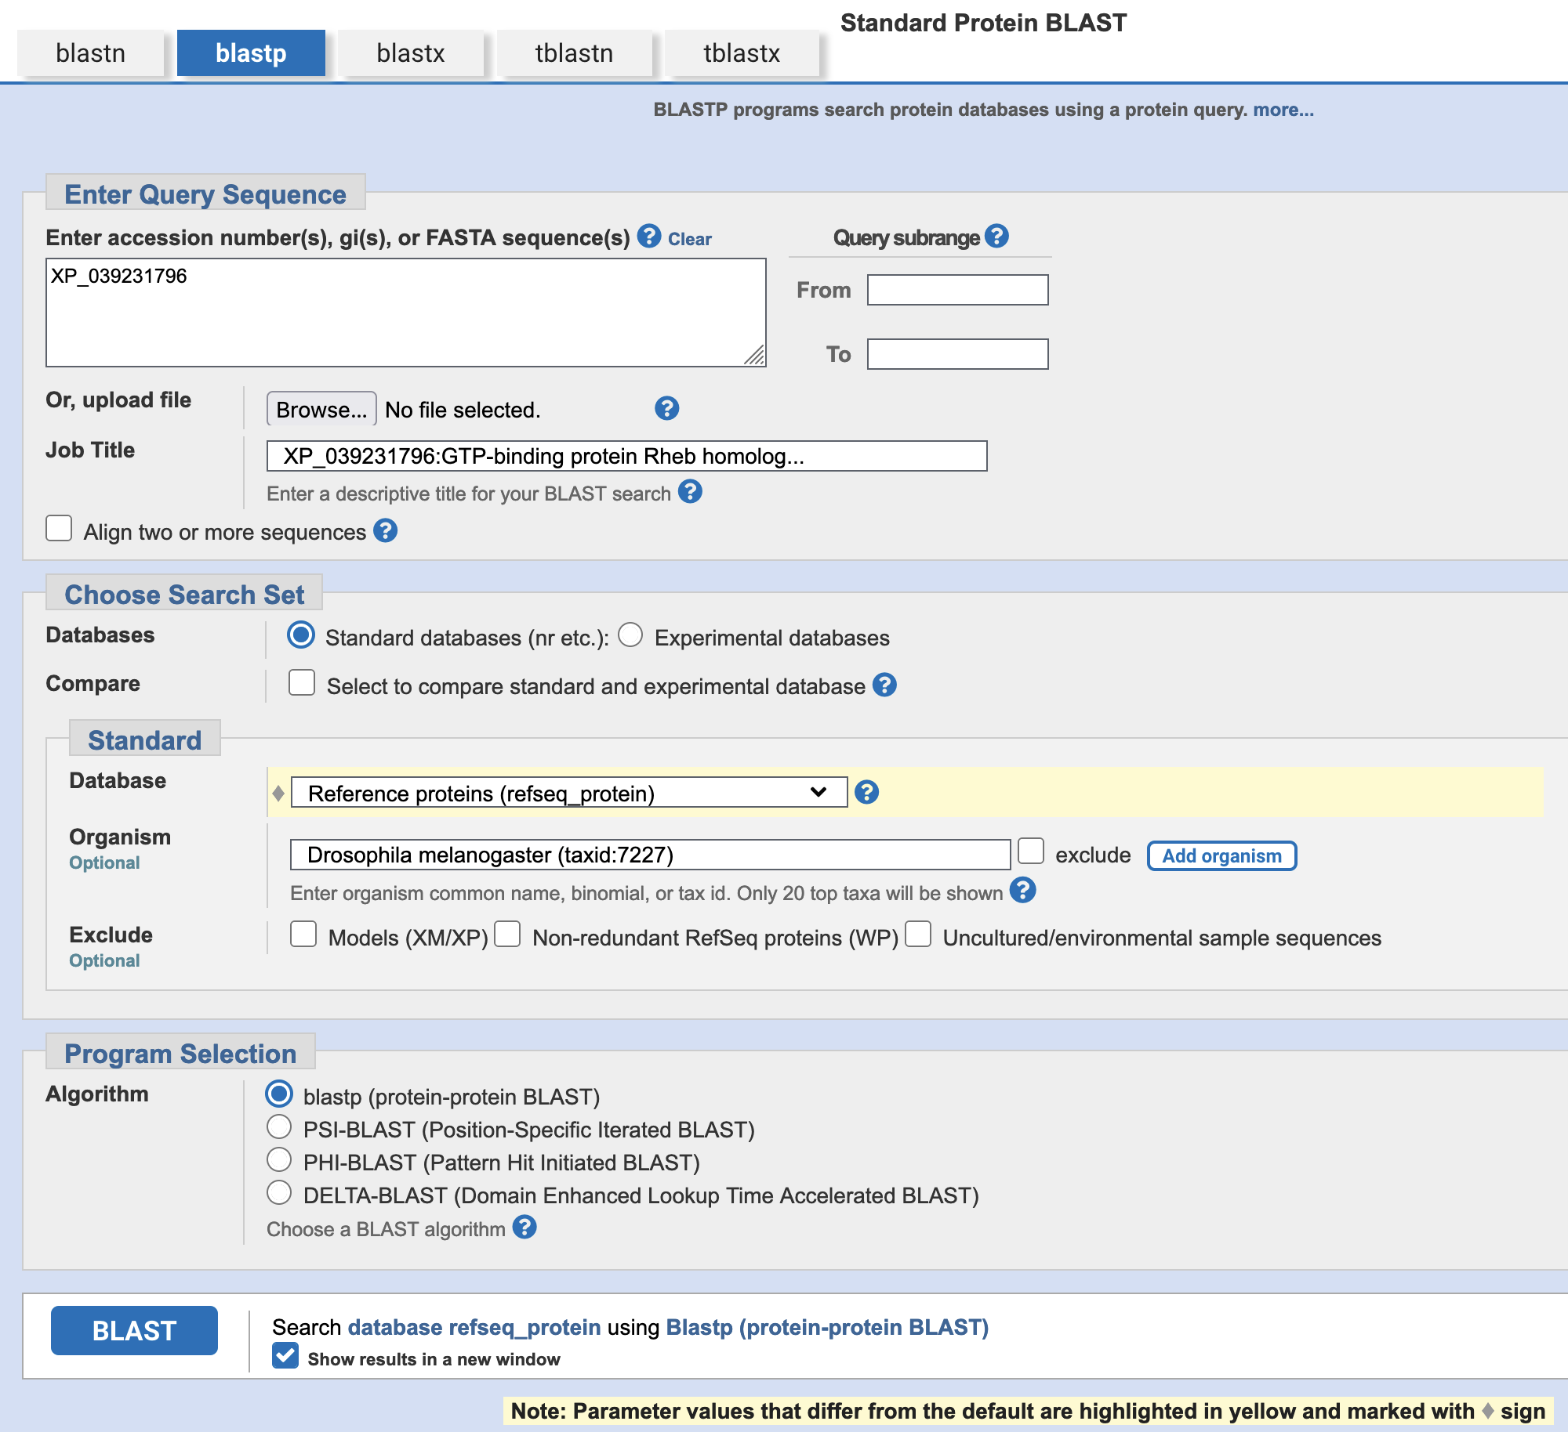
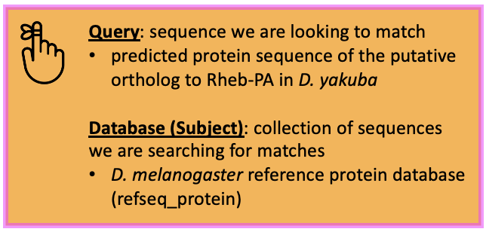
XP_039231796
protein sequence of the putative ortholog to Rheb-PA in D. yakuba
Query: sequence we are looking to match
predicted protein sequence of the putative ortholog to Rheb-PA in D. yakuba
Database (Subject): collection of sequences we are searching for matches
D. melanogaster reference protein database (refseq_protein)

Slide 36
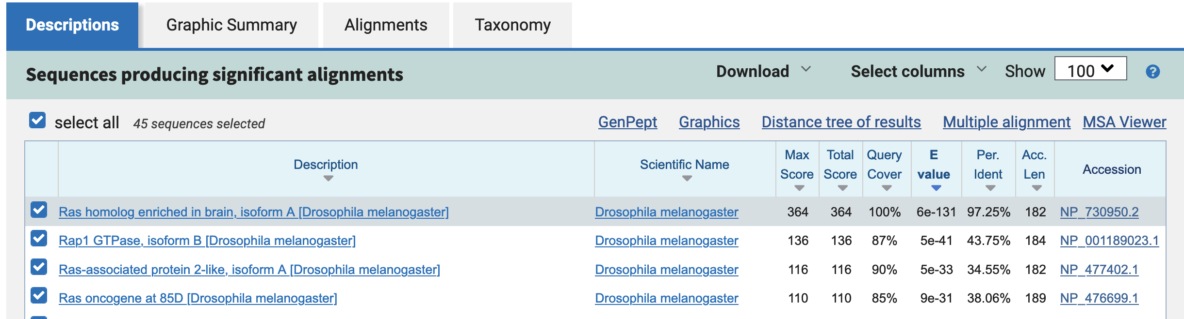

Slide 37
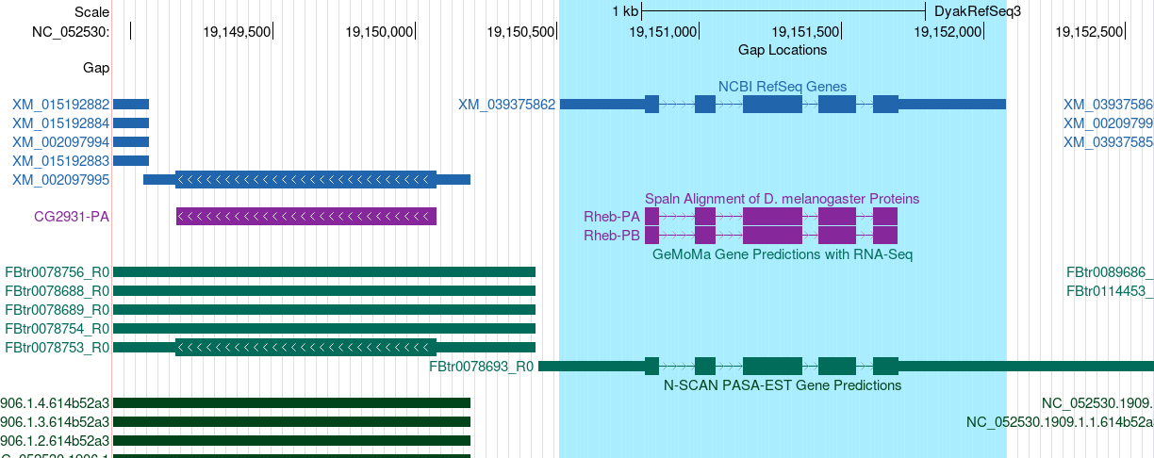
To help us stay oriented to the location of our target gene while
looking at the neighboring genes, we can right-click on the the RefSeq transcript XM_039375862 and then select “Highlight XM_039375862.” We should now see this region highlighted in blue. When we zoom out to examine the neighboring genes, we can easily visualize where our target gene is because it will remain highlighted. You can also highlight additional regions by repeating this process. To clear a highlight, right-click on the highlighted area and then select “Remove highlight.” When right-clicking on the highlighted area, there’s also a “Zoom to highlight” option.

Slide 38
If the coding isoforms of your
gene differ, it’s recommended to use the longest one, that is best supported by the other lines of evidence, as the query for the blastp search. However, choosing a different isoform than the longest will likely still give the results you need.

Slide 39
blastp search results for the protein sequences of the genomic neighborhood of the target gene in the target species against the D. melanogaster reference proteins database (refseq_protein)
 |  | 2nd Closest Upstream | Closest Upstream | Target Gene | Closest Downstream | 2nd Closest Downstream
D. melanogaster | Gene Symbol | CG12746 | CG2931 | Rheb | CRMP | CG2926
 | Strand (+/-) | + | - | + | + | -
Target Species | NCBI RefSeq Gene (mRNA) Accession | XM_015192882 | XM_002097995 | XM_039375862 | XM_002097997 | XM_002097998
 | NCBI RefSeq Protein Accession | XP_015048368 | XP_002098031 | XP_039231796 | XP_002098033 | XP_002098034
 | Strand (+/-) | + | - | + | + | -
Best blastp Result | Accession | NP_649551 | NP_649552 | NP_730950 | NP_730954 | NP_649554
 | D. melanogaster Gene Symbol | CG12746 | CG2931 | Rheb | CRMP | CG2926
 | E-Value | 0.0 | 0.0 | 6e-131 | 0.0 | 0.0
 | Percent Identity | 84.30% | 96.72% | 97.25% | 99.66% | 86.18%
Notes:
XP_015048368
XP_002098031
XP_002098033
XP_002098034

Slide 40
D. yakuba (NC_052530 scaffold)
5’ 3’
CG12746
CG2931
Rheb
CRMP
CG2926
Target Gene
on + strand
Upstream
Downstream

Slide 41
D. melanogaster (chr3R scaffold)
CG12746
CG2931
Rheb
CRMP
CG2926
CG12746
CG2931
Rheb
CRMP
CG2926
D. yakuba (NC_052530 scaffold)

Slide 42
If we enter “rheb” in the Gene Record Finder, we will get an error message because gene
symbols in Drosophila are case-sensitive. For example, Tor and tor correspond to two different genes in D. melanogaster.

Slide 43
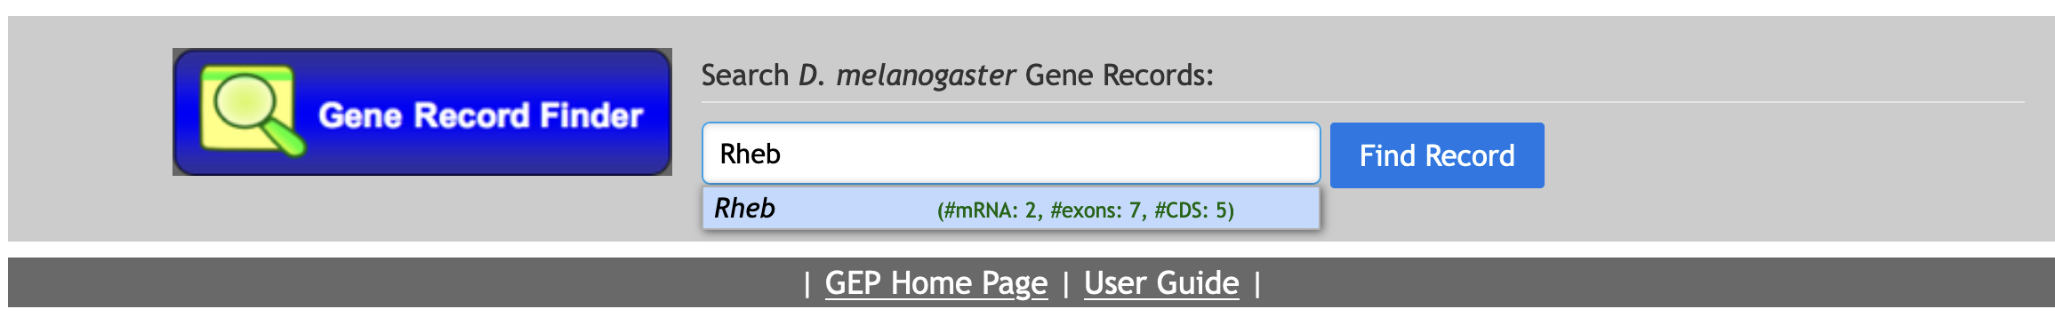

Slide 44
If the coding sequences of ALL isoforms aren’t identical, you’ll
need to annotate each unique isoform (uniqueness is based on the coding sequence).
Notes:
If the coding sequences of ALL isoforms aren’t identical, you’ll need to annotate each unique isoform (uniqueness is based on the coding sequence).

Slide 45
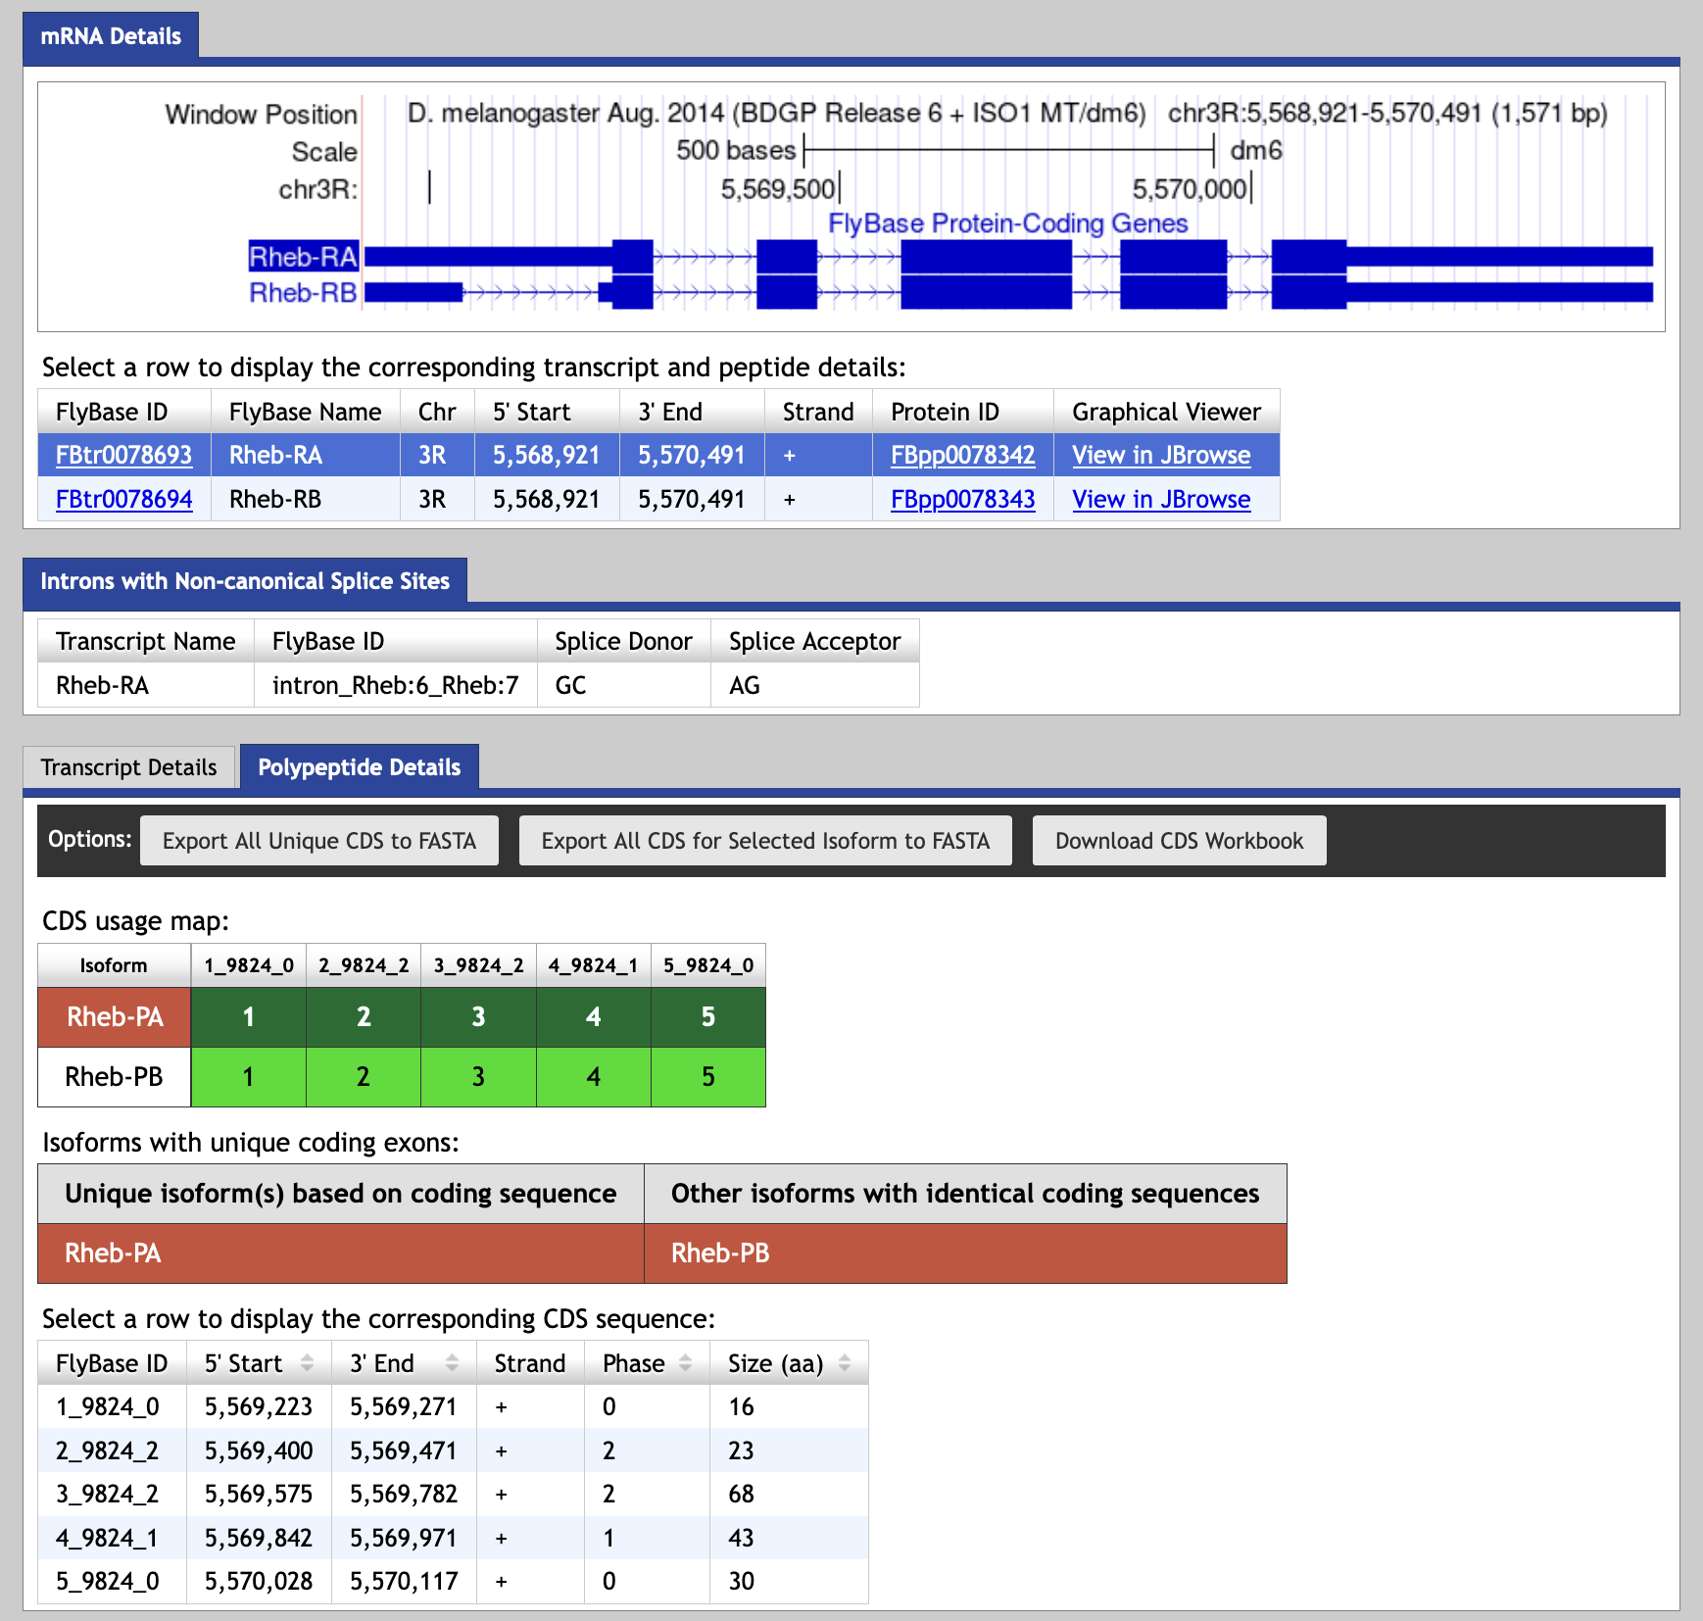
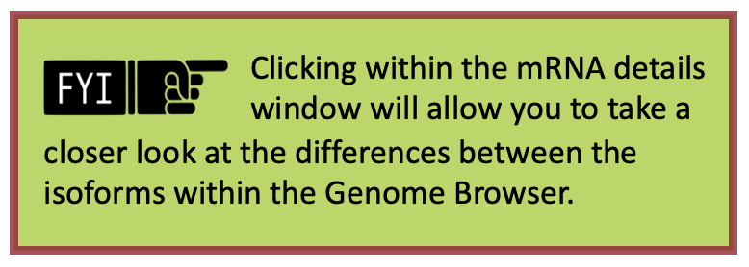
isoforms differ in
5’ UTR region
Clicking within the mRNA details window will allow you to take a
closer look at the differences between the isoforms within the Genome Browser.
coding exons (CDS’s)
Notes:
Clicking within the mRNA details window will allow you to take a closer look at the differences between the isoforms within the Genome Browser.

Slide 46
Because the BLAST algorithm does not take the positions of potential splice sites within a complete protein sequence into account when it generates an alignment, BLAST often extends or truncates
the alignment beyond the coding exon boundary and into the intron. To ameliorate this issue, the Pathways Project annotation protocol recommends mapping each coding exon separately to determine their approximate locations and then further refine the coding exon boundaries by searching for compatible splice donor and acceptor sites through visual inspection using the Genome Browser.
Notes:
Because the BLAST algorithm does not take the positions of potential splice sites within a complete protein sequence into account when it generates an alignment, BLAST often extends or truncates the alignment beyond the coding exon boundary and into the intron. To ameliorate this issue, the Pathways Project annotation protocol recommends mapping each coding exon separately to determine their approximate locations and then further refine the coding exon boundaries by searching for compatible splice donor and acceptor sites through visual inspection using the Genome Browser.

Slide 47
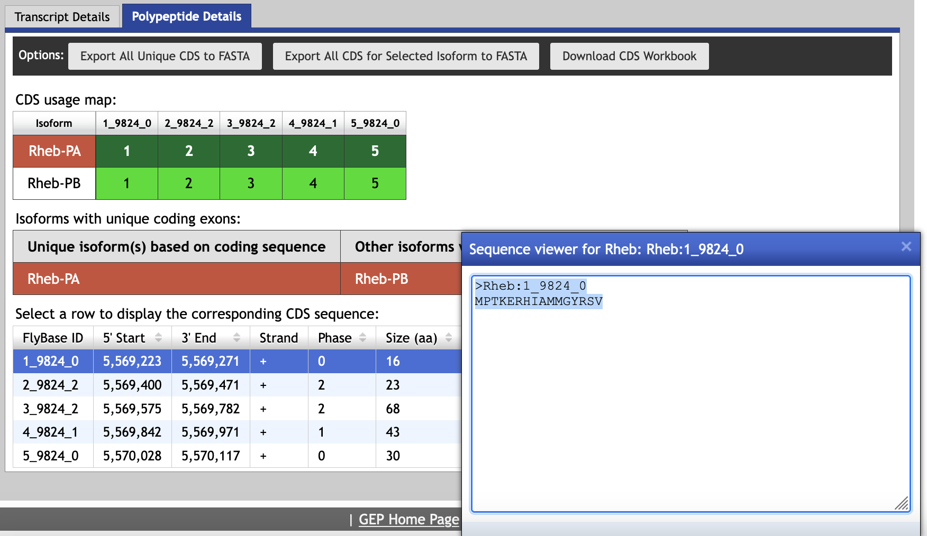
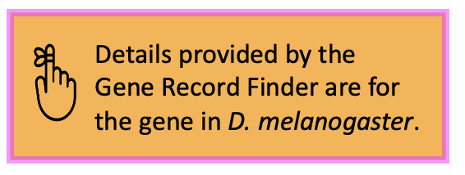
copy protein sequence
Details provided by the Gene Record Finder are for the gene in D. melanogaster.

Slide 48
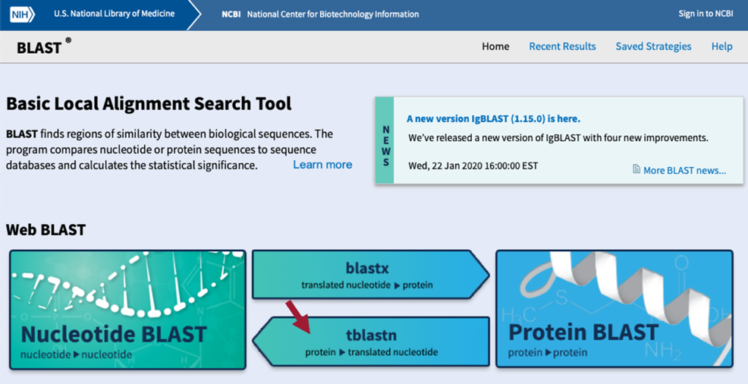

Slide 49
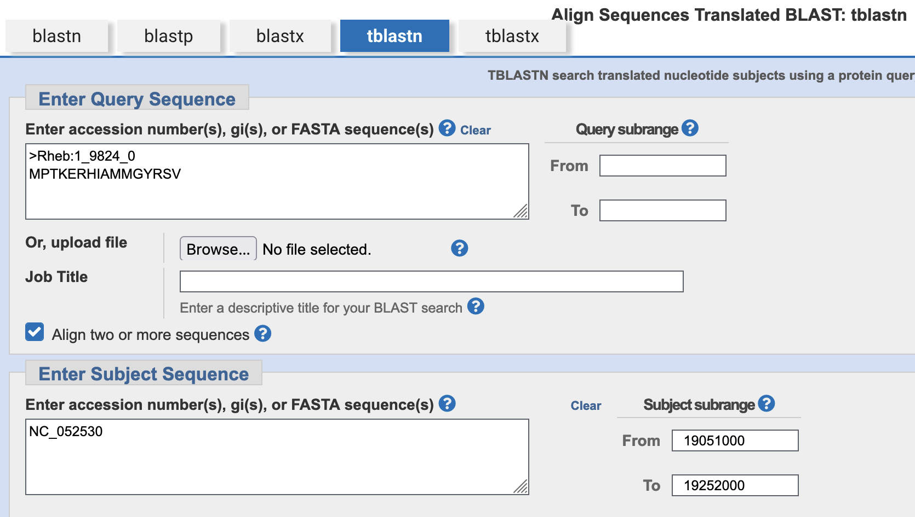
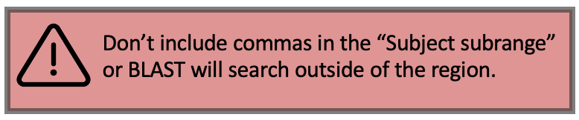
CDS-1 (Rheb:1_9824_0)
from D. melanogaster
D. yakuba NC_052530 scaffold
Limit the search area of the NC_052530 scaffold to the region surrounding our putative ortholog
Don’t include commas in the “Subject subrange” or BLAST will search outside of the region.

Slide 50
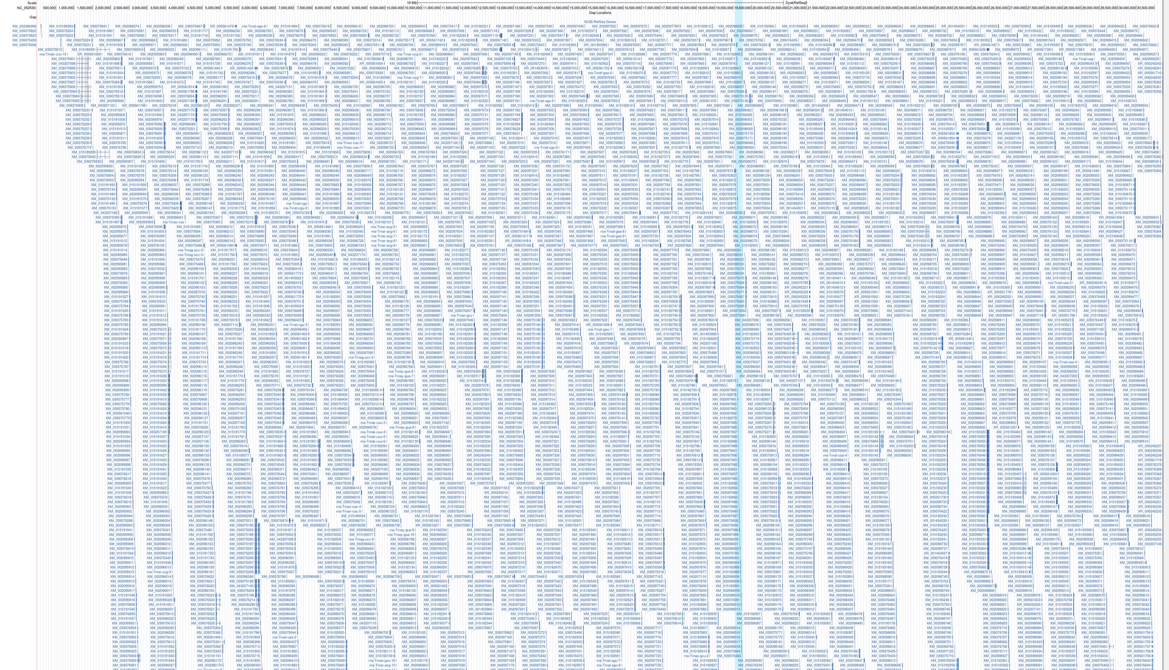
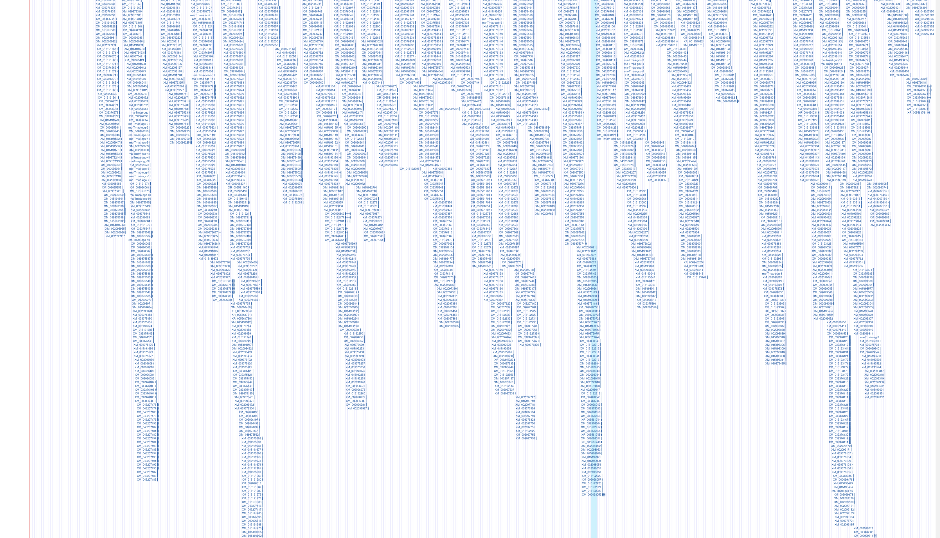
The average novel contains roughly 400,000 characters (not including spaces). The
NC_052530 scaffold in D. yakuba is 30,730,773 bp (or characters) long, which is roughly equivalent to 77 novels worth of information. Furthermore, since BLAST must translate the entire D. yakuba scaffold sequence in all six reading frames, that would be more like searching 462 novels to find a few pages of important information. While the English alphabet consists of 26 letters, the genomic alphabet consists of four (A, T, G, and C). With 462 novels worth of only A’s, T’s, C’s, and G’s BLAST must search, we’re likely to get several spurious alignments; however, limiting the search region will increase the search’s statistical power and reduce the number of spurious matches.
In Part 2 we found the best collinear set of alignments to Rheb-PA in D. yakuba was at 19,150,809-19,151,699 on the NC_052530 scaffold. We can now use those coordinates to narrow down the 462 novels worth of information to less than one novel by limiting the subrange of the NC_052530 scaffold to roughly 100,000 bp on each side of the collinear set of alignments.
The Subject subrange—19,051,000-19,252,000—was determined by subtracting 100,000 from the smaller coordinate (19,150,809), adding 100,000 to the larger coordinate (19,151,699), and then rounding each to the nearest thousandth.
The Genome Browser image above shows all the transcripts found within the NC_052530 scaffold of D. yakuba. Limiting the scaffold’s search area to 19,051,000-19,252,000 (red rectangle), increases the statistical power of our search and helps filter out spurious matches.
Note: the Subrange can be larger or smaller than 100,000 bp on each side. Whatever you choose, be sure to generously round (like you wish your instructor would your grade ☺) in both directions.
Notes:
The average novel contains roughly 400,000 characters (not including spaces). The NC_052530 scaffold in D. yakuba is 30,730,773 bp (or characters) long, which is roughly equivalent to 77 novels worth of information. Furthermore, since BLAST must translate the entire D. yakuba scaffold sequence in all six reading frames, that would be more like searching 462 novels to find a few pages of important information. While the English alphabet consists of 26 letters, the genomic alphabet consists of four (A, T, G, and C). With 462 novels worth of only A’s, T’s, C’s, and G’s BLAST must search, we’re likely to get several spurious alignments; however, limiting the search region will increase the search’s statistical power and reduce the number of spurious matches.
In Part 2 we found the best collinear set of alignments to Rheb-PA in D. yakuba was at 19,150,809-19,151,699 on the NC_052530 scaffold. We can now use those coordinates to narrow down the 462 novels worth of information to less than one novel by limiting the subrange of the NC_052530 scaffold to roughly 100,000 bp on each side of the collinear set of alignments. The Subject subrange—19,051,000-19,252,000—was determined by subtracting 100,000 from the smaller coordinate (19,150,809), adding 100,000 to the larger coordinate (19,151,699), and then rounding each to the nearest thousandth.
Note: the Subrange can be larger or smaller than 100,000 bp on each side. Whatever you choose, be sure to generously round (like you wish your instructor would your grade ☺) in both directions.

Slide 51
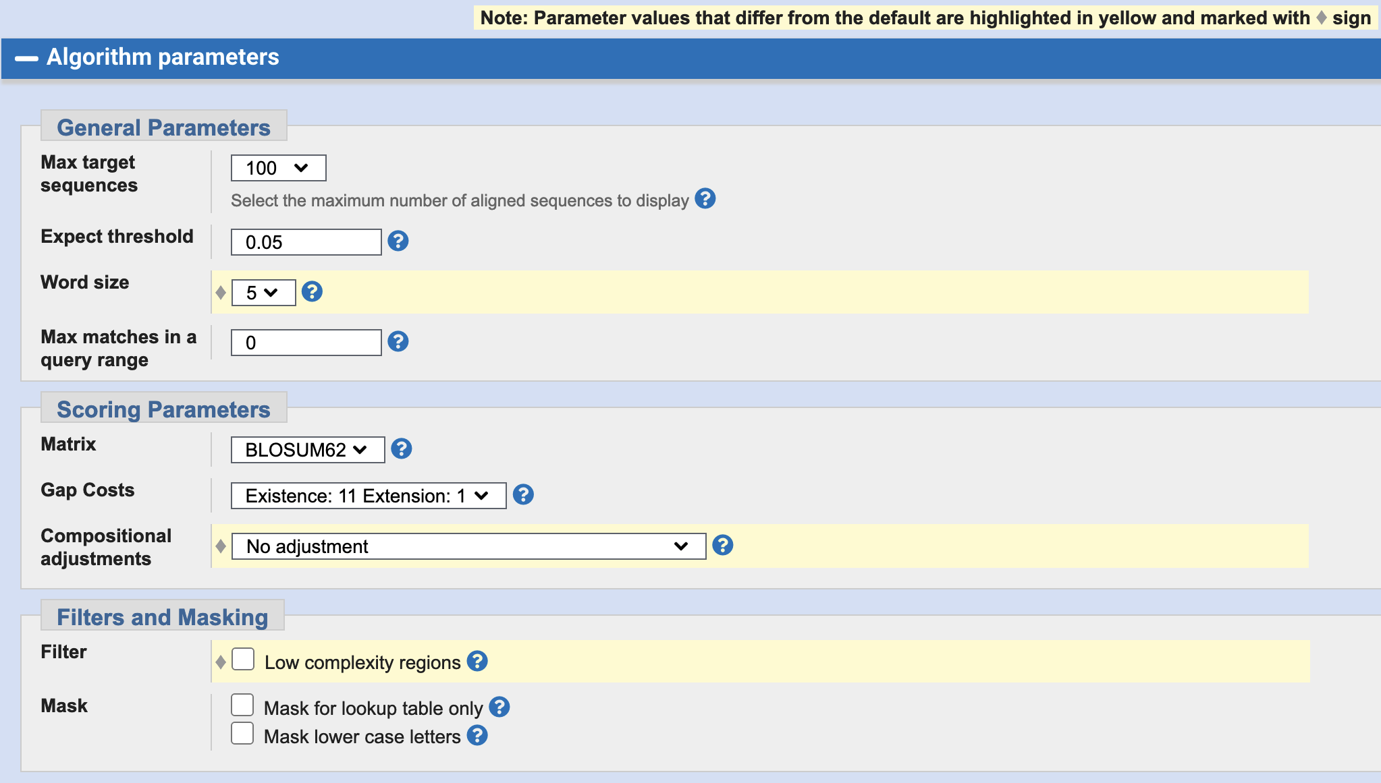

Slide 52
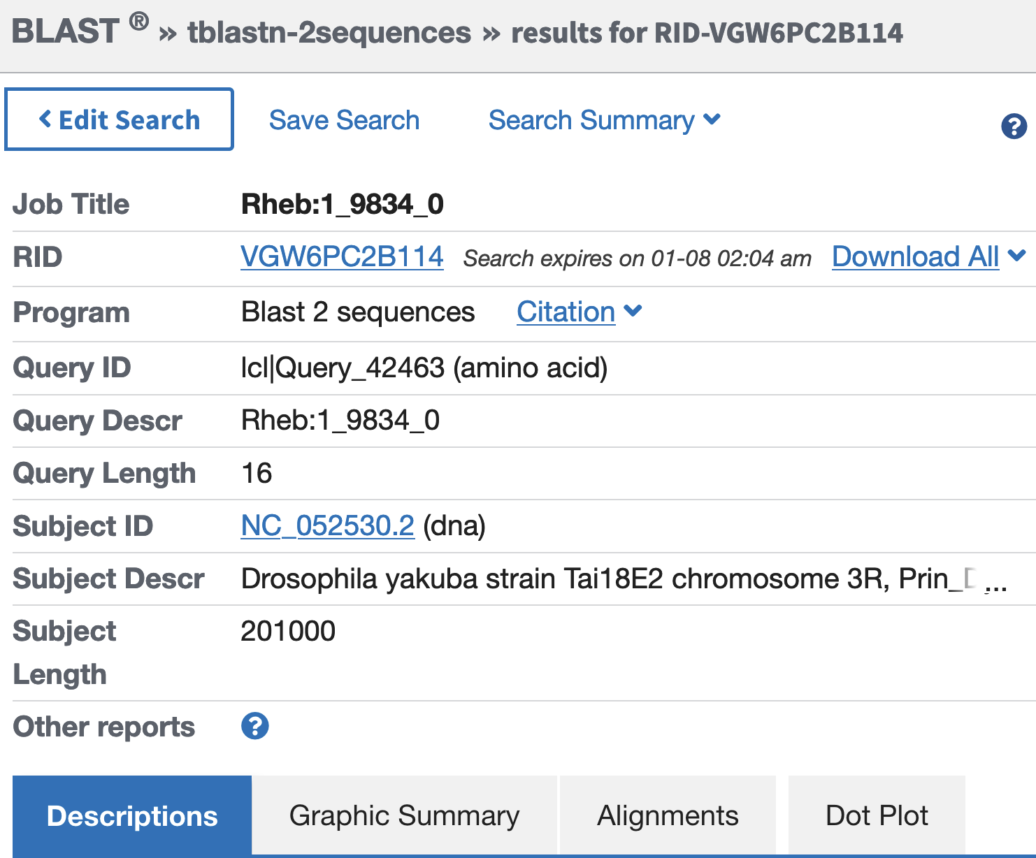
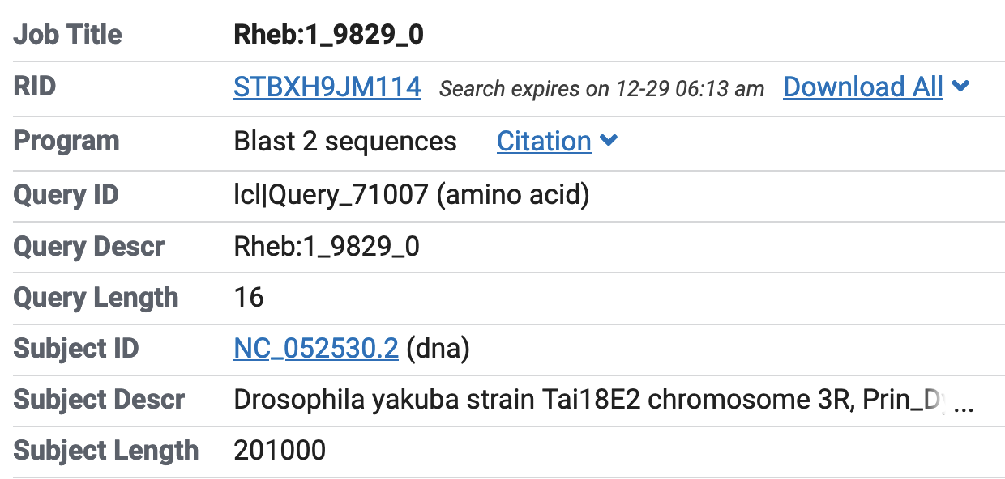

tblastn = protein query (sequence we are trying to match) vs. translated nucleotide subject* (sequence we are searching through to find a match for our query)
Rheb: 1_9833_0
Query is a sequence of amino acids (i.e., it’s a protein)
Query
(sequence to match)
Rheb: 1_9833_0
Query is the protein sequence of Rheb:1_9824_0 (i.e., CDS-1)
Query is 16 amino acids in length
Subject
sequence BLAST is searching for a match to the query
Subject is translated DNA sequence*
(
)
Subject is the D. yakuba NC_052530 scaffold
Subject is 201,000 nucleotides in length; we narrowed down the search area of the NC_052530 scaffold (i.e., Subject subrange) to the region surrounding our putative ortholog
*tblastn translates the scaffold sequence in all six reading frames (i.e., three reading frames of the positive strand and three reading frames of the negative strand) and then searches each conceptual translation for a match to the query
Notes:
tblastn = protein query (sequence we are trying to match) vs. translated nucleotide subject (sequence we are searching through to find a match for our query)
Since we checked the box for “Align two or more sequences,” BLAST used the bl2seq (BLAST 2 sequences) program for the tblastn
D. yakuba chromosome 3R scaffold (i.e., “NC_052530.2”)
We narrowed down the search area of the chromosome 3R scaffold to the region surrounding coordinates we obtained in Part 2.3 (19,150,809 – 19,151,699)

Slide 53
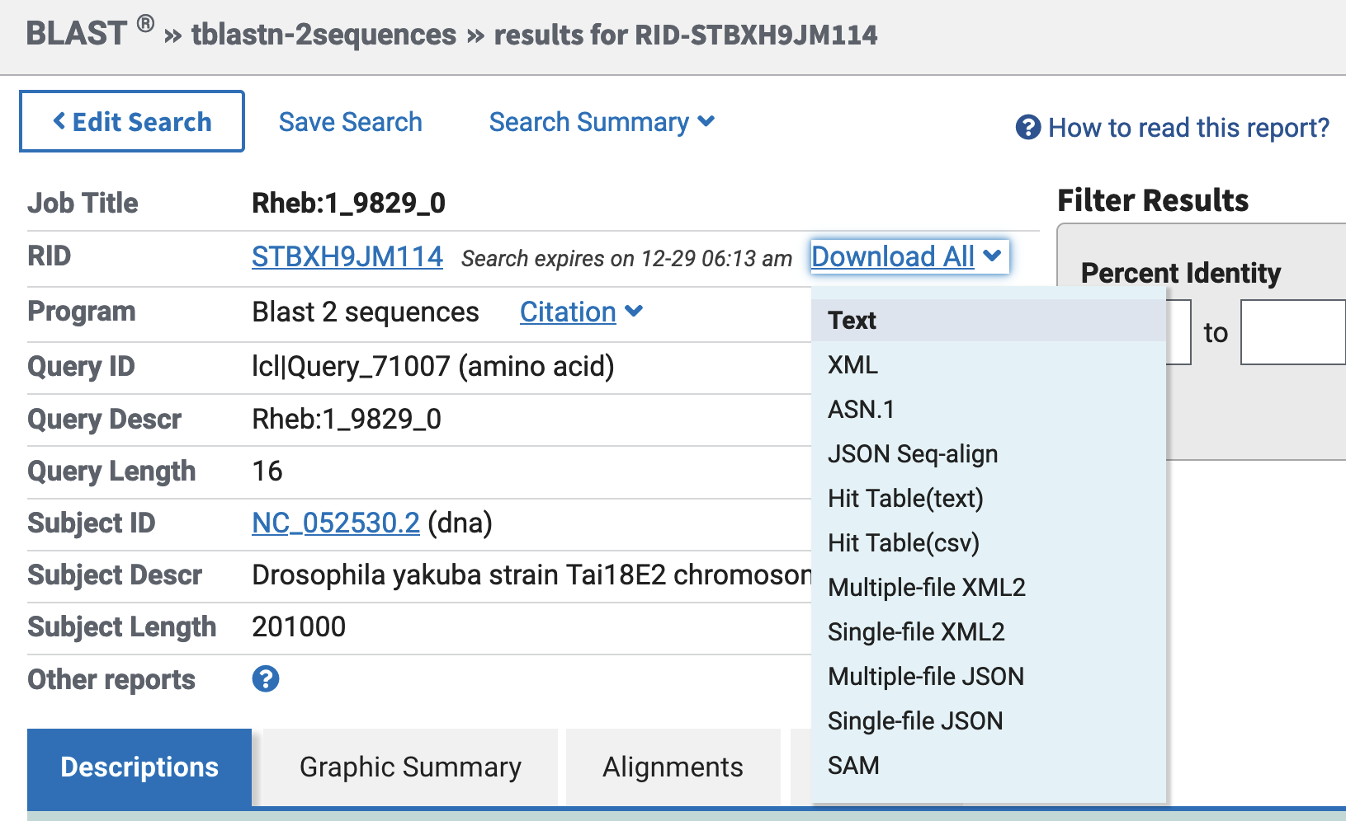
You may find it helpful to download your BLAST results in case you need to refer to
them later. Click on “Download All” and then “Text” in the drop-down menu.
Notes:
You may find it helpful to download your BLAST results in case you need to refer to them later. Click on “Download All” and then “Text” in the drop-down menu.

Slide 54
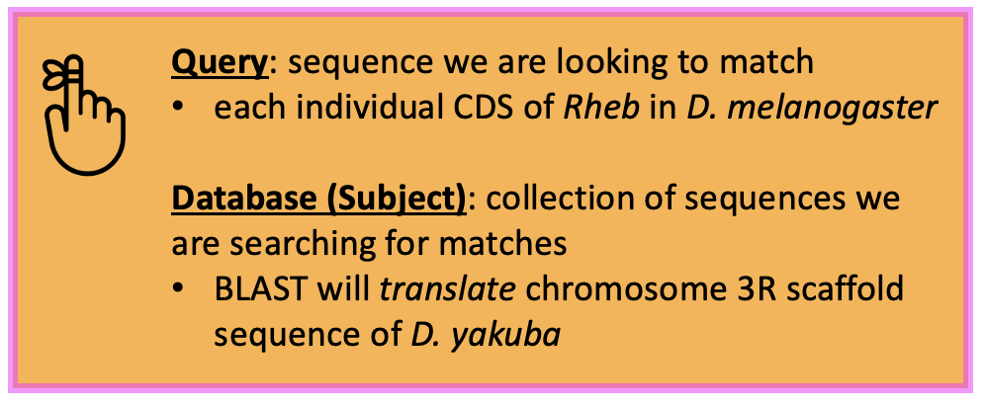
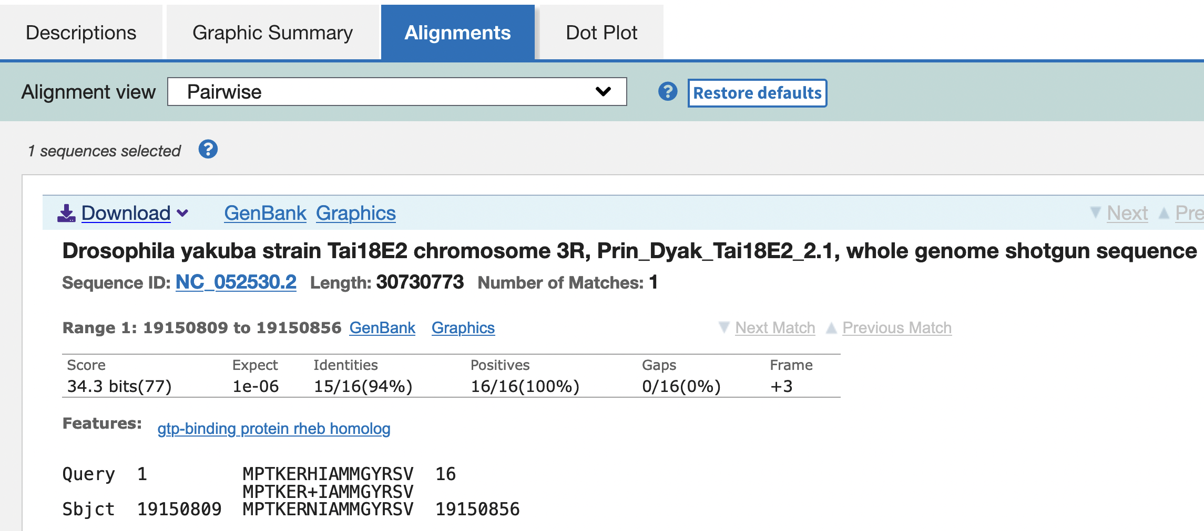

Query: sequence we are looking to match
each individual CDS of Rheb in D. melanogaster
Database (Subject): collection of sequences we are searching for matches
BLAST will translate NC_052530 scaffold sequence of D. yakuba
Rheb: 1_9824_0

Slide 55
CDS | FlyBase ID | Query Length Size (aa) | D. melanogaster |  | Target Species |  | Subject Frame
 |  |  | Query Start | Query End | Subject Start | Subject End
1 | 1_9824_0 | 16 | 1 | 16 | 19,150,809 | 19,150,856 | +3
2 | 2_9824_2 | 23 | 1 | 23 | 19,150,987 | 19,151,055 | +1
3 | 3_9824_2 | 68 | 1 | 68 | 19,151,156 | 19,151,359 | +2
4 | 4_9824_1 | 43 | 1 | 43 | 19,151,422 | 19,151,550 | +1
5 | 5_9824_0 | 30 | 1 | 30 | 19,151,613 | 19,151,702 | +3
Notes:
>Rheb:1_9824_0
MPTKERHIAMMGYRSV
>Rheb:2_9824_2
KSSLCIQFVEGQFVDSYDPTIEN
>Rheb:3_9824_2
FTKIERVKSQDYIVKLIDTAGQDEYSIFPVQYSMDYHGYVLVYSITSQKS
FEVVKIIYEKLLDVMGKK
>Rheb:4_9824_1
VPVVLVGNKIDLHQERTVSTEEGKKLAESWRAAFLETSAKQNE
>Rheb:5_9824_0
SVGDIFHQLLILIENENGNPQEKSGCLVS*

Slide 56

Introns are removed from the pre-mRNA prior to translation. The processed mRNA also includes a 5' cap at the 5' end and a poly-A tail at the 3' end. This walkthrough focuses on annotation of the coding regions so we will not annotate the untranslated regions (UTRs), or the transcription start site (TSS).
codon: sequence of three nucleotides of DNA (A, T, G, and C) or RNA (A, U, G, and C) that corresponds to a specific amino acid
start codon: first codon of a coding sequence; signals the ribosome to begin translating the processed mRNA; ATG (AUG) codes for Methionine (M)
stop codon: signals the termination of translation; sometimes called "nonsense codons," since they do not specify any amino acid; TAA (UAA), TAG (UAG), or TGA (UGA)
5’
3’
Notes:
There are 64 different codons: 61 specify amino acids while the remaining three are used as stop signals.
Stop Codons: TAA (UAA), TAG (UAG), TGA (UGA)

Slide 57

Start Codon
Frame +3

Slide 58


Rheb: 5_9824_0
Stop Codon

Slide 59

Since stop codons do not code for an amino acid, they signal a halt to translation. The newly synthesized amino acid chain is released from the ribosome due to the stop codon triggering the disassociation of the ribosomal subunits.
Stop Codon
Frame +3

Slide 60

During splicing, introns are spliced out (removed) from the pre-mRNA so that adjacent exons are placed next to each other. This means that the ends of an exon do not necessarily correspond to the ends of the complete codon. The
number of nucleotides between the last complete codon and the splice donor site (e.g., CDS-1 in the image below) is known as the phase of the splice donor site. Similarly, the number of nucleotides between the splice acceptor site and the first complete codon (e.g., CDS-2 in the image below) is known as the phase of the splice acceptor site. Because the phases of the splice sites depend on the placement of the complete codon, the phases of the donor and acceptor sites are based on the reading frame of each CDS.
In addition, in order to maintain the open reading frame (ORF) across adjacent CDS's, the phases of the donor and acceptor sites of adjacent CDS's must be compatible with each other. Specifically, the sum of the donor and acceptor phases of adjacent CDS's must either be 0 (i.e., no additional codon) or 3 (i.e., a complete codon). The use of incompatible splice donor and acceptor sites will introduce a frame shift into the translation of the CDS following the splice acceptor site.
In D. melanogaster, approximately 99% of introns have a GT splice donor site and 1% have a GC non-canonical splice donor site. Almost all introns have an AG splice acceptor site. The Pathways Project’s comparative annotation protocol posits that all introns have a GT splice donor site and an AG splice acceptor site unless the D. melanogaster gene model uses a non-canonical splice site, or the non-canonical splice site is supported by RNA-Seq data.
Phase: number of bases between the complete codon and the splice site
Donor phase: number of bases between the end of the last complete codon and the splice donor site (GT/rarely GC)
Acceptor phase: number of bases between the splice acceptor site (AG) and the start of first complete codon
Phase depends on the reading frame of the CDS
Notes:
During splicing, introns are spliced out (removed) from the pre-mRNA so that adjacent exons are placed next to each other. This means that the ends of an exon do not necessarily correspond to the ends of the complete codon. The number of nucleotides between the last complete codon and the splice donor site (e.g., CDS-1 in the image below) is known as the phase of the splice donor site. Similarly, the number of nucleotides between the splice acceptor site and the first complete codon (e.g., CDS-2 in the image below) is known as the phase of the splice acceptor site. Because the phases of the splice sites depend on the placement of the complete codon, the phases of the donor and acceptor sites are based on the reading frame of each CDS.
In addition, in order to maintain the open reading frame (ORF) across adjacent CDS's, the phases of the donor and acceptor sites of adjacent CDS's must be compatible with each other. Specifically, the sum of the donor and acceptor phases of adjacent CDS's must either be 0 (i.e., no additional codon) or 3 (i.e., a complete codon). The use of incompatible splice donor and acceptor sites will introduce a frame shift into the translation of the CDS following the splice acceptor site.
In D. melanogaster, approximately 99% of introns have a GT splice donor site and 1% have a GC non-canonical splice donor site. Almost all introns have an AG splice acceptor site. The Pathways Project’s comparative annotation protocol posits that all introns have a GT splice donor site and an AG splice acceptor site unless the D. melanogaster gene model uses a non-canonical splice site, or the non-canonical splice site is supported by RNA-Seq data.
Phase: number of bases between the complete codon and the splice site
Donor phase: number of bases between the end of the last complete codon and the splice donor site (GT/rarely GC)
Acceptor phase: number of bases between the splice acceptor site (AG) and the start of first complete codon
Phase depends on the reading frame of the CDS

Slide 61

In Part 5, our tblastn alignment for CDS-1 terminated at 19,150,856; so, we expect to find the splice donor site nearby.
Splice Donor
Notes:
tblastn alignment for CDS-1 terminates at 19,150,856

Slide 62
19,150,849
19,150,859
G | A | T | C | C | G | T | G | G | G | T
Aspartic Acid (D) |  |  | Proline (P) |  |  | Tryptophan (W)
 | Isoleucine (I) |  |  | Arginine (R)
 |  | Serine (S) |  |  | Valine (V)
+1
Frame
+2
INTRON-1
+3
Splice Donor
Complete Codon
Extra Nucleotide

Slide 63

Splice Acceptor
In Part 5, our tblastn alignment for CDS-2 started at 19,150,987.
Notes:
In Part 5, our tblastn alignment for CDS-2 started at 19,150,987; so, we expect to find the splice acceptor site nearby.

Slide 64
CDS-2
19,150,980
19,150,985
19,150,990
T | G | C | A | G | G | C | A | A | A | T
 |  |  |  |  |  |  | Lysine (K)
 |  |  |  |  | Alanine (A) |  |  | Asparagine (N)
 |  |  |  |  |  | Glutamine (Q)
+1
Frame
+2
INTRON-1
+3
Splice Acceptor
Complete Codon
Extra Nucleotide
Notes:
How many extra nucleotides (0, 1, or 2) are between the splice acceptor site and the first complete codon of each frame?
Frame +1 has two extra nucleotides (GC) before the first complete codon (Lysine; K).
Frame +2 has zero extra nucleotides since it begins with a complete codon (Alanine; A).
Frame +3 has one extra nucleotides (GC) before the first complete codon (Glutamine; Q).

Slide 65
...
CGA
TCC
GTG
G
GT ...... AG
GC
AAA
TCG
TCG
...
...
CGA
TCC
GTG
GGC
AAA
TCG
TCG
...
Translation:
R
S
V
G
K
S
S
Complete Codon
Extra Nucleotide
Intron

Slide 66
CDS | Frame | Splice Acceptor Phase | Splice Donor Phase
1 | +3 |  | 1
2 | +1 | 2 | 1
3 | +2 | 2 | 2
4 | +1 | 1 | 0
5 | +3 | 0

Slide 67
CDS | Frame | Splice Acceptor Phase | Splice Donor Phase
1 | +3 |  | 1
2 | +1 | 2 | 1
3 | +2 | 2 | 2
4 | +1 | 1 | 0
5 | +3 | 0
Sum of Splice Donor and Splice Acceptor Phase
Does the sum of the donor and acceptor equal 0 or 3?
1 + 2 = 3
1 + 2 = 3
2 + 1 = 3
0 + 0 = 0

Slide 68

Since RNA-Seq reads are derived primarily from processed mRNAs
(where the introns have been removed), the subset of RNA-Seq reads that span multiple exons (i.e., spliced RNA-Seq reads) can provide us with additional evidence for a splice junction. When we map a spliced RNA-Seq read against the scaffold, part of the spliced read will map to one CDS while the rest of the read will map to another CDS. The region between these two alignment blocks corresponds to the intron. Splice site prediction tools such as TopHat or regtools can recognize this distinct mapping pattern of spliced RNA-Seq reads in order to infer the possible locations of the splice junction.
A
B
C
D
A) “Processed mRNA” that had its introns spliced out and, to stabilize the molecule for translation into a protein, had a 5’ cap
(acts like a flashing neon sign for the ribosome to recognize the mRNA and begin translating it
into a protein) and Poly-A tail (long chain of Adenine nucleotides) added to the 5’ and 3’ end, respectively. B) Processed mRNA is fragmented into smaller pieces called “reads” which are then sequenced (i.e., determine order of bases). C) Map the reads against a genomic scaffold looking for overlaps in the coding sequences. D) A computer program analyzes the mapping data and infers the possible locations of the splice junctions.
Notes:
most powerful tool currently available for analyzing gene expression.
From RNA-seq reads to differential expression results
Detect differential expression
A computer program looks for overlaps in the DNA sequences, using them to reassemble the fragments in their correct order to reconstitute the genome.
determining the order of the four chemical building blocks - called "bases"
Most RNA-seq experiments take a sample of purified RNA, shear it, convert it to cDNA and sequence on a high-throughput platform, such as the Illumina GA/HiSeq, SOLiD or Roche 454 [16]. This process generates millions of short (25 to 300 bp) reads taken from one end of the cDNA fragments. A common variant on this process is to generate short reads from both ends of each cDNA fragment, known as 'paired-end' reads. The platforms differ substantially in their chemistry and processing steps, but regardless of the precise details, the raw data consist of a long list of short sequences with associated quality scores; these form the entry point for this review. https://genomebiology.biomedcentral.com/articles/10.1186/gb-2010-11-12-220

Slide 69

CDS-1
CDS-2
Splice Donor
Splice Acceptor
Blue highlighted coordinates were found in Part 6.3
Notes:
19,150,858-19,150,984

Slide 70


Slide 71

CDS-2
CDS-3

Slide 72


Slide 73
Gene Model for Rheb-PA in D. yakuba
CDS | FlyBase ID | Frame | Splice Acceptor Phase | Coordinates |  | Splice Donor Phase
 |  |  |  | Start | End
1 | 1_9824_0 | +3 |  | 19,150,809 | 19,150,857 | 1
2 | 2_9824_2 | +1 | 2 | 19,150,985 | 19,151,056 | 1
3 | 3_9824_2 | +2 | 2 | 19,151,154 | 19,151,361 | 2
4 | 4_9824_1 | +1 | 1 | 19,151,421 | 19,151,550 | 0
5 | 5_9824_0 | +3 | 0 | 19,151,613 | 19,151,699
Notes:
stop codon for the Rheb-PA ortholog is placed at 19,151,700-19,151,702
19150809-19150857,
19150985-19151056,
19151154-19151361,
19151421-19151550,
19151613-19151699

Slide 74

Note that the coordinates for the “Coding Exon Coordinates” field do not
include the stop codon. We will enter the stop codon coordinates separately in the “Stop Codon Coordinates” field.

Slide 75

The Gene Model Checker checklist is designed to highlight unusual features in
the gene model. Warnings and failures reported by the Gene Model Checker do not necessarily mean that the proposed gene model is incorrect. However, the annotator should provide additional evidence that justifies the unusual annotation (e.g., non-canonical splice donor site).
Notes:
The Gene Model Checker checklist is designed to highlight unusual features in the gene model. Warnings and failures reported by the Gene Model Checker do not necessarily mean that the proposed gene model is incorrect. However, the annotator should provide additional evidence that justifies the unusual annotation (e.g., non-canonical splice donor site).

Slide 76

CDS-5
CDS-4
Gap
Target Species Protein
CDS-3
CDS-2
CDS-1
D. melanogaster Protein

Slide 77
The dot plot is a visual/graphical representation of the protein alignment showing the position of the amino acids for the D. melanogaster protein on the x-axis and the position of the amino acids for the target species protein on the y-axis; therefore, large gaps, regions with no sequence similarity, and any other anomalies seen in the dot plot can be located within the protein alignment.

Slide 78

D. melanogaster Protein
match line
Target Species Protein

Slide 79
Clicking on the magnifying glass icon in the Gene Model Checker checklist
allows you to view specific features of your submitted gene model in the context of the other evidence tracks on the Genome Browser.
Notes:
Clicking on the magnifying glass icon in the Gene Model Checker checklist allows you to view specific features of your submitted gene model in the context of the other evidence tracks on the Genome Browser.

Slide 80

Submitted
Gene Model

Slide 81


Slide 82


Slide 83


Slide 84


Slide 85

blastp results of
XP_015048368
Notes:
XP_015048368.1
XP_002098031.1
XP_002098033.2
XP_002098034.1

Slide 86

Notes:
XP_015048368.1
XP_002098031.1
XP_002098033.2
XP_002098034.1

Slide 87


