Slide 1
Pathways Project
Analyzing the evolution of metabolic and signaling pathway genes
Katie M. Sandlin
Last Update: 01/19/2025

Slide 2
Overview
The Pathways Project uses network analysis approaches to better understand the evolution and function of biological pathways.
The current focus is on annotating genes within the insulin signaling pathway across the Drosophila genus.
Notes:
Networks have properties that can be measured using a mathematical approach, and we can make predictions about the evolution of a system based on some of those properties.
A “pathway” in a biological system can be defined as a relatively discrete (though never completely isolated) portion of a network. Generally, we view a pathway as a sequence of gene regulatory and enzymatic reactions that produce some important biological outcomes (e.g., synthesize an energy storage molecule, sense and regulate blood sugar levels).
In this project we will be using network analysis approaches to better understand the evolution and function of biological pathways. The Pathways Project is focused on annotating genes found in well characterized signaling and metabolic pathways across the Drosophila genus. The current focus is on the insulin signaling pathway which is well conserved across animals and critical to growth and metabolic homeostasis. The long-term goal of the Pathways Project is to analyze how the regulatory regions of genes evolve in the context of their positions within a network and we anticipate that other pathways will eventually be part of the analyses.

Slide 3
Insulin
Notes:
Let’s begin by talking about the function of insulin

Slide 4
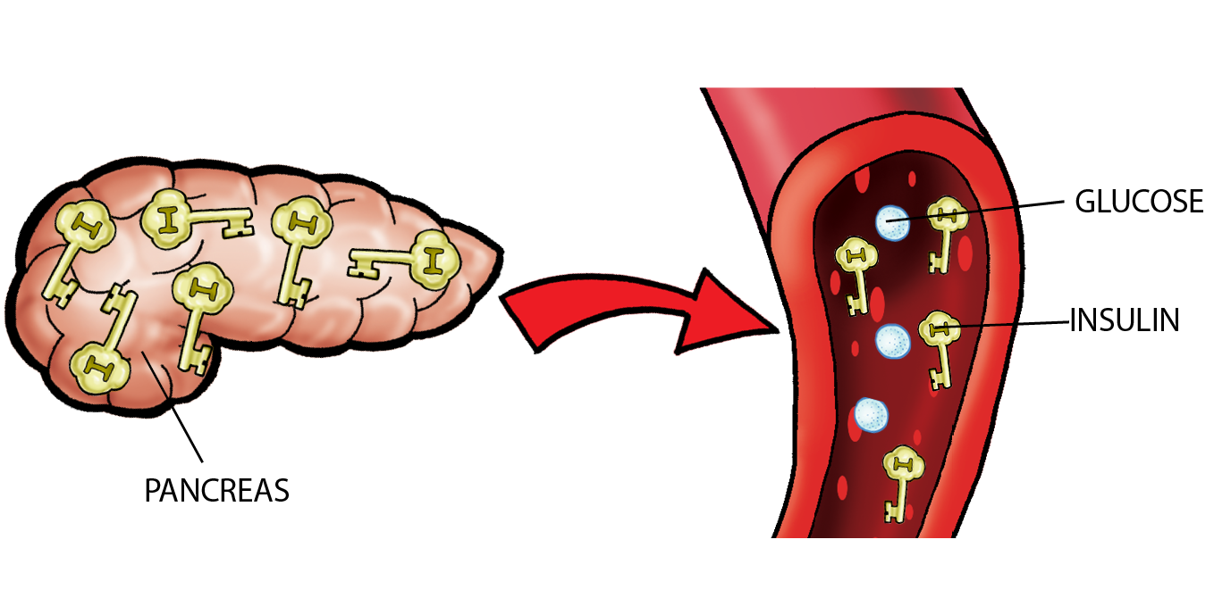
Insulin’s Function
Insulin works like a key, unlocking the doors of the cells in your body to let glucose in.
Once insulin opens the cells’ doors, glucose can move from the blood into the cells, where it can then provide energy to the body.
Diabetes WA
Notes:
Insulin is a signaling molecule (i.e., a hormone) that is produced by beta-cells in the islets of Langerhans within the pancreas.
Insulin controls the entry of glucose into a variety of cell types, particularly muscle cells and adipocytes, by acting as a key to open the doors of these cells to uptake glucose from the blood (insulin is a “gatekeeper” for glucose)
The body is always making insulin but following the consumption of a meal containing carbohydrates, glucose levels rise in the bloodstream, and β-cells respond by quickly ramping up their production of insulin and secreting it into the bloodstream. In turn, insulin opens up cells so they can take in the flood of glucose the body is experiencing, which then allows glucose to be used for energy production.
Increasing levels of insulin production also stimulate lipogenesis in order to store excess glucose as fat and promotes the suppression of hepatic glucose production. When the amount of glucose in the bloodstream decreases, insulin production will return to its basal rate in healthy individuals.
Similar processes for regulating sugar homeostasis have also been well characterized in Drosophila (fruit flies), C. elegans (worms), and many other animals.

Slide 5
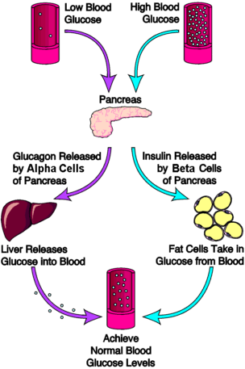
Low vs. High Blood Glucose
endocrineweb.com
Notes:
The body is always making insulin but following the consumption of a meal containing carbohydrates, glucose levels rise in the bloodstream, and β-cells respond by quickly ramping up their production of insulin and secreting it into the bloodstream. In turn, insulin opens up mostly skeletal muscle and adipose cells so they can take in the flood of glucose the body is experiencing, which then allows glucose to be used for energy production. Increasing levels of insulin production also stimulate lipogenesis in order to store excess glucose as fat and promotes the suppression of hepatic glucose production. When the amount of glucose in the bloodstream decreases, insulin production will return to its basal rate in healthy individuals. Insulin coupled with glucagon produced by pancreatic α-cells (when blood glucose levels are low, the catabolic glucagon hormone signals breakdown of glycogen, the storage form of glucose, to increase extracellular glucose concentrations), ensure blood glucose levels remain homeostatic thus providing a ubiquitous energy source for organisms.
https://www.endocrineweb.com/conditions/diabetes/normal-regulation-blood-glucose

Slide 6
What are Signaling Pathways?
Taniguchi, C. M., Emanuelli, B., & Kahn, C. R. (2006). Critical nodes in signalling pathways: insights into insulin action. Nature reviews. Molecular cell biology, 7(2), 85–96.
Notes:
Signaling pathways transduce signals (such as hormones acting as ligands of extracellular receptors) from outside to inside the cell.
The ligand–receptor interaction triggers a cascade of biochemical reactions (often through protein phosphorylation and dephosphorylation).
The transduced signal ultimately activates the effector elements of the pathway, which are responsible for mediating the response.
The Insulin Signaling Pathway plays a central role in many critical biological processes in animals, including organism growth, anabolic metabolism, cell survival, fertility, and lifespan determination.

Slide 7
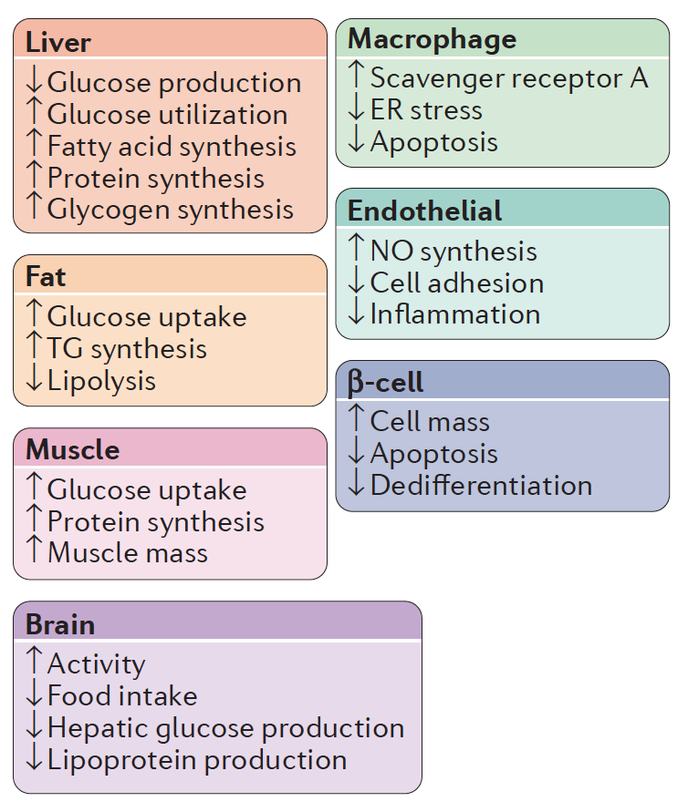
What are the Effects of Insulin Signaling?
Haeusler, R. A., McGraw, T. E., & Accili, D. (2018). Biochemical and cellular properties of insulin receptor signalling. Nature reviews. Molecular cell biology, 19(1), 31–44.
Notes:
Effects of insulin signaling in various tissues and cell types. ER, endoplasmic reticulum; NO, nitric oxide; TG, triglyceride.
Insert pics of liver, adipocytes, muscle, etc.

Slide 8
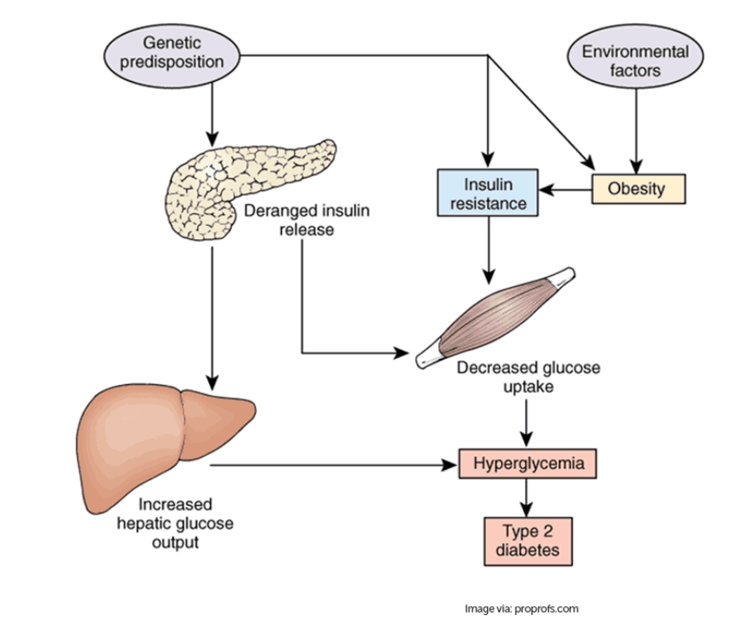
Why analyze evolution of insulin signaling pathway?
“We cannot understand properly a function if not trying to understand history of its origin.”
~ L.A. Orbeli
Notes:
Problems can arise in glucose homeostasis leading to metabolic disorders such as type 2 diabetes mellitus (T2DM).
In order to understand how the system can go awry, one must look at the evolution of the system to adequately understand its function.
While much research is still required to fully elucidate the exact causes and underlying mechanisms behind the development of insulin resistance, and thus T2DM, the authors feel in order to understand how the system can go awry, one must look at the evolution of the system to adequately understand its function. Better understanding of the evolutionary underpinnings of the pathway can facilitate the development of more effective prevention and treatment measures, arguably making it a priority for biomedical research.
Why is insulin signaling important?
Regulates glucose uptake from blood into cells
Regulates growth
Cross-talk with many other signaling pathways
Dysregulation of insulin signaling leads to diabetes and obesity
Obesity/diabetes a leading public health risk
e.g., heart disease, cancer, stroke, Alzheimer’s, kidney disease, COVID-19

Slide 9
Network Architecture
Notes:
Before we dive deeper into the insulin pathway, let’s begin by talking about a few examples of networks and their architectures.

Slide 10
Jog Your Memory
What is a phenotype? Give some examples.
Notes:
Let’s take a moment to jog our memories.
PAUSE FOR 15+ SECONDS TO ALLOW FOR THINK TIME
Question: What is a phenotype?
Phenotype is the physical manifestation of characteristics in an organism.
Question: Give some examples.
Examples include hair color, height, and blood group.

Slide 11
What’s different about the phenotype of House A and House B?
House A
House B
Notes:
Both houses have the same exterior structure. Thus, House A and House B have the same phenotype (house).

Slide 12
What’s different about the architecture of House A and House B?
House A
House B
Notes:
House A has 5 support structures, which is a much lower complexity structure compared to House B which has 12 support structures.

Slide 13
How might their architectural differences impact each house’s ability to evolve in order to adapt to changing conditions (i.e., which house would be easier to change)?
House A
House B
highly evolvable
resistant to evolution
Notes:
House A would be highly evolvable because it’d be easier to add support structures or do any kind of renovation to the architecture.
While House B would be resistant to change/evolution.

Slide 14
How might their architectural differences be impacted by external stimuli?
House A
House B
House B
easily perturbed
robust
Notes:
House A is easily perturbed while House B is robust
House B could lose a support and it’d still stand because there are other supports to take on the load, but House A would fall because there aren’t enough supports to help share the load.

Slide 15
Predicting genetic loci to evolve
Predict low complexity network (House A) would evolve rapidly and loci with high complexity networks (House B) would evolve slowly
House A
House B
highly evolvable
resistant to evolution
easily perturbed
robust
Notes:
House A is easily perturbed but highly evolvable, while House B is robust but resistant to evolution.
Characterize how we might predict genetic loci to evolve: predict low complexity network context (House A) would evolve rapidly and loci with high complexity networks (House B) would evolve slowly

Slide 16
Southwest Airlines canceled 62% of its flights during the 2022 Holiday Travel Season
Notes:
Let’s look at another example of network architecture…
Who remembers seeing this debacle in the news? In the holiday travel season of 2022, Southwest Airlines had to cancel 62% of its flights.

Slide 17
Think, Pair, then Share
Why do you think Southwest Airlines had to cancel so many of its flights when other large airlines such as United, Delta, and American didn’t?
Take 30 seconds to think about your answer to the above, and then share it with your neighbor.

Slide 18
Southwest Airlines
Southwest Airlines uses a point-to-point route model which allows passengers in smaller cities (e.g., Birmingham, AL) to fly directly to their destination.
Delta Airlines uses a hub-and-spoke route model in which passengers from smaller cities must travel to a central hub airport (e.g., Atlanta, GA) to change planes before flying to their destination.
Notes:
Southwest uses a “point-to-point” route model that often lets passengers fly directly from smaller cities and regions without having to stop at a central hub like Denver or New York. Point-to-point flights cut travel times by eliminating the intermediate stop — typically a big advantage for travelers who are not flying from major metro areas.
Other large carriers like United, Delta, and American rely on a “hub-and-spoke” model in which planes typically fly from smaller cities to a hub airport where passengers change planes.
https://www.nytimes.com/2022/12/28/travel/southwest-airlines-flight-cancellations.html
Note: There were other contributing factors to the Southwest Airlines meltdown that students may remember such as their aging technology system.

Slide 19
Think, Pair, then Share
Which of these models do you think is more robust (i.e., could withstand perturbations* like extreme weather conditions in part of the country)?
*a deviation of a system, moving object, or process from its regular or normal state or path, caused by an outside influence
Notes:
With a hub system, there’s a ready pool of crew members and pilots who can report to work at a major airport. That makes it easier to regroup after a storm. Planes also are kept closer to their home airports, rather than being spread across the country.
It’s harder to have a reserve of standby crew members and pilots when airlines serve many smaller markets. There is not usually excess crew in places like Syracuse, N.Y..
As a result, Southwest’s cancellations created a giant snowball effect that rippled across its carefully choreographed network, leaving planes and crews scattered across the country.
https://www.nytimes.com/2022/12/28/travel/southwest-airlines-flight-cancellations.html
Note: Students might say the point-to-point route model is more robust because if one central hub goes down due to a storm, the whole system would stop.

Slide 20
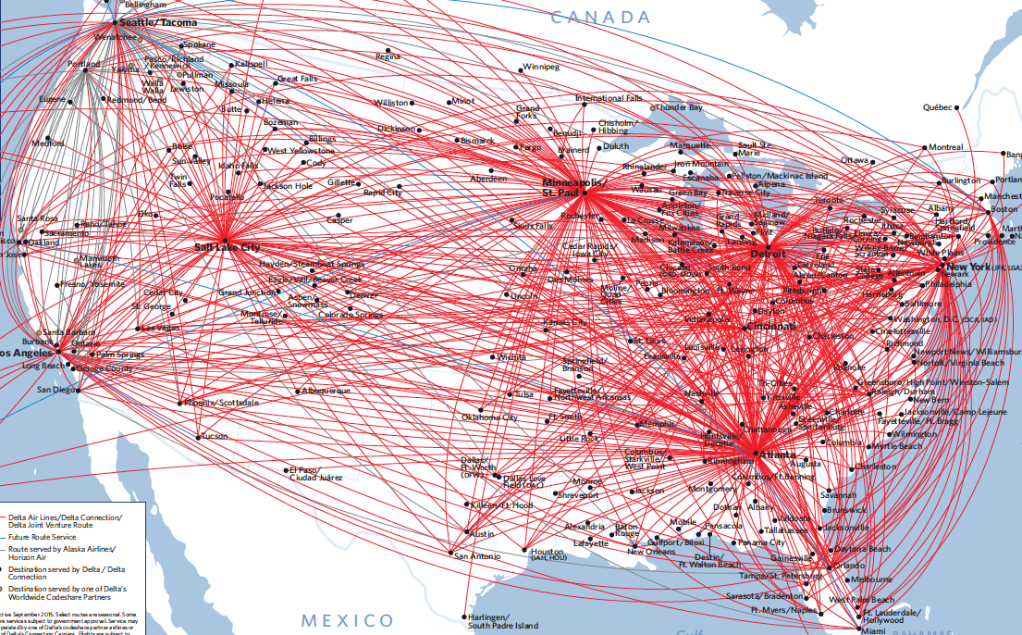
What defines the architecture of a network?
Nodes
Airports
Edges
Flight paths
Architecture can be changed by
Adding/subtracting nodes
New airports
Adding/subtracting edges
New flight path between two airports
An analysis of Delta Route Maps
Image: https://blogs.cornell.edu/info2040/2015/09/11/an-analysis-of-delta-route-maps/
Notes:
Continuing with the airline example, the architecture of an airline network could be defined as having Nodes which are the airports and Edges which are the flight paths.
Architecture of the airline network could be changed by adding or subtracting nodes such as new airports and adding or subtracting edges which could be a new flight path between two airports.

Slide 21
In the context of biological networks…
Nodes
Genes/proteins
Edges
Interaction between two genes/proteins
Architecture can be changed by
Adding/subtracting nodes
Gene duplicates
Adding/subtracting edges
New transcription factor binding site in a gene’s promoter
An analysis of Delta Route Maps
Image: https://blogs.cornell.edu/info2040/2015/09/11/an-analysis-of-delta-route-maps/
Notes:
The architecture of an airline network could be defined as having Nodes which are the airports and Edges which are the flight paths.
Architecture of the airline network could be changed by adding or subtracting nodes such as new airports and adding or subtracting edges which could be a new flight path between two airports.

Slide 22
Review
In our airline example, what were Nodes vs. Edges?
What biological examples of Nodes vs. Edges did we use?

Slide 23
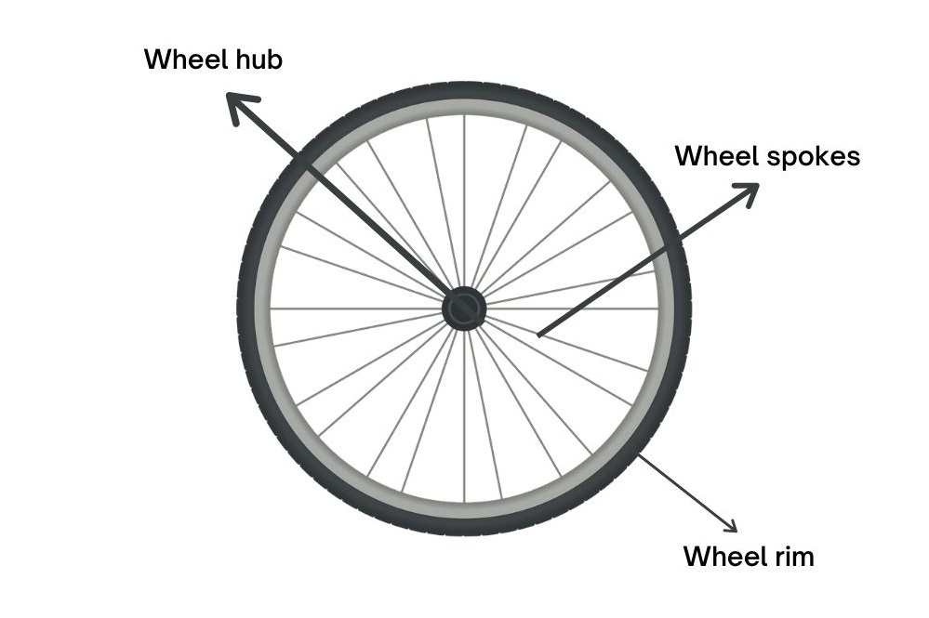
Hub-and-Spoke Model
Image: https://nowboarding.changiairport.com/discover-changi/changi-airport-cafe-hub---spoke.html/

Slide 24
Hub-and-Spoke Network Architecture
In the hub-and-spoke network, most nodes have only a few links, but a few nodes, called hubs (red), have a very large number of links.
The network connectivity can be characterized by the probability, P(k), that a node has k links.
Jeong, H., Tombor, B., Albert, R., Oltvai, Z. N., & Barabási, A. L. (2000). The large-scale organization of metabolic networks. Nature, 407(6804), 651-654.

Slide 25
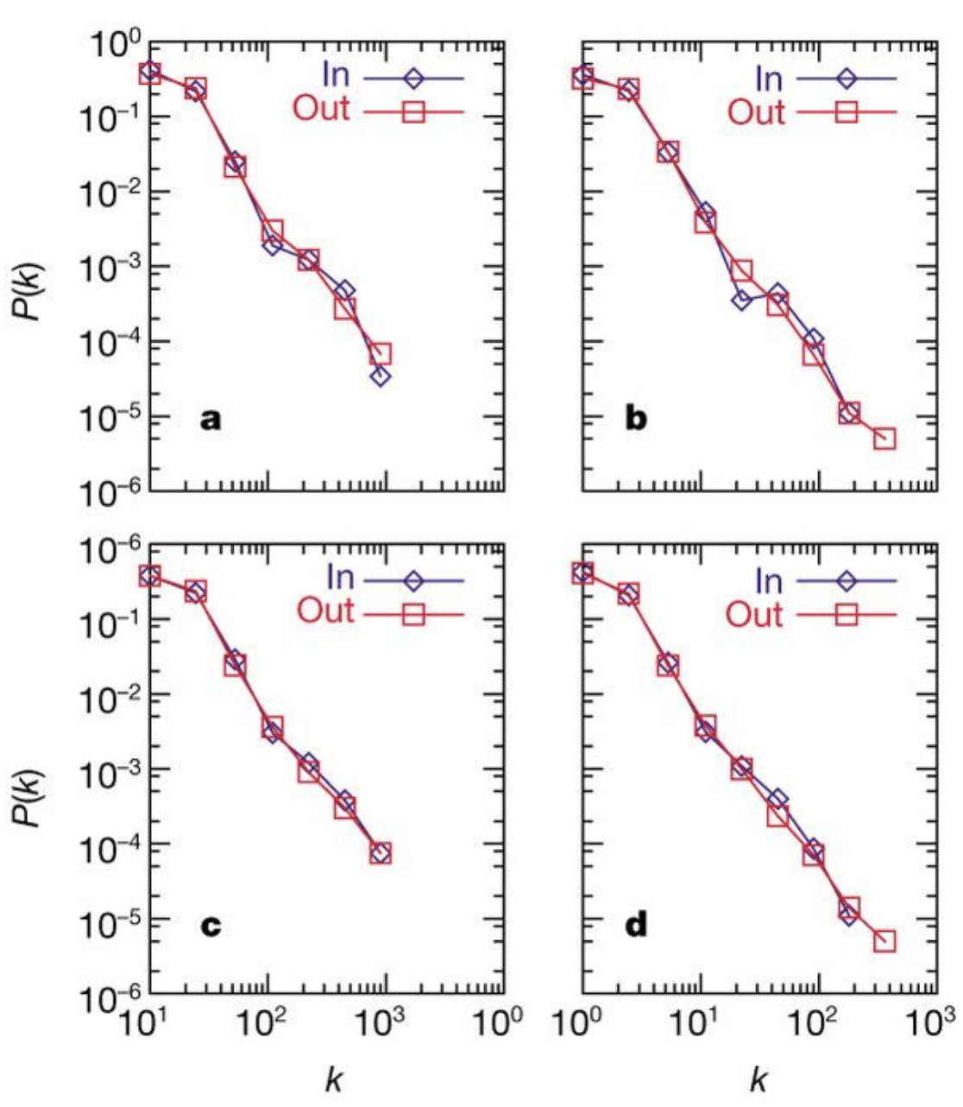
Most biological networks are hub-and-spoke across the domains of life
Metabolic Networks
archaea
Archaeoglobus fulgidus
bacterium
E. coli
probability, P(k), that a node has k links
eukaryote
C. elegans
average of
43 organisms
Jeong, H., Tombor, B., Albert, R., Oltvai, Z. N., & Barabási, A. L. (2000). The large-scale organization of metabolic networks. Nature, 407(6804), 651-654.

Slide 26
Guiding Questions of the Pathways Project
How does network structure determine robustness of function in response to perturbation (within-species timescales)?
How does network structure influence and reflect the process of evolution (between-species timescales)?
Notes:
Do we need to include this?

Slide 27
Rates of Molecular Evolution

Slide 28
Measuring Rate of Molecular Evolution
Number of differences in nucleotide sequence between two species
More differences → more/faster evolution
How do we distinguish between neutral and adaptive evolution?
Substitution Rates:
If difference in nucleotide sequence leads to a change in the amino acid, what type of substitution is this?
non-synonymous (“non-synonym”)
If difference in nucleotide sequence doesn’t lead to a change in the amino acid, what type of substitution is this?
synonymous (“synonym”)

Slide 29
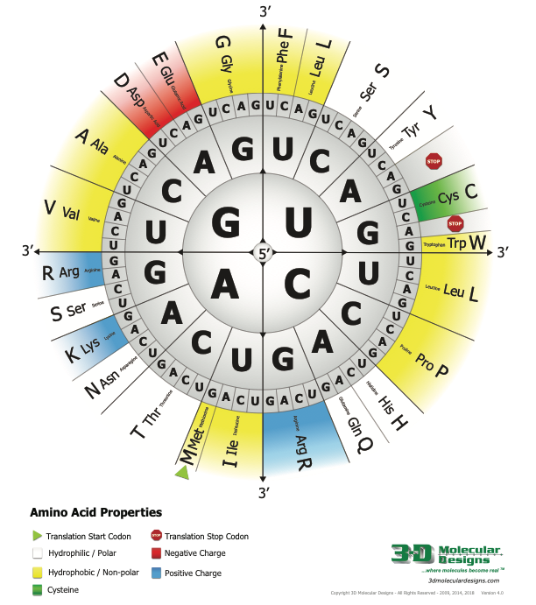
Check For Understanding
What type of substitution would this be? Would it change the chemical properties of the amino acid? If so, how?
GCG → GCA
UUG → UCG
GGA → GUA
Notes:
1. Synonymous as it wouldn’t change the amino acid- GCG and GCA both code for Alanine
2. Non-synonymous as UUG codes for a hydrophobic (non-polar) Leucine and UCG codes for a hydrophilic (polar) Serine
3. Technically non-synonymous as the amino acid would change from Glycine to Valine but since both are hydrophobic (non-polar), the protein may not be altered very much
https://youtu.be/vwmuvcDh9ZM

Slide 30
Measuring Rate of Molecular Evolution
Substitution Rates:
Non-synonymous substitution rate (d_{N})
difference in amino acid → assumed to be non-neutral
Synonymous substitution rate (d_{S})
no change in amino acid → assumed to be neutral
d_{N}/d_{S} = ratio of non-synonymous to synonymous nucleotide substitutions (also called Ka/Ks; ω)
Notes:
Q: Is non-neutral considered adaptive evolution? Non-neutral means the amino acid has changed but doesn’t say anything about whether the change impacts the protein’s function?

Slide 31
d_{N}/d_{S} = 1 gene evolving neutrally
Non-synonymous
Synonymous

Slide 32
d_{N}/d_{S} < 1 gene experiencing selective constraint
Synonymous
Non-synonymous
the proportion of new mutations that are strongly deleterious are removed by purifying selection

Slide 33
d_{N}/d_{S} > 1 gene experiencing adaptive evolution
Non-synonymous
Synonymous
evolutionary changes that are adaptive to a particular environment
Notes:
evolutionary changes that are adaptive to a particular environment

Slide 34
d_{N}/d_{S} = ratio of non-synonymous to synonymous nucleotide substitutions (also called Ka/Ks; ω)
d_{N}/d_{S} = 1 - gene evolving neutrally
d_{N}/d_{S} < 1 - gene experiencing selective constraint
d_{N}/d_{S} > 1 - gene experiencing adaptive evolution
Notes:
Selective constraint (also known as functional or evolutionary constraint) is defined here as the factor by which evolutionary divergence of a functional sequence is reduced, relative to a neutrally evolving sequence, due to the action of purifying selection
the proportion of new mutations that are strongly deleterious and removed by purifying selection

Slide 35
More complex measures consider other factors
Sliding windows
Codon Bias: preferential use of certain codons for particular amino acids
McDonald-Kreitman (MK) test
excess rare polymorphism → positive selection
compare ratio of within species polymorphic (nonsynon:synon) to between species differences (nonsynon:synon)
Tajima’s D
Using linkage disequilibrium to identify selective sweeps
Notes:
doesn’t think that the only way to measure selection is via dn/ds. - excess rare polymorphism is determined by the MK test

Slide 36
Impact of network architecture on evolution of protein-coding genes

Slide 37
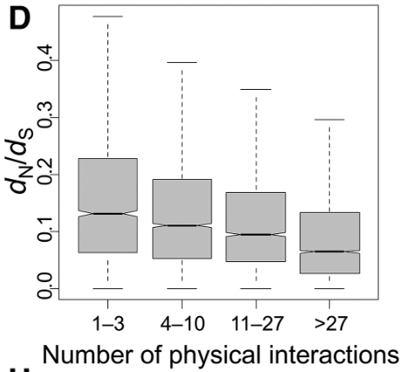
Rate of protein evolution correlates with the number of interactions with other proteins (proteins that are spokes evolve faster)
Human Protein–Protein
Interaction Network
Edge
Hub
Protein Evolution Rate
Spoke (Node)
Jeong, H., Tombor, B., Albert, R., Oltvai, Z. N., & Barabási, A. L. (2000). The large-scale organization of metabolic networks. Nature, 407(6804), 651-654.
Alvarez-Ponce, D., Feyertag, F., & Chakraborty, S. (2017). Position Matters: Network Centrality Considerably Impacts Rates of Protein Evolution in the Human Protein-Protein Interaction Network. Genome biology and evolution, 9(6), 1742–1756.
Notes:
Most biological networks are hub-and-spoke across the domains of life. Biological systems are networks, and in these networks, we can define nodes (e.g., genes, proteins, metabolites) connected through edges (e.g., enzymatic/chemical reactions, transcription regulation).

Slide 38
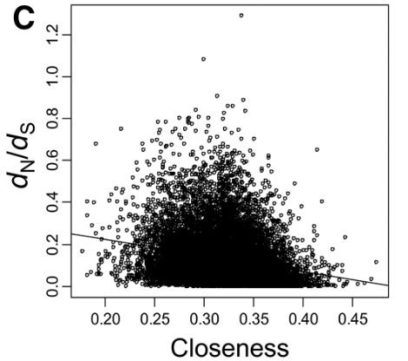
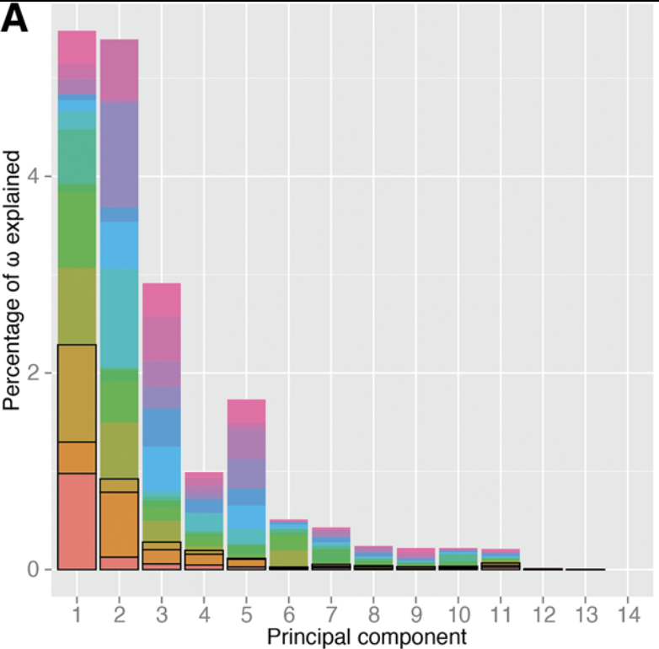
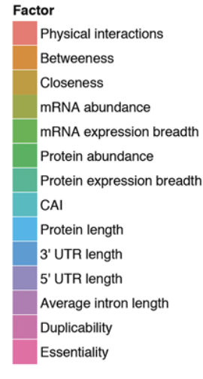
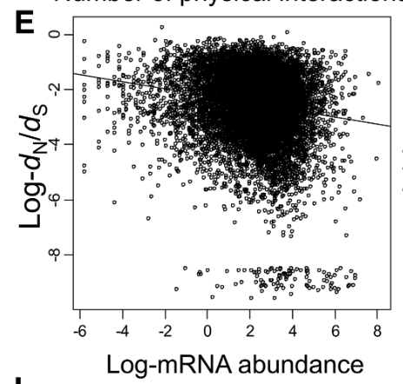
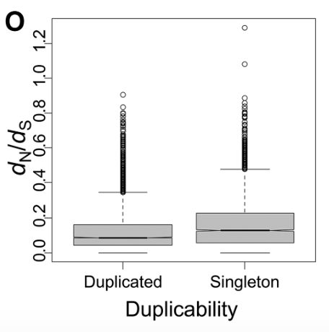
Rates of Protein Evolution Partially Correlated with Many Factors
Relationship between rates of protein evolution and several factors in the human protein–protein interaction network
Same patterns hold for the human signal transduction network, flies, worms, and yeast!
Alvarez-Ponce, D., Feyertag, F., & Chakraborty, S. (2017). Position Matters: Network Centrality Considerably Impacts Rates of Protein Evolution in the Human Protein-Protein Interaction Network. Genome biology and evolution, 9(6), 1742–1756.

Slide 39
Gene Duplication

Slide 40
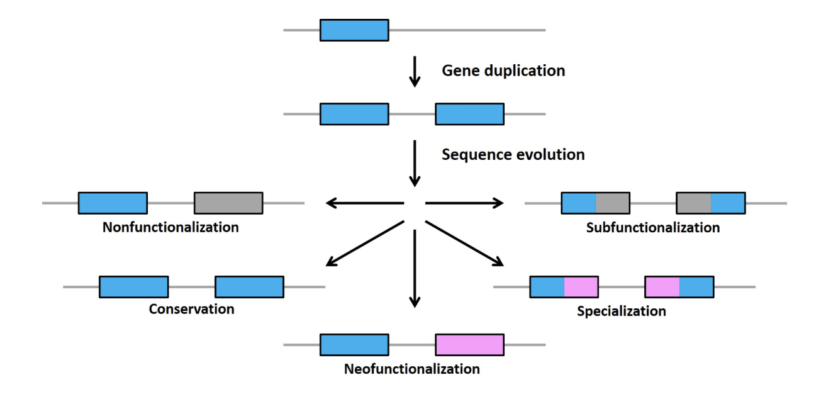
Linking Genetic Evolution to Physiological Networks
Functional evolution of duplicated genes
most common
Lynch, M., & Conery, J. S. (2000). The evolutionary fate and consequences of duplicate genes. Science (New York, N.Y.), 290(5494), 1151–1155.

Slide 41
Regulatory Region Evolution

Slide 42
How to build a beast?
For most of the 20th Century…
“Cows had cow molecules and goats had goat molecules and snakes had snake molecules, and it was because they were made of cow molecules that a cow was a cow.” — Francois Jacob
But, most genes are highly conserved across species…
Most variation in phenotype is caused by changes in the timing and location of gene expression
So, how does regulation of gene expression evolve?
Katie Created with BioRender.com

Slide 43
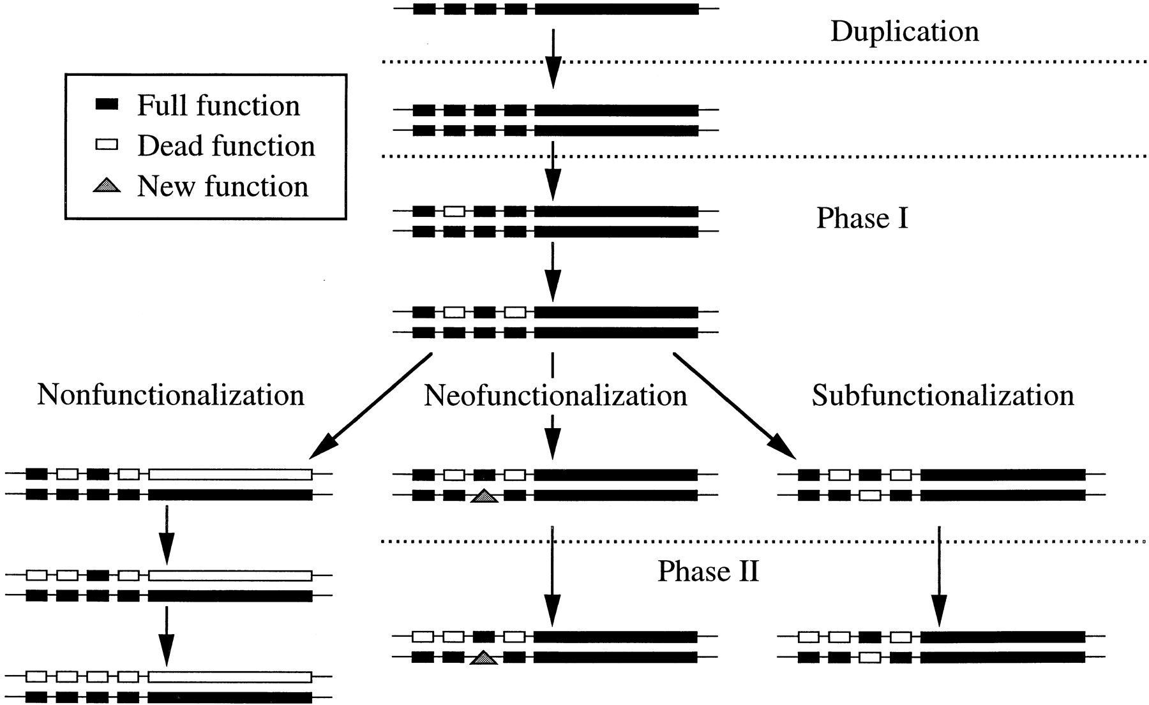
Evolution of Cis-Regulatory Elements
duplication-degeneration-complementation (DDC) model
most common
Force, A., Lynch, M., Pickett, F. B., Amores, A., Yan, Y. L., & Postlethwait, J. (1999). Preservation of duplicate genes by complementary, degenerative mutations. Genetics, 151(4), 1531–1545.
Lynch, M., & Conery, J. S. (2000). The evolutionary fate and consequences of duplicate genes. Science (New York, N.Y.), 290(5494), 1151–1155.

Slide 44
Importance of synteny in assigning orthology

Slide 45
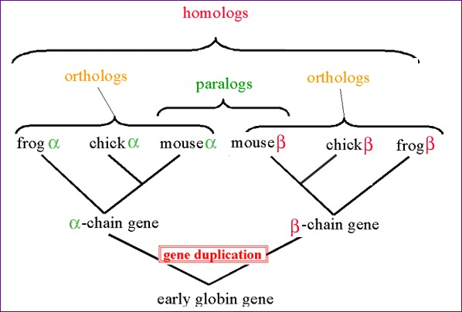
Homologs, Orthologs, and Paralogs
Homology: sequences or structures which share a common ancestor
Two segments of DNA can have shared ancestry (be homologous) because of either a speciation event (orthologs) or a duplication event (paralogs).
Image: BLAST Glossary: orthologs https://www.ncbi.nlm.nih.gov/books/NBK62051/
Notes:
In genomics, nucleic acids and proteins are homologous if they evolved from a common ancestor. Orthologs and paralogs are subcategories of homology.
Orthologs are genes in different species that derive from a single ancestral gene in the last common ancestor of the respective species. Orthologous genes have a shared ancestry of a character or genetic region due to recent speciation.
A paralog is one of a set of homologous genes that have diverged from each other because of gene duplication. For example, the mouse α-globin and β-globin genes are paralogs. The relationship between mouse α-globin and chick β-globin is also considered paralogous.

Slide 46
Defining Synteny
Classic Definition (“Global” synteny): two “genetic entities” (e.g., genes) on the same chromosome
“Local” Synteny: conservation of the order and orientation of genes in the vicinity of a target gene - This is what the GEP uses!
Myers PZ. (2008). Synteny: Inferring ancestral genomes. Nature Education 1(1):47.

Slide 47
Defining Synteny cont.
As organisms evolve, changes occur in their genomes (deletions, insertions, etc.)
Over time, these changes can disrupt synteny
Two genetic entities may no longer be on the same chromosome
The order and orientation of genes relative to a target gene is no longer conserved
Generally, we hypothesize that no changes have taken place, because this is the simplest explanation
Evolutionarily, this concept is known as “parsimony”
More commonly, this is known as Occam’s Razor: “the simplest explanation should be preferred over more complex theories”

Slide 48
Identifying the Ortholog via Synteny
Synteny: the order and orientation of genes tends to be conserved
Species 1
Target Gene
Some divergence
Species 2
Target Gene
More divergence
Species 3
Target Gene

Slide 49
What does synteny look like in the GEP?
D. melanogaster (chr3R)
CG12746
CG2931
Rheb
CRMP
CG2926
Target Gene
Target Gene
CG12746
CG2931
Rheb
Ssadh
Npl4
Synteny conserved
Synteny not conserved
D. pseudoobscura (NC_046679; reverse complement)

