Slide 1
Template preparation
EE Slawson Tempel, © WUSTL

Slide 2
Template preparation
EE Slawson Tempel, © WUSTL

Slide 3
Template preparation
EE Slawson Tempel, © WUSTL

Slide 4
Template preparation
EE Slawson Tempel, © WUSTL

Slide 5
Template preparation
EE Slawson Tempel, © WUSTL

Slide 6
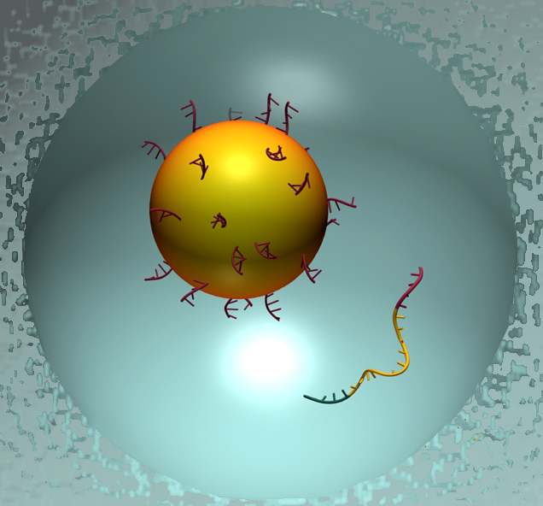
© Roche, EE Slawson Tempel, © WUSTL

Slide 7
EE Slawson Tempel, © WUSTL

Slide 8
EE Slawson Tempel, © WUSTL

Slide 9
EE Slawson Tempel, © WUSTL

Slide 10
EE Slawson Tempel, © WUSTL

Slide 11
EE Slawson Tempel, © WUSTL

Slide 12
EE Slawson Tempel, © WUSTL

Slide 13
EE Slawson Tempel, © WUSTL

Slide 14
EE Slawson Tempel, © WUSTL

Slide 15
EE Slawson Tempel, © WUSTL

Slide 16
EE Slawson Tempel, © WUSTL

Slide 17
EE Slawson Tempel, © WUSTL

Slide 18
EE Slawson Tempel, © WUSTL

Slide 19
EE Slawson Tempel, © WUSTL

Slide 20
EE Slawson Tempel, © WUSTL

Slide 21
EE Slawson Tempel, © WUSTL

Slide 22
EE Slawson Tempel, © WUSTL

Slide 23
EE Slawson Tempel, © WUSTL

Slide 24
EE Slawson Tempel, © WUSTL

Slide 25
454 – Paired end reads
Fragment DNA
EE Slawson Tempel, © WUSTL

Slide 26
454 – Paired end reads
Attach adapters
EE Slawson Tempel, © WUSTL

Slide 27
454 – Paired end reads
Ligate in a circle
EE Slawson Tempel, © WUSTL

Slide 28
454 – Paired end reads
Digest with restriction enzyme
EE Slawson Tempel, © WUSTL

Slide 29
454 – Paired end reads
Isolate fragments containing adapter
EE Slawson Tempel, © WUSTL

Slide 30
454 – Paired end reads
Attach sequencing adapters and sequence
EE Slawson Tempel, © WUSTL

