Slide 1

The Dilemma of
Transposable Elements:
Can’t Live with Them,
Can’t Evolve without Them!
Slides assembled by
SCR Elgin, Washington University
S Parrish, McDaniel College
Genomics Education Partnership
July 5, 2022

Slide 2
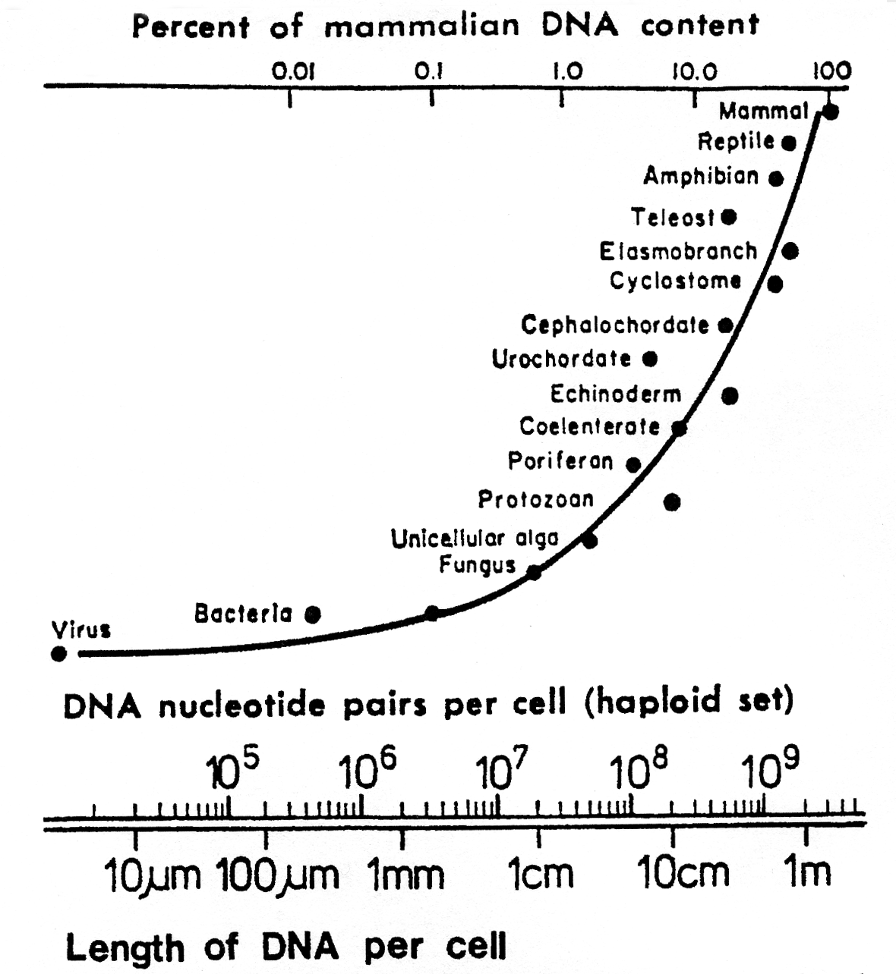
Eukaryotic genomes are surprisingly large!
Minimum haploid DNA content - the C-Value Paradox
Britten RJ, Davidson EH. Gene regulation for higher cells: a theory. Science. 1969 Jul 25;165(3891):349-57.
Notes:
Slide: Figure 3 from Gene Regulation for Higher Cells: A Theory. R Britten & E Davidson, Science, 1969 Jul 25;165(891):349-57. doi: 10.1126/science.165.3891.349.
Notes: The genomes of eukaryotes have a surprisingly large amount of DNA. It has been suggested that this is related to the “complexity” of the organism- but complexity is hard to define! (Note the lack of a Y axis in this representation, published in Science!) Mammals in general have 1000X the DNA of a typical bacterium, but only ~5X as many genes. What is all that extra DNA?

Slide 3
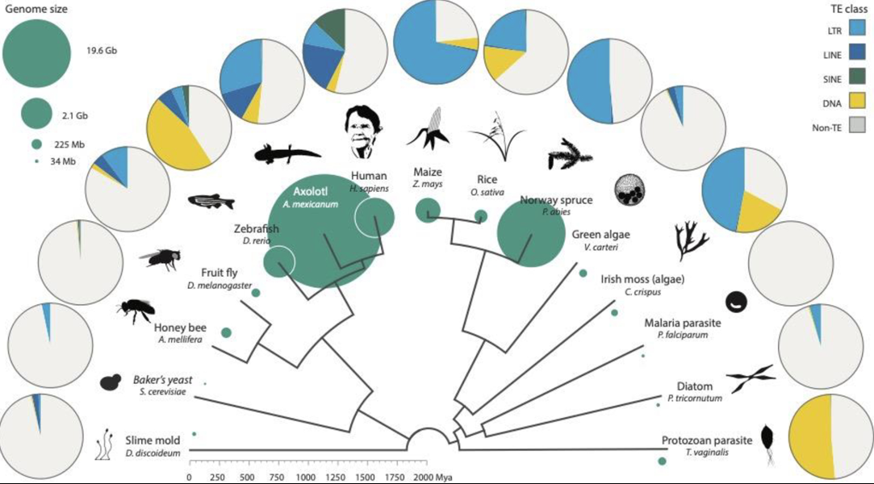
Transposable elements are major contributors
to eukaryotic genomes
Genome size
TE class
LTR
19.6 Gb
LINE
SINE
2.1 Gb
DNA
Non-TE
225 Mb
34 Mb
Wells JN, Feschotte C. A Field Guide to Eukaryotic Transposable Elements.
Annu Rev Genet. 2020 Nov 23;54:539-561.
Notes:
Figure 3 from Wells JN, Feschotte C. A Field Guide to Eukaryotic Transposable Elements. Annu Rev Genet. 2020 Nov 23;54:539-561. doi: 10.1146/annurev-genet-040620-022145.
Legend from the authors: Distribution of TEs across the eukaryote phylogeny. Reference genome size (sea green circles) varies dramatically across eukaryotes and is loosely correlated with TE content. Here, the honey bee TE content is likely an underestimate, as approximately 3% of the genome derives from unusual large retrotransposon derivatives. For ease of visualization, YR retroelements have been included with LTRs and all class II elements are included under DNA. Data were acquired from genome RepeatMasker output files. Figure adapted with permission from Huang et al. (71); the Volvox carteri silhouette was provided by Matt Crook. Abbreviations: LINE, long interspersed nuclear element; LTR, long terminal repeat; SINE, short interspersed nuclear element; TE, transposable element; YR, tyrosine recombinase.

Slide 4
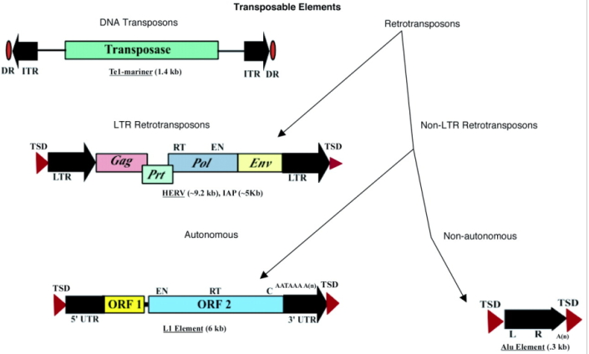
Classes of transposable elements
DNA Transposons
Retrotransposons
LTR Retrotransposons
Non-LTR
Retrotransposons
Autonomous
Non-autonomous
Kazazian HH Jr. Mobile elements: drivers of genome evolution.
Science. 2004 Mar 12;303(5664):1626-32.
Notes:
From the author: DNA transposons (e.g., Tc-1-mariner) have inverted terminal inverted repeats (ITRs) and a single open reading frame (ORF) that encodes a transposase. They are flanked by short direct repeats (DRs). Retrotransposons are divided into autonomous and nonautonomous classes depending on whether they have ORFs that encode proteins required for retrotransposition. Common autonomous retrotransposons are (i) LTRs or (ii) non-LTRs. Examples of LTR retrotransposons are human endogenous retroviruses (HERV) (shown) and various Ty elements of S. cerevisiae (not shown). These elements have terminal LTRs and slightly overlapping ORFs for their group-specific antigen (gag), protease (prt), polymerase (pol), and envelope (env) genes. They produce target site duplications (TSDs) upon insertion. Also shown are the reverse transcriptase (RT) and endonuclease (EN) domains. Other LTR retrotransposons that are responsible for most mobile-element insertions in mice are the intracisternal A-particles (IAPs), early transposons (Etns), and mammalian LTR-retrotransposons (MaLRs). These elements are not present in humans, and essentially all are defective, so the source of their RT in trans remains unknown. L1 is an example of a non-LTR retrotransposon. L1s consist of a 5'-untranslated region (5' UTR) containing an internal promoter, two ORFs, a 3' UTR, and a poly(A) signal followed by a poly(A) tail (An). L1s are usually flanked by 7- to 20-bp target site duplications (TSDs). The RT, EN, and a conserved cysteine-rich domain (C) are shown. An Alu element is an example of a nonautonomous retrotransposon. Alus contain two similar monomers, the left (L) and the right (R), and end in a poly(A) tail. Approximate full-length element sizes are given in parentheses.

Slide 5
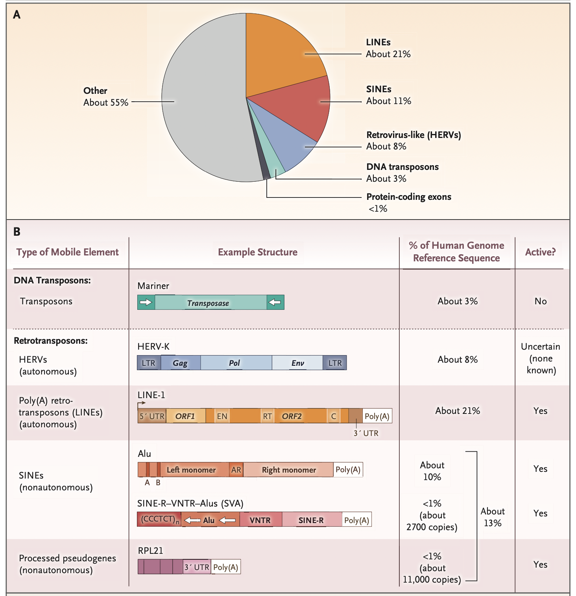
Transposable elements are major contributors to the human genome
Kazazian HH Jr, Moran JV. Mobile DNA in Health and Disease. N Engl J Med. 2017 Jul 27;377(4):361-370.
Notes:
From the authors: Panel A shows protein-coding exons and classes of human transposable elements as a percentage of the genome. As shown in Panel B, DNA transposons encode transposase, an enzyme that binds at or near inverted repeats flanking the element (white arrows flanking transposase) to promote mobility by means of a cut-and-paste mechanism. Retrotransposons mobilize by means of a copy-and-paste mechanism through an RNA intermediate. Human endogenous retroviruses (HERVs) contain sequences analogous to the gag, pol, and env genes of retroviruses, but most HERVs, if not all of them, are not active in humans. Elements are considered to be autonomous when they encode the protein activities necessary for retrotransposition (e.g., an endonuclease [EN] and a reverse transcriptase [RT]). The arrow at the 5′ end of poly(A) retrotransposons denotes the transcription start site from their internal promoter. Nonautonomous elements do not encode proteins; their retrotransposition depends on the proteins encoded by autonomous elements. Nonautonomous elements include Alu elements and SVAs. Alu elements have a size of approximately 280 bp and consist of two monomers separated by an adenosine-rich (AR) linker; the left Alu monomer has an internal RNA polymerase III promoter (bars labeled A and B). SVAs are composite elements with a portion of a HERV (SINE-R [short interspersed element of HERV origin]), a variable number of tandem repeats (VNTRs), and a backward Alu, as well as a CCCTCT multimer. Processed pseudogenes are copies of cellular messenger RNAs that have been reverse- transcribed into DNA and lack introns. C denotes cysteine-rich domain (encoded by ORF2), HERV-K a HERV of the K type, LINE long interspersed element, LTR long terminal repeat, ORF1 open reading frame 1, ORF2 open reading frame 2, and UTR untranslated region. The diagram in Panel B is adapted from Beck et al.¹⁰ See https://www.nejm.org/doi/10.1056/NEJMra1510092 .

Slide 6
Transposable elements are major contributors to the human genome
Kazazian HH Jr, Moran JV. Mobile DNA in Health and Disease. N Engl J Med. 2017 Jul 27;377(4):361-370.
Notes:
From the authors: Panel A shows protein-coding exons and classes of human transposable elements as a percentage of the genome. As shown in Panel B, DNA transposons encode transposase, an enzyme that binds at or near inverted repeats flanking the element (white arrows flanking transposase) to promote mobility by means of a cut-and-paste mechanism. Retrotransposons mobilize by means of a copy-and-paste mechanism through an RNA intermediate. Human endogenous retroviruses (HERVs) contain sequences analogous to the gag, pol, and env genes of retroviruses, but most HERVs, if not all of them, are not active in humans. Elements are considered to be autonomous when they encode the protein activities necessary for retrotransposition (e.g., an endonuclease [EN] and a reverse transcriptase [RT]). The arrow at the 5′ end of poly(A) retrotransposons denotes the transcription start site from their internal promoter. Nonautonomous elements do not encode proteins; their retrotransposition depends on the proteins encoded by autonomous elements. Nonautonomous elements include Alu elements and SVAs. Alu elements have a size of approximately 280 bp and consist of two monomers separated by an adenosine-rich (AR) linker; the left Alu monomer has an internal RNA polymerase III promoter (bars labeled A and B). SVAs are composite elements with a portion of a HERV (SINE-R [short interspersed element of HERV origin]), a variable number of tandem repeats (VNTRs), and a backward Alu, as well as a CCCTCT multimer. Processed pseudogenes are copies of cellular messenger RNAs that have been reverse- transcribed into DNA and lack introns. C denotes cysteine-rich domain (encoded by ORF2), HERV-K a HERV of the K type, LINE long interspersed element, LTR long terminal repeat, ORF1 open reading frame 1, ORF2 open reading frame 2, and UTR untranslated region. The diagram in Panel B is adapted from Beck et al.¹⁰ See https://www.nejm.org/doi/10.1056/NEJMra1510092 .

Slide 7
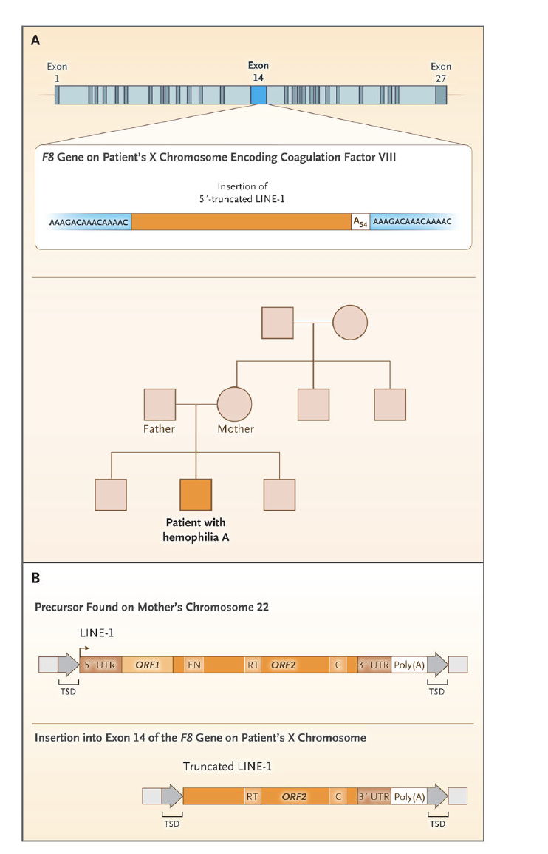
The harm that transposons can do: insertion mutations
Example: hemophilia
Kazazian HH Jr, Moran JV. Mobile DNA in Health and Disease.
N Engl J Med. 2017 Jul 27;377(4):361-370.
Notes:
What happens when transposable elements move around? At some frequency, they will insert into genes and cause mutations. Here a LINE-1 element disrupts the gene for coagulation factor VIII, resulting in hemophilia in males (X chromosome linkage).

Slide 8
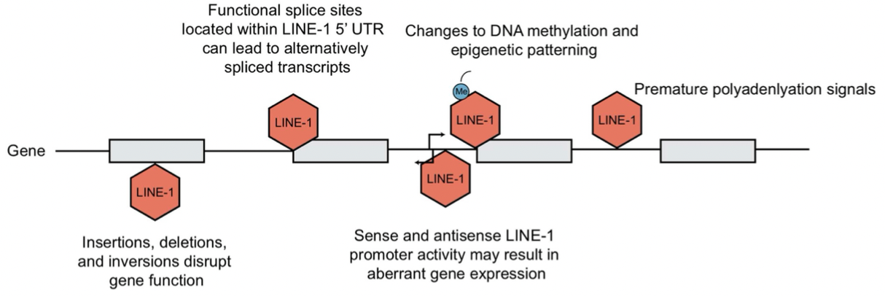
The harm that transposons can do: additional deleterious transposons effects
LINE-1 is clearly active in our present genome
Saleh A, Macia A, Muotri AR. Transposable Elements, Inflammation, and Neurological Disease. Front Neurol. 2019 Aug 20;10:894.
Notes:
From the authors: Consequences of LINE-1 retrotransposition. Retrotransposition can generate genomic instability and consequently interferes with host gene expression at many levels. Consequences include disruption of gene function due to LINE-1 insertions , as well as generation of mis-spliced or prematurely truncated transcripts. Insertions have been shown to impact host gene expression through changes in epigenetic patterning and LINE-1 promoter activity as well. This figure is adapted from Macia et al and Garcia Perez et al.

Slide 9
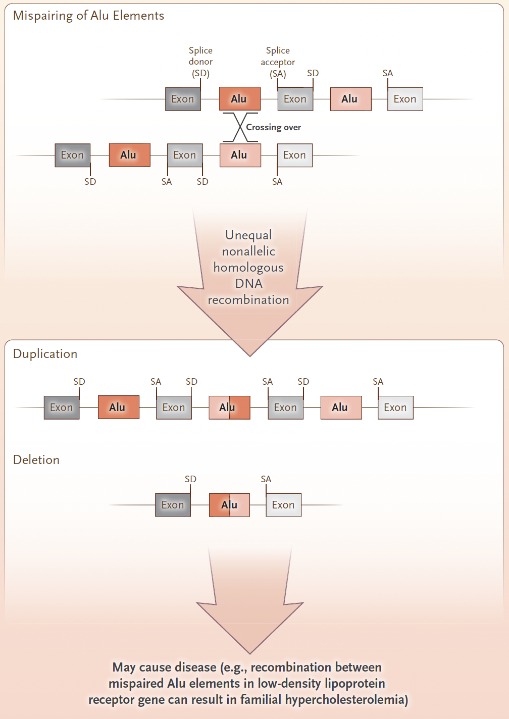
The harm that transposons can do: recombination events and genome instability
Mispairing of Alu Elements
Duplication
Deletion
Kazazian HH Jr, Moran JV. Mobile DNA in Health and Disease. N Engl J Med. 2017 Jul 27;377(4):361-370.
Notes:
From the authors: Mispairing of Alu elements or LINE-1 elements, followed by crossing over and unequal nonallelic homologous recombination, leads to the deletion or duplication of the genomic sequence. Exons and introns (black lines) of the hypothetical gene are shown. The diagram is adapted from Hulme et al.⁵⁶

Slide 10
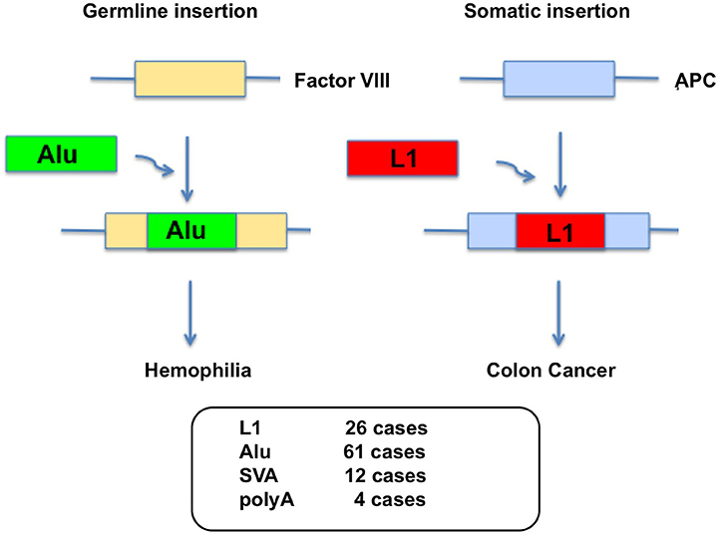
The harm that transposons can do: somatic mutations can lead to cancer
Ariumi Y. Guardian of the Human Genome: Host Defense Mechanisms against LINE-1 Retrotransposition.
Front Chem. 2016 Jun 28;4:28.
Notes:
See following slide for details on TE events observed. Note both germline mutations and somatic mutations play a role.

Slide 11
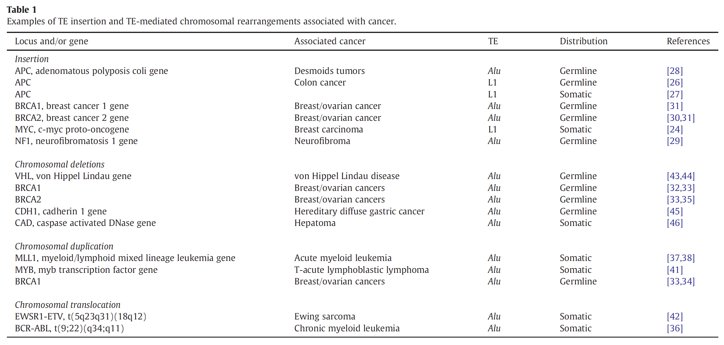
Cancer: many examples of mutations by TEs
Chénais B. Transposable elements and human cancer: a causal relationship?
Biochim Biophys Acta. 2013 Jan;1835(1):28-35.
Notes:
Both TE insertions and TE-mediated chromosomal rearrangements are associated with cancer. The L1 and Alu elements, very common in the human genome, are usually to blame Both germline and somatic mutations have been documented. Note BRCA-1 is involved in DNA repair; thus it is considered a tumor suppressor.

Slide 12
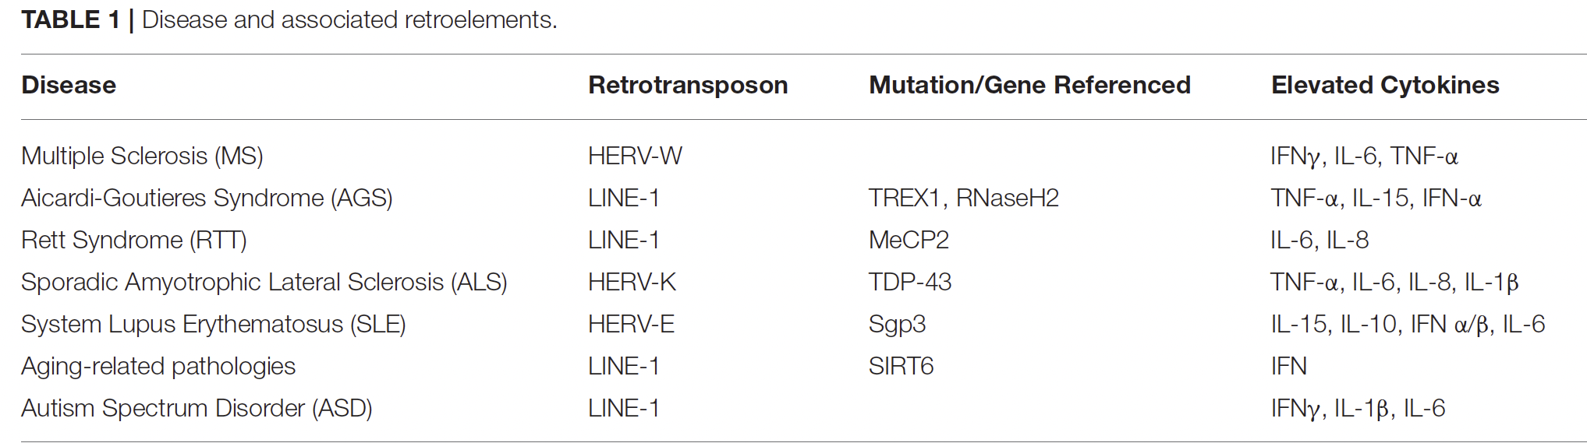
The harm that transposons can do: inflammatory diseases
Saleh A, Macia A, Muotri AR. Transposable Elements, Inflammation, and Neurological Disease.
Front Neurol. 2019 Aug 20;10:894.
Notes:
Damage to a number of genes is involved in inflammatory diseases. HERV-W and LINE-1 are endogenous retroviruses The mutated genes are often involved in gene silencing or DNA repair. TREX1 is the 3’ repair exonuclease; MeCP2 binds to 5mC; TDP-43 is involved in mRNA splicing; SIRT6 is a histone deacetylase; Sgp3 is the “lupus susceptibility locus”, encodes a suppressor of endogenous retrovirus expression.

Slide 13
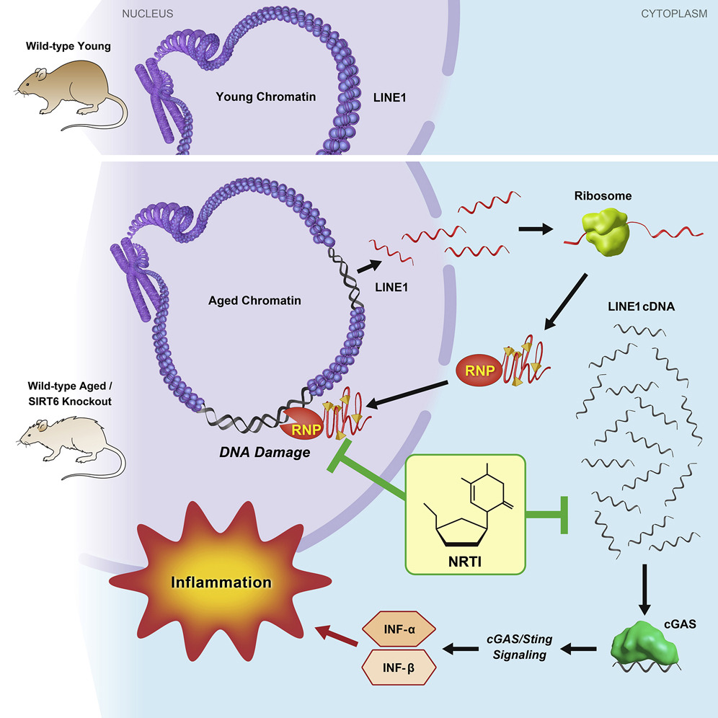
The harm that transposons can do: inflammation
Hope for bolstering defense!
NRT1 = nucleoside reverse-
transcriptase inhibitors;
can reduce this type I
interferon response and
DNA damage; they extend
lifespan and improve health
of SIRT6 KO mice.
Simon M, et al. LINE1 Derepression in Aged Wild-Type and SIRT6-Deficient Mice Drives Inflammation. Cell Metab. 2019 Apr 2;29(4):871-885.e5.
Notes:
Mice with a deficiency of SIRT6 (a histone deacetylase) have a shortened life span and show elevated LINE-1 activity. This results in abundant cytoplasmic L1 cDNA, which triggers strong type I interferon response via activation of cGAS (plasma membrane protein). L1 transcription, cytoplasmic cDNA copy number, and type I interferons are also elevated in wild-type aged mice. Inhibiting L1 replication significantly improved the health and lifespan of aged mice. Use of anti-virals may slow aging. Nucleoside reverse-transcriptase inhibitors (NRT1) rescue type I interferon response and DNA damage; they extend lifespan and improve health of SIRT6 KO mice.

Slide 14
Defense! Most repetitious DNA is packaged as heterochromatin, with concomitant silencing
Transposon
Euchromatin
  Less condensed
  Chromosome arms
  Unique sequences;
  gene rich
  Replicated throughout S
  Recombination during meiosis
Heterochromatin
  Highly condensed
  Centromeres and telomeres
  Repetitious sequences (e.g., TEs); gene poor
  Replicated in late S
  No meiotic recombination
Transcriptional activators
Hyper-acetylated histone tail
Heterochromatin Protein 1 complex
Hypo-acetylated histone tail; methylated H3/K9
Notes:
Slide: Gabriella Farkas, SCR Elgin
Heterochromatin was originally defined by cytology, as the condensed material in the nucleus. Over time, characterization of euchromatin / heterochromatin expanded to the collection of properties given on the slide. During the last 40 years we have begun to define heterochromatin in biochemical terms. A common feature of heterochromatin is the abundance of repetitious sequences. Indeed, it appears that repetitious sequences are targeted for heterochromatin formation. This appears to be a primary line of defense, preventing TE expression and thus mobilization.

Slide 15
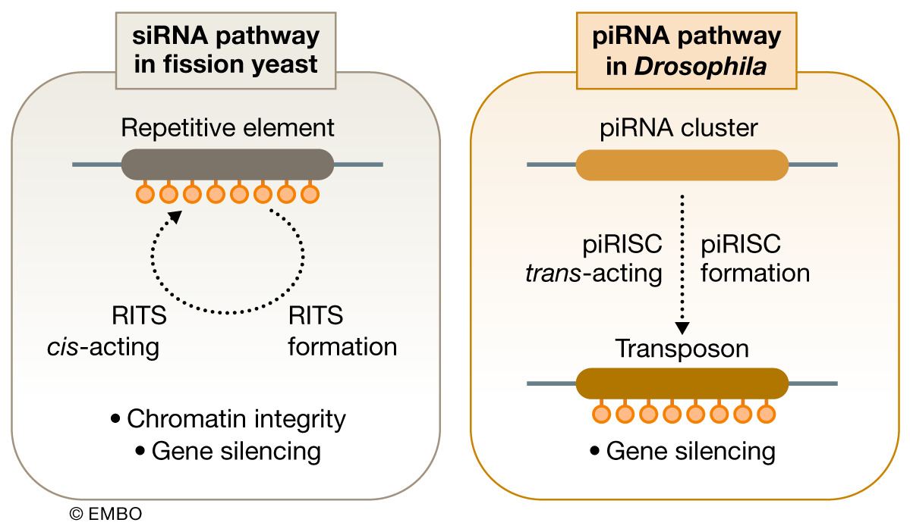
Heterochromatin formation: a defense against repeats (TEs)
Onishi, R., et al. piRNA- and siRNA-mediated transcriptional repression in Drosophila, mice, and yeast: new insights and biodiversity. EMBO Reports. 2021 22: e53062.
Notes:
Summary: all classes of repeats appear to be recognized as such and silenced. Silencing is essential to protect the integrity of the genome. If silencing capacity is lost [for example by a mutation in the Drosophila H3K9 methyl transferase Su(var)3-9], one sees dramatic increases in extra-chromosomal circular DNA made up of tandem repeats of rDNA or Satellite 1.688 DNA, indicating local recombination events – small circles of DNA are popping out of the genome! (Peng and Karpen, 2007, Nat Cell Biol 9: 25-35. doi: 10.1038/ncb1514). Silencing is required both to maintain stability of these tandem repeats, and to avoid activation/mobilization of the transposable elements. Considerable evidence shows that the TEs are recognized and targeted for silencing by a piRNA mechanism (a form of RNAi); how the tandem repeats are recognized has not been studied as extensively, but likely involves an RNAi mechanism. Details of the mechanism can vary significantly among organisms.
Nomenclature: RITS = RNA-induced transcriptional silencing; piRISC = piRNA-induced silencing complex. piRNA is the largest class of small non-coding RNA molecules produced in animal cells; generally created from loci with sequences from transposable elements such that piRNAs can recognize TEs and target them for silencing.

Slide 16
Heterochromatin formation: a defense against repeats (TEs)
Repeats are targeted for silencing,
generally by heterochromatin formation
  Simple sequences: 2 to 20 nucleotides in tandem array; ex. (AATAT)_{n}
  Transposable elements: retroviruses, DNA transposons, & remnants
  Genes: rRNA genes, histone genes; foreign insertions
Foreign repeats and endogenous duplications
can both induce robust silencing
TEs recognized by piRNA; organisms differ in exact mechanism.
Protection of the germline against TE mobilization and tandem
repeat instability is critical.
f
Notes:
Summary: all classes of repeats appear to be recognized as such and silenced. Silencing is essential to protect the integrity of the genome. If silencing capacity is lost [for example by a mutation in the Drosophila H3K9 methyl transferase Su(var)3-9], one sees dramatic increases in extra-chromosomal circular DNA made up of tandem repeats of rDNA or Satellite 1.688 DNA, indicating local recombination events – small circles of DNA are popping out of the genome! (Peng and Karpen, 2007, Nat Cell Biol 9: 25-35. doi: 10.1038/ncb1514). Silencing is required both to maintain stability of these tandem repeats, and to avoid activation/mobilization of the transposable elements. Considerable evidence shows that the TEs are recognized and targeted for silencing by a piRNA mechanism (a form of RNAi); how the tandem repeats are recognized has not been studied as extensively, but likely involves an RNAi mechanism. Details of the mechanism can vary significantly among organisms.

Slide 17
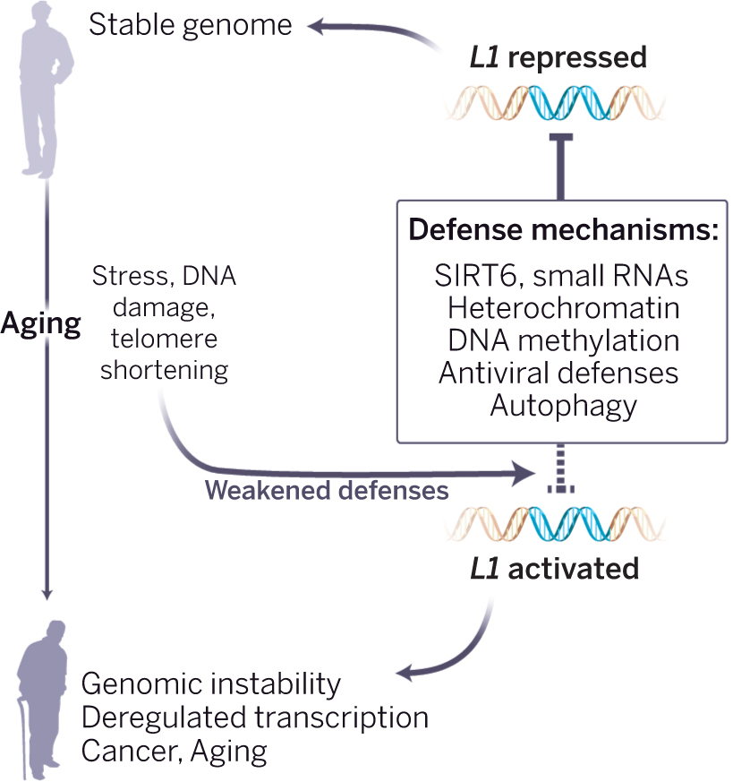
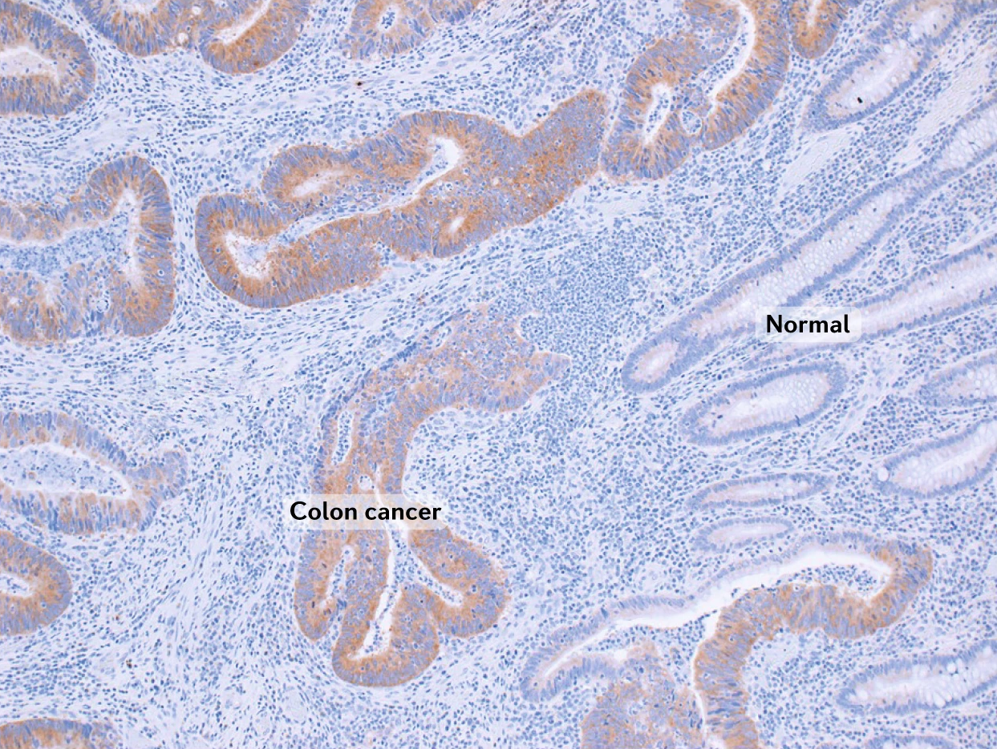
The aging problem: we appear to lose silencing as we get older
Histological section of a colon cancer and adjacent
normal epithelium. Brown stain = LINE-1 ORF1p
protein; blue = cell nuclei.
Gorbunova V, et al. Human Genomics. Sleeping dogs of the genome. Science. 2014 Dec 5;346(6214):1187-8.
Payer LM, Burns KH. Transposable elements in human genetic disease. Nat Rev Genet. 2019 Dec;20(12):760-772.
Notes:
Left: Gorbunova V, et al. Human Genomics. Sleeping dogs of the genome. Science. 2014 Dec 5;346(6214):1187-8. doi: 10.1126/science.aaa3177. Figure 1, legend: Aging guards invite a jailbreak. With aging, increased stress, DNA damage, and telomere shortening weaken the multiple systems that keep retrotransposons in check. Aged cells lose repressive heterochromatin, SIRT6 relocalizes away from L1 promoters, and autophagy becomes less efficient. Other defense pathways may also lose their effectiveness. The consequent unleashing of L1 elements could lead to profound somatic damage, driving age-associated cell and tissue dysfunction.
Right: Payer LM, Burns KH. Transposable elements in human genetic disease. Nat Rev Genet. 2019 Dec;20(12):760-772. doi: 10.1038/s41576-019-0165-8. Figure 2, legend from the authors: The image shows histologic sections of a colon cancer and adjacent, normal colonic epithelium. The brown stain marks immunoreactivity for long interspersed element 1 (LINE-1 or L1) ORF1p protein; cell nuclei are counterstained in haematoxylin (blue). ORF1p is selectively expressed in the malignant compartment.

Slide 18
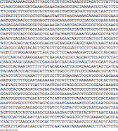
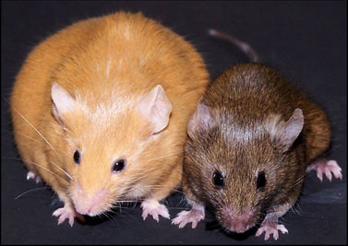
What good can transposons do? What advantages provided by repeats/TEs have led to their persistence in genome?
Environment (diet,
stress, maternal care)
Phenotype
agouti mouse
Epigenetics:
chromatin
packaging
Genotype
Development
Sibs: yellow coat = unhealthy
- brown coat = healthy
Chromatin packaging;
essential for differential gene expression
enables multicellular organisms with distinct cell types from common genome
enables response to environmental changes
The need to silence TE’s (by chromatin packaging) may be a key driver of evolution → chromatin system → eukaryotes
Notes:
Slide: Nicole Riddle, Washington University in St. Louis; mouse picture from T Wang, Washington University in St Louis
A normal mouse has a brown coat. The phenotype shown here (including yellow coat color, obesity, high cancer incidence) is due to an active transposable element (TE) driving expression of a transcription factor in an incorrect tissue; if you feed a methyl donor (i.e. folate) to the mother mouse, you can shift the phenotype back toward wildtype (brown), presumably due to silencing of the TE (see following slide). (Photo from NIH Director’s Blog.) Because chromatin formation depends on histone modifications, which in turn depend on cellular metabolism, gene expression (the phenotype) is sensitive to the environment, responding to changes in diet as well as to internal signals (hormones).
Loss of silencing can have profound impacts, including mobilization of TEs. For example, it has been reported that levels of maternal care can impact L1 copy number in the brain (Bedrosian et al. 2018, Science 359: 1395-99. doi: 10.1126/science.aah3378). It has also been suggested that retrotransposon mobilization could contribute to generating a diversity of brain cells. Other studies look at altered packaging of a given TE site, which can potentially impact surrounding genes. Clearly TE’s can trigger local silencing, with profound impacts on the program of gene expression. Ability to express different genes in different cell types is essential to being a eukaryote.

Slide 19
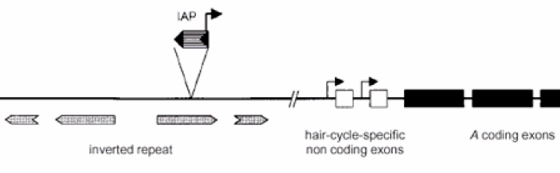
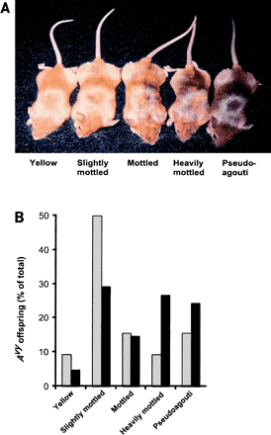
Silencing is critical: impact on the agouti locus, where ectopic expression is triggered by a TE
Mothers fed BPA (soaks up methyl) → higher IAP expression (yellow coat)
(
Mothers fed folate (methyl donor) → lower IAP expression (brown coat)
Trait stable at least to the following generation (your grandparents diet could affect your epigenetics!);
Demonstrates selective silencing, critical for development as well as environmental responses.
Black bars = folate feeding
Waterland RA, Jirtle RL. Transposable elements: targets for early nutritional effects on epigenetic gene regulation. Mol Cell Biol. 2003 Aug;23(15):5293-300.
Notes:
The agouti locus is apparently the consequence of a transposable element insertion that drives inappropriate expression of a transcription factor. DNA and histone methylation promote silencing of this element, returning the gene to its normal expression pattern, producing a fairly normal mouse. Disruptors of methyl metabolism in the mother’s diet, such as BPA (which was used in plastic bottles), can result in a higher proportion of affected offspring [feeding experiment; RA Waterland, RL Jirtle (2003) Transposable elements: targets for early nutritional effects on epigenetic gene regulation. Mol Cell Biol 23: 5293 – 300. doi: 10.1016/S0002-9440(10)63823-0.]. However, there are very few loci of this type (Kazachenka et al 2018 Cell 175: 1259-1271. doi: 10.1016/j.cell.2018.09.043). The effect requires a TE with variable methylation levels, and a nearby gene that is impacted at the start of transcription. Note: BPA has now been restricted by the FDA – no longer used in soft plastic bottles, can liners etc. – but the substitutes in use have very similar chemical structures. Antidote? Eat your leafy green vegetables – spinach salad!
Nomenclature: IAP = intercisternal A particle, a retrovirus

Slide 20
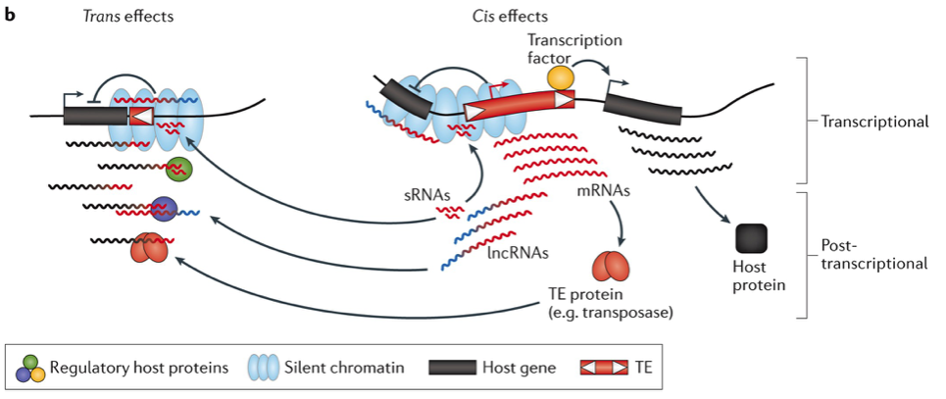
Transposable elements can function as
cis- or trans-regulatory elements, creating new networks
TEs have promoters and enhancers.
TEs are silenced through epigenetic mechanism.
Exaptation: a process where a genetic element has been co-opted
for alternative function than original purpose.
Chuong EB, Elde NC, Feschotte C. Regulatory activities of transposable elements: from conflicts to benefits.
Nat Rev Genet. 2017 Feb;18(2):71-86.
Notes:
Chuong, EB, NC Elde & C Feschotte 2017 Regulatory activities of transposable elements: from conflicts to benefits. Nature Rev Gen 18: 71-86. doi: 10.1038/nrg.2016.139. https://www.nature.com/articles/nrg.2016.139
Figure 1b, legend from the authors: Diagram depicting different types of regulatory activities exerted by TEs. These include effects mediated by cis-regulatory DNA and RNA elements (right) as well as trans effects mediated by TE-produced non-coding RNAs and proteins (left)…. Many TEs have biochemical hallmarks of regulatory activity on the basis of genome-wide assays (e.g. TF binding sites). However, additional evidence is required to determine which of these TEs alter the regulation of host genes and affect organismal phenotypes and fitness.
Nomenclature: lncRNA = long non-coding RNA; sRNAs = small RNA, including piRNA; TE protein = transposable element-coded protein.

Slide 21
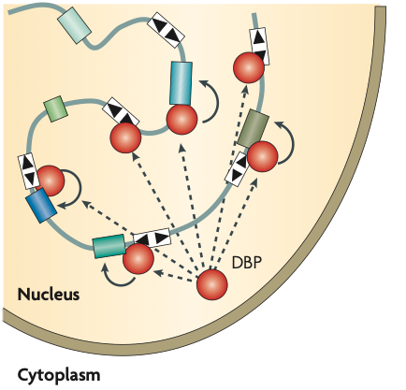
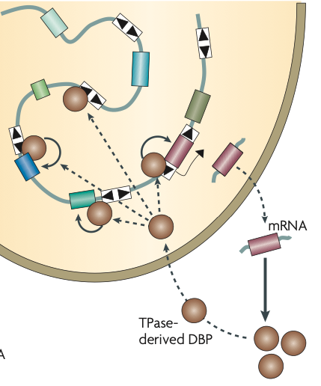
The good that transposons can do:
TEs wire genetic regulatory networks & contribute regulatory proteins
Key: white box (with inverted terminal repeats = TE
colored boxes = endogenous genes
red circles = endogenous DNA binding protein; brown circles = TE-derived protein
Feschotte, C. Transposable elements and the evolution of regulatory networks.
Nat. Rev. Genet. 9, 397–405 (2008).
Notes:
Figure 2, a and d from Feschotte, C. Transposable elements and the evolution of regulatory networks. Nat. Rev. Genet. 9, 397–405 (2008). doi: 10.1038/nrg2337
Legend from the author: Building regulatory systems with transposable elements. A family of DNA transposons is shown, with its multiple copies (white boxes) delimited by terminal inverted repeats (black tri- angles) and interspersed with genes (colored boxes) in the genome. Left: Wiring of a transcriptional regulatory network by TE-derived cis-elements. A binding site for a DNA binding protein (DBP) has been dispersed throughout the genome as part of the TE. If the DBP is a transcription factor, its binding to a TE adjacent to a gene might influence the expression of that gene (solid arrows). Multiple genes are brought simultaneously under the control of the transcription factor through their association with different copies of the same TE family. Right: De novo assembly of cis and trans com- ponents of a transcriptional network from a DNA transposon family. In this model, the DBP is derived from a transposase (TPase), and therefore has the potential to bind to a network of sites previously distributed around the genome by related TEs. If the TPase-derived DBP has transcription-factor activity, it might regulate the expression of genes located in proximity to a binding site embedded within a related TE, including its own.
SE: in fact, many examples of such networks have now been identified. More complex versions using small RNA signals are also observed.
Ting Wang, Washington University in St Louis: The regulatory elements that control expression of tumor suppressor protein p53 were among the first to be identified as derived from transposable elements (Wang T…Haussler D 2007 Proc Natl Acad Sci USA 104:18613-8). Since then, many examples have been identified, confirming that this is a major strategy for coordinating expression of a group of genes in eukaryotes, where operons are rare. Transposable elements have been key to many evolutionary “advances” because of their ability to “rewire” gene expression patterns.

Slide 22
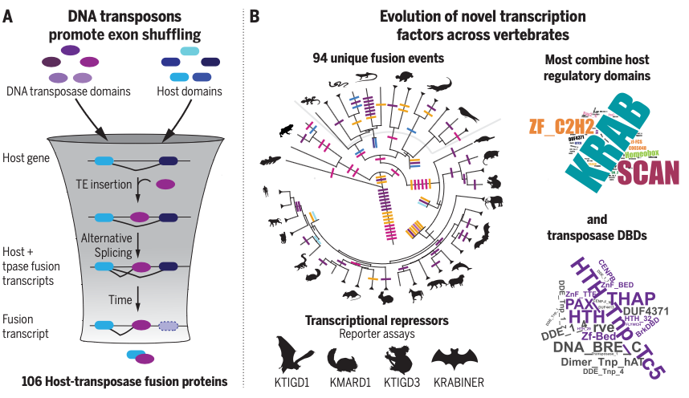
The good that transposons can do: creation of new
host-transposon fusion proteins with regulatory impacts
Cosby RL, et al. Recurrent evolution of vertebrate transcription factors by transposase capture (2021)
Science 371: 797.
Notes:
Figure from Cosby R….C Feschotte 2021 Recurrent evolution of vertebrate transcription factors by transposase capture. Science 371: 797. doi: 10.1126/science.abc6405.
Transposase capture contributes to the evolution of transcription factors by combining DNA transposase and host domains. (A) Model for how transposase capture occurs following insertion of the TE in an intron. (B) Abundance and characteristics of identified HTFs (host-transposase fusion gene). The investigators identified 106 distinct HTFs derived from 94 independent fusion events over the course of ~300 million years of evolution. Most of them consist of transposase DNA binding domains fused to host domains that are predicted to function in transcriptional and/or chromatin regulation, especially the repressive Kruppel-associated box (KRAB) domain; these proteins can drive gene silencing in a sequence-specific manner. Exon shuffling is a powerful path to form genes encoding proteins with novel functionalities. Several genes with critical developmental functions, such as the Pax transcription factor, are thought to have been formed this way.
Nomenclature: TE, transposable element; tpase, transposase; DBDs, DNA binding domains.

Slide 23
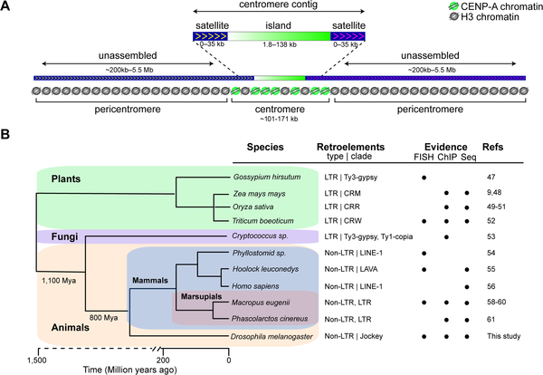
The good that transposons can do:
Drosophila centromere organization based on Jockey
Chang CH, et al. Islands of retroelements are major components of Drosophila centromeres.
PLoS Biol. 2019 May 14;17(5):e3000241.
Notes:
Figure from Chang CH, Chavan A, Palladino J, Wei X, Martins NMC, et al. (2019) Islands of retroelements are major components of Drosophila centromeres. PLOS Biology 17(5): e3000241. https://doi.org/10.1371/journal.pbio.3000241 https://journals.plos.org/plosbiology/article?id=10.1371/journal.pbio.3000241
Centromeres are defined by CENP-A, which substitutes for H3 in the nucleosome. CENP-A has 65% aa identity in the folded portion, but is more divergent in the N-terminal region; it creates a nucleosome packaging that is more open, and can bind other centromeric proteins to create the kinetochore. Centromeres evolve rapidly; they appear to be based on retroelements flanked by satellite DNA.

Slide 24
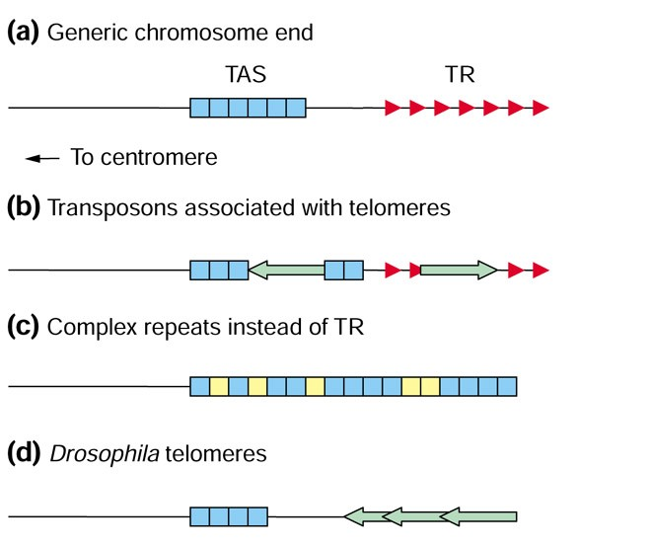
The good that transposons can do: telomeric DNA
Telomeres contain complex repetitive DNA in a variety of species
Generic telomere, e.g. humans
(TR = G-rich repeats)
S. cerevisiae, Bombyx mori, Chorella, Giardia
Anopheles, Allium, Chironomus, D. virilis
D. melanogaster and relatives
Slide credit: Chris Ellison
Louis EJ. Are Drosophila telomeres an exception or the rule?
Genome Biol. 2002 Sep 27;3(10):REVIEWS0007.
Notes:
Slide from Chris Ellison. Key: TAS = telomere associated sequences; TR = telomere repeats; boxes = repetitious sequences, generally derived from transposable elements; green arrows = transposable elements.

Slide 25
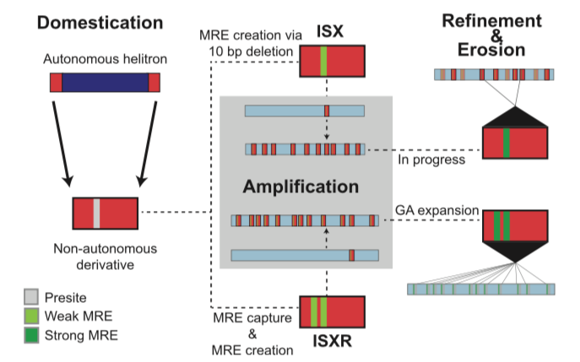
The good that transposons can do:
TEs can evolve to mark specific chromosomes (ex. sex chromosomes)
Drosophila miranda neo-X chromosome:
Step 1: Domestication: a mutation in a TE generates ISX, with an MRE X dosage compensation site
Step 2: Amplification: Transposition of ISX creates multiple binding sites along the chromosome arms; sites are selected for on the neo-X and against elsewhere.
Step 3: Refinement: mutations create stronger binding sites on the neo-X, weaker ones elsewhere.
Ellison CE, Bachtrog D. (2013) Dosage compensation via transposable element mediated rewiring of a regulatory network. Science 342: 846-50.
Notes:
Modified from the authors: The evolutionary process of acquiring chromatin entry sites (CES; binding sites for the MSL complex, critical for dosage compensation) on XR and the neo‐X suggest a three‐step model for the TE‐mediated wiring of a newly evolved X chromosome into the dosage compensation network, followed by erosion of nonfunctional elements of the TE. The first step, domestication, involves the acquisition of a non-autonomous TE derivative with an MRE sequence motif capable of acting as a CES for the MSL complex. The domesticated TE is amplified across the genome and is beneficial on a newly formed X chromosome, but selected against on autosomal locations. This results in the accumulation of the domesticated TE, along with the MRE motif that it carries, on the neo-X. The amplified MRE motif may initially be suboptimal, as seen with the younger ISX elements on the neo‐X, but over time, secondary fine‐tuning mutations within each MRE can refine the ability to recruit optimal levels of MSL complex, as seems to have occurred with the older ISXR elements on XR (not shown here). This is accompanied by erosion of TE sequences that are not required for MSL-binding, eventually degrading the signature of TE involvement for supplying CES. Ellison C & Bachtrog D 2013 Science 342: 846-850. doi: 10.1126/science.1239552.

Slide 26
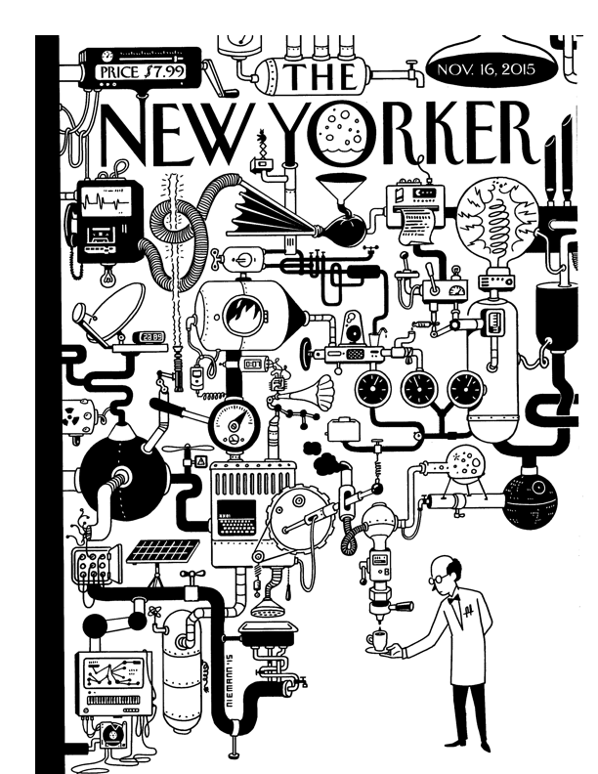
We live in uneasy balance with our transposable elements
Response – Yin/Yang problem
Silencing new TEs, maintaining
silencing essential for individual,
but TEs contribute to genome;
activity essential for the species?
Adaptation for species?
  Fixing mutations – slow
  Genome rearrangement,
  shuffling parts, shifting
  pattens of gene expression
  TEs can help!
  TEs more active when
  organism stressed
  Whatever works, survives
  Results appear more
  complex than logically
  necessary
  View as of 2022 – SCR Elgin
“Coffee Break,” by Christoph Niemann
Notes:
Big picture! Source: The New Yorker, 11/16/2015; Coffee Break, by Christoph Niemann. A Rube Goldberg device is a complex machine designed to accomplish a simple outcome, usually a response to a specific event (for example, a complicated system to wake you up when the sun comes up). Our genome often looks like a Rube Goldberg device, just patched together – one thing added after another - rather than an intelligent overall design. The required outcome is survival to reproduce in a highly competitive world, while responding to repeated invasions by different TEs. We have gained the ability for complex, differential gene expression as we gained the ability to manage our TEs. A likely bonus is that the TEs give us more flexibility to respond to changes in the environment, as outlined in the slide.
This is of course one viewpoint based on evidence available in June 2022. The picture may well change as new data on genes and genomes is acquired.

Slide 27
Alternative slides
Notes:
The first three slides that follow might be considered when discussing the role of TEs in setting up regulatory networks. The fourth is a more complex version of the evidence for marking sex chromosomes using TEs.

Slide 28
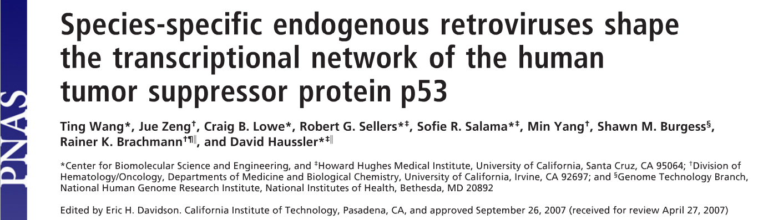
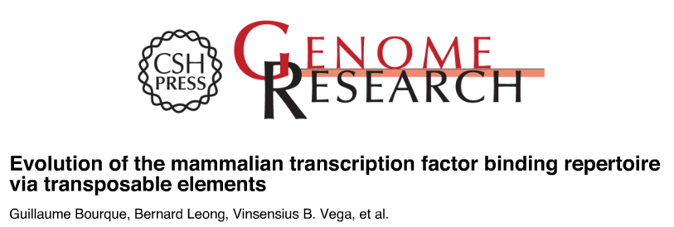

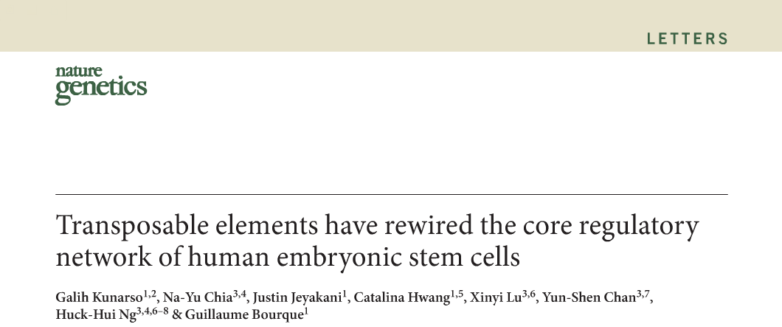
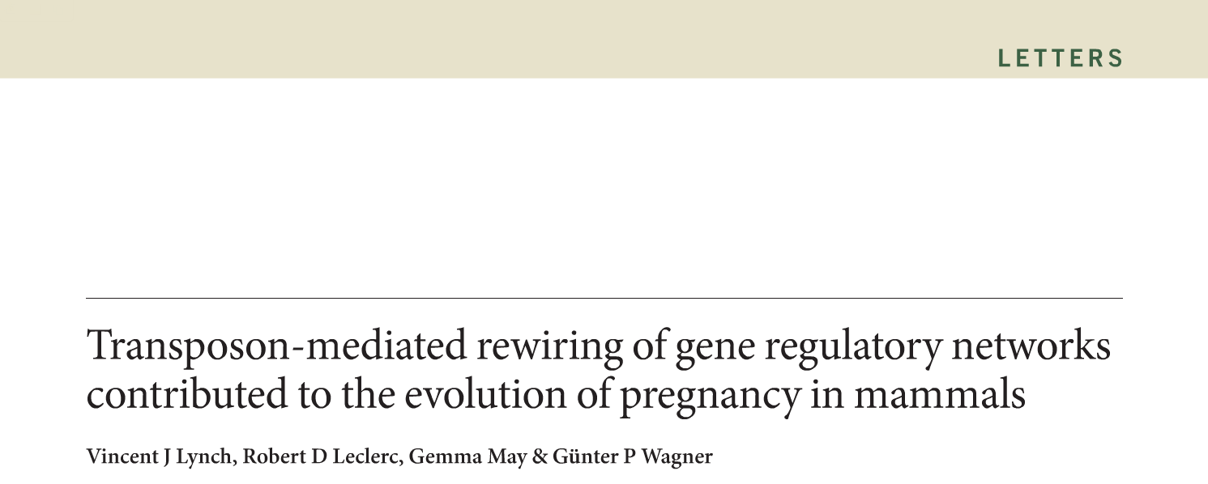

The good that transposons can do:
TEs wire genetic regulatory networks
Hence, species-specific transposable elements have substantially altered the evolutionarily divergent transcriptional circuitries of core cellular processes.
Notes:
Slide from T Wang, Washington University in St. Louis.
The regulatory elements that control expression of tumor suppressor protein p53 were among the first to be identified as derived from transposable elements (Wang T…Haussler D 2007 Proc Natl Acad Sci USA 104:18613-8). Since then, many examples have been identified, confirming that this is a major strategy for coordinating expression of a group of genes in eukaryotes, where operons are rare. Transposable elements have been key to many evolutionary “advances” because of their ability to “rewire” gene expression patterns.

Slide 29
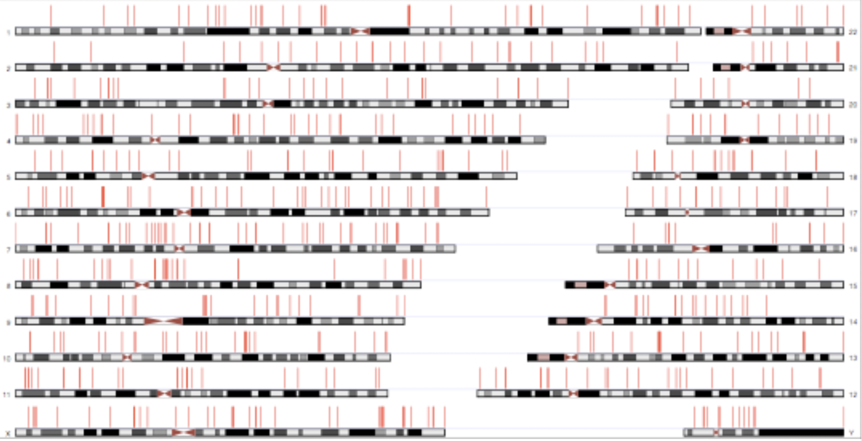
The good that transposons can do:
TEs have contributed significantly to p53 Binding Sites
Red bars = ERV sites that bind p53
(human genome)
Wang et al. 2008 PNAS 104: 18613-18618.
Notes:
From Ting Wang, Washington University in St. Louis: Scanning the human or mouse genome with TE sequences identifies many matches within known transcription factors binding sites. About 1/3 of the p53 binding sites in the human genome clearly derive from ERVs, notably the LTR10 and MER61 families. These ERV families are primate-specific and trans- posed actively near the time when the New World and Old World monkey lineages split. Tests of some sites show that the ERV-derived site is impacting gene regulation. Acquisition? Likely that p53 binding site is part of the progenitor LTR.
Reference: Ting Wang*, Jue Zeng†, Craig B. Lowe*, Robert G. Sellers*‡, Sofie R. Salama*‡, Min Yang†, Shawn M. Burgess§, Rainer K. Brachmann†¶􏰀, and David Haussler*‡􏰀2008 Species-specific endogenous retroviruses shape the transcriptional network of the human tumor suppressor protein p53. Proc Natl Acad Sci 104: 18613-18618. doi􏰁10.1073􏰁pnas.0703637104

Slide 30
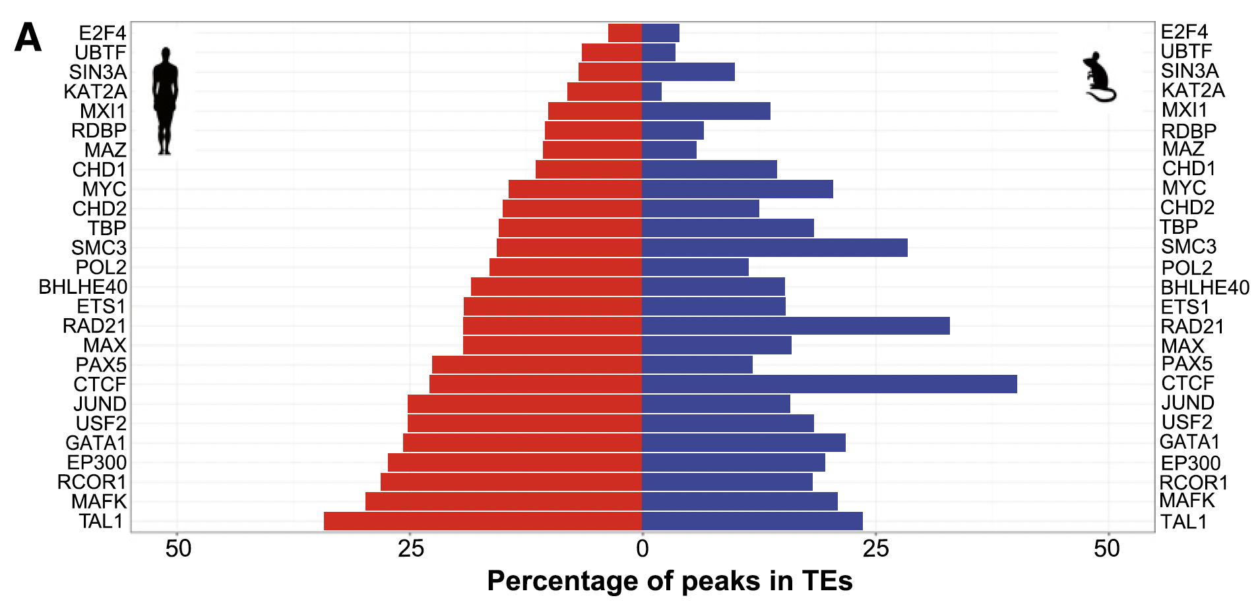
The good that transposons can do:
TEs have contributed significantly to TF Binding Sites in human and mouse genomes
Xie, Nat Genetics 2013
Sundaram, Genome Res 2014
Sundaram…Wang, Nat Comm 2017
Notes:
From Ting Wang, Washington University in St. Louis: Scanning the human or mouse genome with TE sequences identifies many matches within known transcription factors binding sites.
Xie M, et al. DNA hypomethylation within specific transposable element families associates with tissue-specific enhancer landscape. Nat Genet. 2013 Jul;45(7):836-41.
Sundaram V, et al. Widespread contribution of transposable elements to the innovation of gene regulatory networks. Genome Res. 2014 Dec;24(12):1963-76.
Sundaram V, et al. Functional cis-regulatory modules encoded by mouse-specific endogenous retrovirus. Nat Commun. 2017 Mar 28;8:14550.

Slide 31
The good that transposons can do:
TEs can evolve to mark specific chromosomes (ex. sex chromosomes)
Drosophila miranda neo-X chromosome: Step 1: mutation of a domesticated TE generates ISX, with a binding site for the critical dosage compensation complex MSL. (Earlier mutations created ISXR on the ancestral X.) Step 2: Transposition of the mutated form creates multiple binding sites along the chromosome arms; these are selected for on the neo-X and against elsewhere. Step 3: Refinement can create stronger binding sites on the neo-X, driving it to full sex chromosome status.
Ellison CE, Bachtrog D. Dosage compensation via transposable element mediated rewiring of a regulatory network. Science. 2013 Nov 15;342(6160):846-50.
Notes:
From the authors: TE-mediated evolution of new sex chromosomes. Comparison of the two evolutionary time points of acquiring chromatin entry sites (CES; binding sites for the MSL complex, critical for dosage compensation) on XR and the neo‐X suggest a three‐step model for the TE‐mediated wiring of a newly evolved X chromosome into the dosage compensation network followed by erosion of nonfunctional elements of the TE. The first step, domestication, involves the acquisition of an MRE sequence motif capable of acting as a CES for the MSL complex. The domesticated TE is amplified across the genome and is beneficial on a newly formed X chromosome, but selected against on autosomal locations. This results in the accumulation of the domesticated TE, along with the MRE motif that it carries, on the neo-X. The amplified MRE motif may initially be suboptimal, as seen with the younger ISX elements on the neo‐X, but over time, secondary fine‐tuning mutations within each MRE can refine the ability to recruit optimal levels of MSL complex, as seems to have occurred with the older ISXR elements on XR. This is accompanied by erosion of TE sequences that are not required for MSL-binding, eventually degrading the signature of TE involvement for supplying CES. Ellison C & Bachtrog D 2013 Science 342: 846-850.

