Slide 1
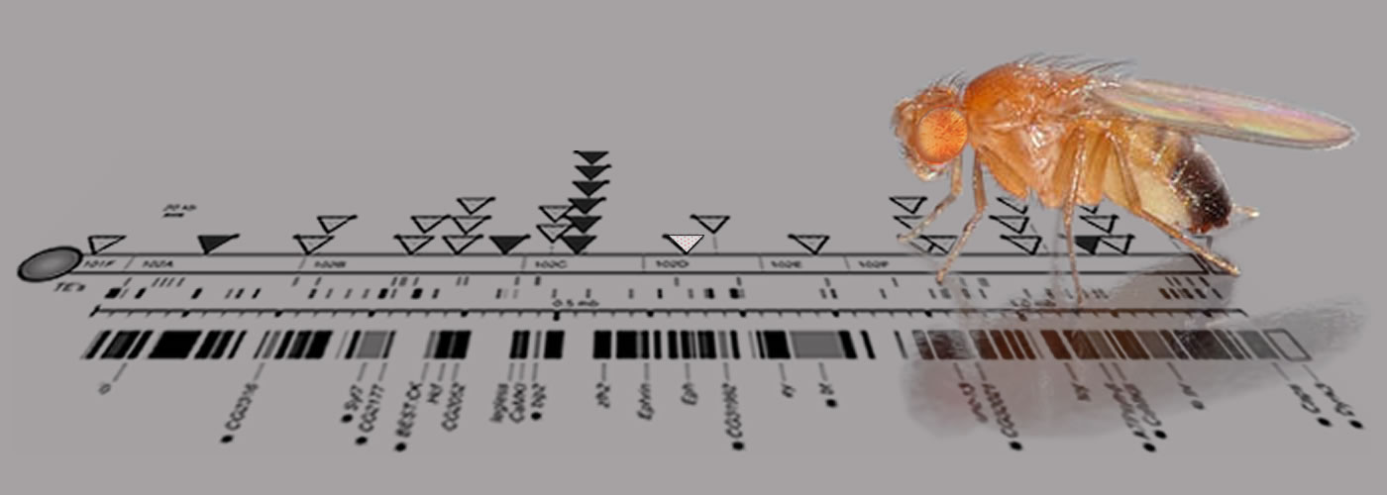
The Strange Case of the Dot Chromosome of Drosophila
Sarah C R Elgin
Bio 4342/434W
Copyright 2020, Washington University
Notes:
Slide: from Karmella Haynes.
Our research this semester will be a comparative genomics project looking at the evolution of the dot chromosomes (F element) of Drosophila, an interesting region because of its mix of properties. In particular, we are initiating a study of the F element from four different species, where that element has expanded: the region containing the genes is 1.4 Mb in D melanogaster, but over 18 Mb in D. ananassae. How has that happened? What are the implications for the structure of the F element genes – have they also expanded? How has the expansion impacted their structure, function , evolution?

Slide 2
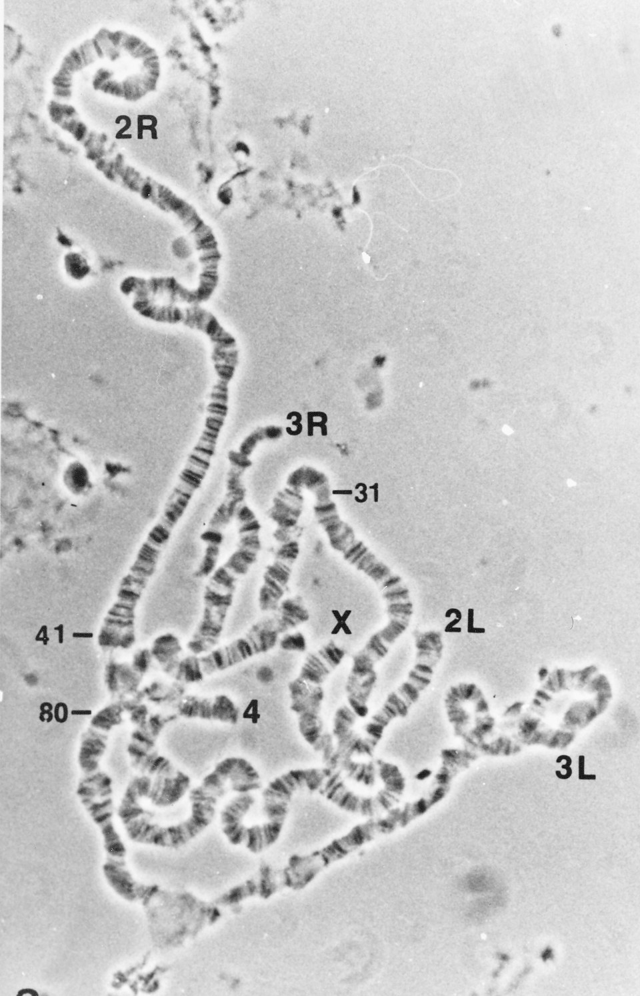
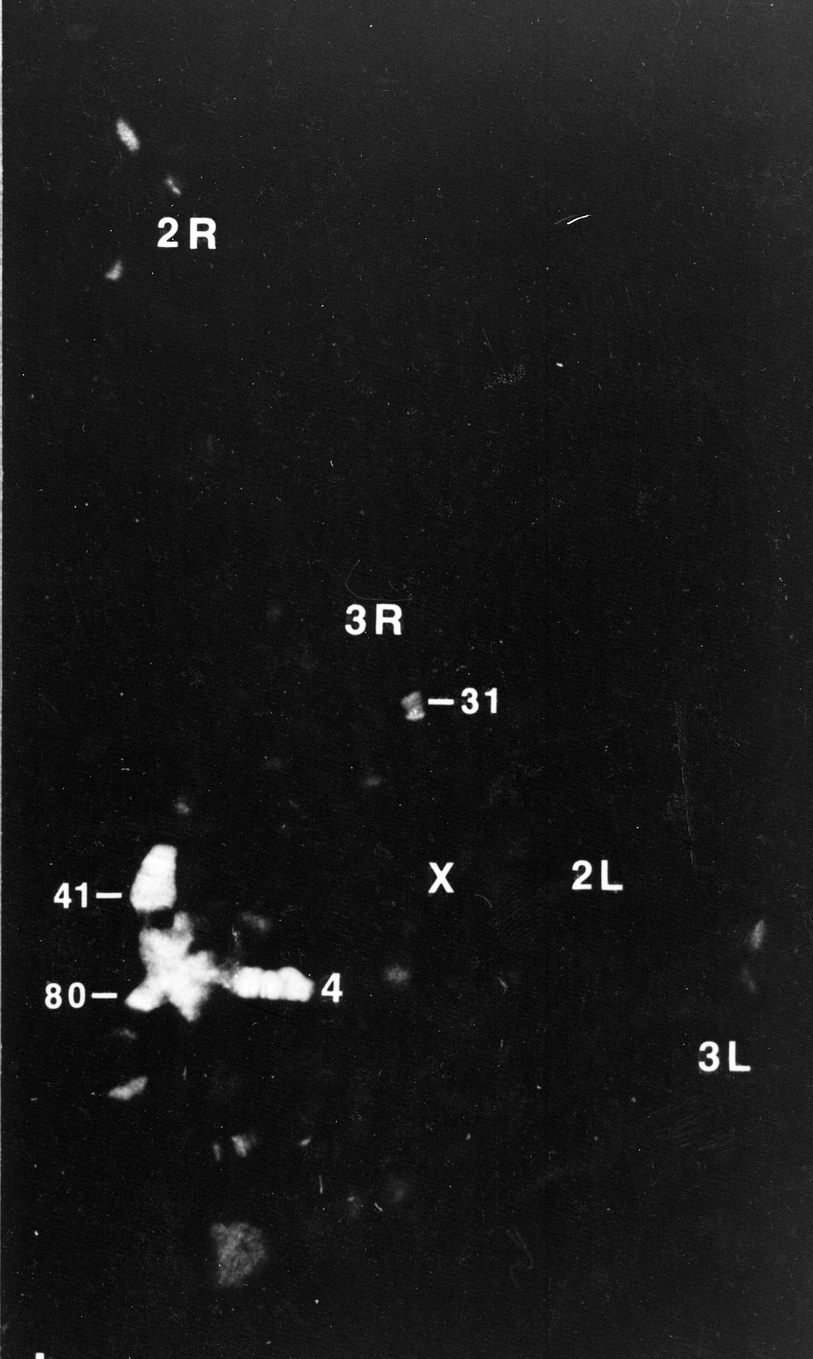
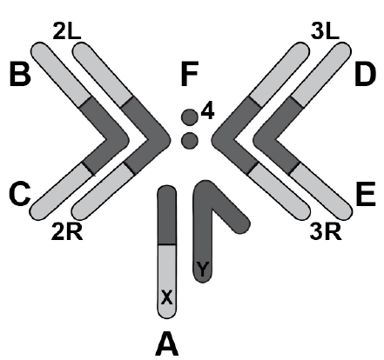
The Drosophila melanogaster fourth chromosome is largely heterochromatic, but the distal 1.3 Mb has a gene density equal to that of euchromatic arms
Heterochromatic properties:
late replication, lack of recombination
high repeat density (30%)
antibody staining → high levels of HP1, H3K9me2/3
But…
the fourth has ~ 80 genes in the distal 1.3 Mb
these genes are transcriptionally active
C
C
James et al, Mol Cell Bio 1986
D element
Control region
Phase
HP1
Notes:
The dot chromosome is a puzzle: the chromosome as a whole exhibits properties of heterochromatin (see slide), yet the distal 1.4 Mb is amplified during polytenization (a property of the euchromatic arms). The dot has ~80 genes, including housekeeping genes such as Rad23, and genes expressed in specific developmental patterns, such as eyeless, a gene essential for eye development. Most Drosophila species have a dot chromosome, although in D. ananassae this domain is greatly expanded, and is no longer a dot in metaphase spreads, but a chromosome with two distinct arms.

Slide 3
Heterochromatin formation results in greater nucleosome stability
Euchromatin
  Less condensed
  Chromosome arms
  Unique sequences;
  gene rich
  Replicated throughout S
  Recombination during meiosis
Heterochromatin
  Highly condensed
  Centromeres and telomeres
  Repetitious sequences;
  gene poor
  Replicated in late S
  No meiotic recombination
Transcriptional activators
Hyper-acetylated histone tail
Heterochromatin Protein 1 complex
Hypo-acetylated histone tail; methylated H3/K9
Notes:
Drawing by G. Farkas.

Slide 4
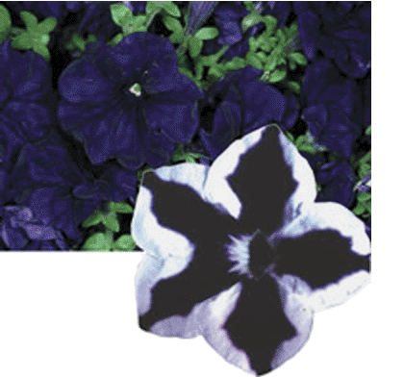
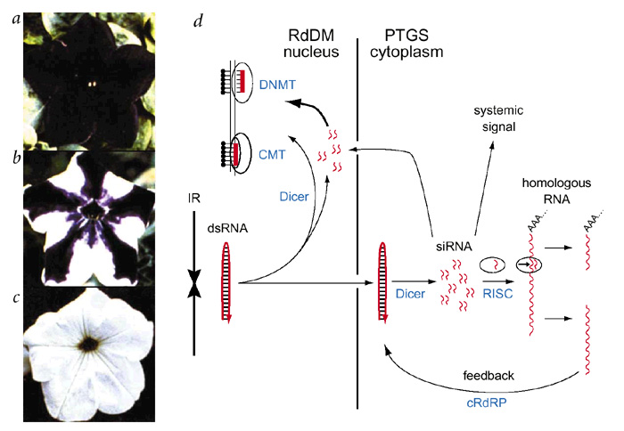
Repetitious elements are recognized as such and silenced, an epigenetic change
Napoli et al 1990 Plant Cell 2: 279
Petunias
Extra copy of gene needed for pigment production leads to silencing by heterochromatin formation; → variegation
Silencing of repeats is important for genome stability/ transposon control
Parent line
+transgene
+transgene
from N. Riddle; work by Jorgensen lab
Notes:
4
There appears to be an intimate link between heterochromatin formation and the need to silence much of the genome – the part made up of repetitious elements (ref. lecture#1). One of the first clues was the observation that adding extra copies of a gene did not result in more gene product – but in silencing! This suggests that repeats are recognized as such, and silenced – a defense against invading retroviruses and transposons (transposable elements – TEs). So the high repeat density of the dot chromosome may be key. What can we learn from a comparison of dot chromosomes among Drosophila species; what features do they have in common?

Slide 5
Muller F elements consistently have a higher repeat density than Muller D elements but differ in repeat type
Leung et al 2015 G3 5: 719
Notes:
Figure from Leung et al 2015 G3 5: 719-740. Data has been completed for D. erecta, D. mojavensis, and D. grimshawi, and compared to D. melanogaster. Density of transposons for the Muller F element and euchromatic reference regions is shown here. Muller F elements in D. melanogaster, D. erecta, D. mojavensis, and D. grimshawi show higher repeat density than euchromatic reference regions from the Muller D element. Note in particular the contrast in levels of transposon density.

Slide 6
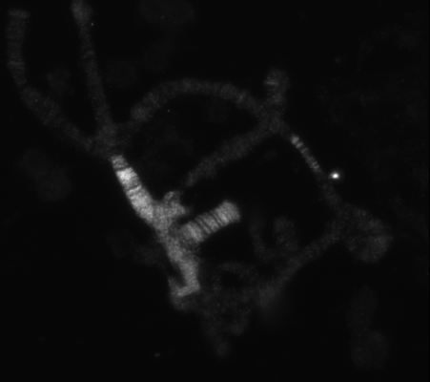
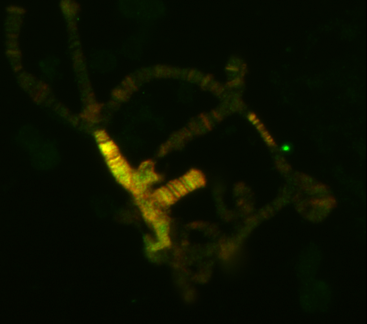
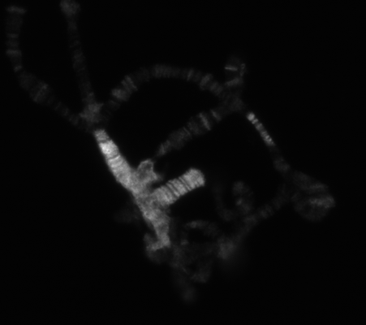
HP1 has a banded pattern on chromosome 4; could the genes lie in HP1-depleted domains?
HP2
Merge
Merge
Region 31
← 4th chr
HP1
Shaffer et al 2002 PNAS 99: 14332
Notes:
This shows a close-up of immunofluorescent staining of the polytene chromosomes using antibodies to HP1, and antibodies to HP2, a HP1-interacting protein. Staining of the fourth chromosome (projecting to the right) clearly shows a banding pattern. Perhaps this indicates domains of heterochromatin (containing repeats) interspersed with domains of euchromatin (containing the genes). Alternatively, it could indicate variation of packaging in these specialized (polytene) chromosomes that depends on some other feature of higher-order packaging. (Other banded regions observed are the base of chromosome arm 2R (pointing to 11 o’clock) and region 31 in the middle of the third chromosome, a skinny region referred to as the “goose neck.”) Mapping heterochromatic domains at higher resolution may resolve this question.

Slide 7
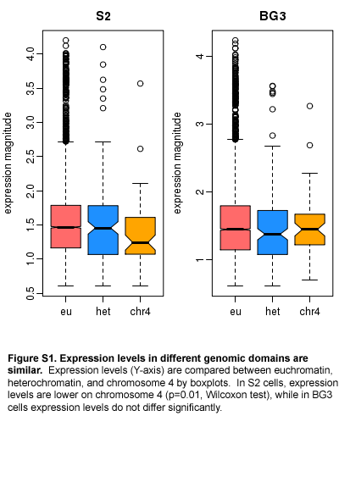

Expression levels of genes in the
different genomic domains are similar
Adapted from Riddle et al 2012, PLoS Genetics 8: e1002954
Notes:
Data reported in Riddle et al 2012 PLoS Genet 8: e1002954.

Slide 8
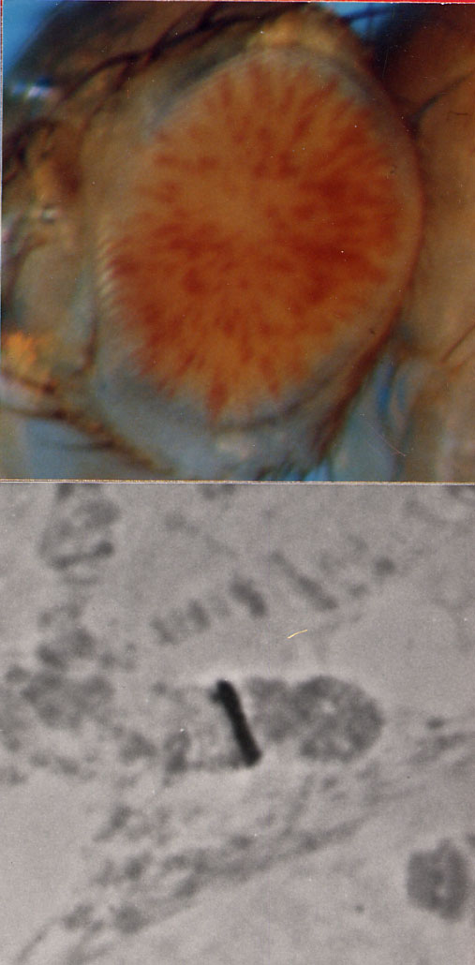
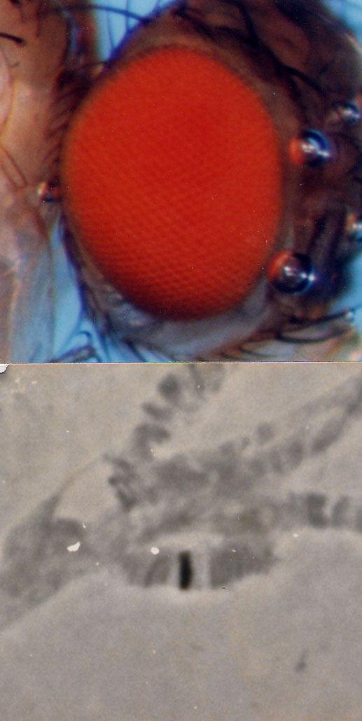
Insertion sites resulting in a variegating phenotype identify heterochromatin domains
X
2L
2R
Silenced
1%
3L
3R
4
Can we map heterochromatic domains on the fourth? Are there permissive domains on the fourth that allow full expression? Screen for lines giving variegating or red-eye phenotype with insertion sites on the fourth chromosome
(first red-eyed fourth chromosome insertion = #707).
Active
99%
Wallrath and Elgin, 1995
Notes:
How could the dot chromosome genes function in heterochromatin? Perhaps there are also euchromatic domains on the fourth that contain the genes in protected “islands.” We can check this by screening for P element insertions onto the fourth that give a red eye (full expression), and mapping the positions of these domains relative to the genes. (Triangles in map above indicate insertion sites for reporter P element that result in variegating lines.) The initial screen mobilized a P element on the X, recovered red-eyed lines, and screened for those on the fourth, with a plan to test 1000 red-eyed lines. The first to be an insertion on the fourth chromosome was #707.

Slide 9
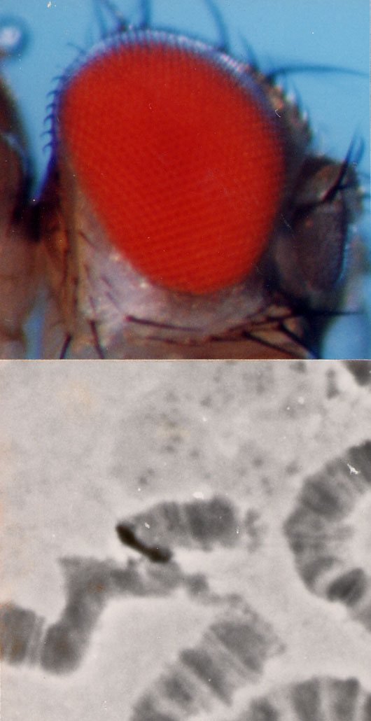
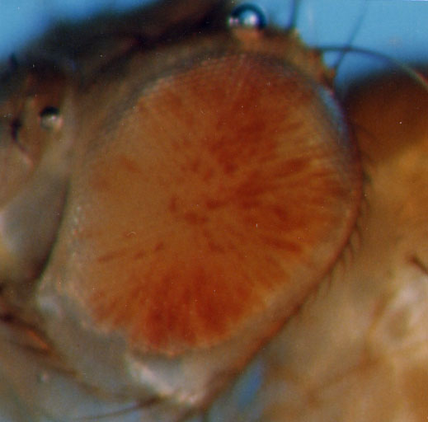
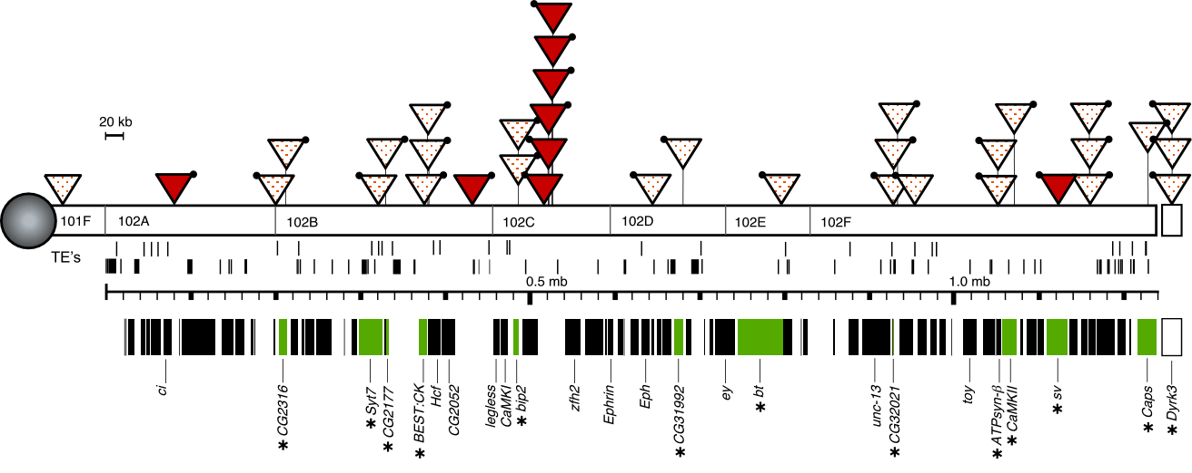
The fourth chromosome has interspersed
silencing and permissive domains –
what are their sequence characteristics?
2-M1021
39C-12
2-M390
39C-52
200 kb
Sun et al 2004 Mol Cell Bio 24: 8210
C
T
Each triangle indicates a line carrying a single P element reporter inserted at that site, with the
eye phenotype shown, red or variegating, indicating a permissive (euchromatic?) or
silencing (heterochromatic) environment. Most insertions into genes are variegating.
Notes:
We can recover both variegating and red-eyed lines. It is difficult to recover red-eyed lines – of all of the variegating lines recovered, about half represent insertions of the fourth chromosome, but of the red-eyed lines, only ~1% are on the fourth chromosome – the rest are in the long euchromatic arms. Nonetheless, this experiment provides a proof of the principle. Do the genes all lie in permissive domains? When the sequence of the D melanogaster genome became available, and we could map our reporters precisely (by doing inverse PCR off the end of the P element to obtain the flanking sequence), we found that this is not the case – the genes are distributed fairly evenly across this region of the dot chromosome (thick black bars), and the repetitious elements are distributed fairly evenly across the chromosome (short black bars, row labeled “TE’s”). In fact in 12 cases we have reporters in a gene (green boxes), and in all but one case (sv), these reporters show a variegating phenotype. So we set out to map at higher resolution in the 200kb region indicated by the box, where we have evidence of interspersed silencing and permissive domains.

Slide 10
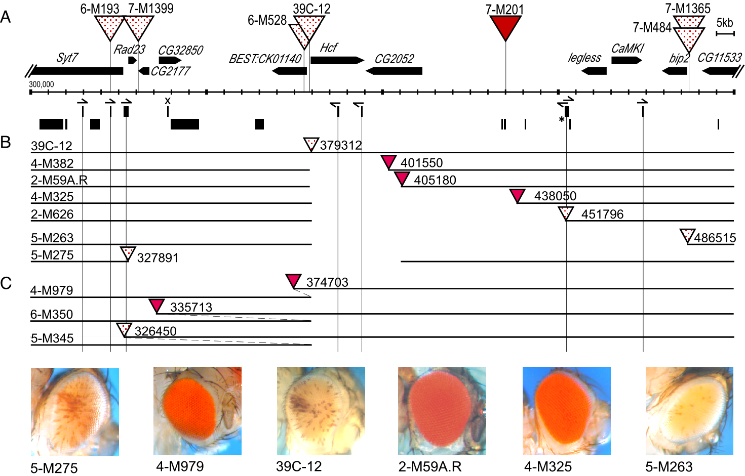
Local genome deletions and duplications produce
a switch in eye phenotype
MAP (200 kb)
Element 1360
OTHER TE’S
DELETIONS
Sun et al 2004 Mol Cell Bio 24: 8210
DUPLICATIONS
Proximity to 1360 (within ~10 kb) appears critical
Notes:
To speed the process, we looked for local transposition, starting with a variegating line 39C-12, crossing this fly to a fly carrying the transposase, and looking for a change in the eye phenotype to full red. (P elements are known to be biased to local transposition.) To our surprise, when the flanking DNA was mapped, most of our lines did not show a transposition event, but rather deletion or duplication of the flanking DNA. We also started with a red-eyed line, and asked for events that switched the eye phenotype to variegating. Clearly a change in flanking DNA can switch the phenotype one way or the other, arguing that determinants in the DNA are critical for setting the chromatin pattern. Indeed, examination of our results indicates that the element 1360 may be playing such a role; note the distribution of this element relative to the reporter, both in the lines resulting from transposition events (top triangles, above the map), and in the lines resulting from local deletions and duplications (below the map). The 1360 element is a remnant of a DNA transposon. Other TE’s in this region do not show a similar correlation.

Slide 11
1360 is not the ONLY target for heterochromatin formation on the F element, but not all TEs are targets
3’P
hsp26-pt
hsp70-white
5’P
7-M1015/
7-M547
7-M484/
7-M1365
8-M1
Inserts
39C-12
7-M1061
7-M201
8-M294
4-M1030
8-M22
500kb
1Mb
101F
102A
102B
102C
102D
102E
102F
1360s
Other TEs
Genes
zfh2
Syt7
bip2
CG2316
CG2165
CG31992
bt
CG32021
CaMKII
Caps
CG32017
sv
20kb
ATPsyn-Β
Riddle et al 2008, Genetics 178: 1177
Notes:
To check further, we repeated this screen starting from the red-eyed line inserted into the sv gene, crossing with transposase, and asking for a variegating phenotype. This region of the dot chromosome has relatively few copies of 1360. As anticipated, we recovered variegating lines where the reporter was now close to other TE’s. This identified several TE’s that might contribute, but no single element dominated, as appears to be the case in the Hcf region.

Slide 12
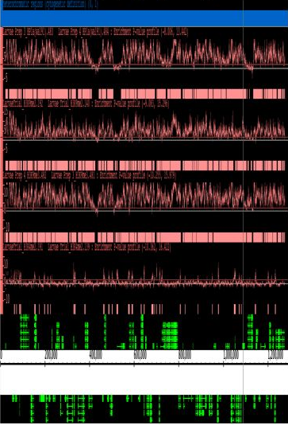
ChIP mapping shows that the fourth chromosome is largely heterochromatic, but has islands of H3K4me2
Centromere
Telomere
HP1a
H3K9me2
Riddle et al 2010, Genome Res
H3K9me3
H3K4me2
genes
Notes:
Looking at individual tracks, ChIP mapping (as well as our earlier analysis) shows that the fourth chromosome region is largely heterochromatic. [Pink bars above show a significant enrichment in association of that mark, mapped against the chromosome sequence (bottom line; genes shown in green).] However, we also see evidence of a mark associated with gene activation – H3K4me2.

Slide 13
An expanded view of the fourth chromosome: variegating reporters lie in domains that are red (#1, TSS) or blue (#7/8, heterochromatin).
[Red-eye reporters lie in domains that are grey (#6, Polycomb) in at least one cell type; → #6 is a permissive state.]
Pericentric heterochromatin
10 Mb
chr3L
chr4
Red
Variegating
Slide from W Leung
chr4
500 kb
BG3 cells, chromatin states:
1 | 2 | 3 | 4 | 5 | 6 | 7 | 8 | 9
Notes:
Slide: Wilson Leung
Source: mapped according to the 9 state model of Kharchenko et al (2011).
Notes: Using the maps of protein/histone modification data, we can identify 9 different chromatin “states”; for example, state 1, found at Transcription Start Sites is enriched for H3K4me3 and RNA polymerase. We can now map the different chromatin states across an expanded fourth chromosome. We find that while much of the chromosome is in states 7 and 8 (blue and light blue, associated with H3K9me2/3), there are domains in state 1 (red, associated with H3K4me2/3, transcription start sites) and state 6 (grey, associated with H3K27me3, regulated by the Polycomb system). Our variegating reporters lie in domains that are in state 1 or state 7/8 in Bg3 cells; note that the reporters showing full expression lie in domains that are found in state 6 in at least one cell type, indicating that this state is permissive for gene expression. State 6 has H3K27me3, but no H3K9me3.

Slide 14
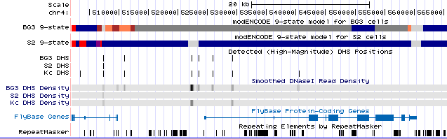
A subset of 4th genes is associated with Polycomb;
these domains are permissive for reporter expression
(red eyed fly).
Notes:
Source: UCSC-style browser assembled by Wilson Leung, Washington University in St Louis; modENCODE data
Notes: We find that the lines showing full expression of the reporter on the fourth chromosome have the reporter inserted into a domain packaged with Polycomb in at least one cell type. Note that these domains allow assembly of 5’ DHS sites.

Slide 15
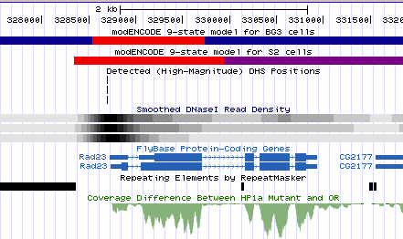
The fourth chromosome has many “red/blue” genes which are consistently expressed; use Rad23
1360
Try to determine what feature(s) drives 4th chromosome gene
expression that is absent from euchromatic genes (hsp70-white)
Notes:
Source: UCSC-style browser assembled by Wilson Leung, Washington University in St Louis; modENCODE data.
How do fourth chromosome genes manage to assemble the TSS state (red) when they lie in proximity to TEs? We do not know. Note that many of these genes, like heterochromatic genes, are reported to require normal levels of HP1a for optimal expression, although they still function in the H3K9R mutation stocks.

Slide 16
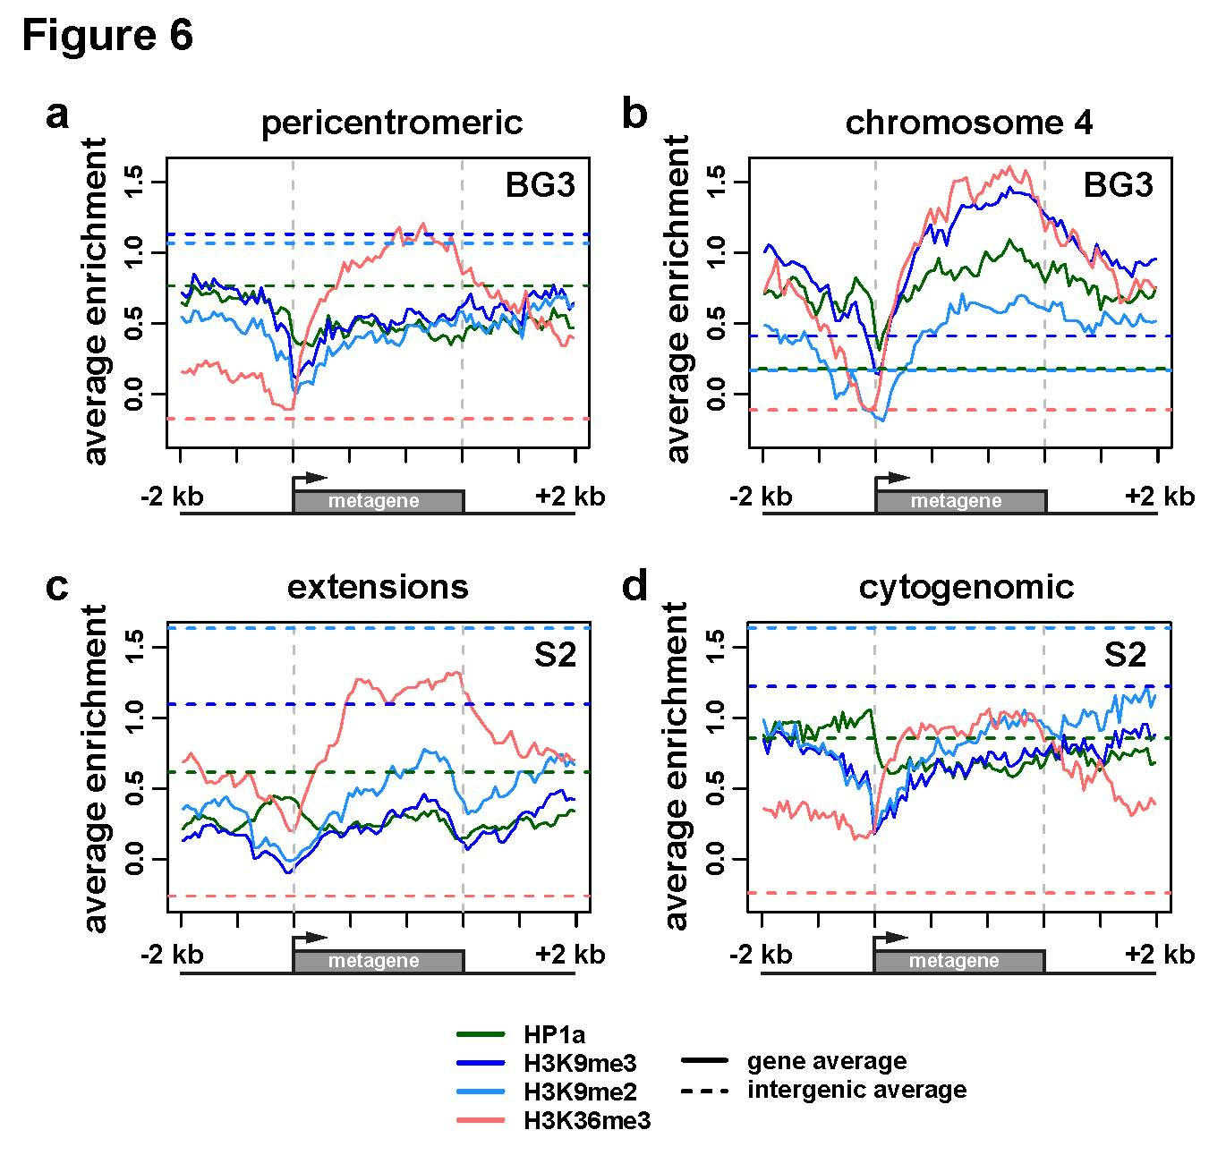
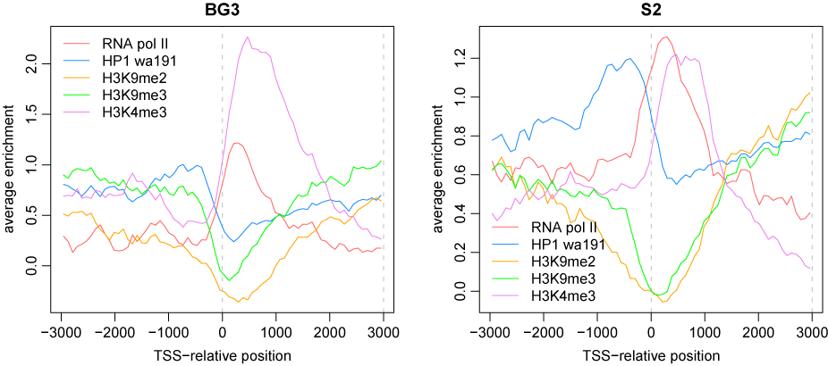
Active fourth chromosome genes show depletion of HP1a and
H3K9me3 at the TSS, but enrichment across the body of the gene
chromosome 4
Average enrichment
Riddle et al. 2011 Genome Res 21:147-63
TSS-relative position
RNA pol II H3K4me3
HP1 H3K9me2 H3K9me3
Notes:
Slide: Nicole Riddle
Source: Riddle et al (2011) Genome Res 21: 147 – 63. Figure 6B and supplemental figure.
Notes: Looking both at Bg3 cells and S2 cells (D melanogaster cell lines), and grouping the data around the TSS of all genes active in that cell type, one sees a depletion of H3K9me2/3 (silencing marks) and an increase in H3K4me3 (an activation mark) just downstream of the binding site of the RNA polymerase. HP1a appears to show less depletion, and in fact might have a peak at -800. Some genes show H4K16ac (which boosts transcription on the male X), but this is not consistent. These results imply the there is a mechanism to provide access, to generate a DS site at the TSS, as seen for genes in euchromatin; but that the downstream region of the gene reverts to heterochromatin packaging. Given the results above, we will focus our motif hunt on the region around the Transcription Start Site (TSS), as the shift in chromatin structure here appears to be key for transcription initiation.

Slide 17
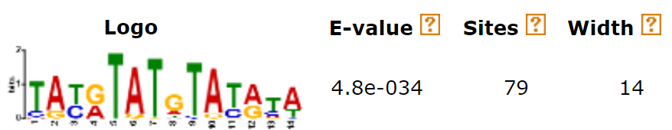
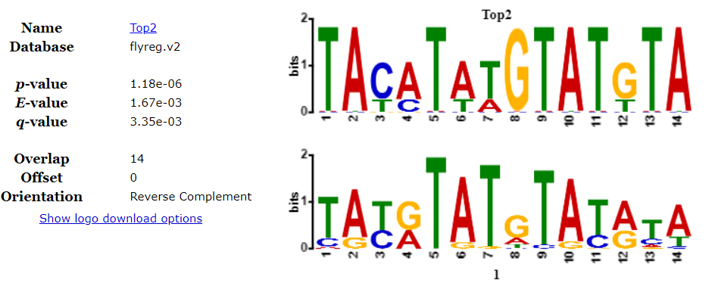
Fourth chromosome TSS regions are enriched for
a putative Top2 binding site
141 D. melanogaster F element TSS search regions
Analysis of the TSS search regions of D. melanogaster with MEME identified statistically significant enrichment of the AT-rich motif shown. Tomtom was used to determine that the motif identified by MEME has significant similarity (q-value = 3.35e-03) to the reported binding site for Topoisomerase II (Top2).
B French and W Leung, unpublished.

Slide 18
Putative Top2 binding sites are present at ~50% of the heterochromatic genes and ~4% of euchromatic genes
 | F element TSS | chr2 and chr3 heterochromatic region TSS | D_base TSS
Number of input sequences | 141 | 212 | 244
Number of significant motif occurrences (q-value < 0.05) | 267 | 224 | 13
Number of TSS with at least one significant motif occurrence | 70 | 104 | 9
Percentage of TSS with a significant motif occurrence | 49.6% | 49.1% | 3.7%
B French and W Leung, unpublished.

Slide 19
A putative Top2 site promotes gene expression on the F element
Adding the putative Top2 site to the hsp70-white construct results in ca. full expression.
Mutating or deleting the putative Top2 site from Rad23-white constructs results in loss of expression.
E Gracheva, S Elgin et al, unpublished

Slide 20
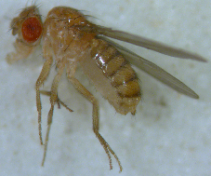
Our research goal: to use Drosophila comparative genomics to understand the organization, evolution and gene function on the F element
(dot chromosome), a unique heterochromatic domain
D. mojavensis
D. navojoa
D. arizonae
D. willistoni
D. hydei
D. grimshawi
D. obscura
D. virilis
D. miranda
D. busckii
D. pseudoobscura
F Element Projects
D. sechellia
D. persimilis
Informant Species
D. ananassae
D. simulans
GEP Publications
D. bipectinata
Motif Project
D. melanogaster
D. kikkawai
D. erecta
D. serrata
Expanded F Project
D. yakuba
D. ficusphila
D. suzukii
D. elegans
D. eugracilis
D. rhopaloa
D. biarmipes
D. takahashii
Tree scale: 0.1
W Leung
Notes:
Tree by Wilson Leung

Slide 21
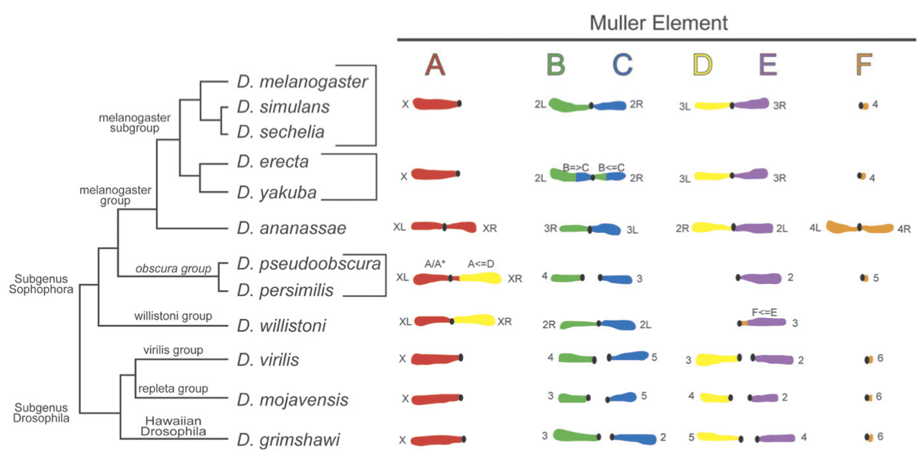


Expansion of the D. ananassae Muller F element
G3 (Bethesda). 2017 Aug 7;7(8):2439-2460.
(239 co-authors participated as students)
Schaeffer SW, et al. Genetics. 2008 Jul;179(3):1601-55.
Notes:
Improved and annotated 1.4Mb region of the D. ananassae F element; 1.7Mb region of the D element

Slide 22
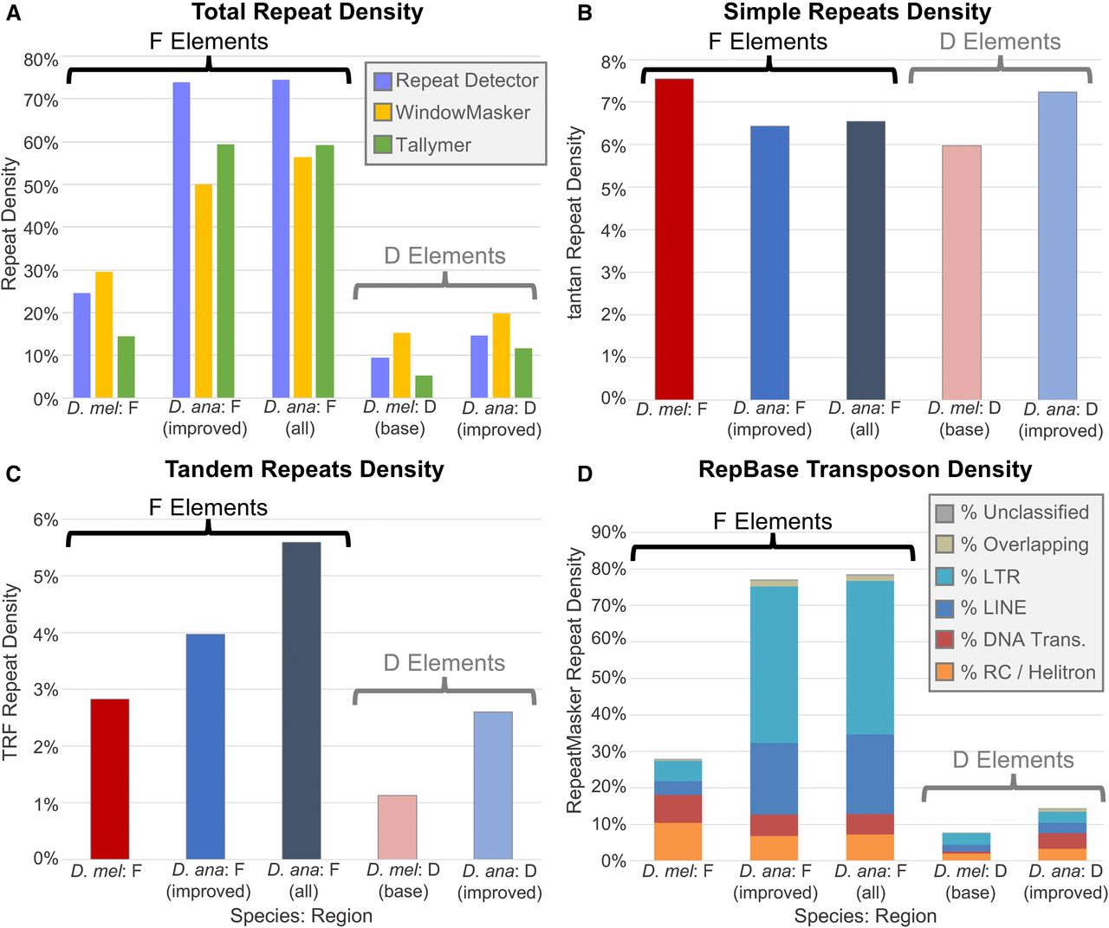
Initial analysis of the D. ananassae F element suggests that expansions can primarily be attributed to the high density of LTR and LINE retrotransposons.
Wilson Leung et al. G3 2017;7:2439-2460
©2017 by Genetics Society of America
Wolbachia DNA, which might be present through lateral gene transfer, does
not make a significant contribution to the expansion of the F element.
Notes:
Expansion of the D. ananassae F element can primarily be attributed to the high density of LTR and LINE retrotransposons. (A) Total repeat density estimates from de novo repeat finders (Red, WindowMasker, and Tallymer) show that the D. ananassae F element has higher repeat density than the D. melanogaster F element (56.4–74.5% vs. 14.4–29.5%). Both F elements show higher repeat density than the euchromatic reference regions from the base of the D elements in D. ananassae (11.6–19.8%) and in D. melanogaster (5.4–15.2%). The repeat densities of the improved D. ananassae F-element scaffolds [D. ana: F (improved)] are similar to the repeat densities for all D. ananassae F-element scaffolds [D. ana: F (all)]. (B) Results from the tantan analysis show that the five analysis regions from D. melanogaster and D. ananassae have similar simple repeat density (6.0–7.5%). (C) TRF analysis shows that D. ananassae has higher tandem repeats density than D. melanogaster on both the F (5.6 vs. 2.8%) and the D elements (2.6 vs. 1.1%). (D) RepeatMasker analysis using the Drosophila RepBase library shows that the F element has higher transposon density than the D element both in D. melanogaster (28.0 vs. 7.7%) and in D. ananassae (78.6 vs. 14.4%). There is a substantial increase in the density of LTR and LINE retrotransposons on the D. ananassae F element compared to the D. melanogaster F element (42.1 vs. 5.5% and 21.8 vs. 3.8%, respectively). The D. ananassae euchromatic reference region also shows higher transposon density than D. melanogaster, but most of the difference can be attributed to the density of DNA transposons (4.3 vs. 0.6%). The region of overlap between two repeat fragments is classified as “Overlapping” if the two repeats belong to different repeat classes.
Note that the The high density of “Wolbachia” sequences in the D. ananassae F element can be attributed to Drosophila transposons in the wAna assembly; Wolbachia DNA does not significantly contribute to the expansion of the F element regions that contain the genes, but may contribute to the pericentric heterochromatin.

Slide 23
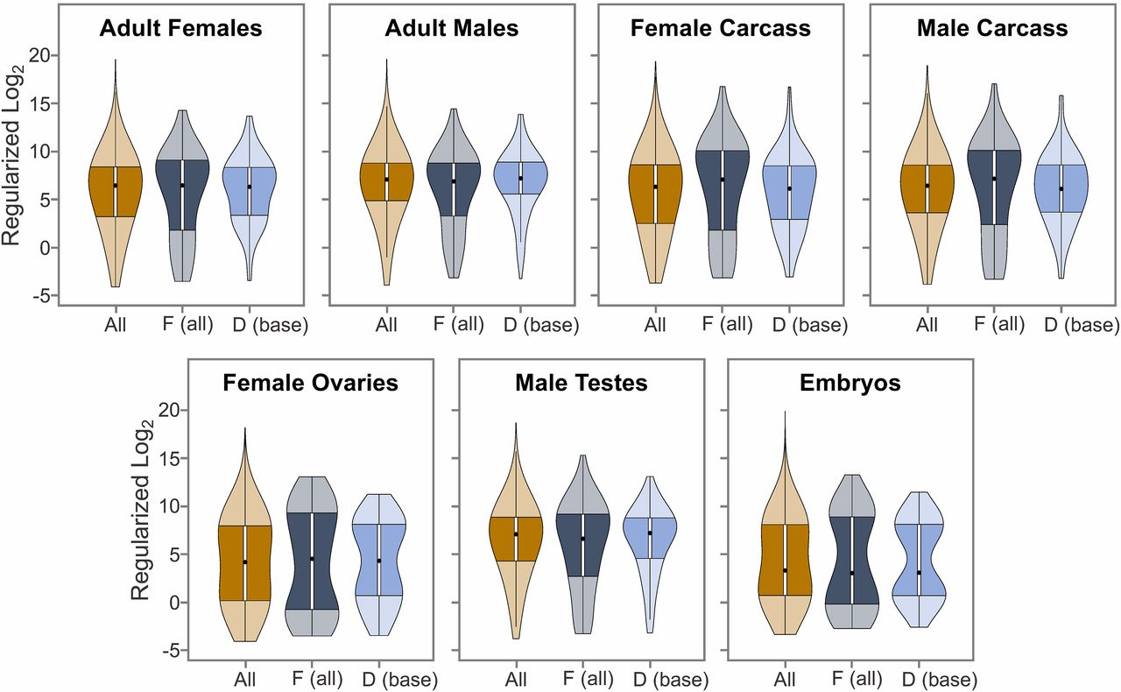
D. ananassae F-element genes show similar expression values compared to genes on other Muller elements.
Wilson Leung et al. G3 2017;7:2439-2460
©2017 by Genetics Society of America
There is no impairment of transcription, despite the increased intron size.
Notes:
D. ananassae F-element genes show similar expression patterns compared to genes on other Muller elements. RNA-Seq reads from seven samples (adult females, adult males, female carcass, male carcass, female ovaries, male testes, and embryos) were mapped against the improved D. ananassae genome assembly and the read counts for the Gnomon gene predictions were tabulated by htseq-count. The read counts for the seven samples were normalized by library size and then transformed using Tikhonov/ridge regularization in the DESeq2 package to stabilize the variances among the samples. The violin plots compare the distributions of the regularized log₂ expression values for the D. ananassae Gnomon gene predictions on all scaffolds (All), on the F-element scaffolds [F (all)], and on the base of the D element [D (base)] for these different developmental stages and tissues. The results argue that there is no impairment of transcription, despite the increased intron size.

Slide 24
Project overview
Proposed GEP project:
  Sequence improvement and gene annotations of four Drosophila species: D. ananassae, D. bipectinata, D. kikkawai, and D. takahashii
Scientific questions:
  What is the impact on gene characteristics and epigenomic landscape?
  What factors (e.g., transposons) contribute to F element expansion?
  Other questions, in consultation with Dr. J Braverman
Where are we now?
  D. ananassae available now; generating PacBio and Nanopore assemblies for 3 additional species with expanded F
  For D. ananassae, have RNAseq and Rampage data, ChIP data on four histone modifications.
New tools and concepts needed:
  New protocol for transcription start site (TSS) annotations
S Elgin

Slide 25
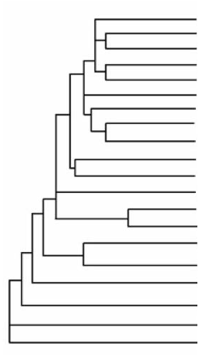
Additional sequencing data for Drosophila species
D. melanogaster
PTre
F Element Motif Project
D. simulans
Previous GEP Publications
D. sechellia
D. yakuba
D. erecta
Expanded F Projects
D. ficusphila
D. eugracilis
Nanopore (Danny Miller)
D. biarmipes
D. takahashii
Nanopore (Bernard Kim)
D. elegans
Nanopore (Re-analyzed)
D. rhopaloa
D. kikkawai
D. bipectinata
PacBio (GEP/Elgin lab, WU)
D. ananassae
D. pseudoobscura
PacBio (A Clark, Cornell)
D. persimilis
D. willistoni
D. mojavensis
Tree produced by
Thom Kaufman, Indiana
D. virilis
D. grimshawi

Slide 26
F element genes have larger coding spans, more repeats in introns, and more exons than D element (base) genes
Leung et al 2015 G3 5: 719
Notes:
Figure from Leung et al 2015 G3 5: 719-740. The larger coding spans seen for F element genes are due to two factors: F element genes have larger introns, due to the presence of more repetitious sequence, and the genes have a larger number of coding exons. The exon size distribution does not change significantly.

Slide 27
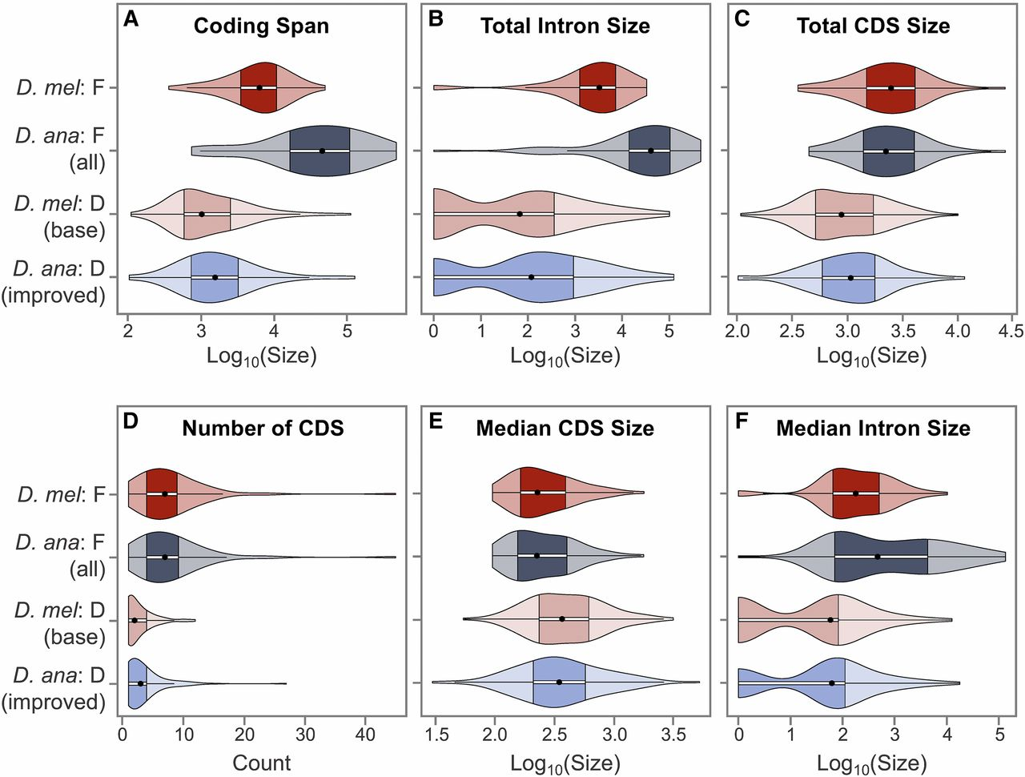
D. ananassae F-element genes are much larger than
D. melanogaster F-element genes.
Wilson Leung et al. G3 2017;7:2439-2460
©2017 by Genetics Society of America
Notes:
F-element genes show distinct gene characteristics compared to D-element genes. Each violin plot is comprised of a box plot and a kernel density plot. The ● in each violin plot denotes the median and the darker region demarcates the IQR, which spans from the first (Q1) to the third (Q3) quartiles. The whiskers extending from the darker region spans from Q1 = −1.5 × IQR to Q3 = +1.5 × IQR; data points beyond the whiskers are classified as outliers. (A) D. ananassae F-element genes have larger coding spans (start codon to stop codon, including introns) than D. melanogaster F-element genes. (B) The D. ananassae F-element genes have larger coding spans because they have larger total intron sizes than D. melanogaster F-element genes. (C) F-element genes have larger total coding exon (CDS) sizes than D-element genes in both D. ananassae and D. melanogaster. (D) F-element genes have more CDS than D-element genes. (E) F-element genes have smaller median CDS size than D-element genes. (F) The median intron size for D. ananassae and D. melanogaster F-element genes shows a bimodal distribution; this distribution pattern indicates that the expansion of the coding spans of D. ananassae F-element genes compared to D. melanogaster F-element genes can be attributed to the substantial expansion of a subset of introns.

Slide 28
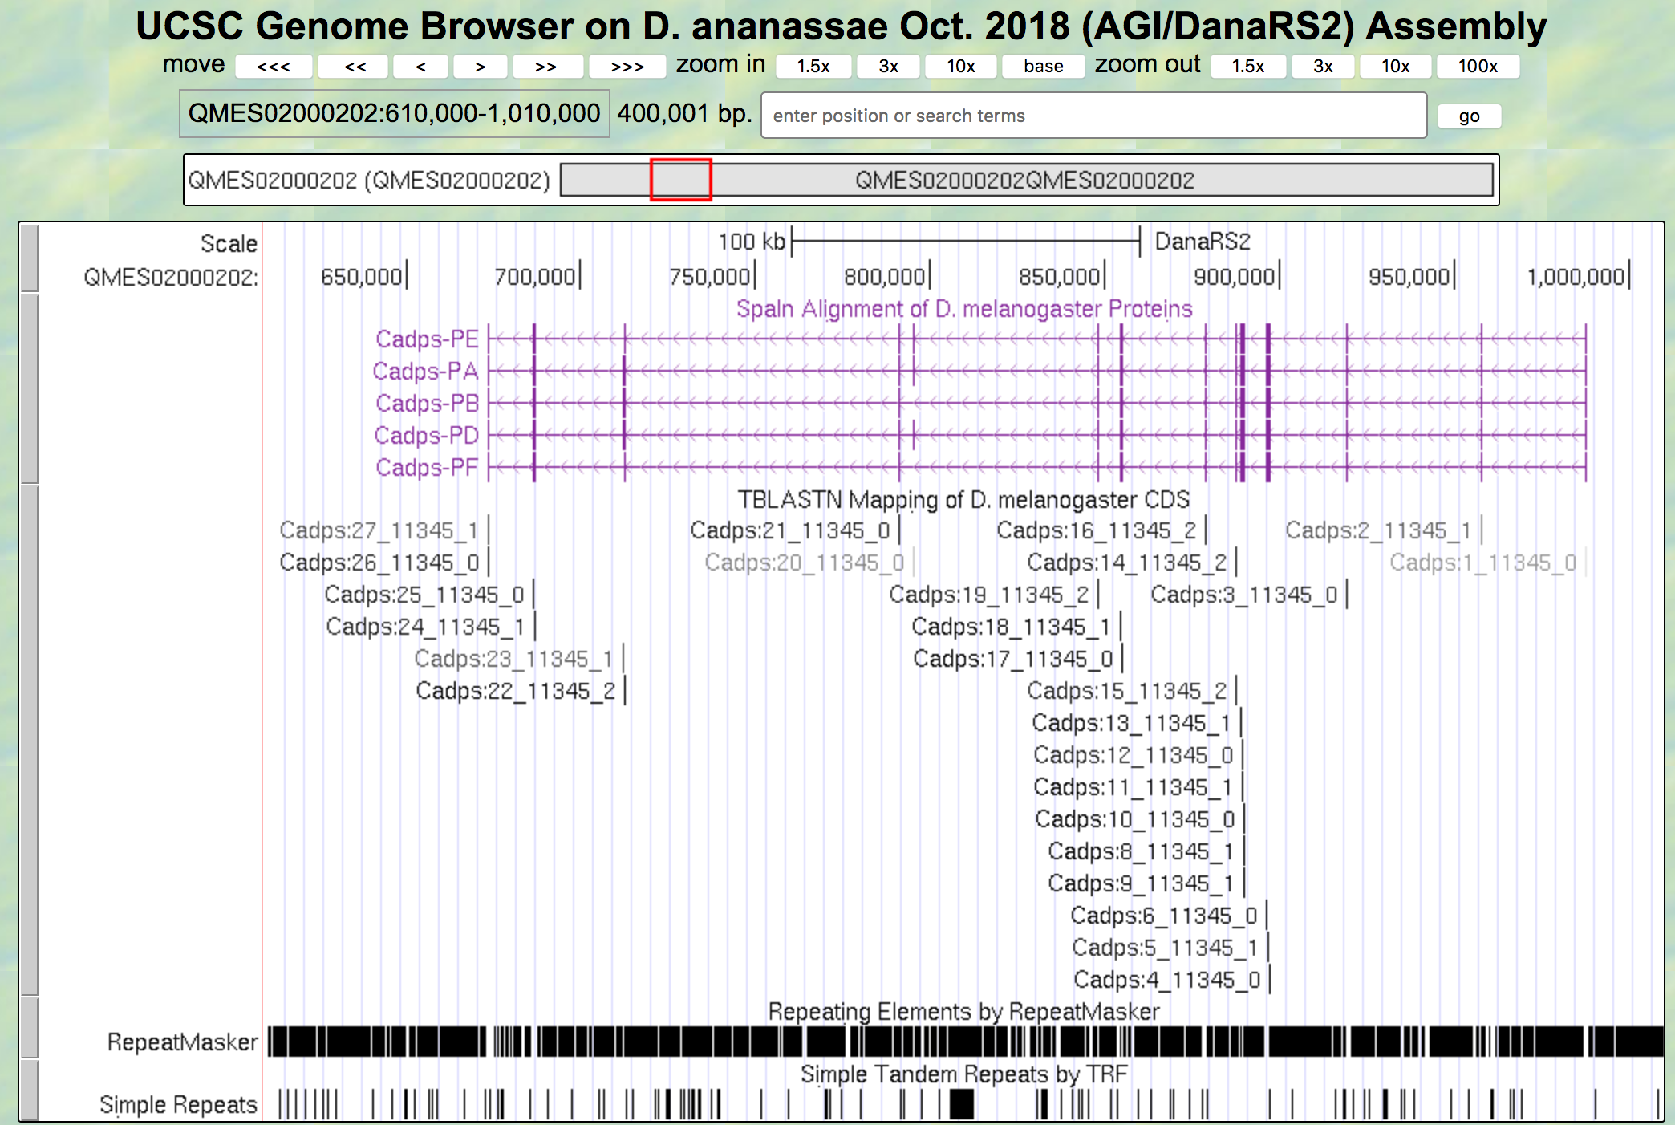
Expansion of an F element gene (Cadps) in D. ananassae
D. mel Proteins
tblastn CDS alignments
RepeatMasker
TRF
314 kb
Notes:
Slide from W Leung. D. melanogaster Cadps: coding span: 38kb; gene span: 41kb
8x increase in size of coding span

Slide 29
F element genes show low codon bias, indicating weak selective pressure (exception: D. grimshawi)
Leung et al 2015 G3 5: 719
Notes:
Figure from Leung et al 2015 G3 5: 719-40. Nc indicates the number of codons used; CAI adjusts for genome-wide codon bias. A negative slope on a plot of one against the other (CAI on the x-axis, Nc on the y-axis) indicates selective pressure. Three of the four F elements do not exhibit the negative slop, suggesting little or no selective pressure, presumably due to the lack of recombination. It is not clear why D grimshawi (a Hawaiian fruitfly) differs in this regard. See Leung et al 2015 for a more detailed discussion.

Slide 30
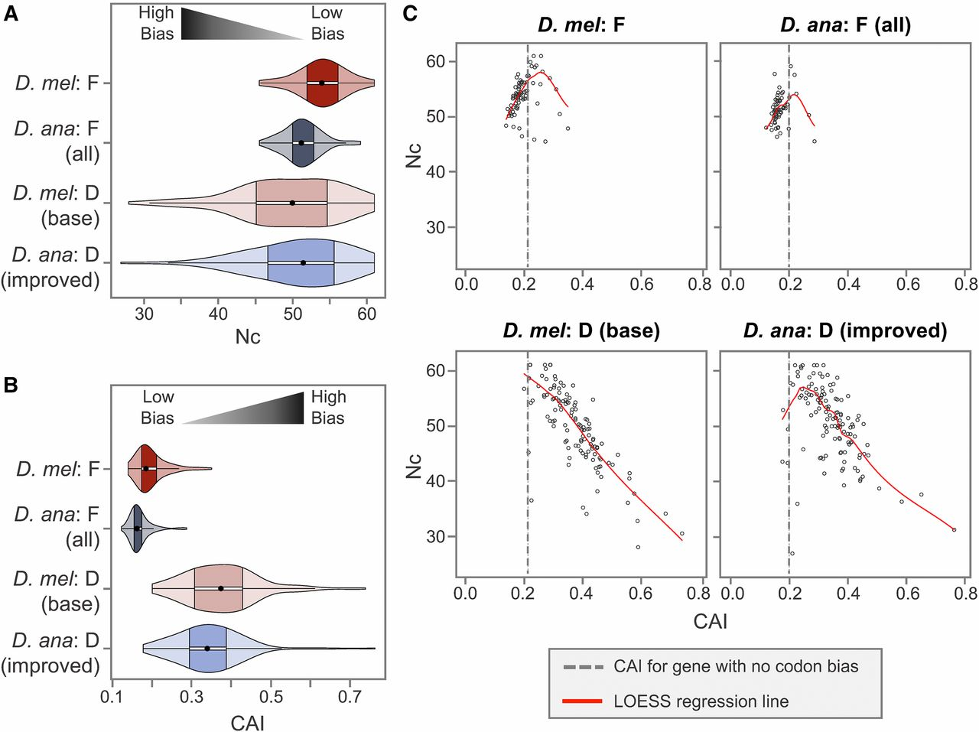
Codon bias in D. ananassae F-element genes can primarily be attributed
to mutational biases instead of selection.
Wilson Leung et al. G3 2017;7:2439-2460
©2017 by Genetics Society of America
Notes:
Codon bias in D. ananassae F-element genes can primarily be attributed to mutational biases instead of selection. (A) Violin plots of the Nc show that D. ananassae F-element genes exhibit stronger deviations from equal usage of synonymous codons (lower Nc) than D. melanogaster F-element genes. (B) Violin plots of the CAI show that D. ananassae F-element genes exhibit less optimal codon usage (lower CAI) than D. melanogaster F-element genes. F-element genes in both D. ananassae and D. melanogaster show less optimal codon usage (lower CAI) than D-element genes. (C) Scatterplot of Nc vs. CAI suggests that the codon bias in most D. ananassae and D. melanogaster F-element genes can be attributed to mutational bias instead of selection, as indicated by the placement of most of the genes in the portion of the LOESS regression line (red line) with a positive slope. By contrast, the codon bias in most D. ananassae and D. melanogaster D-element genes can be attributed to selection, as denoted by the LOESS regression line with a negative slope. The dotted line in each Nc vs. CAI scatterplot corresponds to the CAI value for a gene with equal codon usage relative to the species-specific reference gene sets constructed by the program scnRCA (0.200 for D. ananassae and 0.213 for D. melanogaster). Hence this species-specific threshold corresponds to the CAI value when the strengths of mutational bias and selection on codon bias are the same. A smaller percentage of F-element genes in D. ananassae (6/64; 9.4%) have CAI values above this species-specific CAI threshold compared to D. melanogaster (18/79; 22.8%).

Slide 31
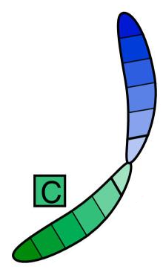
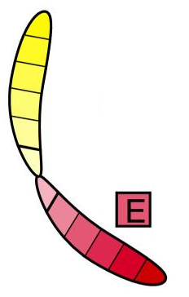



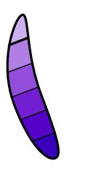

D. melanogaster
Drosophila subgenus
D. mojavensis
D. grimshawi
Movement:
Sopho.
repleta
Sopho.
Hawai. Dros.
Sopho.
Dros.
CG5262
CG9935
CG5367
rho-5
CG1732
dot
Or13a
Leung et al.2010 Genetics 185: 1519 + updates
CG9935
CG4038
CG11076
Or13a
PRY
CG11076
Y chromosome
CG11077
yellow-h
Wanderer genes have moved to/from the dot: hotspot + at Ank in D moj
Notes:
Slide: update of analysis from Leung et al 2010.
We find that about 10% of the genes have moved from the dot chromosome to another chromosome, in most cases changing their local environment from heterochromatin to euchromatin. In most cases (but not all), these genes show the characteristics of the present milieu; they are shorter and show more codon bias when they lie in a euchromatic domain than when they ore in a heterochromatic domain. We do not know the mechanism for such transposition, but helitrons (a type of TE known to pick up flanking DNA) may be involved.

Slide 32
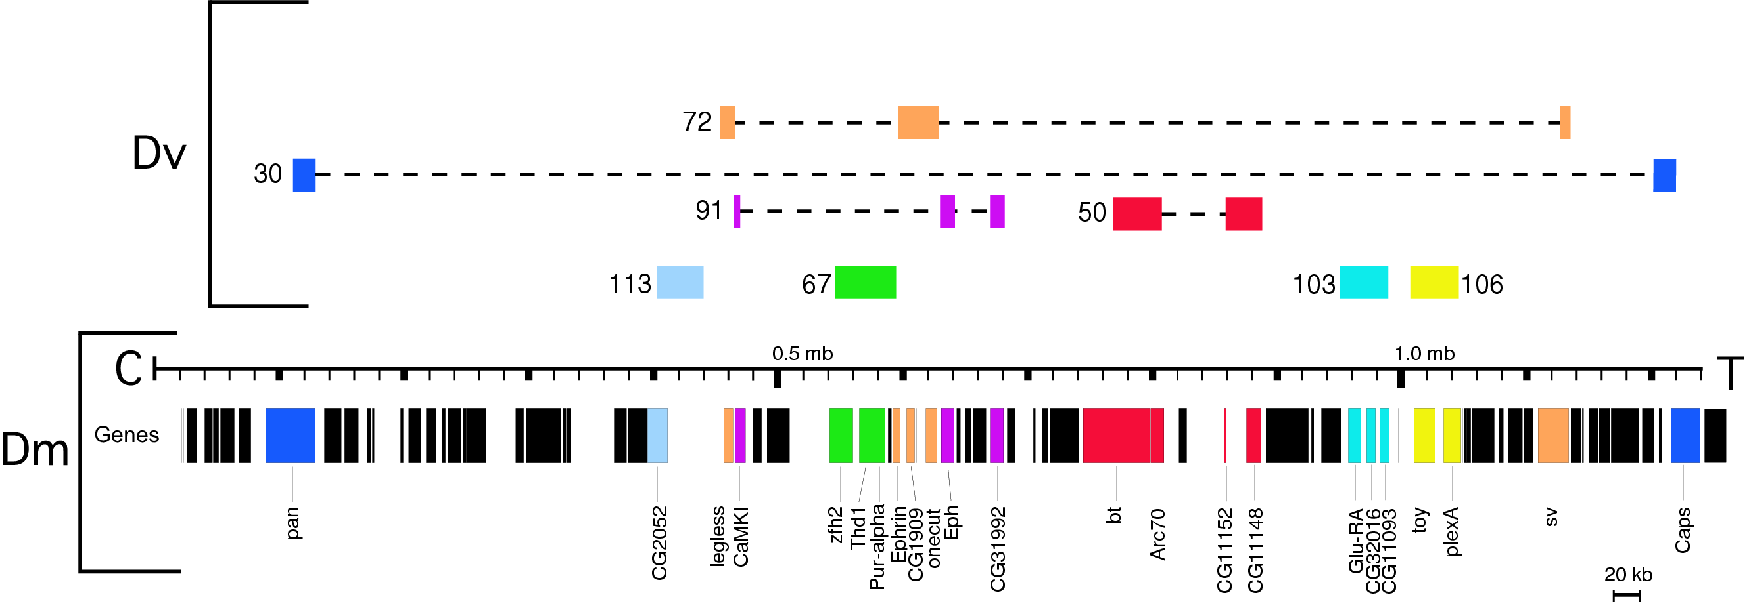
Synteny: the order and orientation of the genes:
Initial analysis of the Drosophila virilis dot chromosome fosmids
Almost all of the same genes are present,
but rearrangements within the chromosome are common!
Slawson et. al., 2006 Genome Biology, 7(2):R15.
Notes:
While most of the same genes are found on the dot chromosomes in D melanogaster and D virilis, there have been extensive rearrangements, presumably by inversions. For example, pan and Caps are on opposite ends of the dot in D melanogaster, but are found on the same fosmid (#30, dark blue) in D. virilis. In contrast, the gene cluster of fosmid #103 (turquoise) has maintained the same order and orientation – perfect synteny.

Slide 33
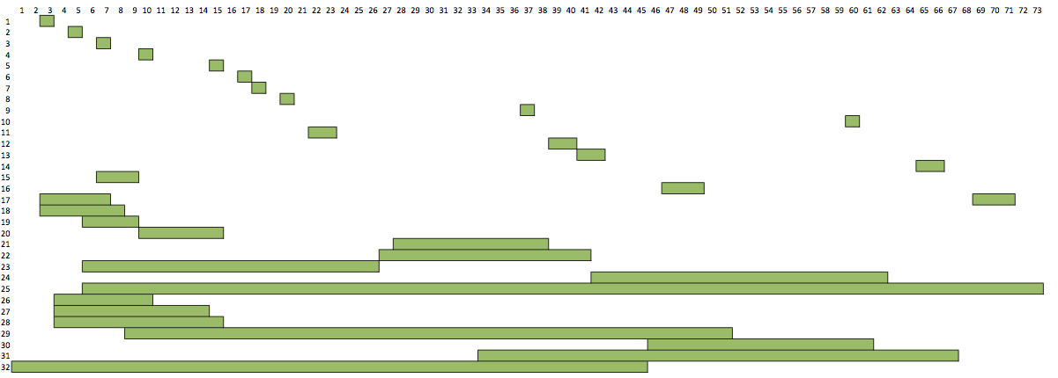
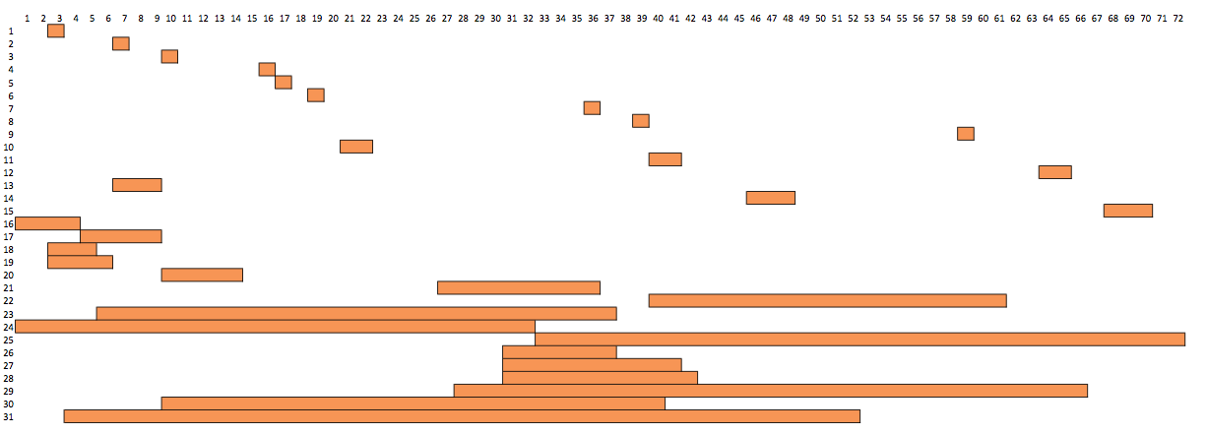
Synteny analysis of the D. melanogaster, D. virilis, and
D. mojavensis F elements shows large numbers
of inversions, in contrast to little recombination
Relative gene order and orientation
D. mel
Species (from / to) | Est. # Inversions | # Shared Genes
D. mel / D. vir | 32 | 73
D. mel / D. moj | 31 | 72
D. vir / D. moj | 7 | 79
D. vir
D. mel
Gene association with H3K9me2,
H3K27me3, or H3K4me2
remained the same in D.
melanogaster and D. mojavensis,
indicating local signals.
D. moj
D. moj
D. vir
Inversion step
Leung et al 2010 Genetics 185:1519;
Leung et al 2015 G3 5: 719.
Notes:
The minimal number of inversions required to change the order and orientation of the genes on the dot chromosome in one species to that of another species. There have been numerous changes over the 40 million years separating D. melanogaster from D. virilis. Again, by looking at the set of species we can make some inferences as to when these events happened, The chromatin state of the gene remains the same, regardless of the arrangement, indicating local signals.

Slide 34
Conclusions
The fourth chromosome of D. melanogaster is largely heterochromatic
-- ~30% repetitious DNA (higher in D. ananassae);
  but ca. 80 genes in ~1.4 Mb, a normal gene density;
  gene expression at similar levels as seen in euchromatic domains;
  ten-fold higher levels of repetitious sequences around genes.
Incomplete transposition of the P element on the fourth chromosome in D. melanogaster
  results in local deletions and duplications that can cause a switch in phenotype, indicating a switch in chromatin packaging;
  argues against a fixed boundary, supports an equilibrium model;
  -- proximity to 1360 associated with heterochromatin formation; requires high repeat density and/or proximity to chromocenter.
Gene/ chromatin structure of fourth chromosome genes
  genes are larger, show low codon bias.
  most are “heterochromatic genes,” dependent on HP1a for optimal expression; active marks at TSS, but revert to heterochromatin marks over the body of the gene; see enrichment of Top2 motif.
S Elgin
Notes:
Conclusions based on the preceding data.

Slide 35
Challenges, Questions
What happens to all of these characteristics when the chromosome is 8X larger due to repetitious elements?
Scientific questions:
  What is the impact on gene characteristics and epigenomic landscape? Intron/exon organization, size; relative position of the TSS; distribution of histone modifications.
  What factors (e.g., transposons) contribute to F element expansion?
  Other, to be determined in consultation with Dr. Braverman
Available evidence
  High quality D. ananassae genome assembly
  For D. ananassae, have RNAseq and Rampage data, ChIP data on four histone modifications.
Good luck, and good hunting!
S Elgin
Notes:
Questions that we want to be thinking about as we work on our GEP research project this semester.

