Slide 1
RNA Quantitation from RNA-Seq Data
Jeremy Buhler
for GEP Alumni Workshop

Slide 2
RNA-Seq Pipeline for Expression Analysis
Map reads to transcripts
Extract and Sequence
RNA-Seq Read Count
per Transcript
RNA Source
RNA Reads
37251
20653
9827
5121
RNA Abundance
per Transcript
Quantify

Slide 3
Topics for Today
Read mapping and RNA quantitation from read counts are two key computational steps in RNA-Seq expression analysis.
Mapping: how do we do it fast?
Quantitation: how do we get from mapped reads to transcript abundance?

Slide 4
From mapped reads to transcript abundance
More highly expressed transcripts should produce more RNA-Seq reads
Read counts versus population of RNA transcripts
Inferences we would like to make:
Gene g is expressed at k copies per cell
Gene g shows 2-fold higher expression than gene h
Gene g shows 2-fold higher expression in sample 2 than in sample 1
Which of these inferences are feasible?
Notes:
How to make this statement quantitative?
Explore relationship between read counts and the population of RNA transcripts

Slide 5
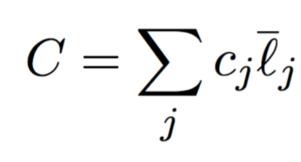
Simple model for RNA transcript abundance
Sample contains n different transcripts
Transcript i appears c_{i} times in the sample
Sample has M RNA reads with length s
Effective length:
The start position of a mapped read (with length s) cannot be at the last s-1 positions of the transcript
s-1
Number of possible start positions across all RNA molecules in a sample:
Notes:
Assume reads can map to every position in the transcript except the end
Assume each start position is equally likely
Number of times transcript appears in sample * effective length = C

Slide 6
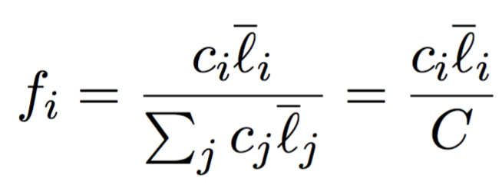
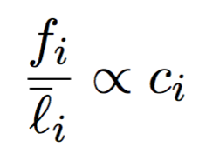
Number of mapped reads versus number of copies of transcript i
f_{i} = fraction of all starting positions for a mapped read that lie within a copy of transcript i
Relationship between f_{i} and c_{i}:
Every transcript in the sample has the same constant of proportionality:
Notes:
Expect more reads to map to longer transcripts
C = number of possible start positions in all RNA molecules in a sample
Proportional to number of copies of the transcript in the sample

Slide 7
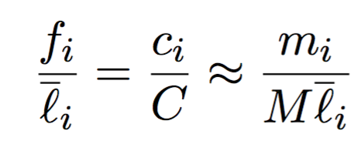
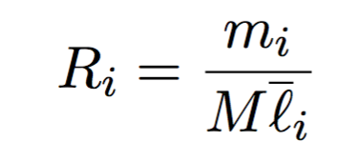
Estimate transcript abundance from the number of mapped reads
m_{i} = number of RNA-Seq reads in the sample mapped to transcript i
M = total number of RNA-Seq reads
is a good estimator of :
Estimate from RNA-Seq data:
Notes:
Model assumes each read is sampled randomly among all feasible positions
Hence m_i/M is a good estimator of f_i

Slide 8
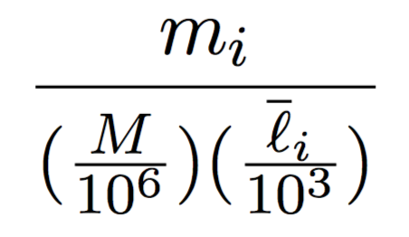
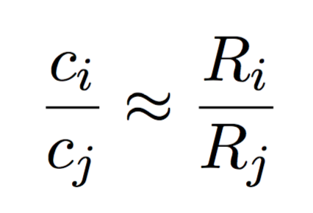
Scaled version of R_{i} = RPKM
RPKM = Reads Per Kilobase of transcript i per Million reads sampled:
Use RPKM to compare abundance of two transcripts within a sample
Ratio of abundances for transcripts i and j:

Slide 9
RPKM values for the same transcript are not comparable across multiple samples
The same R_{i} values in two different samples could correspond to two different counts (c_{i})
The constant of proportionality (C) depends on the quantities of other RNAs in the sample

Slide 10
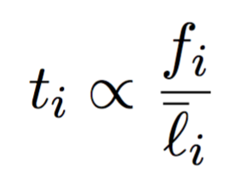
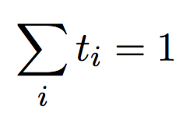
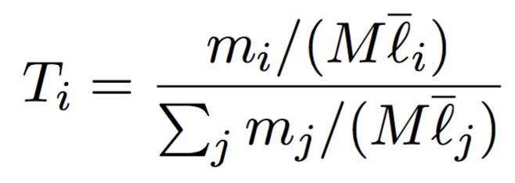
Estimate abundance using TPM
t_{i} = fraction of all RNA molecules in a sample that are copies of transcript i
By definition:
Estimate t_{i} from RNA-Seq read counts:
Multiply T_{i} by 10⁶
TPM = copies of Transcript i Per Million RNA molecules
Notes:
Normalize for gene length first, then by sequencing depth = TPM
Normalize for sequencing depth, then by gene length = RPKM
Measure of transcript abundance that is more meaningful across samples: TPM
m_i/M is a good estimator of f_i

Slide 11
Is TPM better than RPKM?
TPM is no better than RPKM for comparing transcript abundance within a sample
TPM are better than RPKM for comparisons across samples:
Show transcript i forms a larger or smaller fraction of all transcripts in sample 2 than in sample 1
TPM does not provide the absolute number of copies of transcript i (c_{i}) in a sample
Notes:
One possibility is to use spike-in controls with known copy numbers of each transcript for calibration

Slide 12
Differential expression analysis tools
Examples: DESeq2, edgeR
Uses different modeling approach that compares raw read counts
Normalize by sequencing depth per sample
Often use the negative binomial distribution as the reference distribution

Slide 13
Additional considerations for RNA quantitation
For paired-end reads, count fragments instead of reads (i.e., FPKM)
Model fragment lengths distribution
Biases due to library construction, sequencing
Multi-mapped reads
Different isoforms, conserved domains, repeats
Unmapped reads
Incomplete transcriptome / genome
Sequencing errors, polymorphisms
Notes:
Tools such as RSEM attempts to take these factors into account

