Slide 1
Design and Use of RepeatMasker
Jeremy Buhler
jbuhler@wustl.edu
Notes:
Last Update: 12/22/2023

Slide 2
Parts of RepeatMasker
Programs
Smit AFA, Hubley R, and Green P. “RepeatMasker-Open 4.0.” 2013-2015. http://www.repeatmasker.org/
RMBlast (NCBI variant), HMMER for comparisons
Data
Dfam https://www.dfam.org
Notes:
RepBase is now by subscription only
The RepeatMasker track on the GEP UCSC Genome Browser shows the results from the last RepeatMasker version of the RepBase repeat library (i.e., RepBaseRepeatMaskerEdition-20181026).

Slide 3
Overview
Sources of repetitive sequence data
How RepeatMasker finds repeats
Issues and limitations

Slide 4
Data Source
Uses a library of known repeat seqs
Supplied by Dfam (“DNA families DB”)
Repeat families in Dfam are carefully curated using multiple alignment tools.

Slide 5
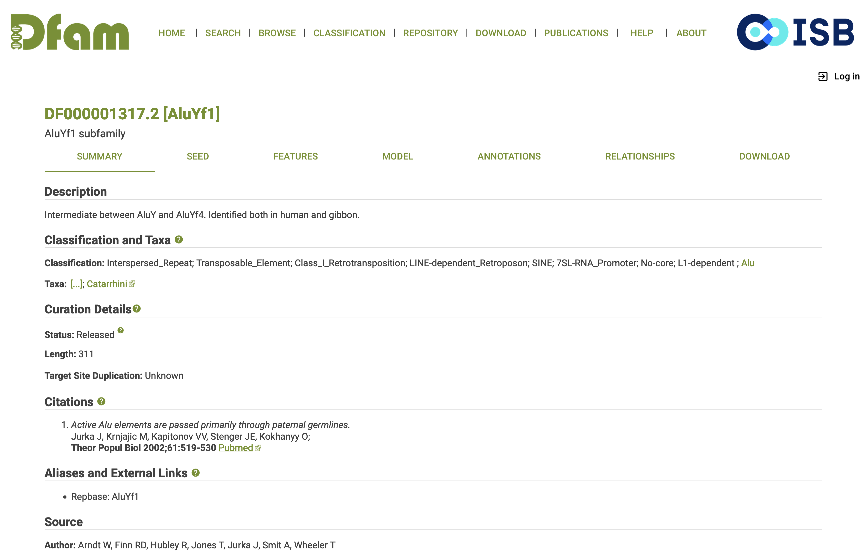
Example of a
repeat family
summary page from Dfam

Slide 6
Repeats are DNA Motifs
Repeats occur in multiple instances, so use motif technology to represent them
accgataggtatacgtatca-tttacgatac
atcgct-ggtttacgcgtcaattcaggatgc
accggt-tgtttacgtagcaatctaggatac
accgat-ggtttacgtatcaatttaggatac

Slide 7
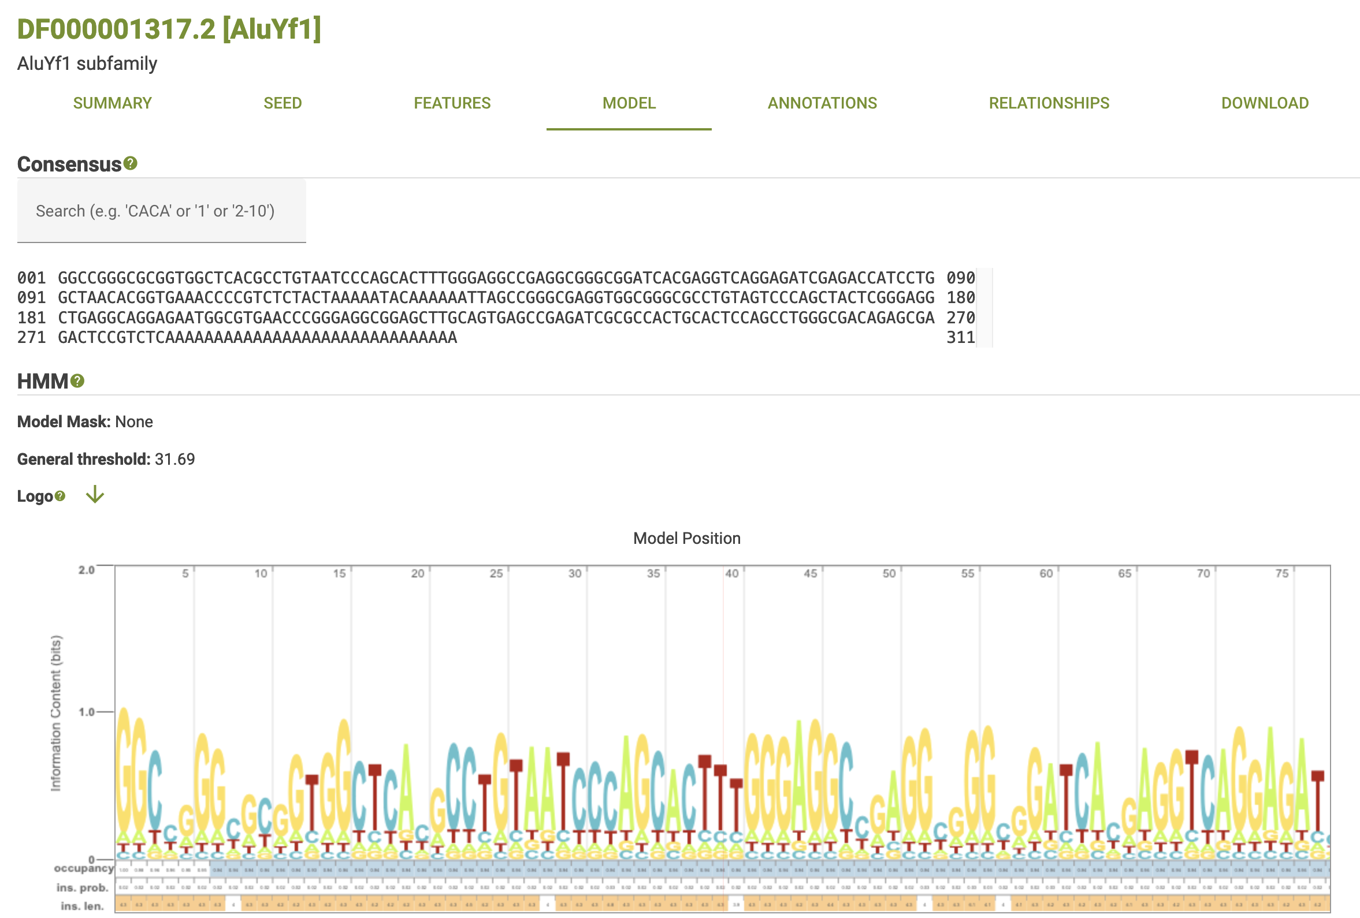
Two kinds of model:
consensus and HMM (= weight matrix + gaps)

Slide 8
Why Use Motifs for Repeats?
Faster to compare one sequence/model to genome than many seqs
Even simple motifs, like a consensus sequence, are better than individual instances for discovering new copies of a repeat.

Slide 9
Utility of Motif vs Instances
actggt
acacgt
atagct
3
3
4
tcaggc

Slide 10
Utility of Motif vs Instances
actggt
acacgt
atagct
acaggt
2
tcaggc

Slide 11
Types of Repeats Identified
Interspersed (Alu, LINE, MIR, …)
Micro- and mini-satellites
Noncoding RNAs (tRNA, rRNA, snoRNA, …)
Short tandem + low complexity (agagagag, actactactact, aaaaataataaaa, …)
Common artifacts (E. coli, vectors)

Slide 12
Overview
Sources of repetitive sequence data
How RepeatMasker finds repeats
Issues and limitations

Slide 13
The Basics
Uses RMBlast (BLAST-like tool) to compare query to consensus model library
Uses HMMER (vaguely BLAST-like, but with much fancier math) to compare query to HMM library

Slide 14
Partial Repeats
RepeatMasker will cheerfully report an incomplete match to a repeat.
Detects best-conserved parts
Some repeats (retroposons) typically incomplete

Slide 15
Nested Repeats
RepeatMasker tries to detect nesting
time

Slide 16
Nested Repeats
RepeatMasker tries to detect nesting
time

Slide 17
Nested Repeats
RepeatMasker tries to detect nesting
time

Slide 18
Nested Repeats
RepeatMasker tries to detect nesting
time
(Please don’t ask me how)

Slide 19
Nested Repeats
RepeatMasker tries to detect nesting
time
(Please don’t ask me how)
See the RepeatMasker presentation by Dr. Jessica Storer for details
Notes:
Dr. Jessica Storer’s RepeatMasker presentation at the 6th Uppsala Transposon Symposium provides more details on the strategies used by the ProcessRepeats script to detect and resolve nested repeats (https://www.youtube.com/watch?v=fem_Jvgunts; at ~17:20)

Slide 20
Overview
Sources of repetitive sequence data
How RepeatMasker finds repeats
Issues and limitations

Slide 21
Library Choice
Make sure to use correct libraries for your target species
(Commonly used organisms have preselected library lists)
Danger: mis-identifications!

Slide 22
Incomplete Masking
Highly diverged repeats can be tough to find
Might leave ends of a repeat unmasked
Is this really a new feature?
(masked)
BLAST hit

Slide 23
Use the Right Tool
Tandem repeats and duplications
Dust (short) — Morgulis et al., 2006
TRF (long) — Benson et al., 1999
RNA
tRNAscan-SE, Infernal, …
Other repeats
Search for matches to Dfam (HMMER) and the NCBI nt database (BLAST)
Check the “Repeat tools” page on TE Hub
Notes:
DUST:
Morgulis A, Gertz EM, Schäffer AA, Agarwala R. A fast and symmetric DUST implementation to mask low-complexity DNA sequences. J Comput Biol. 2006 Jun;13(5):1028-40. doi: 10.1089/cmb.2006.13.1028. PMID: 16796549. (https://pubmed.ncbi.nlm.nih.gov/16796549/)
Download link: https://ftp.ncbi.nlm.nih.gov/pub/agarwala/dustmasker/
TRF:
Benson G. Tandem repeats finder: a program to analyze DNA sequences. Nucleic Acids Res. 1999 Jan 15;27(2):573-80. doi: 10.1093/nar/27.2.573. (https://pubmed.ncbi.nlm.nih.gov/9862982/)
Download link: https://github.com/Benson-Genomics-Lab/TRF
TE Hub is creating a directory of tools for detecting different types of repeats: https://tehub.org/en/resources/repeat_tools

Slide 24
In conclusion…
Hey, let’s be careful out there!
Neal Wellons; https://flic.kr/p/FrUFPX
Notes:
Image credit:
Neal Wellons
Description: North Carolina Transportation Museum, Spencer, NC
Source: https://flic.kr/p/FrUFPX
License: CC BY-NC-ND 2.0

