Slide 1
Using BLAST for Genomic Sequence Annotation
Jeremy Buhler
Adapted by Wilson Leung
Last Update: 08/16/2023

Slide 2
Overview
What is comparative annotation?
How to measure similarity between biosequences
How to decide whether two sequences are “similar enough”

Slide 3
Comparative Annotation
Identify functional elements in DNA sequence
Uses comparison to databases of sequences with known function
New
DNA
sequence
human CFTR gene
Biosequence
Database
Probably CFTR
mouse CFTR gene
dog CFTR gene

Slide 4
Why Does It Work?
Functional sequences are under negative selection → fewer mutations
More conservation → greater similarity
BLAST software recognizes similarity.

Slide 5
Caveats w/Similarity Evidence
Similarity without conservation
random chance
Conservation without selective pressure
slow mutation
recent divergence
Similar selective pressures, but seqs have two distinct functions

Slide 6
Overview
What is comparative annotation?
How to measure similarity between biosequences
How to decide whether two sequences are “similar enough”

Slide 7
What is Similarity?
How to measure similarity of two DNA seqs?
Mutations happen…
Measure should reflect desired evolutionary inference

Slide 8
Mutational Model
Sequences change by series of events of (only) three types:
Substitution of one base
Insertion of one base
Deletion of one base
ACG
ATG
ACG
ACAG
ACG
AG

Slide 9
Sequence History (1/2)
Suppose seqs S, T diverged from a common ancestral sequence U…

Slide 10
Sequence History (2/2)
Draw lines between bases of S and T that come from same base of U.
This is a “tree alignment” of S,T,U.

Slide 11
Sequence Alignment
Now elide the ancestor…
Result is correspondence between bases of S, T – a sequence alignment

Slide 12
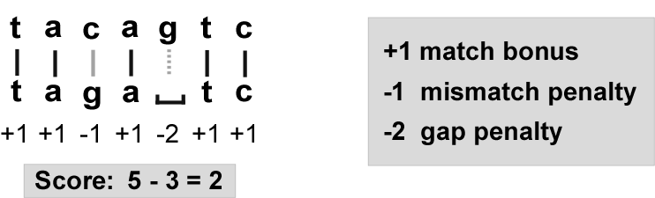
Similarity Score of Alignment
Fewer mutations → more conservation
Give bonus for matches, penalties for substitutions and gaps

Slide 13
One Small Problem…
Do you own a time machine?
If not, how do you know
ancestral sequence U?
history of mutation?
Hence, how to get correct alignment?

Slide 14
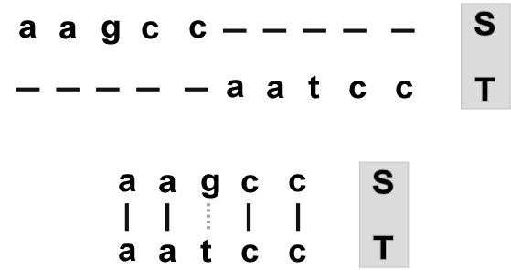
What We Do In Practice
Guess an alignment that minimizes # of hypothesized mutations
(more precisely, maximizes score)

Slide 15
Overview
What is comparative annotation?
How to measure similarity between biosequences
How to decide whether two sequences are “similar enough”

Slide 16
Deciding What to Report
Any two sequences can be aligned with some score.
Higher scores are better…
When is score high enough to be evidence of conservation?

Slide 17
Idea: Test a Null Hypothesis
Suppose two DNA seqs S, T are completely unrelated.
What is probability that best alignment between S, T has score at least Θ?
If score(S,T) is unlikely to occur by chance, then report (S,T)

Slide 18
Null Model Assumptions
Bases of seqs S, T generated independently at random
a
c
a
g
random process S
t
random process T
t
c
c
g
a

Slide 19
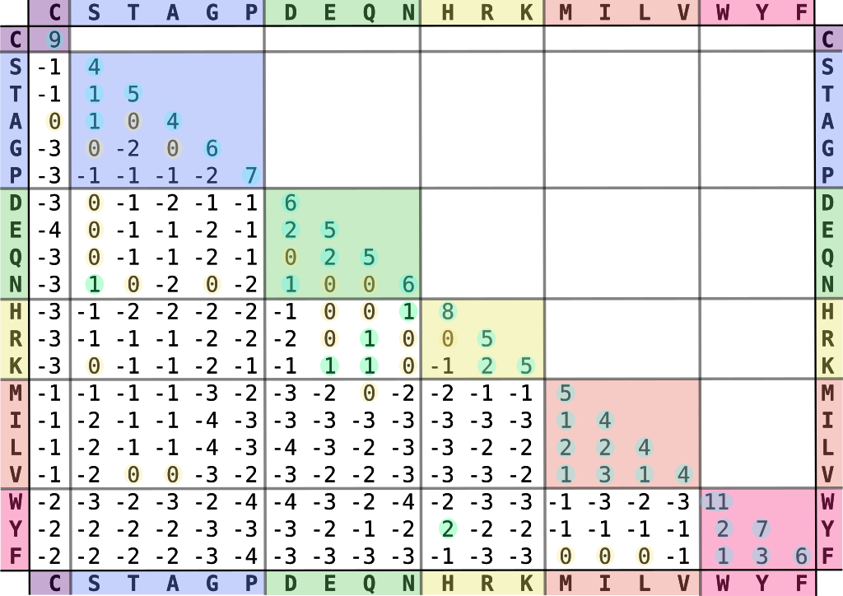
Scoring Systems
BLOSUM62 Matrix
Amino acids grouped by the Dayhoff classification scheme
“BLOSUM”. Wikipedia. Ppgardne.
Eddy SR. Where did the BLOSUM62 alignment score matrix come from? Nat Biotechnol. 2004 Aug;22(8):1035-6.
Notes:
Image source: Ppgardne
https://en.wikipedia.org/wiki/File:Blosum62-dayhoff-ordering.svg

Slide 20
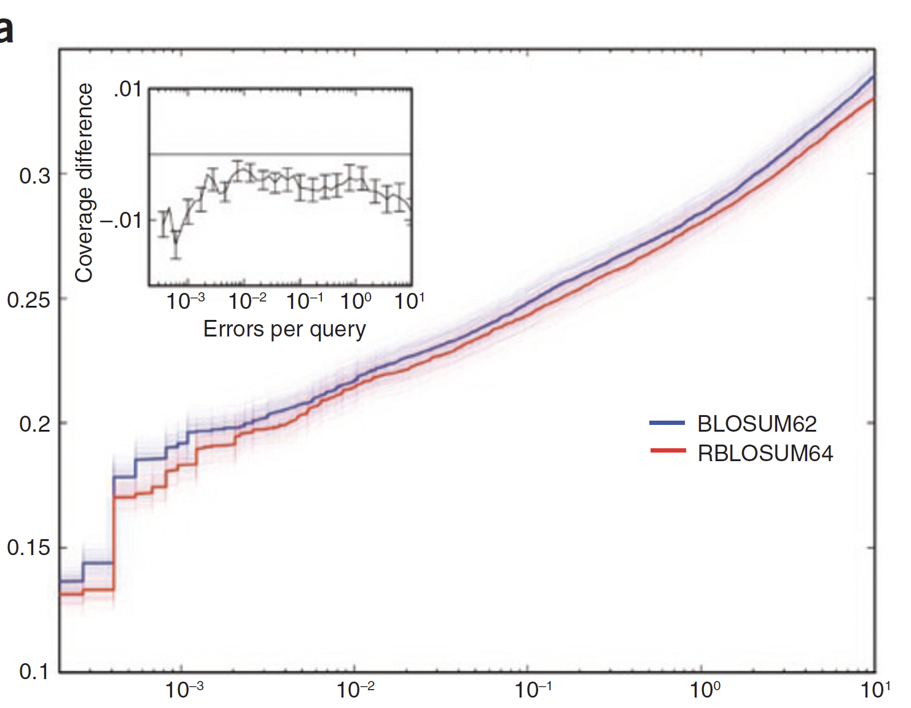
Errors in the BLOSUM Matrices
Benchmark: detect distant homologs in the ASTRAL database
The “correct” matrix (RBLOSUM64) performs worse than the BLOSUM62 matrix
Subsequent ”fix” of the BLOSUM matrices:
Hess M, et al. Addressing inaccuracies in BLOSUM computation improves homology search performance. BMC Bioinformatics. 2016 Apr 27;17:189.
Fraction of homologs identified by BLAST search (coverage)
Errors per query
Styczynski MP, et al. BLOSUM62 miscalculations improve search performance. Nat Biotechnol. 2008 Mar;26(3):274-5.
Notes:
Two matrices differ in 15% of their positions
Errors per query (E-value)

Slide 21
P-values
Given random seqs S’, T’ with same base distributions as S, T
Karlin-Altschul theory tells us probability that S’, T’ align with score at least Θ
If p(Θ) is small, report alignment of S,T

Slide 22
E-values
For computational reasons, BLAST reports not p(Θ) but rather E(Θ)
E(Θ) = expected # times alignment with score at least Θ happens by chance in current search
If E(Θ) < 1, then score Θ is interesting

Slide 23
Caveats about E-values
Model from which E-values are com-puted is too simple for real bioseqs
Large margin of safety is wise
Be very skeptical of “matches” with E > 10⁻⁵

Slide 24
Explanation for E-value = 0.0
E-value is less than 1.0e-180
Notes:
NCBI BLAST source code:
https://www.ncbi.nlm.nih.gov/IEB/ToolBox/CPP_DOC/lxr/source/src/algo/blast/api/blast_seqalign.cpp

Slide 25
Summary
Comparative annotation with BLAST uses similarity as evidence for conserved function.
Similarity score based on hypothesized evolutionary relations among sequences.
E-values indicate whether scores are high enough to be real biological conservation.

Slide 26
Additional Resources
Introduction to Dynamic Programming
Overview of the algorithms for calculating global, semiglobal, and local alignments
From Smith-Waterman to BLAST
Discuss the heuristics used by BLAST to reduce the search space and quickly report high-scoring local alignments

