Slide 1
Annotation of Other Genomic Features within the F Element Project
Wilson Leung
12/23/2023

Slide 2
Checking for additional features
Analyze each Genscan gene prediction that does not overlap with the genes you have annotated
Analyze regions with RNA-Seq read coverage that do not overlap with the features you have annotated or with transposon remnants identified by RepeatMasker
Notes:
See the “Check for additional features in your project” section of the F Element Annotation Report.

Slide 3
Analysis of Genscan predictions
FlyBase blastp search of the predicted protein against the D. melanogaster “Annotated proteins” database
Analyze matches with E-values < 1e-5
NCBI blastp search of the predicted protein against the NCBI “Reference proteins (refseq_protein)” database
Analyze matches to curated RefSeq gene models (i.e., accession numbers with the “NP_” prefix)
Determine if the feature is a protein-coding gene (e.g., novel paralog), pseudogene, or partial gene duplication

Slide 4
Analysis of regions with substantial RNA-Seq read coverage
The FANTOM consortium uses an arbitrary length cutoff of 300 nt (100aa) to identify putative mRNAs
Reviewed in Dinger ME et al., 2008
Identify regions with contiguous RNA-Seq read coverage
Perform a NCBI blastx search of each region against the refseq_protein database
Analyze matches to curated RefSeq gene models with E-values < 1e-5
Dinger ME, et al. Differentiating protein-coding and noncoding RNA: challenges and ambiguities. PLoS Comput Biol. 2008 Nov;4(11):e1000176.

Slide 5
Goals for the analysis of additional genomic features
Analysis of the features might require additional techniques and tools beyond the standard annotation protocol
Document the genomic features in the annotation report for the F Element Project
Reconcilers can follow up on the analysis of the feature
Consult with Wilson during Office Hours for the F Element Project

Slide 6
Examples of additional features in the expanded F Elements
Paralogs
Pseudogenes
Retrogenes
Partial gene duplications
Pseudogene clusters
Nuclear mitochondrial DNA segments (NUMT)
Paralogs (Chris Hemauer)
Pseudogenes (Ishtar Olaveja)
Retrogenes (Meher Arora)
Partial gene duplications (Meher Arora)
Pseudogene clusters (Ethan Cordes)
Nuclear mitochondrial DNA segments (NUMT) (Martin Dalling)

Slide 7
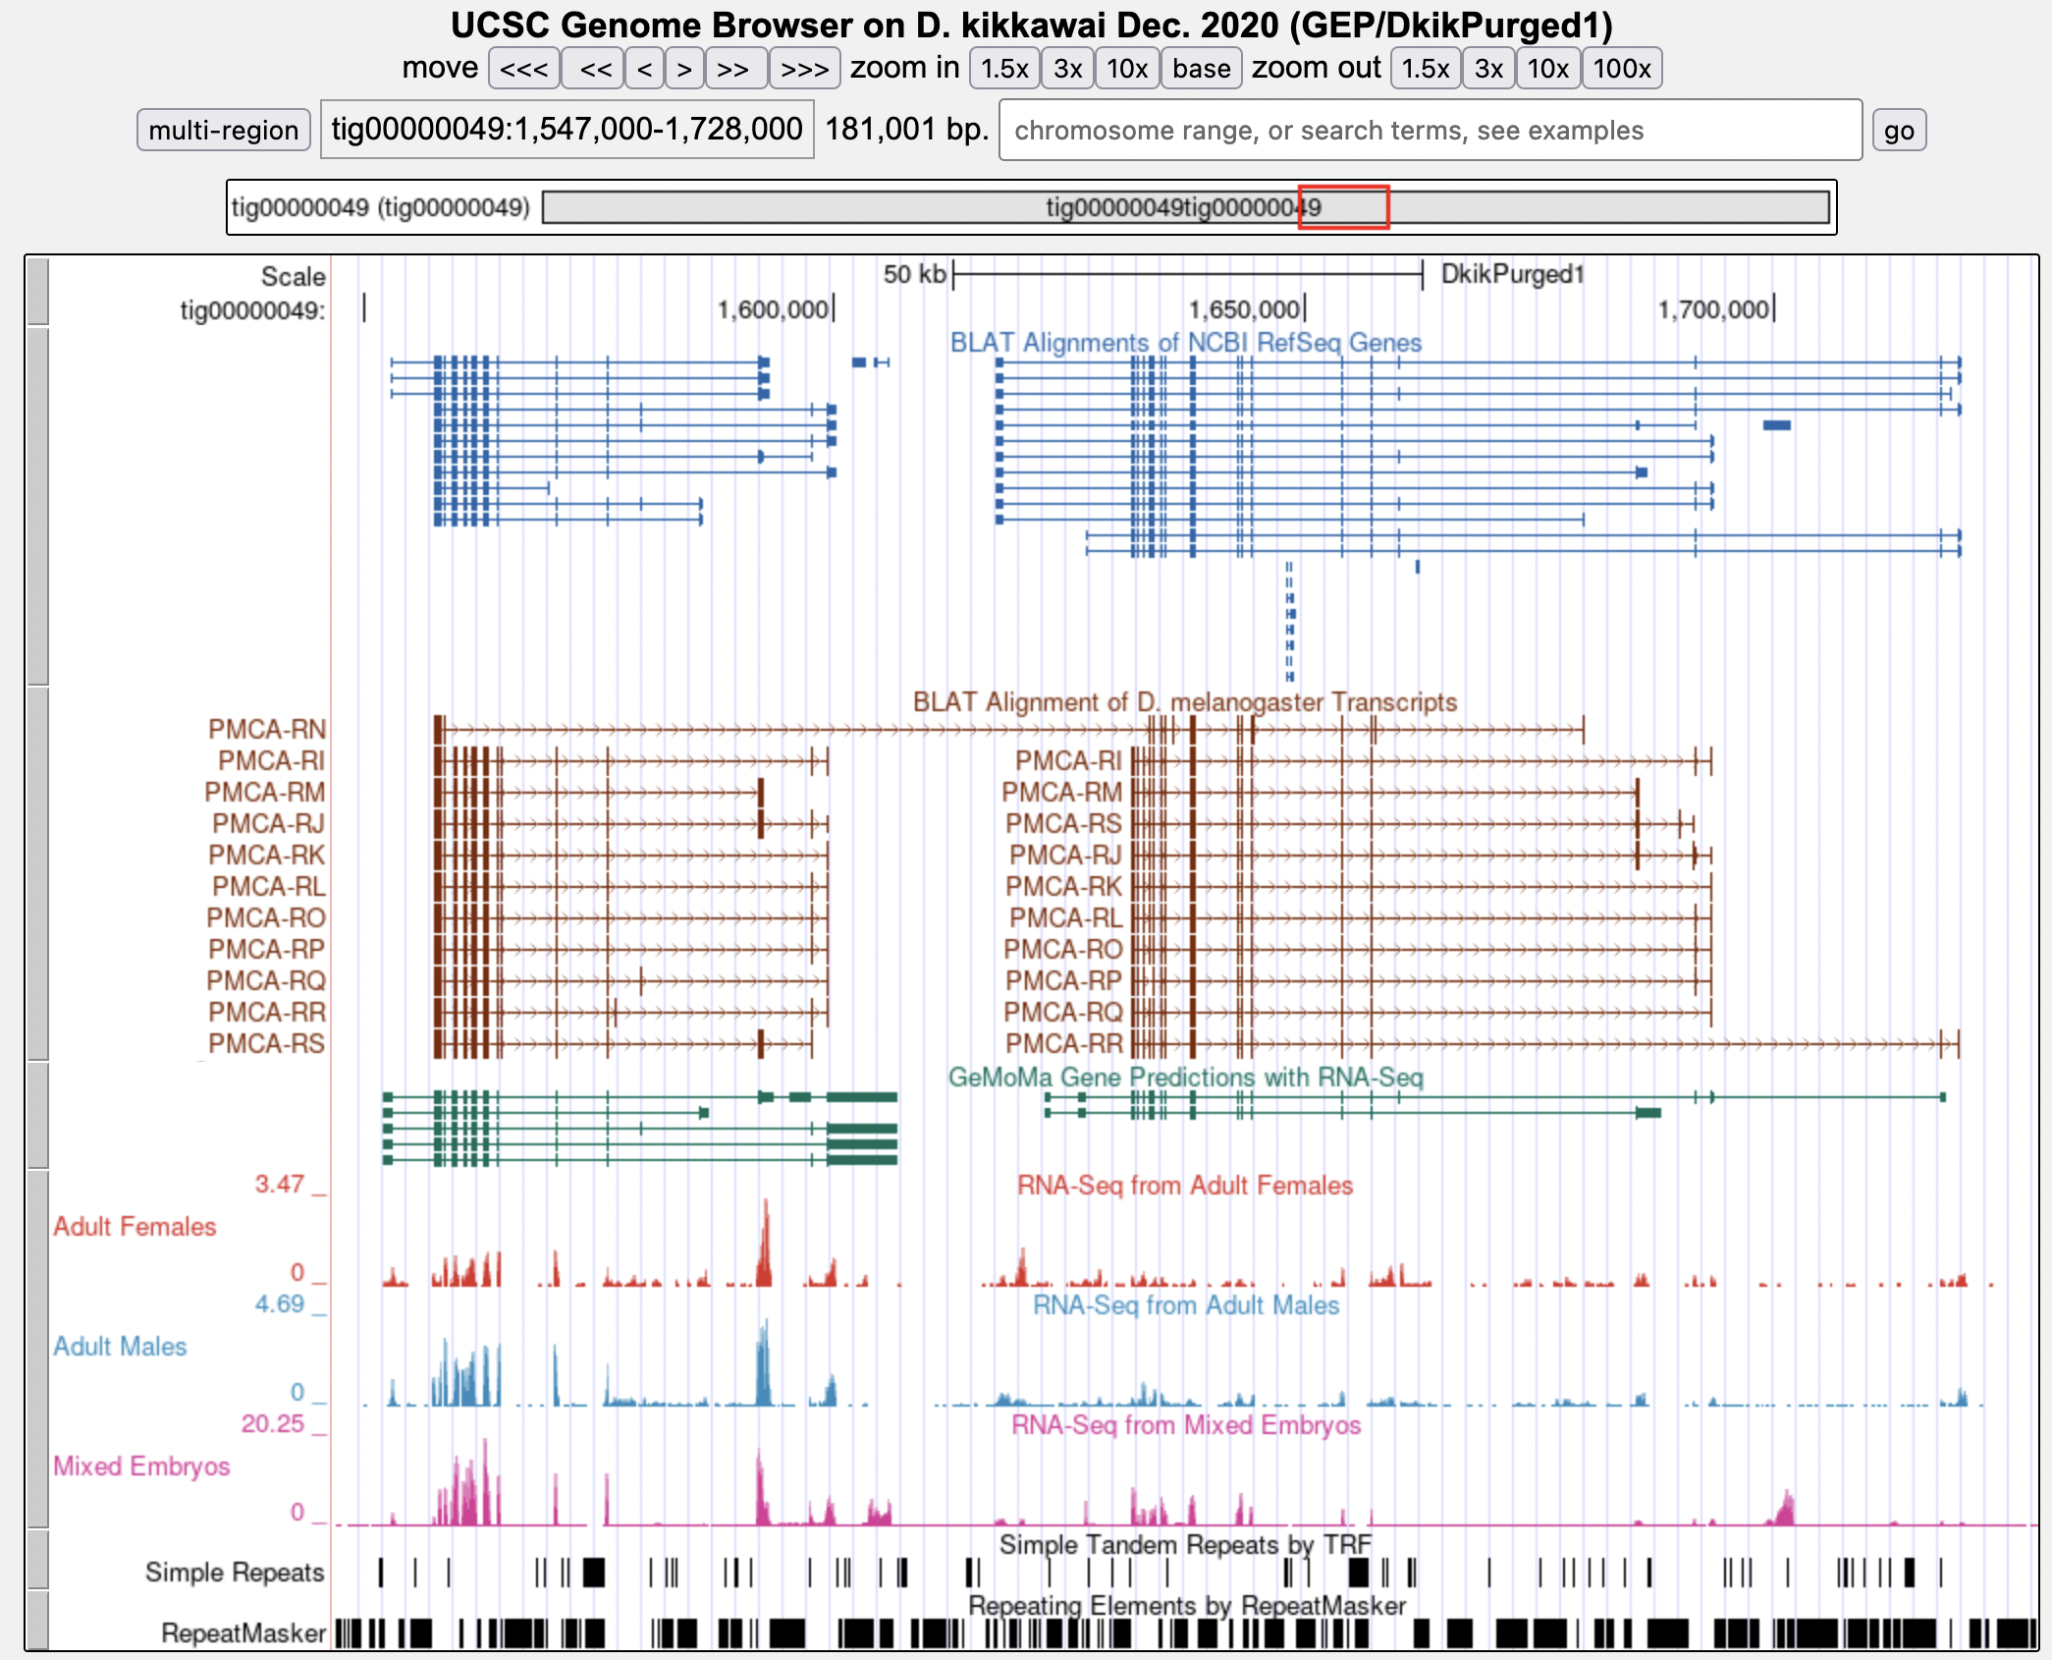
Novel paralog of PMCA in the D. kikkawai F Element scaffold tig00000049
PMCA
PMCA paralog
RefSeq Genes
D. mel Transcripts
Gene Predictions
RNA-Seq
Repeats
Chris Hemauer. Personal communication

Slide 8
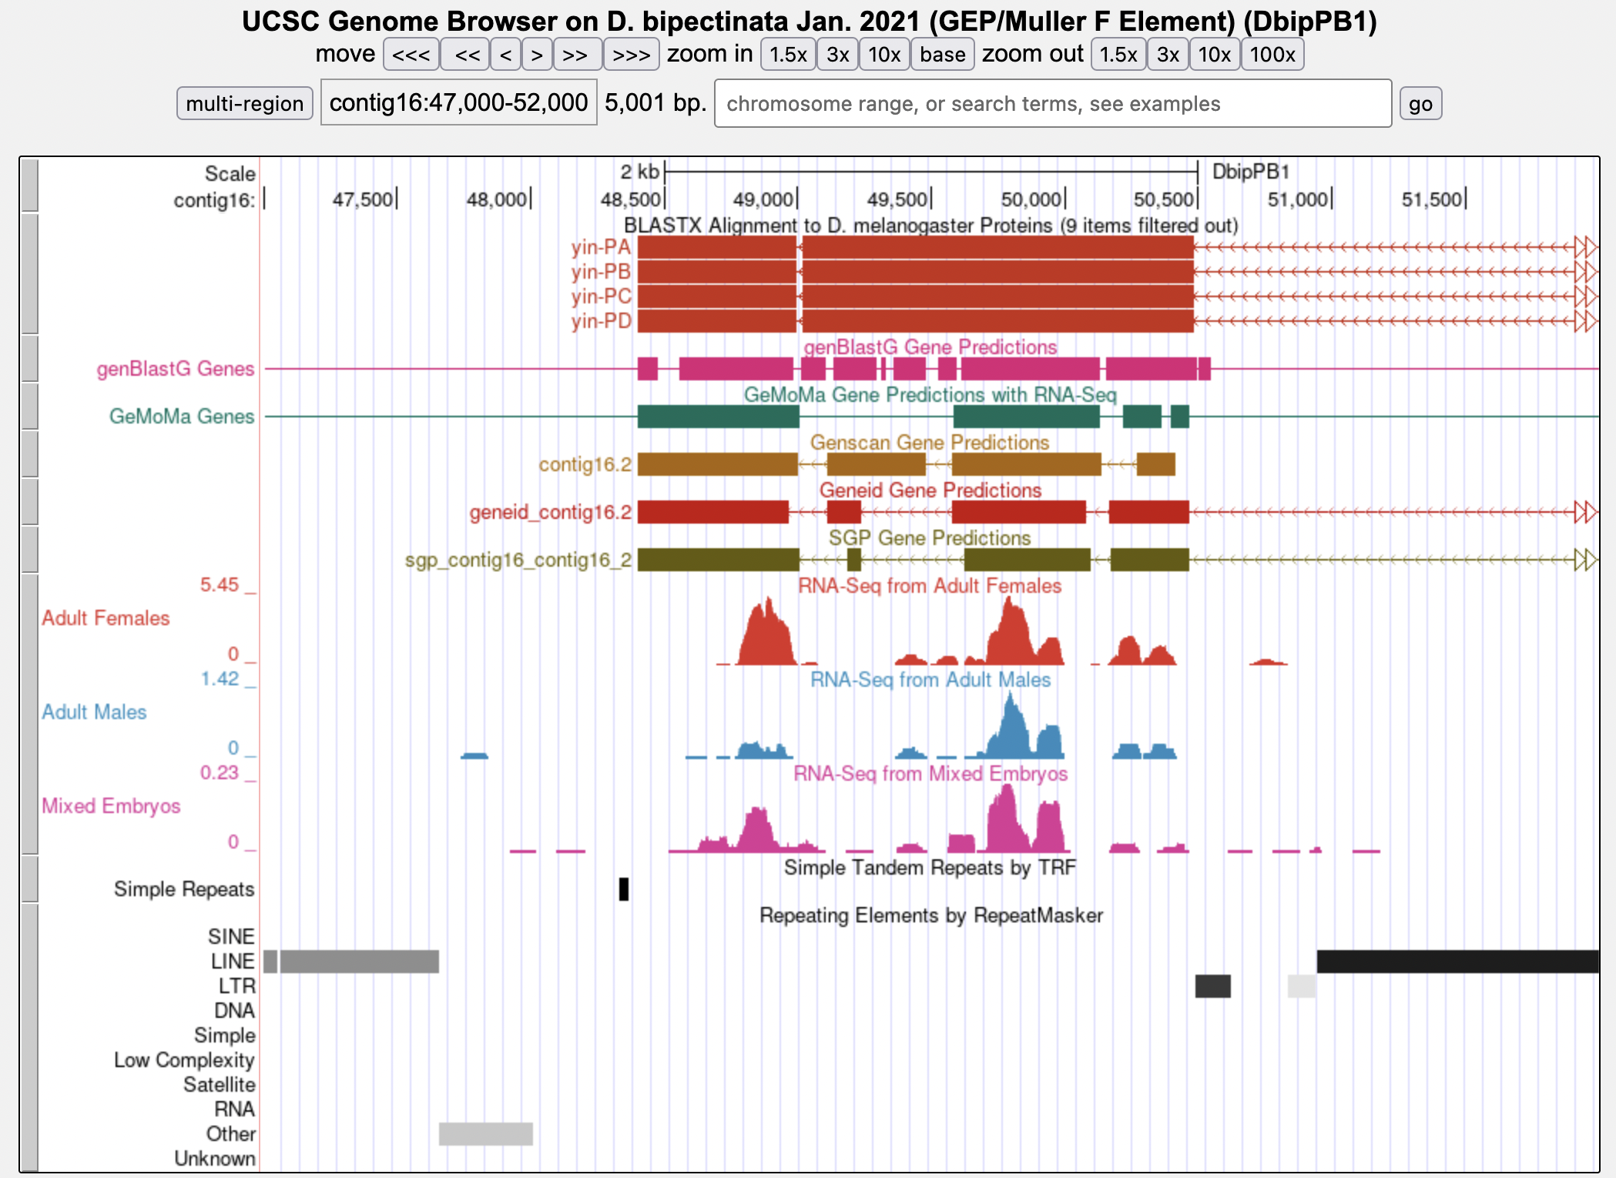
Region with similarity to yin in the D. bipectinata F Element project contig16
D. mel Proteins
Gene Predictions
RNA-Seq
Repeats
Loa-1_DBp
RTE-1_DBp
BEL-11_DBp-I
Helitron-N1_DBp
Similarity to yin
Ishtar Olaveja. Personal communication

Slide 9
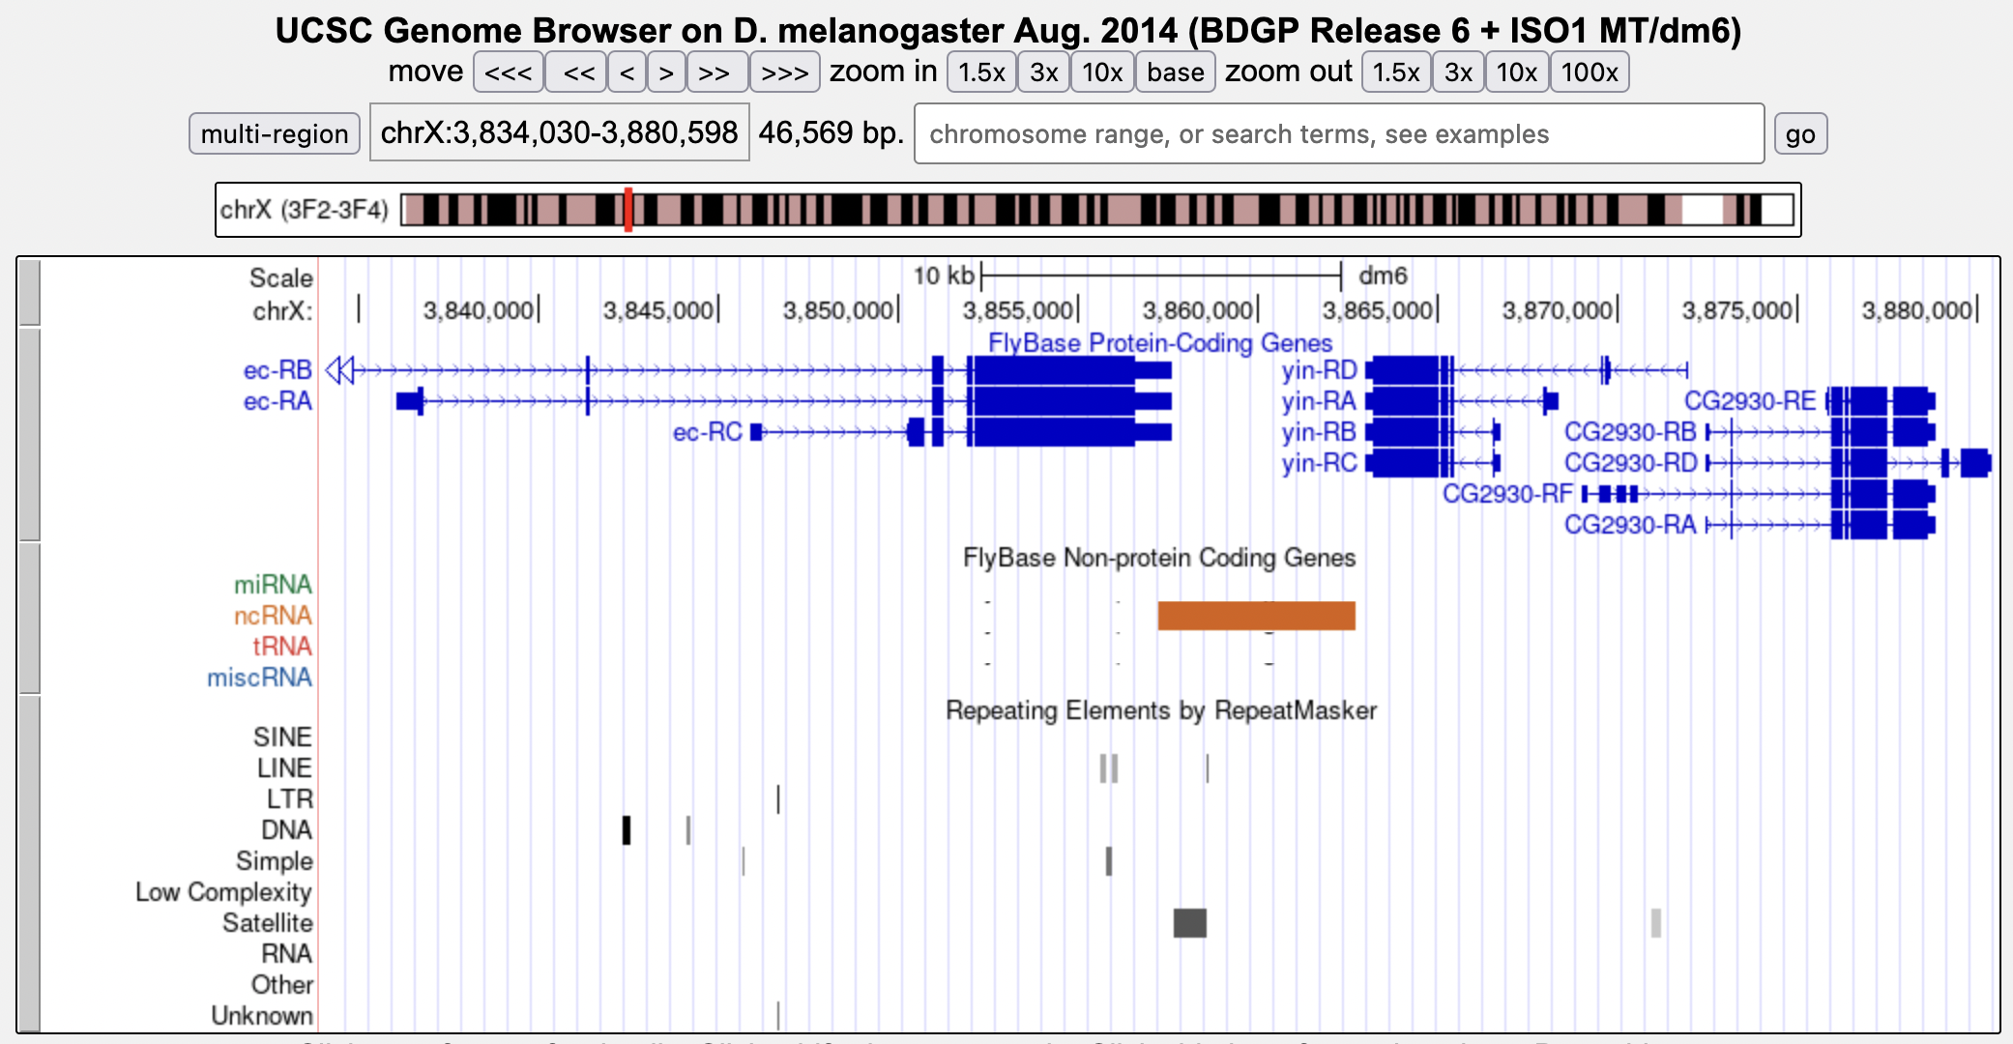
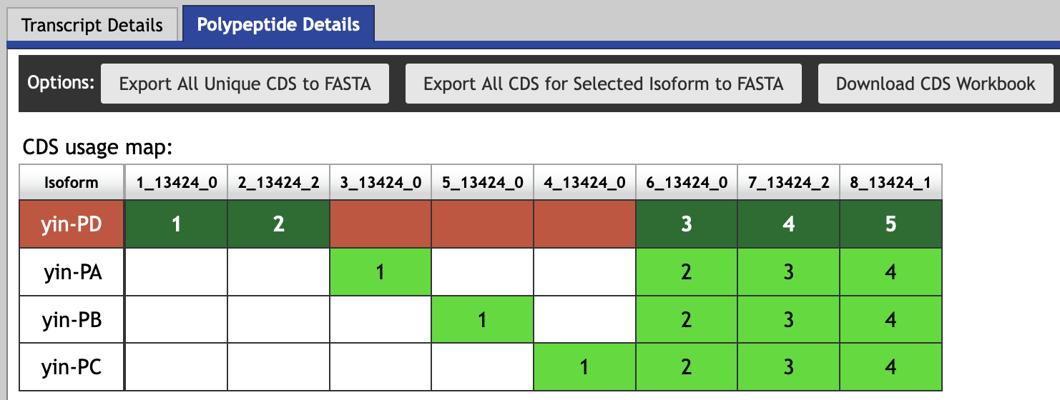
The D. melanogaster yin gene is located on the X chromosome
yin
Ishtar Olaveja. Personal communication

Slide 10
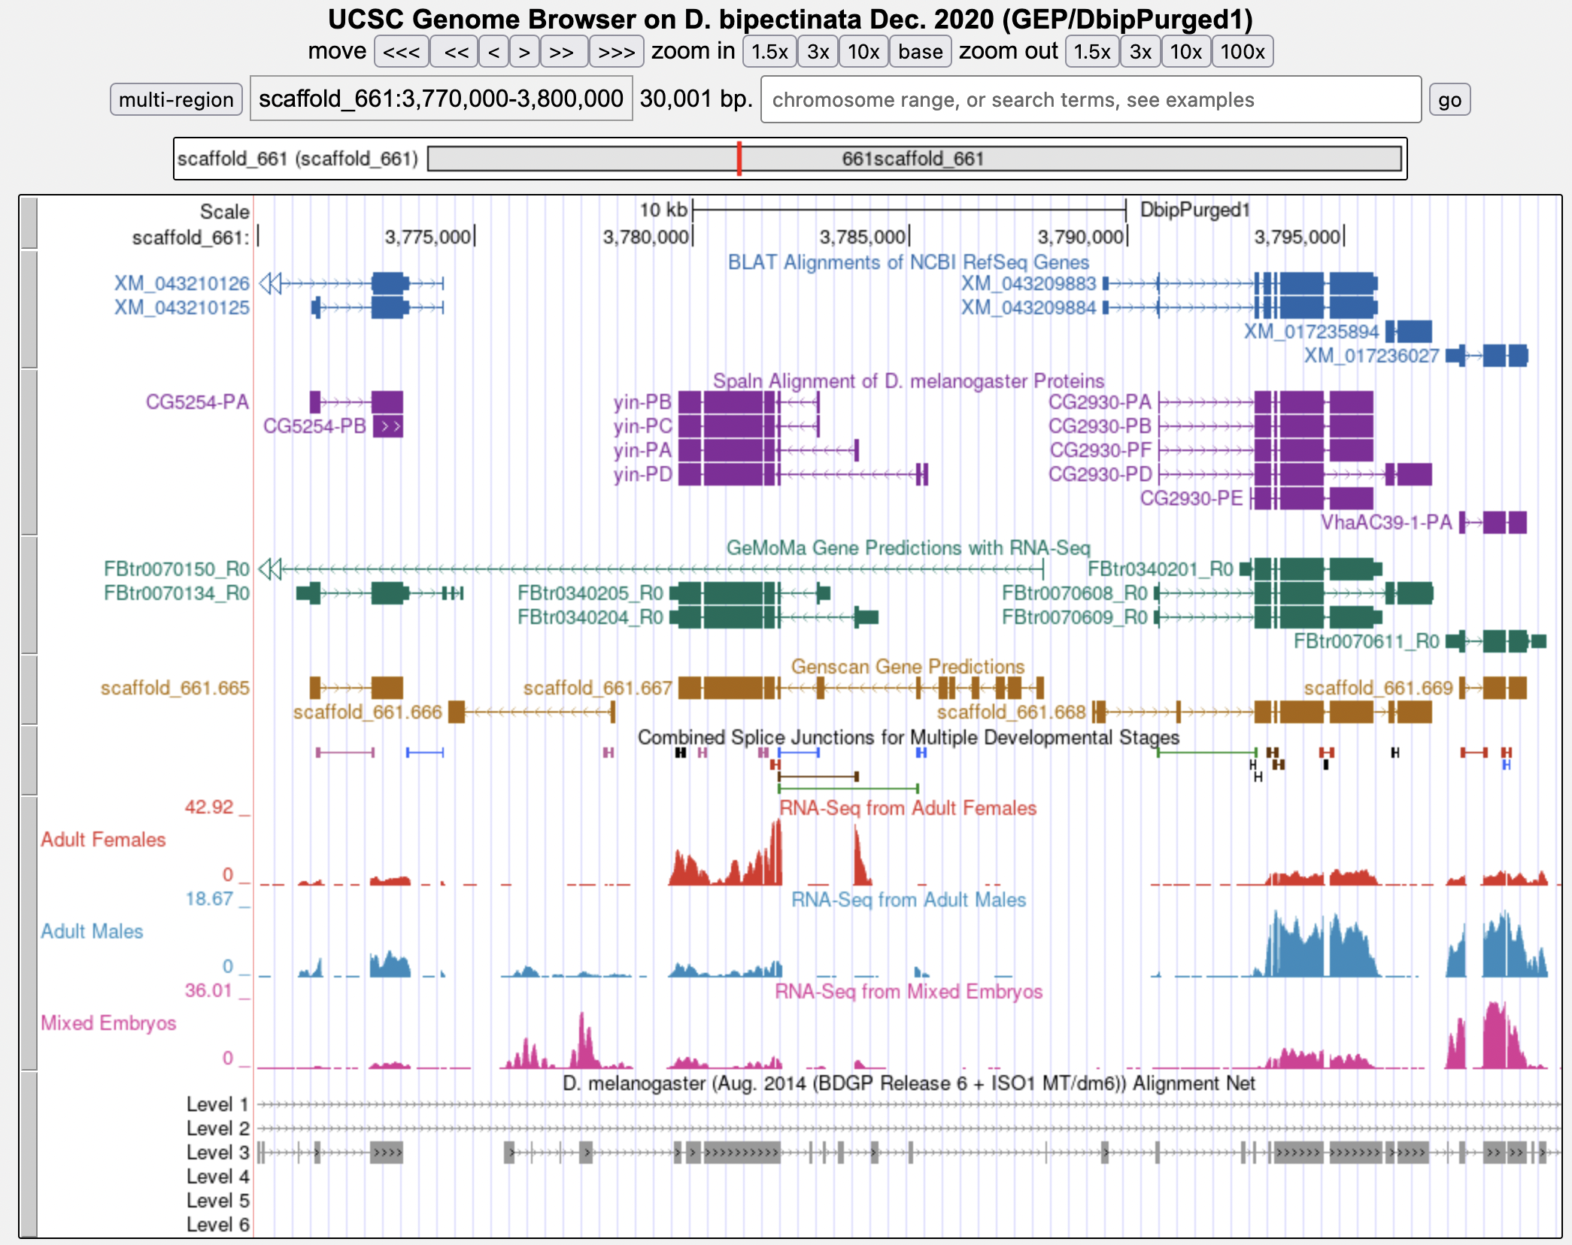
Putative ortholog of yin is placed at scaffold_661 in the D. bipectinata assembly
RefSeq Genes
yin
D. mel Proteins
Gene Predictions
RNA-Seq
Net Alignments
Similarity to D. melanogaster chrX
Ishtar Olaveja. Personal communication

Slide 11
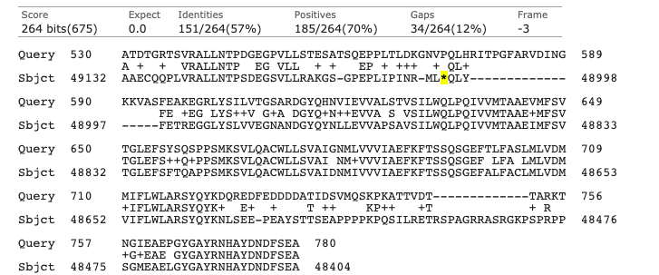
The tblastn alignment of yin-PD against contig16 include frame-shifts and in-frame stop codons
Query: yin-PD (780aa); Subject: contig16
Frame -1
Query: 364-528
Subject: 49599-49132
Query: 364-528
Subject: 49599-49132
Stop codons
Frame -3
Query: 530-780
Subject: 49132-48404
Query: 530-780
Subject: 49132-48404
Ishtar Olaveja. Personal communication

Slide 12
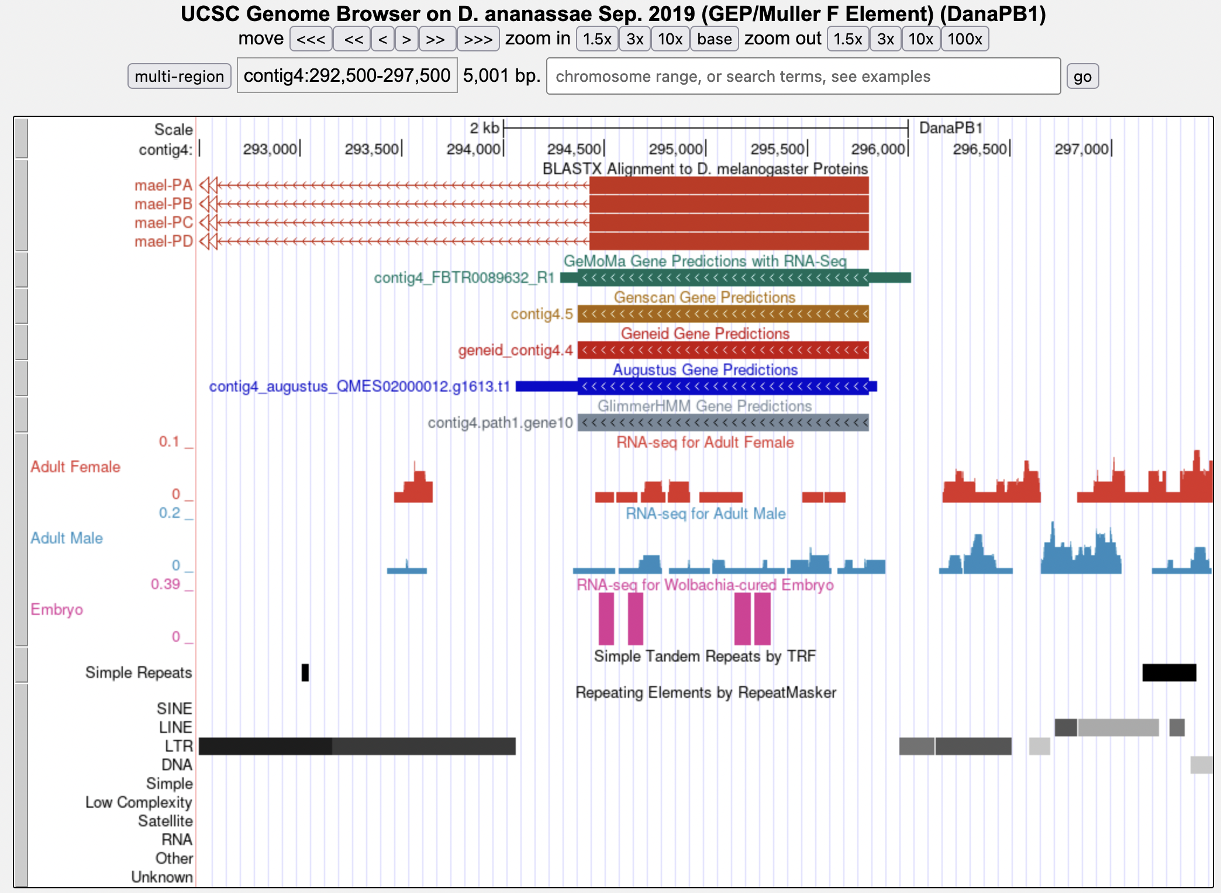
Analysis of a mael retrogene in the D. ananassae F Element project contig4
D. mel Proteins
Gene Predictions
RNA-Seq
Repeats
Gypsy-41_DAn-LTR
Gypsy-41_DAn-LTR
Meher Arora. Personal communication
Similarity to mael
Notes:
Retrogene: Protein-coding gene derived from the processed mRNA of another gene

Slide 13
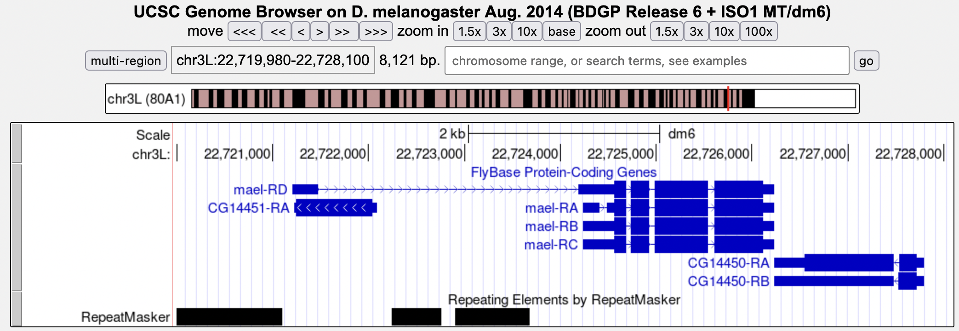
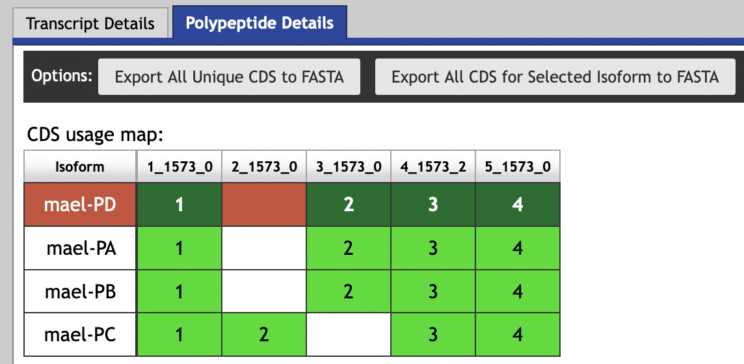
The D. melanogaster mael gene is located on the Muller D Element (chr3L)
mael
Meher Arora. Personal communication

Slide 14
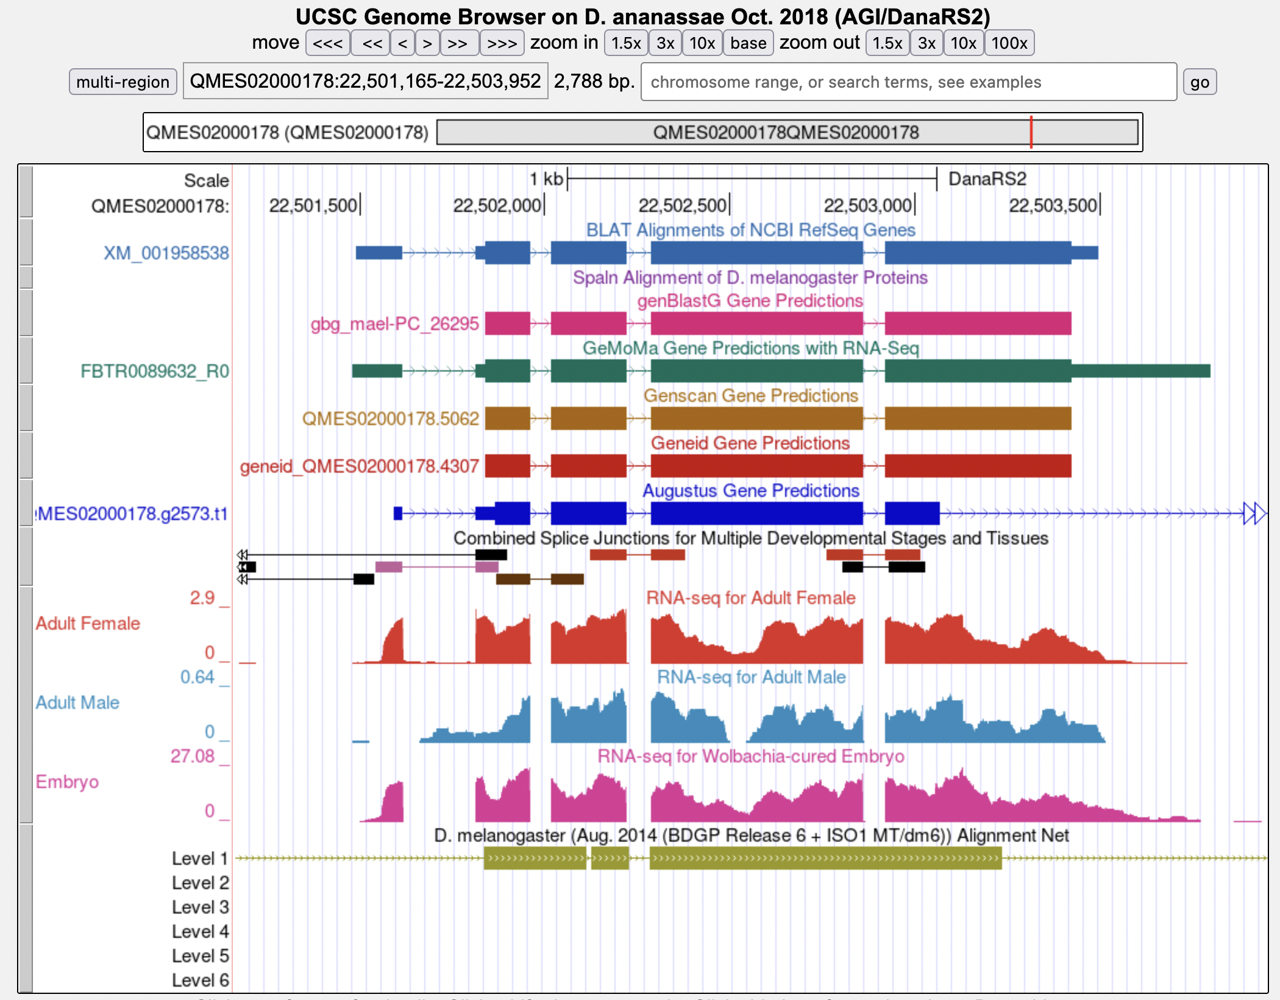
Putative ortholog of mael is placed at scaffold QMES02000178 in the D. ananassae assembly
mael
RefSeq Genes
Gene Predictions
RNA-Seq
Net Alignments
Similarity to D. melanogaster chr3L
Meher Arora. Personal communication

Slide 15
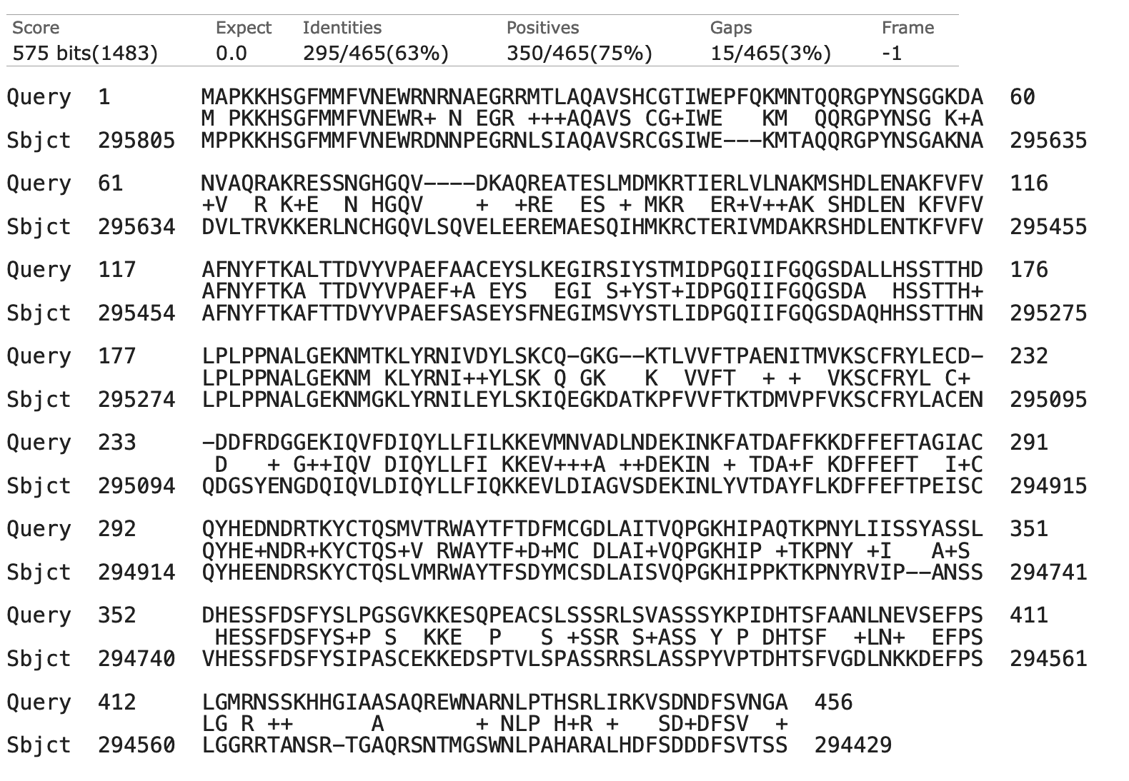
The tblastn alignment of mael-PC against contig4 shows one open reading frame
Query: mael-PC (462aa); Subject: contig4
Frame -1
Query:
1-456
Subject:
295805-294429
Meher Arora. Personal communication

Slide 16
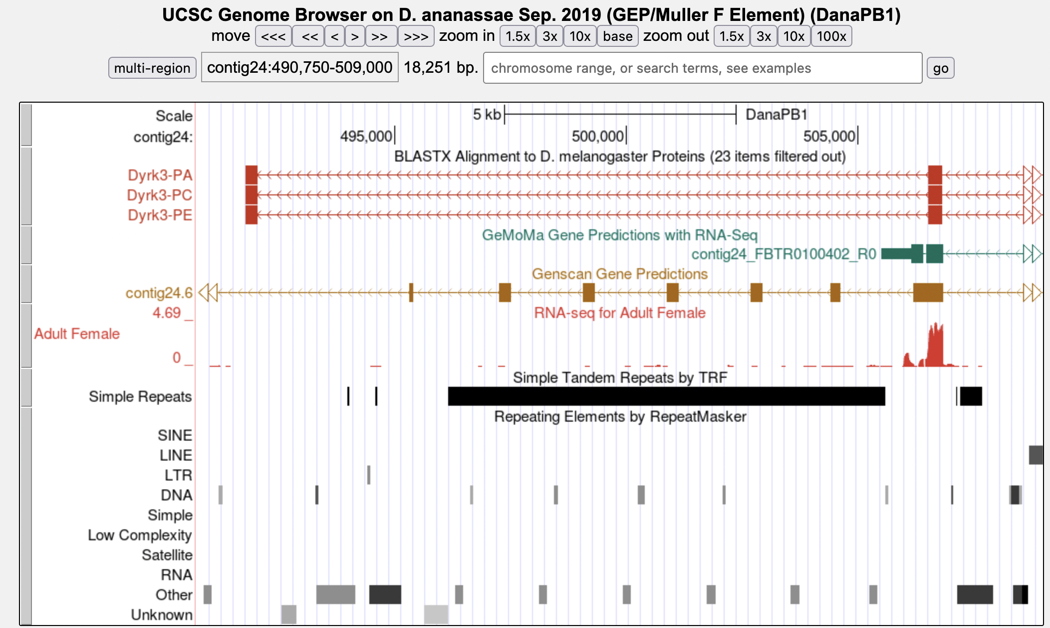
Partial duplication of Dyrk3 in the D. ananassae F Element project contig24
blastx match
5_2336_2
Meher Arora. Personal communication
Tandem repeats

Slide 17
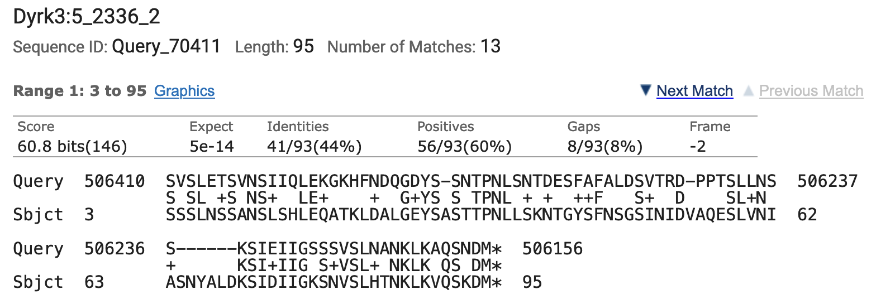
Multiple blastx matches to Dyrk3 CDS 5_2336_2 in the D. ananassae F Element contig24
Query: contig24; Subject: Dyrk3 CDS 5_2336_2 (95aa)
Query: 506410-506156
Subject: 3-95
E-value: 5e-14
Identities: 41/93 (44%)
Query: 502900-502646
Subject: 3-95
E-value: 5e-14
Identities: 41/93 (44%)
Meher Arora. Personal communication
Identical matches at two locations in contig24

Slide 18
Additional matches to CDS 5_2336_2 in contig24 contain in-frame stop codons
Query: contig24; Subject: Dyrk3 CDS 5_2336_2 (95aa)
Query: 501086-500853
Subject: 3-88
E-value: 4e-08
Identities: 32/86 (37%)
Stop codon
Query: 504576-504382
Subject: 16-88
E-value: 1e-04
Identities: 26/73 (36%)
Stop codon
Meher Arora. Personal communication

Slide 19
Region with multiple matches to CDS 5_2336_2 contain multiple copies of Helitron-N1 transposons
5_2336_2
Similarity to Helitron-N1 helitrons in D. ananassae or D. bipectinata
Meher Arora. Personal communication

Slide 20
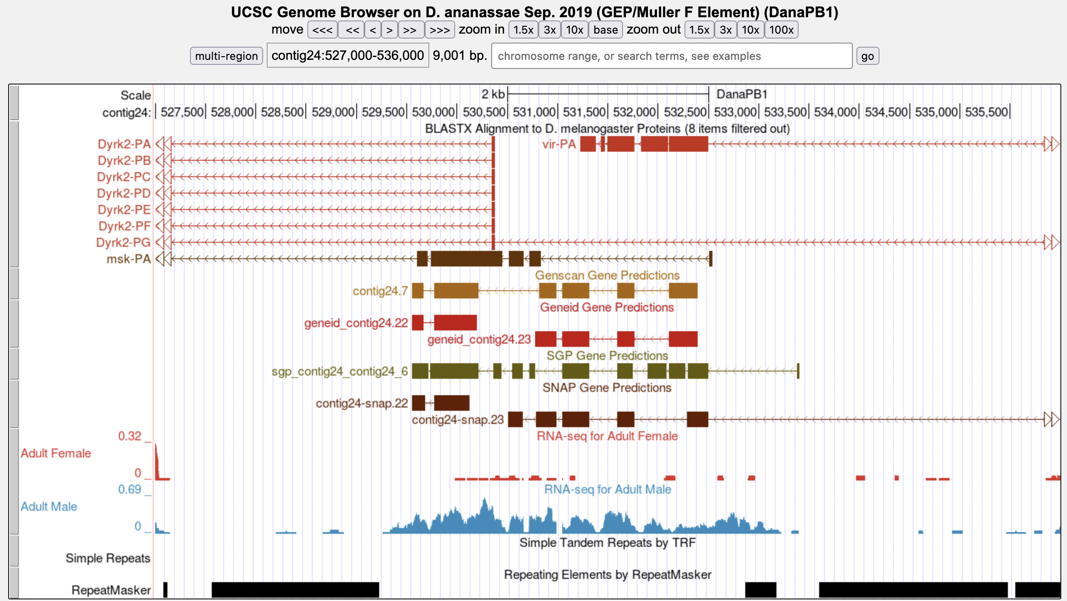
Region with similarity to msk and vir in the D. ananassae F Element project contig24
msk
vir
CR1-2_DAn
CR1-2_DAn
Ethan Cordes. Personal communication
Helitron-1_DEl

Slide 21
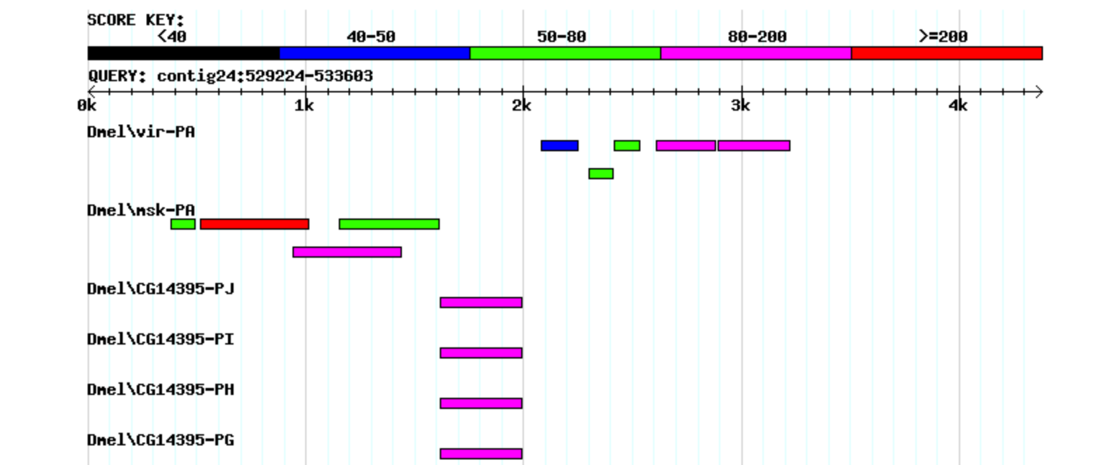
FlyBase blastx search shows three potential genes within this region of contig24
Query: contig24:529224-533603 (4380 nt)
Database: “Annotated proteins” in D. melanogaster
vir
msk
CG14395
msk
CG14395
vir
Ethan Cordes. Personal communication

Slide 22
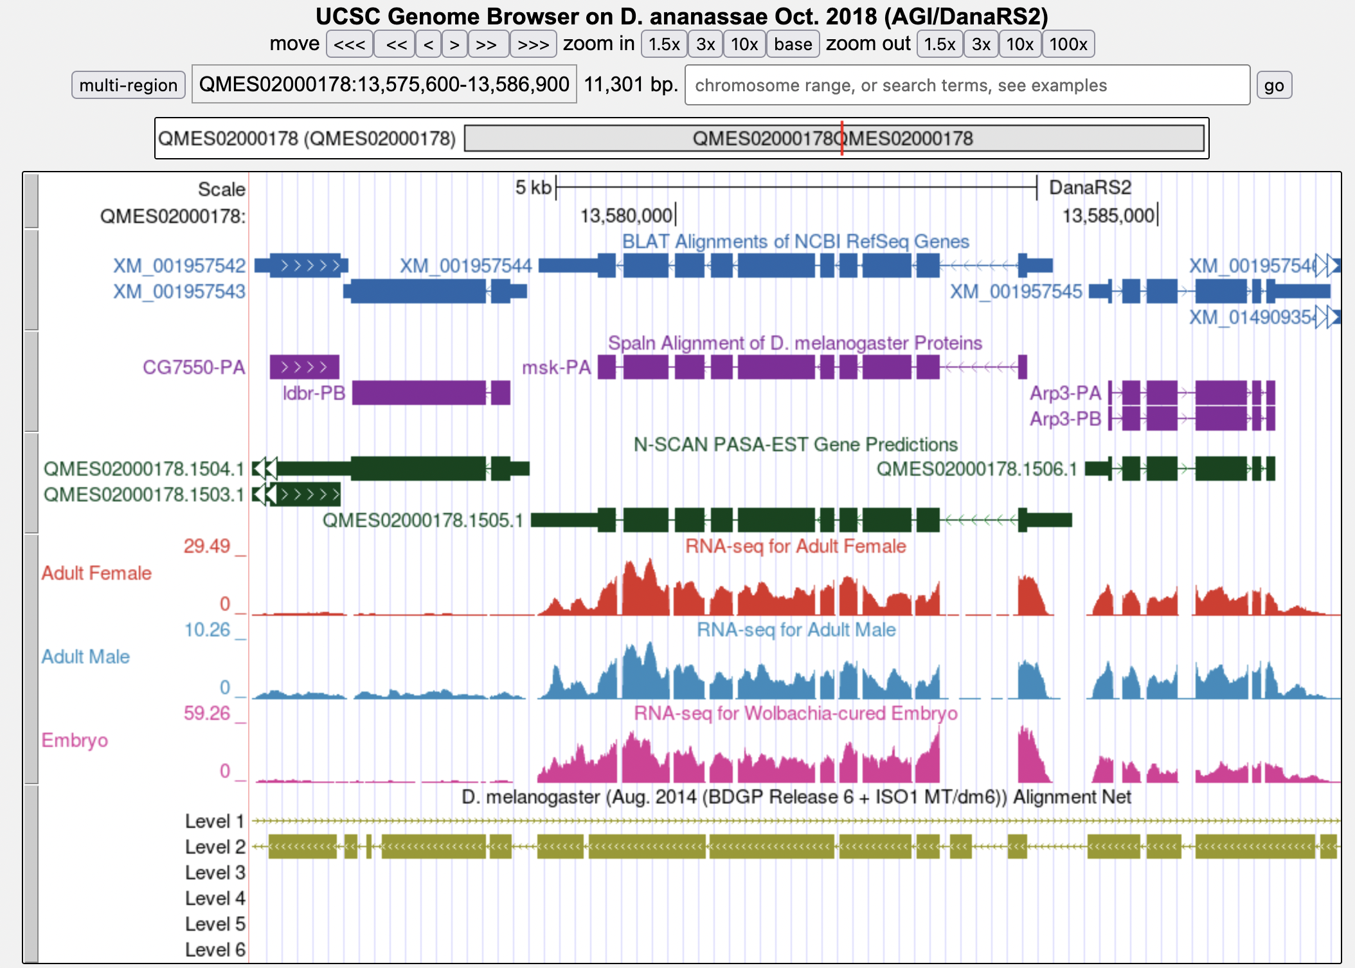
Putative ortholog of msk is placed at scaffold QMES02000178 in the D. ananassae assembly
msk
RefSeq Genes
D. mel Proteins
Gene Predictions
RNA-Seq
Net Alignments
Similarity to D. melanogaster chr3L
Ethan Cordes. Personal communication
Notes:
contig24: QMES02000202
msk is located on the Muller D Element (chr3L) in D. melanogaster

Slide 23
Frame shift and in-frame stop codon in the blastx alignments between the msk CDS 6_2200_2 and D. ananassae F Element contig24
Query: contig24; Subject: msk CDS 6_2200_2 (265aa)
Query: 530454-530380
Subject: 1-25
Frame -3
Stop codon
Frame -1
Query: 530384-530163
Subject: 29-98
Ethan Cordes. Personal communication

Slide 24
A previous study shows the transfer of mitochondrial DNA to the D. ananassae F Element
Sawamura K et al. Mol Phylogenet Evol. 2008 Sep;48(3):1087-93.

Slide 25
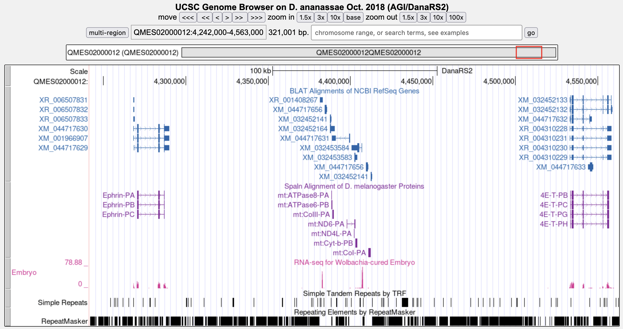
D. ananassae F Element scaffold QMES02000012 shows similarity to mitochondrial proteins
RefSeq Genes
D. mel Proteins
RNA-Seq
Repeats
Similarity to
mitochondrial proteins
Martin Dalling. Personal communication

Slide 26
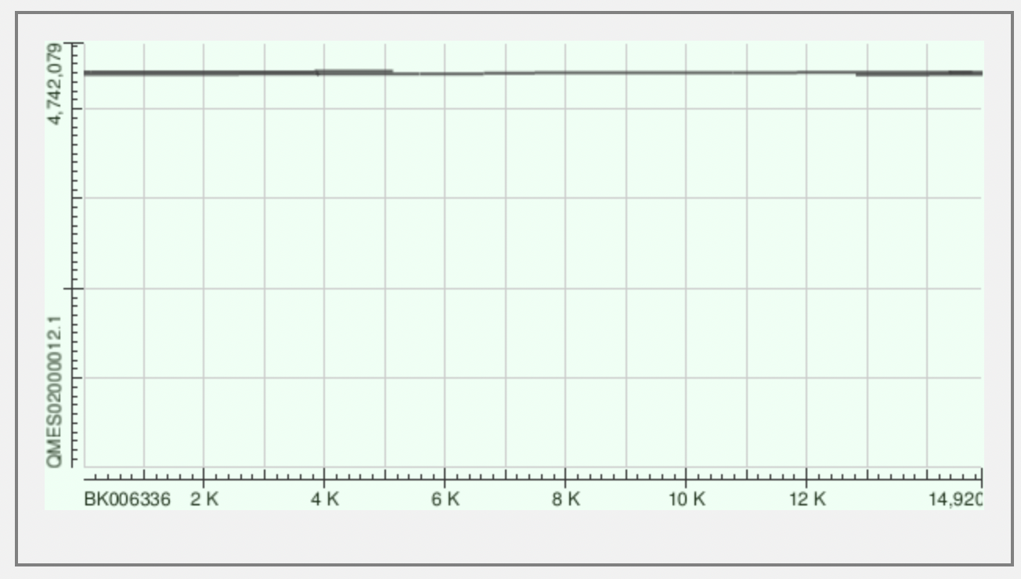
Insertion of the D. ananassae mitochondrial genome into the F Element scaffold QMES02000012
Alignment Scores
 | < 40
 | 40 - 50
 | 50 - 80
 | 80 - 200
 | ≥ 200
Query: QMES02000012
Martin Dalling.
Personal communication
Subject: D. ananassae mitochondrial genome
(BK006336; 14920 nt)
Notes:
Length of BK006336 = 14920 nt

Slide 27
Analysis summary of other genomic features on the expanded F Elements
Transposons are major contributors to the expansion of the Drosophila F Elements
Active transposons might introduce unusual genomic features to the F Element
Novel paralogs, pseudogenes, retrogenes, NUMTs, ...
Consult with F Element Project staff or the GEP Virtual TAs on the analysis of these genomic features
F Element Project Office Hours

Slide 28
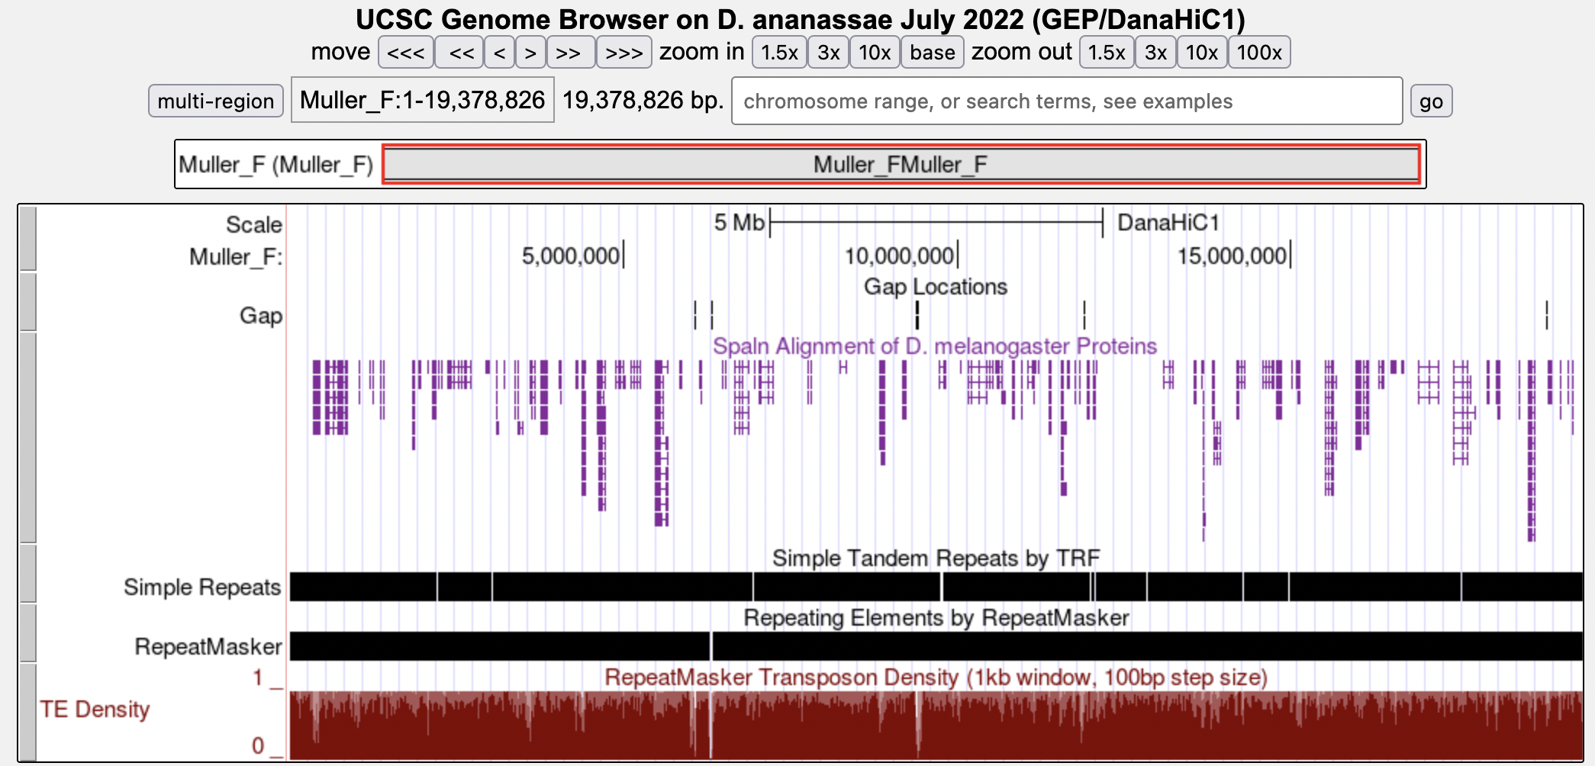
Questions?
ß
Gaps
D. mel Proteins
Repeats
TE Density
Transposon density = 78%
Nicole Torosin (Ellison Lab)

