Slide 1
Sequence Similarity
Introduction
Katie M. Sandlin, M.S.
Last Update: 10/26/2023

Slide 2

Bioinformatics
Involves the use of computers to store, retrieve, analyze, and compare the composition of biological molecules, specifically DNA and protein sequences
Notes:
Bioinformatics is a field of science that encompasses biology, chemistry, computer science, and mathematics

Slide 3
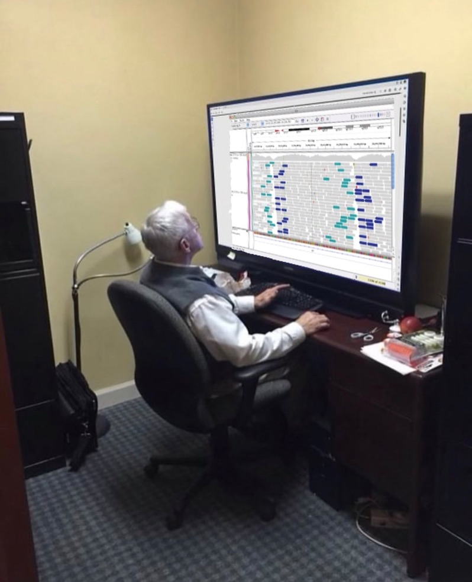
Bioinformatics
Bioinformatic tools allow scientists (including YOU!) to access the abundant genomic and protein sequences that are available in databases via the internet.
Photo: Huge monitor meme generator
Notes:
The ability to utilize these resources is of great importance for understanding genomic sequences (e.g., assigning probable functions to genes), identifying previously unknown microorganisms, investigating phylogenetic relationships (ancestry), and tracking disease outbreaks.

Slide 4
Overview
Many of the tools used in bioinformatics (e.g., BLAST) are based on the ability to search for either nucleotide or amino acid sequences that share some degree of similarity.
In this exercise, you will be introduced to the idea of similarity and the alignment of amino acid and nucleotide sequences.

Slide 5
Objectives
After completing this exercise, you should be able to:
  Define similarity in a non-biological and biological sense.
  Quantify the similarity between two sequences.
  Explain how a substitution matrix is used to quantify similarity.
  Calculate amino acid similarity scores using the BLOSUM 62 substitution matrix.
  Explain how BLAST detects similarity between two sequences.
  Explain how to use BLAST and interpret the alignments.

Slide 6
Q1. Investigation of Similarity
What do we mean when we describe two objects as being similar?
Notes:
Students should brainstorm and list ideas – no incorrect answers here

Slide 7
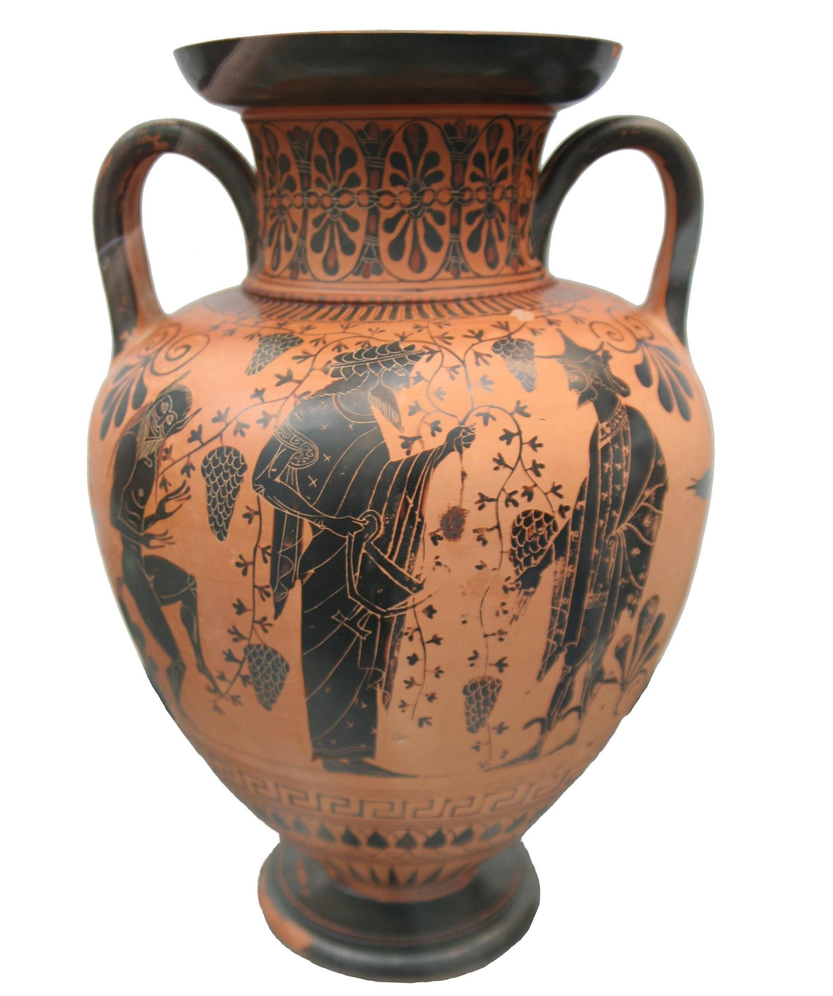

Q2. Investigation of Similarity
Are these objects similar? If so, in what way(s) would you consider them to be similar?
Matthias Kabel, CC BY-SA 3.0, via Wikimedia Commons.
Andre Karwath, CC BY-SA 2.5, via Wikimedia Commons.
Notes:
Students should be able to relate similar form to similar function.

Slide 8
Similarity
Defined as a resemblance or likeness; related in appearance or nature; or having a corresponding aspect or feature.
Notes:
This implication also holds true for biological sequences, which can be more easily quantified than anatomical or behavioral traits.

Slide 9
Similarity
In addition to obvious similarities among objects with the same function, written works can also display similarity.
  When two passages are highly similar, it is considered plagiarism. This implies a common origin to the passages (i.e., the second passage was copied from the first).

Slide 10
Q3. How could the similarity between these two passages be quantified? What must be done prior to determining the similarity of these passages?
Passage 1
Passage 2
One fish, two fish,
red fish, blue fish.
Black fish, blue fish,
old fish, new fish.
This one has a little star.
This one has a little car.
Say! what a lot of fish there are.
One sheep, two sheep,
black sheep, blue sheep.
Red sheep, blue sheep,
old sheep, new sheep.
This one has a little bell.
That one drank from a well.
Wow! what loads of sheep there are.
Dr. Seuss, 1960
Notes:
Idea here is to get the students to identify the need to “align” the passages and to use a simple scoring matrix (e.g., +1 for identical words, 0 if words are different but have the same meaning, -1 if the words are different and have different meaning; the higher the score, the more similar the passages).

Slide 11
Similarity in Bioinformatics
”Excessive" (i.e., more than one would expect based on chance) amount of physical similarity between two organisms implies a common ancestry
  This implication also holds true for biological sequences.
Shared ancestry between two organisms or sequences is known as homology.

Slide 12
Similarity in Bioinformatics
It is important to note that sequence similarity does not always ensure sequence homology, but that sequence similarity is an expected consequence of homology.

Slide 13
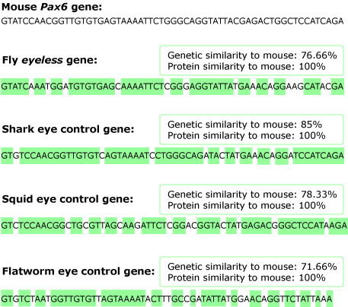
Homology
Similarities to the mouse gene (Pax6) are highlighted in green.
https://evolution.berkeley.edu/why-the-eye/homologous-genes/
Notes:
We’ve seen that Pax6 from vertebrates and eyeless from flies are remarkably similar in sequence and function, but what about our other visionaries — the squid and the flatworm? Despite the major differences in their eyes, they all have genes similar to Pax6. Here are corresponding sections of the Pax6-like eye-building genes for our visionaries. Similarities to the mouse gene are highlighted in green.
But why are these genes so similar when the animals from which they come, and the eyes that they develop, are so different? There are two basic evolutionary explanations for similarities: homology and analogy. Are these genes homologous (i.e., were they passed down from the common ancestor of all these different organisms) or analogous (i.e., did they all evolve independently through convergent evolution)?
Based on the observations that all these gene versions are remarkably similar in sequence, have related functions, and are incredibly widespread (animals all across the tree of life have them), scientists have concluded that they must be homologous and must have been inherited from the common ancestor of all these animals. It is just too unlikely that all these different animal lineages happened to independently evolve remarkably similar genes that do remarkably similar jobs. The most parsimonious explanation is that the gene evolved just once long ago and was then passed down to all these different modern animal lineages.

Slide 14
Identifying Similarity
Imagine that you have identified a new gene or protein. What questions might you be asking?
  What is the function of this protein?
  What type of protein is encoded by this gene?
A first step in answering these questions would likely include a search of nucleotide and/or protein databases for a known gene or protein that is similar to your recently identified sequence.

Slide 15
Identifying Similarity
A search of these databases is based on finding a sequence that can be aligned with your sequence of interest and then the similarity of the sequences can be calculated using a suitable scoring matrix.

Slide 16
Scoring Similarity
Several scoring matrices for amino acid sequence comparisons (e.g., BLOSUM, PAM) have been developed by scientists.
These matrices take into account the substitution of chemically and/or physically similar amino acids and the relative frequency of such substitutions in naturally occurring proteins.

Slide 17
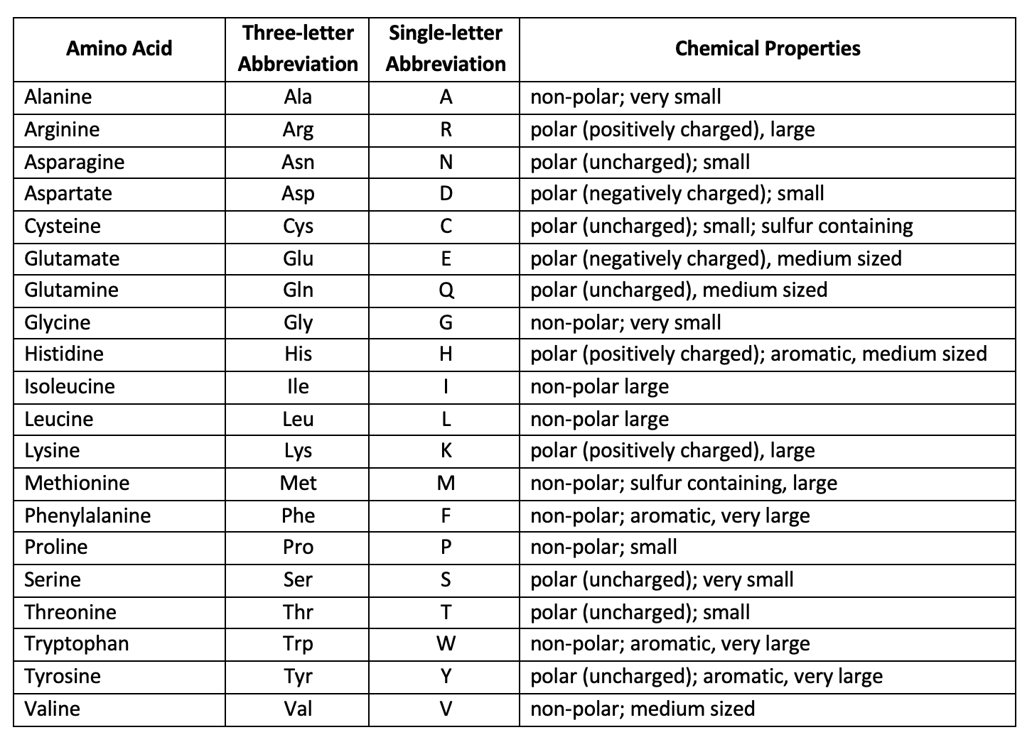
Notes:
The 20 commonly occurring amino acids are represented by a single letter or three letter abbreviations within the table and each possible substitution is given a numerical score that is associated with how similar or different the substituted amino acid properties are (Table 1).
Amino acid substitutions between residues that are similar in size and/or polarity are generally scored as positive values.
Chemically dissimilar substitutions are generally scored as negative in a substitution matrix.

Slide 18
Q4.
Considering amino acid residue chemical properties, explain why an Alanine substituted with a Serine is assigned a score of 1, while an Alanine substituted with a Tryptophan is assigned a score of -3 in the BLOSUM 62 substitution matrix.
Notes:
Amino acid substitutions between residues that are similar in size and/or polarity are generally scored as positive values.
Chemically dissimilar substitutions are generally scored as negative in a substitution matrix.

Slide 19
Scoring Similarity
How positive or negative a substitution score is depends on the relative similarity in residue chemical properties.
BLOSUM 62 is a commonly used substitution matrix.

Slide 20
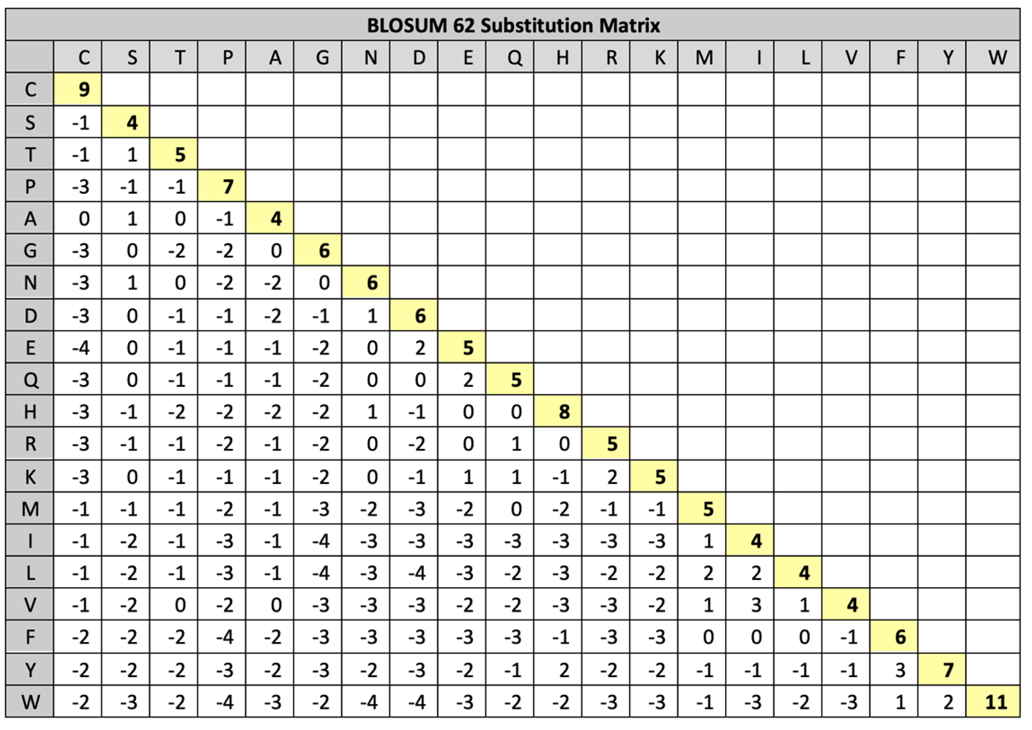
Query: MGDVEKGKKIFIMKC
Subject: MGEVERGKKLFIMKC
Notes:
To illustrate the use of this matrix, let’s say you have isolated a protein with the following amino acid sequence (this will be our query sequence): MGDVEKGKKIFIMKC. We want to compare the similarity of this sequence to the following sequence that was found in a database of protein sequences: MGEVERGKKLFIMKC. The arrangement of two sequences to identify regions of similarity is termed sequence alignment.
To do this, find the first amino acid of the query in the top row of the BLOSUM 62 matrix, then look for the first amino acid of the subject sequence (the sequence being compared to the query) in the left column of the matrix and locate the box at the intersection of these two amino acids in the table. The number that corresponds to this pairing is noted and added to the value for each of the subsequent pairings. For example, the first amino acid of each sequence is methionine (M) which scores 5 and the second amino acid of each sequence is glycine (G) which scores 6. The third amino acid of the query sequence is aspartate (D) but in the subject sequence it’s glutamate (E) which scores 2. Therefore, our total score thus far of 13.

Slide 21
What is the total similarity score for these two aligned sequences?
  Query: MGDVEKGKKIFIMKC
  Subject: MGEVERGKKLFIMKC
Notes:
5 6 2 4 5 2 6 5 5 2 6 4 5 5 9 = 71

Slide 22
Finish Questions 6-9
Read the text on pages 6-8

Slide 23
Query Word
Query Sequence: | R | P | P | E | G | L | F
Database Sequence: | D | P | P | E | G | V | V
Score: | -2 | 7 | 7 | 5 | 6 | 1 | -1
What’s our query word (i.e., scan for an exact match that is 3 amino acids long)?
Optimal Accumulated Score = 7 + 7 + 5 + 6 + 1 = 26
Notes:
PEG

Slide 24
Query Word
Query Sequence: | R | P | P | E | G | L | F
Database Sequence: | D | P | P | E | G | V | V
Score:
Score: | -2 | 7 | 7 | 5 | 6 | 1 | -1
7
5
6
Optimal Accumulated Score = 7 + 7 + 5 + 6 + 1 = 26
Notes:
extends in both directions until a negative substitution value is aligned on both sides

Slide 25
Query Word
Query Sequence: | R | P | P | E | G | L | F
Database Sequence: | D | P | P | E | G | V | V
Score: | -2 | 7 | 7 | 5 | 6 | 1 | -1
Optimal Accumulated Score = 7 + 7 + 5 + 6 + 1 = 26
Notes:
In the examples used above, the query and subject sequences were of the same length and had very few substitutions, making a direct comparison of the sequences easily accomplished. An alignment approach that attempts to align all residues between two sequences is termed a global alignment. In reality, when a newly identified amino acid sequence is used to query a database of amino acid sequences there will likely be considerable differences in the sequence length and/or in the number of amino acid substitutions, unless the protein is highly conserved. Local alignments can find sequence similarity between divergent sequences of different length, often using a subset of the query sequence. Thus, to find known sequences that are similar to the query sequence, the query sequence must be aligned with all possible sequences and similarity scores calculated.
Aligning a sequence against a database also allows the user to infer homology between the query and the output subject sequences, by considering statistical metrics associated with alignments. The Expect value (E value) is a statistic that represents the number of times that one can expect the alignment in question to randomly arise between the query and a given subject within the database. It is important to note that query length and database size will influence E values. Shorter query sequences and larger databases will make it more likely that the query will randomly align with a subject sequence in the database. Alignments with relatively small E values are more likely to be significant and biologically interesting. It is important to note that similarity between sequences does not imply homology, but similarity is an expected consequence of homology. Thus, if a query sequence returns a long list of small E value hits that correspond to a described gene in several different species, it is likely that you have identified a homologous sequence.
This alignment of amino acid or nucleotide sequences is based on pattern matching and is often carried out using a local alignment tool called Basic Local Alignment Search Tool (BLAST). In this process, a sequence is “cut” into short segments (query words) that can be used to locate a match(es) within the database. BLAST takes this approach, opposed to aligning the full-length query sequence, to reduce the amount of computational time needed to return database hits and avoid searching for possible alignments that are unlikely to be biologically relevant. The increase in speed imparted by this strategy comes with the tradeoff of being less accurate than other alignment algorithms, but the results are still quite robust. Once a match to this query word is found, further matching between the query and target sequences is determined (Altschul et al., 1990). BLAST relies on a user defined scoring threshold when choosing query words and extending alignments. In this activity, we will model a simplified version of BLAST through the use of a single query word followed by the construction of alignments started by an exact query word match that extends in both directions until a negative substitution value is aligned on both sides (Figure 2).

Slide 26
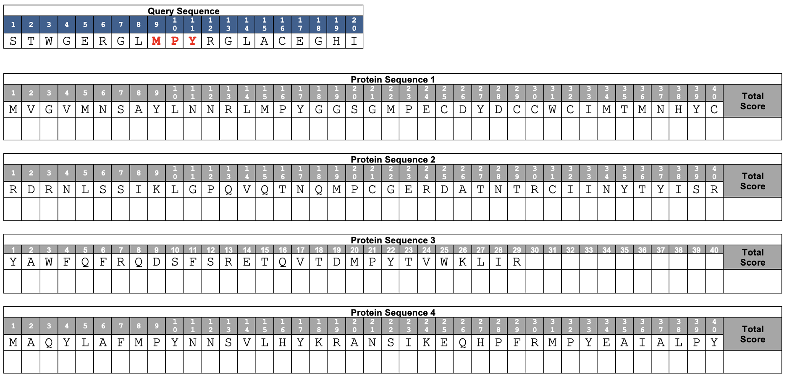
Calculate Total Score

Slide 27
Calculate Total Score
23
0
19
19
25
Notes:
The C-terminus of protein sequence 4 is most similar to the query using MPY as a query word (highest total score). This should get the students to think about how all possible query words should be used in order to answer this question during use of the real BLAST algorithm (not just exact matches in this simplified model). That being said, students may conclude that #2 is least similar due to lack of query word MPY.
The students are encouraged to use a simplified version of the BLAST algorithm in this exercise. In the real BLAST algorithm, negative substitution values may not terminate the extension process as long as the total alignment score is above a user defined value. Thus, this would influence the solution to this question.

Slide 28
Caveat
Negative substitution values may not terminate the extension process as long as the total alignment score is above a user defined value.
  We must also deal with gaps in the alignment. For more information on this see Introduction to Dynamic Programming.

Slide 29
Basic Local Alignment Search Tool (BLAST)
BLAST finds regions of local similarity between nucleotide or protein sequences
  by comparing nucleotide or protein sequences to sequence databases (or to an individual nucleotide or protein sequence)
  calculates the statistical significance of each match
Notes:
The statistical values we will focus on is the E Value. The Expect value (E value) is a statistic that represents the number of times that one can expect the alignment in question to randomly arise between the query and a given subject within the database. It is important to note that query length and database size will influence E values. Shorter query sequences and larger databases will make it more likely that the query will randomly align with a subject sequence in the database. Alignments with relatively small E values are more likely to be significant and biologically interesting. It is important to note that similarity between sequences does not imply homology, but similarity is an expected consequence of homology. Thus, if a query sequence returns a long list of small E value hits that correspond to a described gene in several different species, it is likely that you have identified a homologous sequence.

Slide 30
Exercise 1
Complete the Computational Procedure for the Protein BLAST.
Answer Q10-12.

Slide 31
Q11.
What was the query for this search?
What species database did you search for a hit to the query?

Slide 32
Q12.
If we were to compare the nucleotide sequences for the gene encoding this protein between humans and chimps, do you think they would be identical? Explain.
Notes:
It is likely that the nucleotide sequences encoding H4 are not identical even though their protein sequence is identical.
Students should review and discuss codon degeneracy. It may help to prompt students to discuss the genetic code and why the genetic code is considered redundant.
The instructor may want to have an image of the genetic codon table available to review with students that there are 64 possible combinations of RNA nucleotides, but only 20 commonly occurring amino acids (includes 3 Stop codons).

Slide 33
Exercise 2
Complete the Computational Procedure for the Nucleotide BLAST.
Answer Q13-15.

