Slide 1
Gene Finding in Chimpanzee
Evidence-based improvement of ab initio gene predictions
Last Update: 08/2021
Chris Shaffer 06/2009
Notes:
Last Updated: 08/11/2021

Slide 2
Chimp Analysis
Prerequisites (BLAST exercises):
Detecting and Interpreting Genetic Homology
Using mRNA and EST Evidence in Annotation
Learning objectives:
Exposure to mammalian genomes
Practice computational and cognitive skills
Two parts:
BAC analysis — in class worksheet
Chimp chunks — selected regions of the chimp genome are annotated by groups of 2–3 students; ends with paper and presentation

Slide 3
Agenda
Abridged version of Bio 4342 lecture (next 5 slides)
Work together on one chimp feature from “BAC analysis”
Optional work on chimp chunk individually with help from TA’s

Slide 4
Basic Strategy for Annotation
Use ab initio prediction to focus attention on genomic features (areas) of interest
80% failure rate; where are the mistakes?
Add as much other evidence as you can to refine the gene model and support your conclusion
What other evidence is there?
Basic gene structure
Motif information
BLAST homologies: nr, protein, ESTs
Other species or other proteins

Slide 5
Chimpanzee Annotation
1. Basic gene structure
Only ~15% of known mammalian genes have one exon
Many pseudogenes are mRNAs that have retrotransposed back into the genome; many of these will appear as a single exon genes
Increase vigilance for signs of a pseudogene when considering any single exon gene
Alternatively, there may be missing exons

Slide 6
Chimpanzee Annotation
2. Motif information
Genscan uses statistical methods to predict genes, will tag all apparent ORFs of sufficient length
Since genomes are very large, statistical methods will give some false positives
Sequence looks like a gene simply by chance
If the predicted gene has protein motifs found in other proteins, it is much less likely to be a false positive and more likely to be a real gene or a real pseudogene

Slide 7
Chimpanzee Annotation
3. BLAST homology: nr, protein, EST
Homology to known proteins argues against false positive
Mammals have many gene families and many pseudogenes
Both can show high sequence similarity to your predicted gene
Consider length and percent identity when examining alignments
Human vs. chimp orthologs should differ by <1%
Most paralogs or homologs will differ by more than this
Without good EST or RNA-Seq evidence you can never be sure; make your best guess and be able to defend it

Slide 8
Chimpanzee Annotation
4. Other species or other proteins
For any similarity hit, look for even better hits elsewhere in the genome
Paralogs and pseudogenes will look similar but will usually have an even better hit somewhere else
If you are convinced you have a gene and it is a member of a multi-gene family, be sure to pick the right ortholog
Look at synteny with properly distant species (mouse or rat)
Evidence for a transposition suggests a pseudogene

Slide 9
Chimp BAC Analysis
Worksheet in your folder, follow along, ask for help
Genscan was run on the repeat-masked BAC using the vertebrate parameter set (GENSCAN_ChimpBAC.html)
Genscan is a good ab initio gene finder
Predicts 8 genes within this BAC
By default, Genscan also predicts promoter and poly-A sites; however, these are generally unreliable
Output consists of map, summary table, peptide and coding sequences of the predicted genes

Slide 10
Chimp BAC Analysis
Analysis of Gene 1 (423 coding bases):
Use the predicted peptide sequence to evaluate the validity of Genscan prediction
blastp of predicted peptide against the nr database
Typically uses the NCBI BLAST page:
https://blast.ncbi.nlm.nih.gov/Blast.cgi
Click on the “Protein BLAST” image
Select the “blastp” algorithm
Search against the nr database
For the purpose of this tutorial, open blastpGene1.txt

Slide 11
Interpreting blastp Output
Many significant hits to the nr database that cover the entire length of the predicted protein
Do not rely on hits that have accession numbers starting with XP_
XP_ indicates RefSeq without experimental confirmation
NP_ indicates RefSeq that has been validated by the NCBI staff
Click on the “Description” for the best curated RefSeq hit in the blastp output (NP_001288157.1)
Indicates hit to human HMGB3 protein

Slide 12
Investigating HMGB3 Alignment
The full HMGB3 protein has length of 200 aa
However, our predicted peptide only has 140 aa
Possible explanations:
Genscan mispredicted the gene
Missed part of the real chimp protein
Genscan predicted the gene correctly
Pseudogene that has acquired an in-frame stop codon
Functional protein in chimp that lacks one or more functional domains when compared to the human version
Best Source: further evidence from the human genome

Slide 13
Analysis Using the UCSC Genome Browser
Go back to Genscan output page and copy the first predicted coding sequence
Navigate to the UCSC Genome Browser at https://genome.ucsc.edu
Click on the “BLAT” link (under “Our tools”)
Select the “Human” genome
Select the “Mar. 2006 (NCBI36/hg18)” assembly
Paste the coding sequence into the text box
Click “Submit”

Slide 14
Human BLAT Results
Predicted sequence matches to many places in the human genome
Top hit shows sequence identity of 99.1% between our sequence and the human sequence
Next best match has identity of 93.6%, below what we expect for human / chimp orthologs (98.5% identical)
Click on “browser” for the top hit (on chromosome 7)
The genome browser for this region in human chromosome 7 should now appear

Slide 15
Human UCSC Genome Browser
Zoom out 3x to get a broader view
There are no known genes in this region
Only evidence is from hypothetical genes predicted by SGP and Genscan
SGP predicted a larger gene with two exons
There are also no known human mRNAs or human ESTs in the aligned region
However, there are ESTs from other organisms

Slide 16
Investigate Partial Match
Go to GenBank record for the human HMGB3 protein (using the BLAST result)
Click on the “FASTA” link to obtain the sequence
Go back to the BLAT search page to use this sequence to search the human genome assembly
Mar. 2006 (NCBI36/hg18)

Slide 17
BLAT Search of Human HMGB3
Notice the match to part of human chromosome 7 we observed previously is only the 7th best match
Identity of 88.8%
Consistent with one of our hypotheses that our predicted protein is a paralog
Click on “browser” to see corresponding sequence on human chromosome 7
BLAT results overlap Genscan prediction but extend both ends
Why would Genscan predict a shorter gene?

Slide 18
Examining Alignment
Now we need to examine the alignment:
Go back to previous page and click on “details”
The alignment looks good except for a few changes
However, when examining some of the unmatched (black) regions, notice there is a “TAG” — a stop codon
Examine the side-by-side alignment to confirm that the “TAG” sequence is an in-frame stop codon on human chromosome 7
This in-frame stop codon caused Genscan to predict a shorter gene

Slide 19
Confirming Pseudogene
Side-by-side alignment color scheme
Lines = match
Green = similar amino acids
Red = dissimilar amino acids
We noticed a red “X” (stop codon) aligning to a “Y” (tyrosine) in the human sequence

Slide 20
Confirming Pseudogene
Alignment after stop codon showed no deterioration in similarity suggest our prediction is a recently retrotransposed pseudogene
To confirm hypothesis, go back to BLAT results and get the top hit (100% identity on chromosome X)
The real HMGB3 gene in human has four coding exons!

Slide 21
Conclusions
Based on evidence accumulated:
As a cDNA, the four-exon HMGB3 gene was retrotransposed
It then acquired a stop codon mutation prior to the split of the chimpanzee and human lineages
The retrotransposition event is relatively recent
Pseudogene still retains 88.8% sequence identity to the source protein

Slide 22
Questions?

Slide 24
ab initio Gene Finders
Examples:
Glimmer for prokaryotic gene predictions
(S. Salzberg, A. Delcher, S. Kasif, and O. White 1998)
Genscan for eukaryotic gene predictions
(Burge and Karlin 1997)
We will use Genscan for our chimpanzee and Drosophila annotations
Notes:
Salzberg SL, Delcher AL, Kasif S, White O. Microbial gene identification using interpolated Markov models. Nucleic Acids Res. 1998 Jan 15;26(2):544-8. doi: 10.1093/nar/26.2.544.
Burge C, Karlin S. Prediction of complete gene structures in human genomic DNA. J Mol Biol. 1997 Apr 25;268(1):78-94. doi: 10.1006/jmbi.1997.0951.

Slide 25
Genscan Gene Model
Genscan considers the following:
Promoter signals
Polyadenylation signals
Splice signals
Probability of coding and non-coding DNA
Gene, exon and intron length
Chris Burge and Samuel Karlin, Prediction of Complete Gene Structures in Human Genomic DNA, JMB. (1997) 268, 78-94

Slide 26
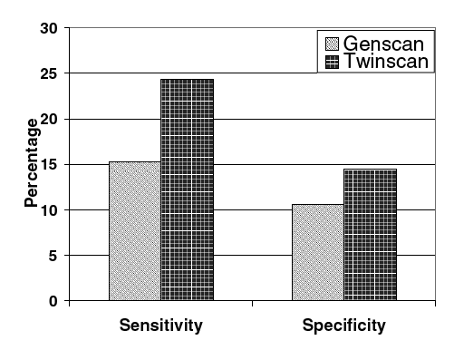
How to Improve Predictions?
New gene finders use additional evidence to generate better predictions:
Twinscan extends model in Genscan by using homology between two related species
Separate model used for exons, introns, splice sites, UTR’s
Ian Korf, et al. Integrating genomic homology into gene structure prediction. Bioinformatics. (2001) 17 S140-S148.

Slide 27
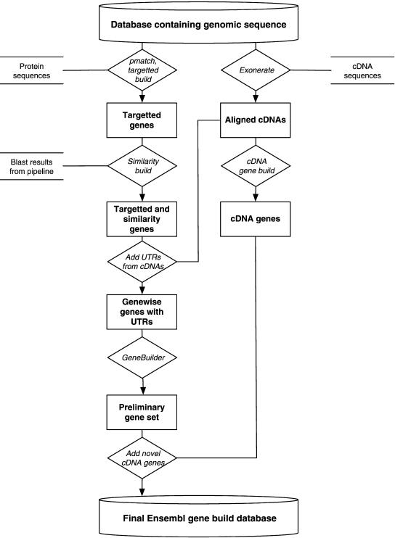
Gene Annotation System
All Ensembl gene predictions are based on experimental evidence
Predictions based on manually curated UniProtKB / Swiss-Prot / RefSeq databases
UTRs are annotated only if they are supported by EMBL mRNA records
Val Curwen, et al. The Ensembl Automatic Gene Annotation System Genome Res., (2004) 14 942 - 950.

Slide 28
UCSC Genome Browser
UCSC Genome Browser is created by the Genome Bioinformatics Group at UC Santa Cruz
Development team: https://genome.ucsc.edu/staff.html
Led by Jim Kent and David Haussler
The UCSC Genome Browser was initially created for the human genome project
It has since been adapted for many other organisms

