Slide 1
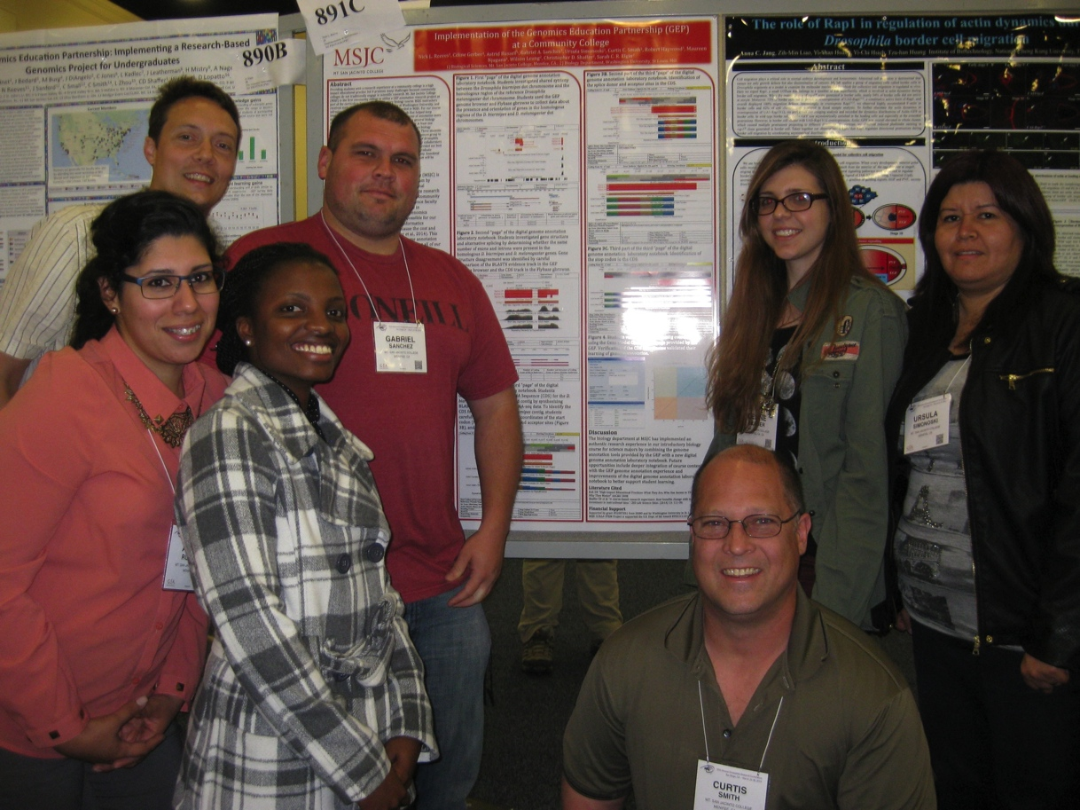
GEP Implementation at Mt. San Jacinto Community College
Nick Reeves, Ph.D.
Notes:
Last Update: 09/01/2020

Slide 2
GEP Training Concerns - July 2013
Will it be possible to implement the Genomics Education Partnership in an introductory majors biology course at a community college?
Can we connect the GEP experience to our introductory biology curriculum?
Do we have enough lab time available to make the GEP implementation worthwhile for our students?
Can I guide students all the way through an annotation project?

Slide 3
GEP Training Concerns - July 2013
Will it be possible to implement the Genomics Education Partnership in an introductory majors biology course at a community college?
Can we connect the GEP experience to our introductory biology curriculum?
Do we have enough lab time available to make the GEP implementation worthwhile for our students?
Can I guide students all the way through an annotation project?

Slide 4
Can we connect the GEP experience to our introductory biology curriculum?
Textbook: Campbell Biology, Reece et al.
Learning Objective 1: Design, perform and evaluate experimental investigations in biology through application of the scientific method, and report on the investigation using scientific format.
Learning Objective 2: Relate DNA information to protein products through the mechanisms of transcription and translation.
Lecture Schedule:

Slide 5
GEP Training Concerns - July 2013
Will it be possible to implement the Genomics Education Partnership in an introductory majors biology course at a community college?
Can we connect the GEP experience to our introductory biology curriculum?
Do we have enough lab time available to make the GEP implementation worthwhile for our students?
Can I guide students all the way through an annotation project?

Slide 6
Do we have enough lab time to implement GEP gene annotation?
Used the ABLE workflow as a starting point (Emerson et al. 2013)

Slide 7
Do we have enough lab time to implement GEP gene annotation?
General Biology includes a 2 unit (2 x 3 hours) lab section
Pre-GEP Lab Schedule:

Slide 8
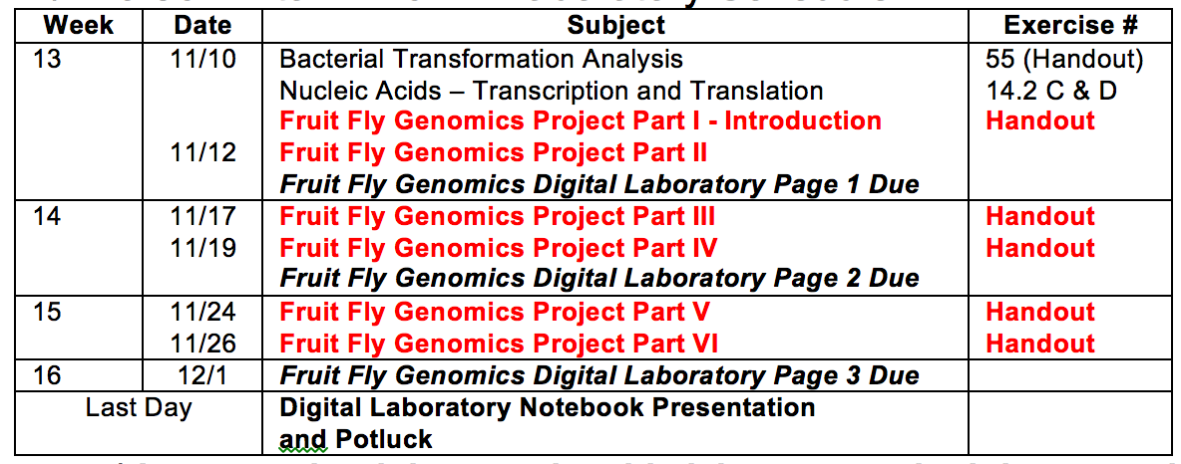
Do we have enough lab time to implement GEP gene annotation?
General Biology includes a 2 unit (2 x 3 hours) lab section
Post-GEP Lab Schedule (Fall 2014):

Slide 9
GEP Training Concerns - July 2013
Will it be possible to implement the Genomics Education Partnership in an introductory majors biology course at a community college?
Can we connect the GEP experience to our introductory biology curriculum?
Do we have enough lab time available to make the GEP implementation worthwhile for our students?
Can I guide students all the way through an annotation project?

Slide 10
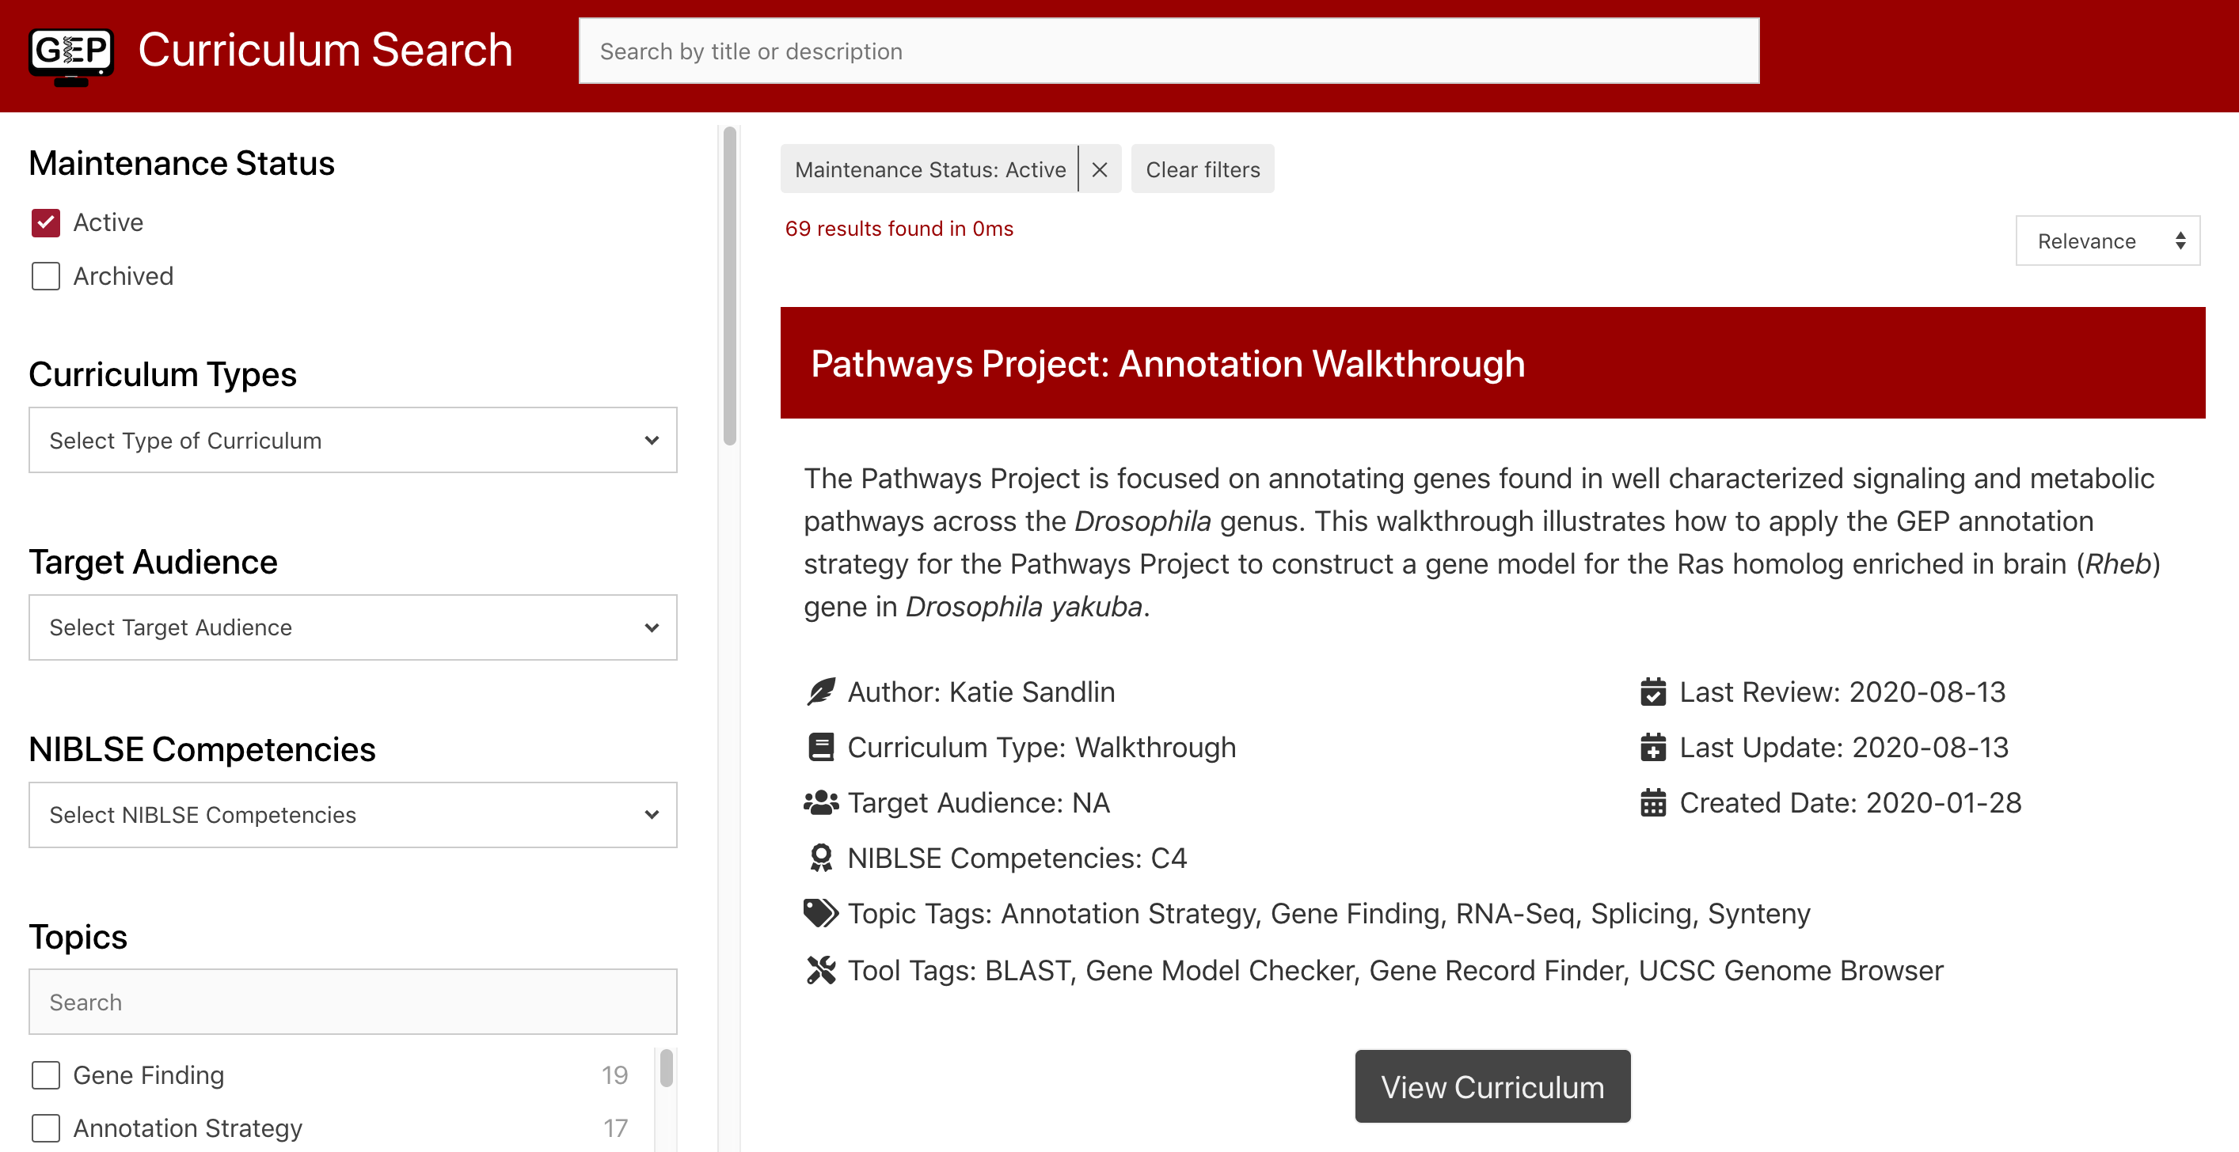
Can I guide students through an annotation project?
GEP Curriculum Resources
https://thegep.org/curriculumsearch

Slide 11
Can I guide students through an annotation project?
Curriculum, Recruitment, & Training Specialist:
Katie Sandlin (kmsandlin@ua.edu)
IT Technical Specialist:
Chinmay Rele (gep.rele.chinmay@gmail.com)
Director of IT:
Wilson Leung (wleung@wustl.edu)
GEP Program Director:
Dr. Laura K. Reed (lreed1@ua.edu)
GEP Committee Leadership:
https://thegep.org/staffandleadership/

Slide 12
Can I guide students through an annotation project?
Most of the GEP curriculum is geared for upper division courses
Decided to develop a clear and reproducible documentation process for annotation: Digital Laboratory Notebook
Formatted Microsoft Word files that help students collect all of the data needed to annotate a gene in a standardized way
Still improving and interested in feedback/ideas

Slide 13
Can I guide students through an annotation project?
Define the Coding DNA Sequence of the query gene by synthesis evidence provided in genome browser

Slide 14
Other Institution-Dependent Opportunities
Strong Honors Enrichment Program at MSJC: 5+ honors biology students in each class of ~32 students
Career and transfer center – enlighten students about bioinformatics careers and identify local bioinformatics programs

Slide 15
CURE (course-based undergraduate research experience) Achieved
Questions?
Contact Information Nick Reeves Mt. San Jacinto College nreeves@msjc.edu 951-639-5735

Slide 16
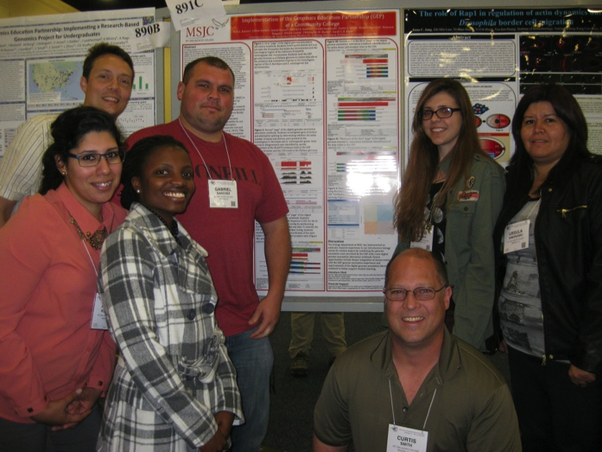
Presentations Reinforced Concepts
The honors biology students presented their work at 2 conferences:
Annual Drosophila Research Conference in San Diego – Wow! There sure are a lot of scientists working on fruit flies!
Honors Transfer Council Conference for California Community Colleges – Honors capstone experience

Slide 17
What exactly are we doing for honors?
Started with Introduction to Gene Annotation
Emphasized
GEP history/background
Reference/query species
Evolution of trait differences (biarmipes wing spots) as evidence of gene sequence change
Basic gene structure
Annotation evidence – BLAST/Predictions/RNA-seq/RepeatMasker

Slide 18
BLAST finds genes by homology
Walk through introductory BLAST activity with students and discuss results
Students clearly didn’t understand how a BLAST hit differs from a random sequence match… Tried a different approach in spring

Slide 19
Gene prediction finds gene sequences
Developed an extension of the BLAST activity that uses a gene prediction program online to find the same gene
Discussed the difference in approaches between BLAST (homology) and gene prediction algorithms (sequence signals)

Slide 20
Evidence without an assignment…
Difficulty explaining RNA seq to students that have not learned sanger sequencing much less next gen sequencing
RepeatMasker algorithm is unclear to me and hard to demonstrate to students

Slide 21
BLAST Activity Version 2.0

Slide 22
Adopt a DNA chunk
I claimed lower difficulty contigs (level 4) with 1 to 2 genes
Honors students chose one of the claimed contigs to work through
All files were delivered to student computers through Course Blackboard site and Dropbox which worked but was clunky… Google docs is probably a better choice

Slide 23
Digital Laboratory Notebook
How can I guide students through the annotation workflow without working with them one on one?
Clear and reproducible documentation of their steps will help me help them
Develop a Microsoft Word based Digital Laboratory Notebook (DLN) that collects the data needed to annotate a gene in a standardized way
Stole content from DiAngelo’s Simple Annotation Exercise as a starting point

Slide 24
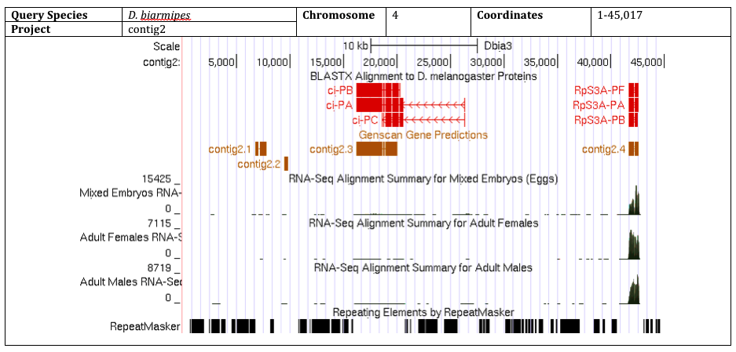
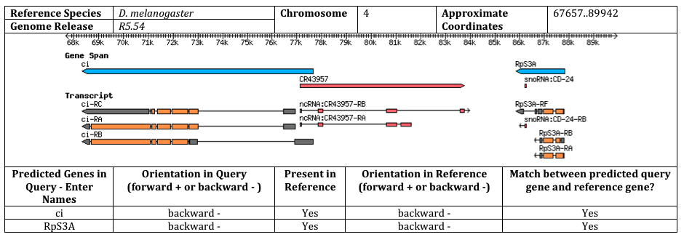
DLN Page 1 - Synteny
Orient students to the GEP genome browser and FlyBase Gbrowse
Synteny analysis that aligns with chromosome concepts covered in class – loci/linkage/cell division

Slide 25
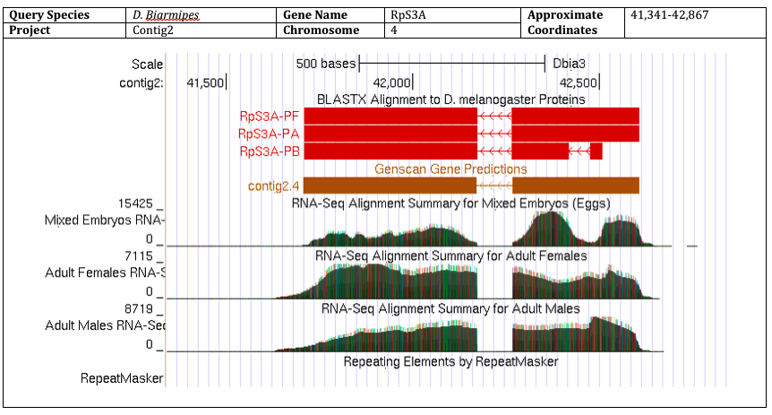
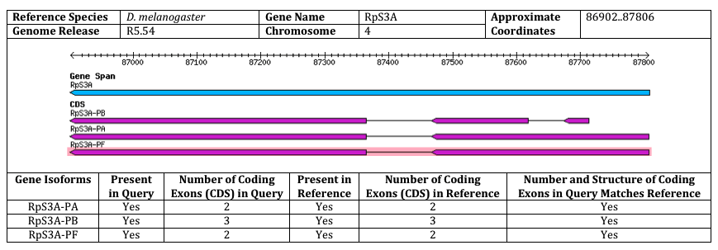
DLN Page 2 – Gene Structure
Pick a gene and compare the gene structure of the BLASTX track for D. biarmipes to the D. melanogaster annotation
Emphasize
Number of isoforms
Number of exons
Alternative splicing
Not considering the sequence yet

Slide 26
DLN Page 3 – Gene Annotation
Start at the start codon – It’s painted green!
Watch what strand you are reading from
Consilience of evidence
BLAST track finds homologs
Gene predictions indicate boundaries
RNA-seq shows expression and verifies boundaries but 5’ UTR is confusing for intro students – trumps other tracks

Slide 27
DLN Page 3 – Gene Annotation
Intron boundaries
Frame vs. phase – critical thinking! Prep assignments needed though…
Is it an AG or GT? Beyond the basic text…
Compare to the D. melanogaster protein as you go – Gene Record Finder

Slide 28
DLN Page 3 – Gene Annotation
Stop at the stop codon – It’s painted red
Check whether amino acids match D. melanogaster
Don’t get confused by BLASTX (ends before stop codon – does not an amino acid) and RNA-seq (ends after stop codon – 3’UTR)
All coordinates in highlighted boxes and ready to go but isoforms are tricky to document in the DLN

Slide 29
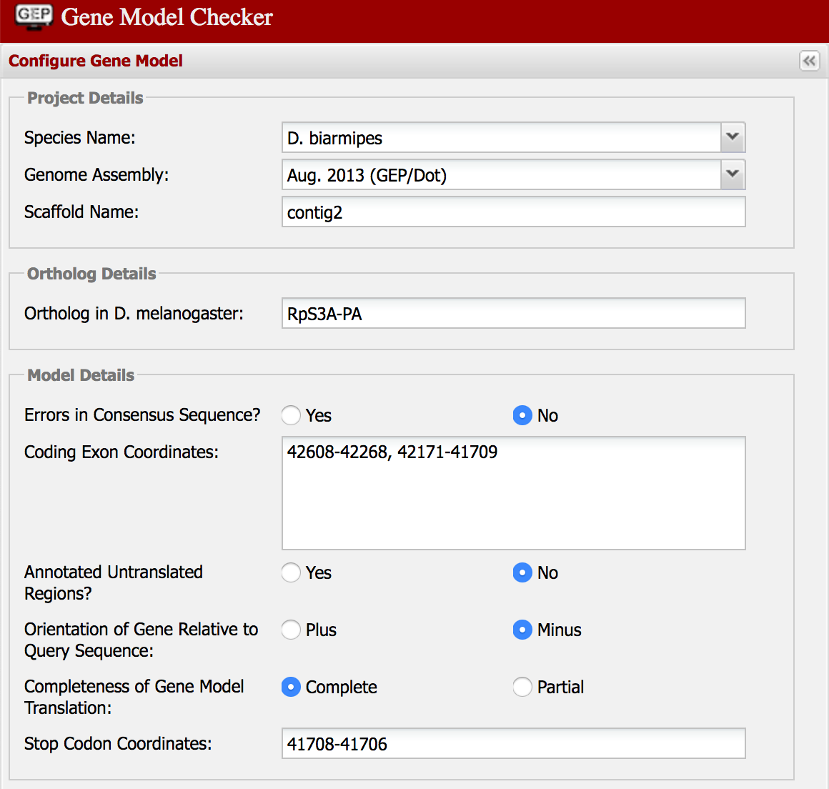
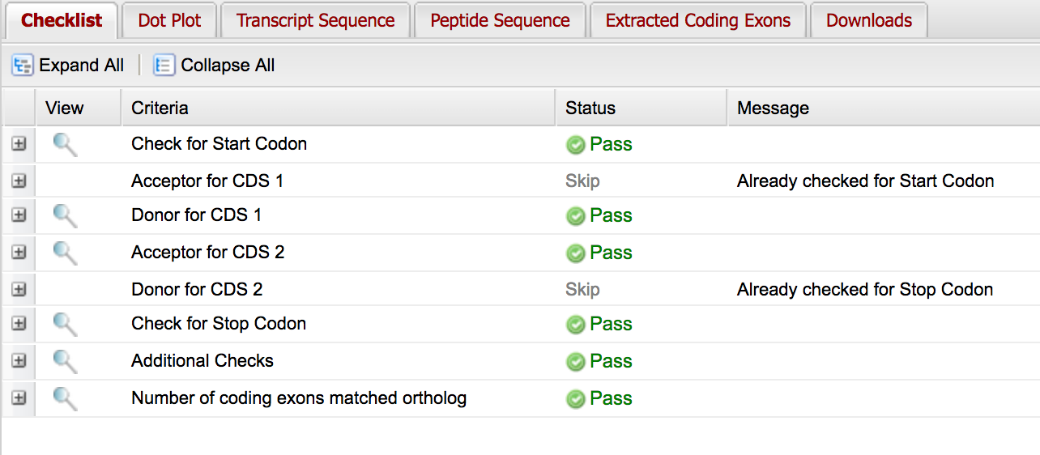
DLN Page 4 – Project Report
DLN Page 3 coordinates used to run the gene model checker
Students could mostly navigate this part on their own with a little intervention
Only ~20% finished a gene isoform in 15 hours…
Honors students completely finished during the summer…

Slide 30
Presentations Reinforced Concepts
The honors biology students presented their work at 2 conferences:
Annual Drosophila Research Conference in San Diego – Wow! There sure are a lot of scientists working on fruit flies!
Honors Transfer Council Conference for California Community Colleges – Honors capstone experience

