Slide 1
Common Errors in Student Annotation Submissions contributions from Paul Lee, David Xiong, Thomas Quisenberry
Annotating multiple genes at the same locus based on blastx alignments
Over-reliance on BLAST alignments
Over-reliance on gene predictors
Not annotating all genes or all isoforms
Missing small exons
Annotating incorrect splice sites
Notes:
Last update: 12/24/2023

Slide 2
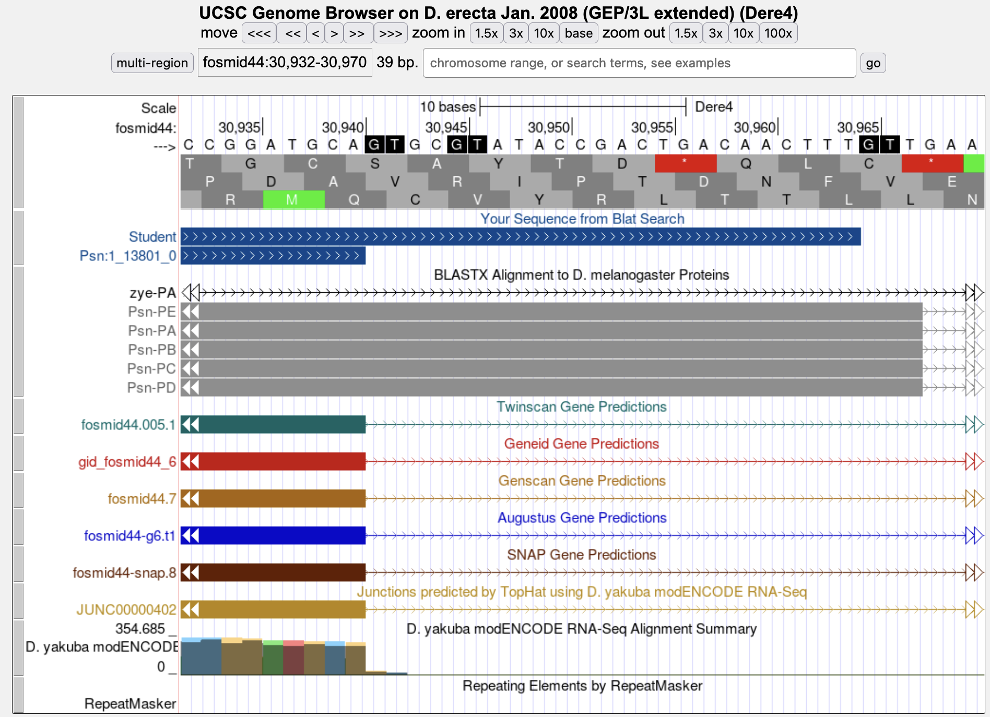
Over-reliance on blastx alignment
Annotations
blastx Alignment
Gene Predictors
RNA-Seq Data

Slide 3
Relying on a single gene predictor
Annotations
Gene Predictors
RNA-Seq Data

Slide 4
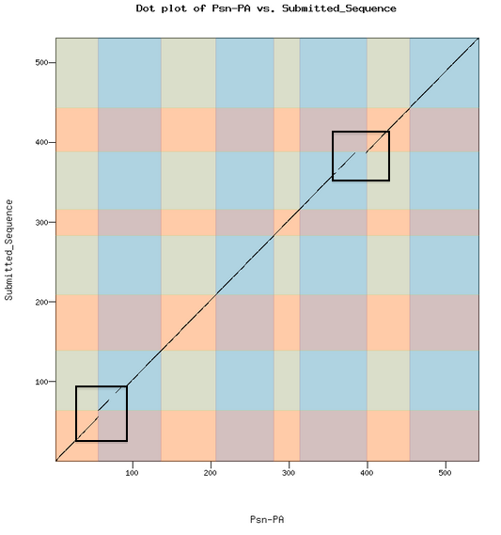
Strategies to resolve common errors
Dot plot
tblastn / blastx with exon-by-exon strategy
RNA-Seq
Identify small coding exons using “Small Exons Finder”
Use dot plot and peptide sequence alignment to check

Slide 5
An interesting annotation problem: contig34 (Liz Chen’s project from Bio 4342), reconciliation by Thomas Quisenberry
Submitted annotations:
Did Liz include an extra exon at 32298-32363?
Her model has 10 exons, while the Drosophila melanogaster model only has 9.
Liz suggested that there is an extra exon between 4_9472_0 and 5_9472_1

Slide 6
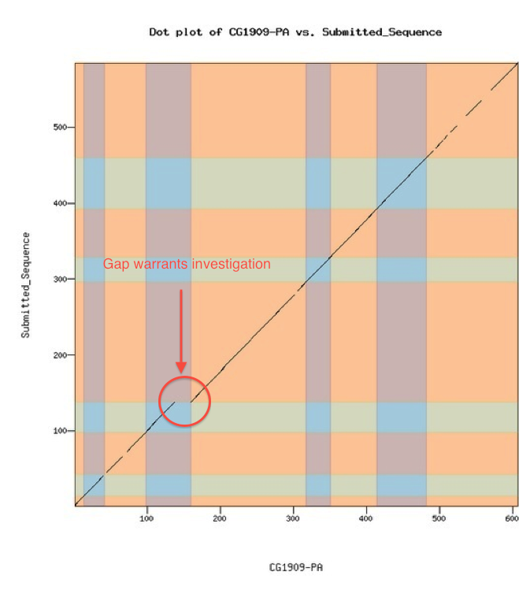
Continuing investigation of contig34
Checked other student’s submission forms for CG1909, the gene in question:
y-axis = student annotation submission; x-axis = D. melanogaster gene model
Gap (red) indicates residues in D. melanogaster gene that are not present in student annotation
All in all, this dot plot warrants further investigation
Gap warrants investigation

Slide 7
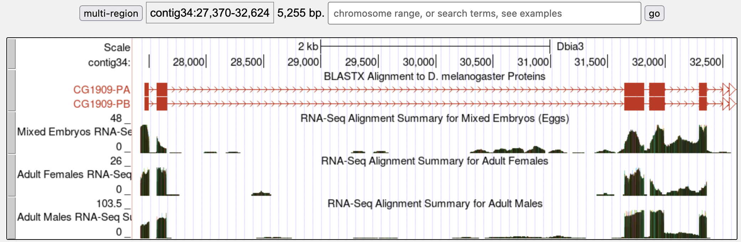
contig34 continuing investigation
Check UCSC Genome Browser view for this gene in D. biarmipes:
Above: blue box marks blastx alignment and RNA-Seq data in the region of extra exon.
Right-hand exon (fifth) is supported by RNA-Seq data, conservation.
Below: tblastn results using a.a. sequence of fourth exon in D. melanogaster model as the query and nucleotide sequence of contig34 as the subject → two regions of conservation

Slide 8
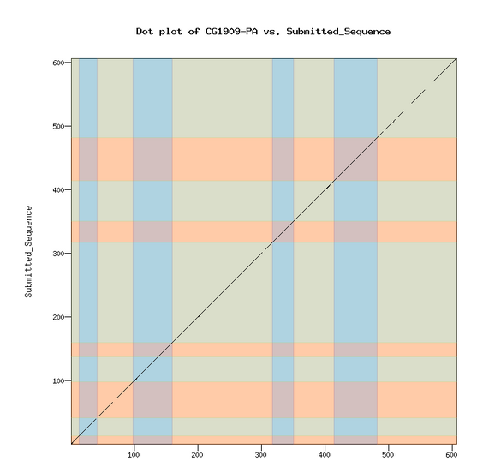
contig34 completed ☺
Gene model checker dot plot output for model including additional exon
Much better than before!
Amino acid sequence conserved
Appropriate splice junctions maintaining ORF identified
Model has one more exon
Notes:
-> Demonstrates the importance of scrutiny when revising these projects

Slide 9
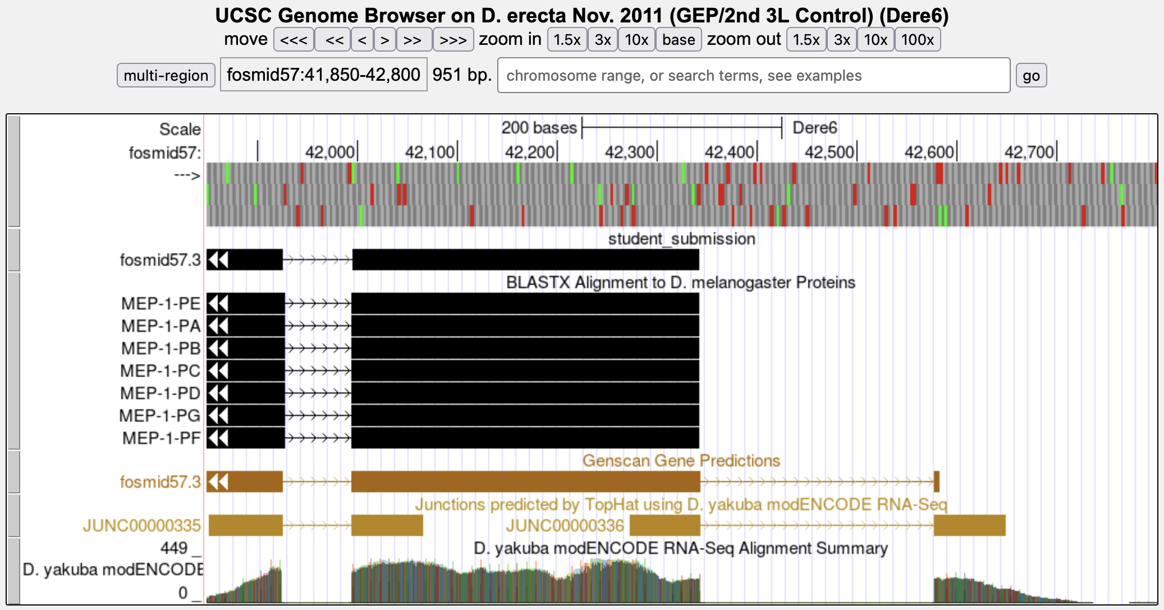
Strategies to identify small exons, particularly those with start and stop codons: Use RNA-Seq and TopHat to identify the 5’ and 3’ UTRs.

Slide 10
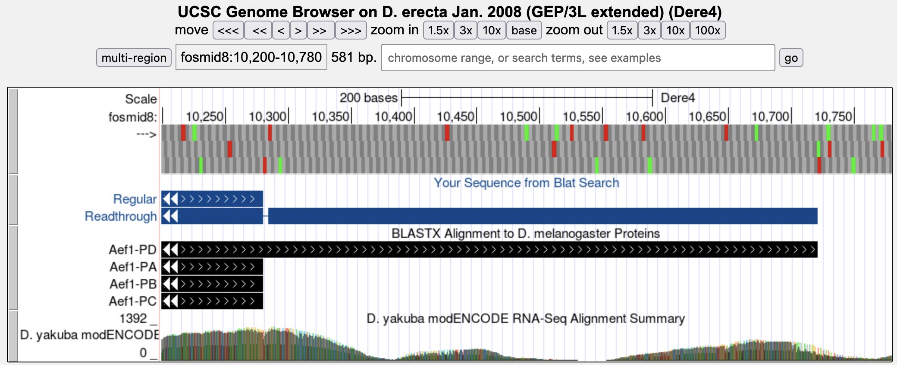
Interesting annotation challenges: Read-through stop codons
Jungreis et al “Evidence of abundant stop codon read-through in Drosophila and other metazoa.” Genome Res. 2011 21: 2096-113.

Slide 11
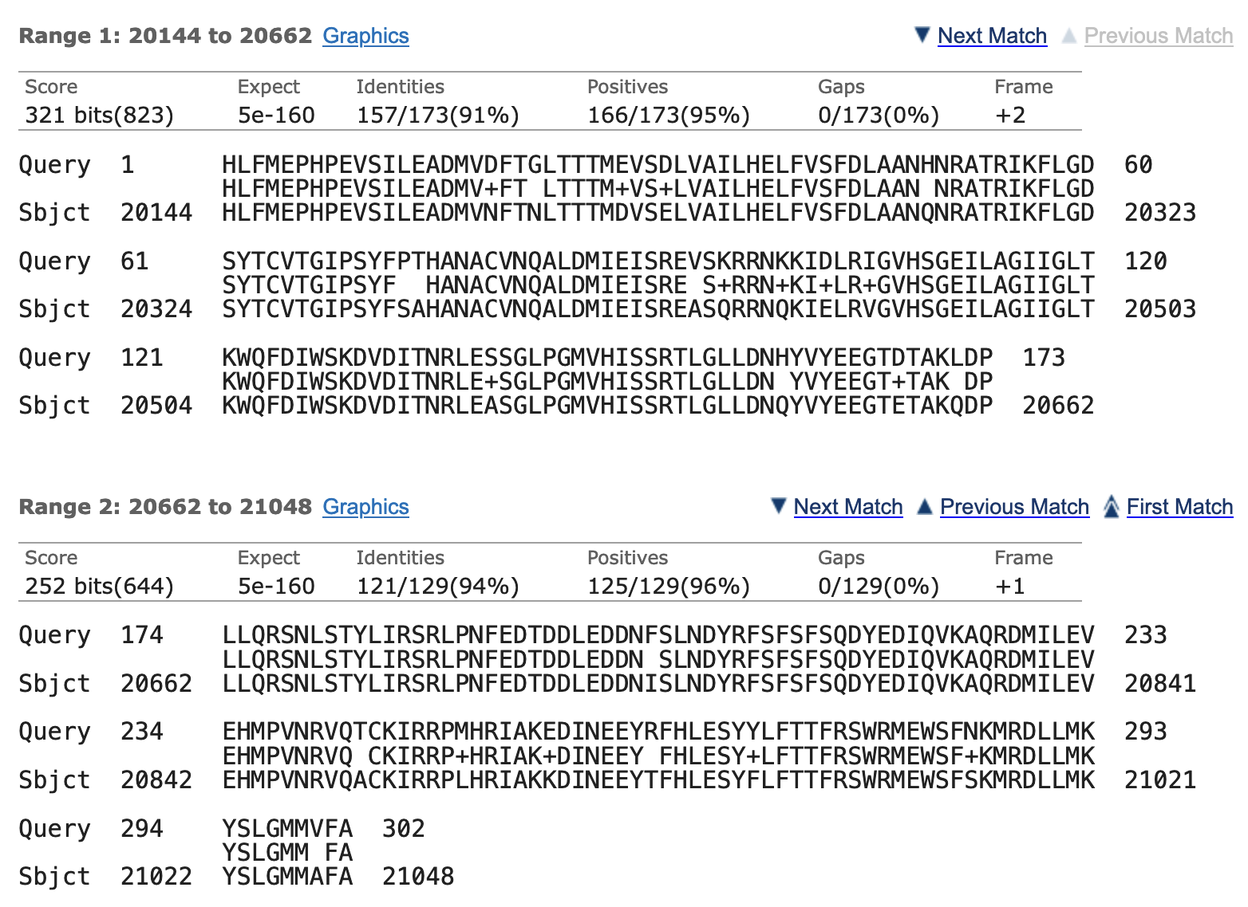
Interesting annotation challenges Errors in the consensus sequence
Frame +2
Query: CG32301:7_10856_1
Subject:
fosmid40 from the
D. erecta Nov. 2011 (GEP/2nd 3L Control) (Dere6) assembly
Frame +1
tblastn search of exon against contig shows a frame shift in the middle of the exon (problem with 454 sequencing)

Slide 12
To avoid these discrepancies, students should remember to…
check the dot plot and peptide sequence alignment comparison with D. melanogaster (output from Gene Model Checker); be able to explain & defend any differences!
look for discrepancies by going back to the Gene Record Finder and comparing exon lengths and locations;
double check all splice sites; check whether any proposed non-canonical splice sites are also observed in the D. melanogaster model or nearby species;
check all final annotation models with blastp alignments to the D. melanogaster ortholog (higher resolution);
for 454 sequenced species, check DNA sequence using added Illumina reads or RNA-Seq data if needed.

