Slide 1

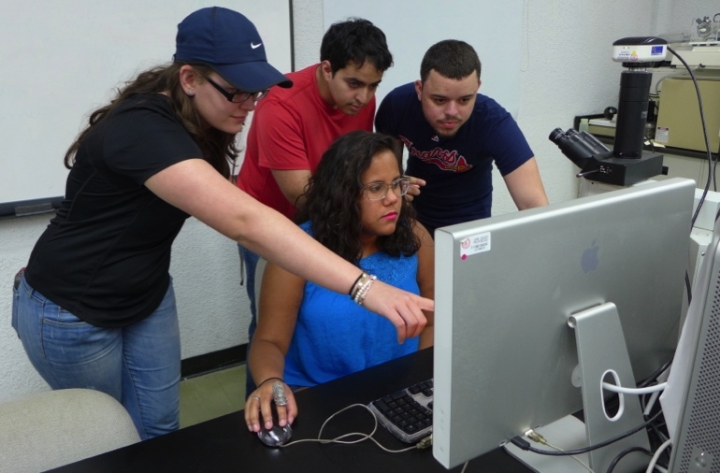
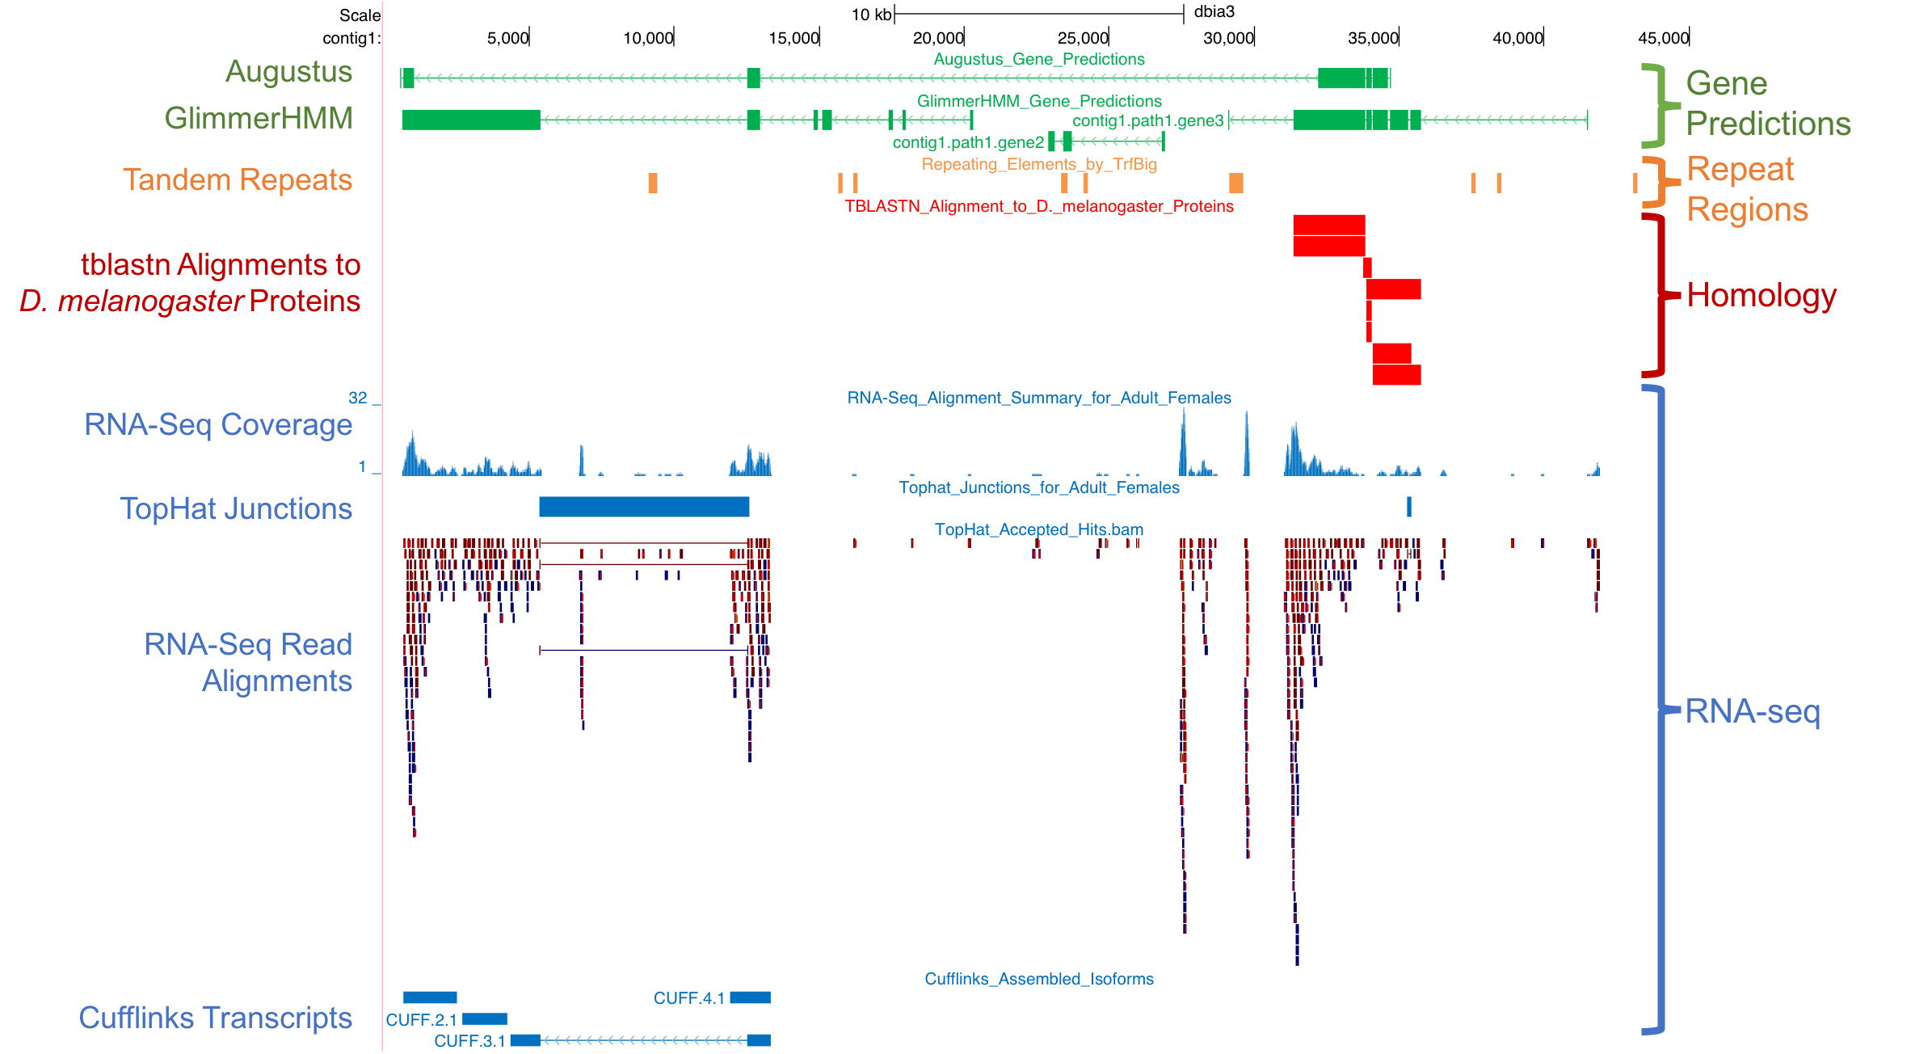
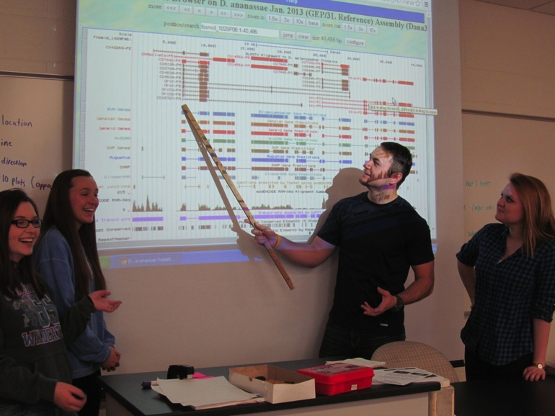
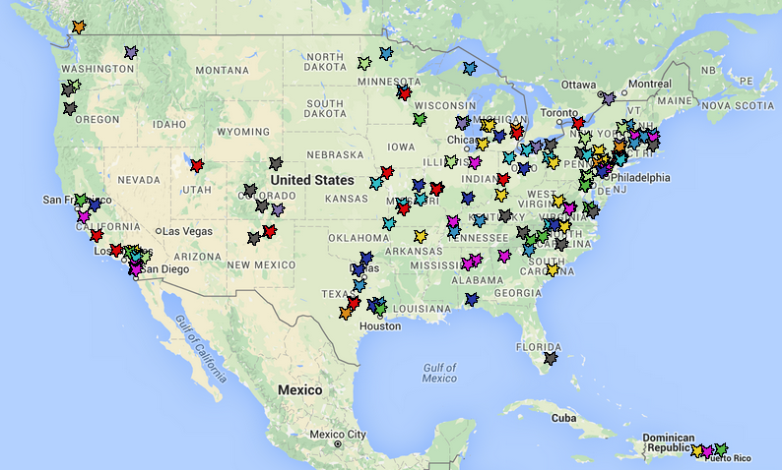
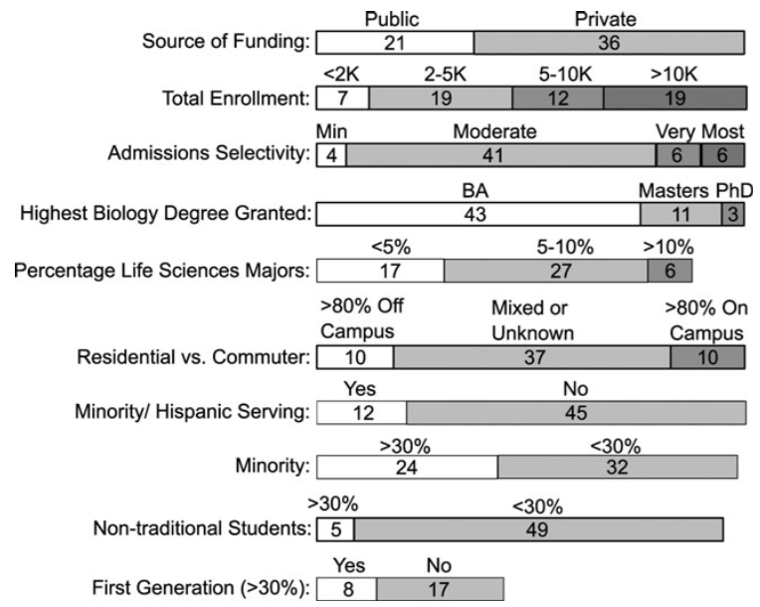

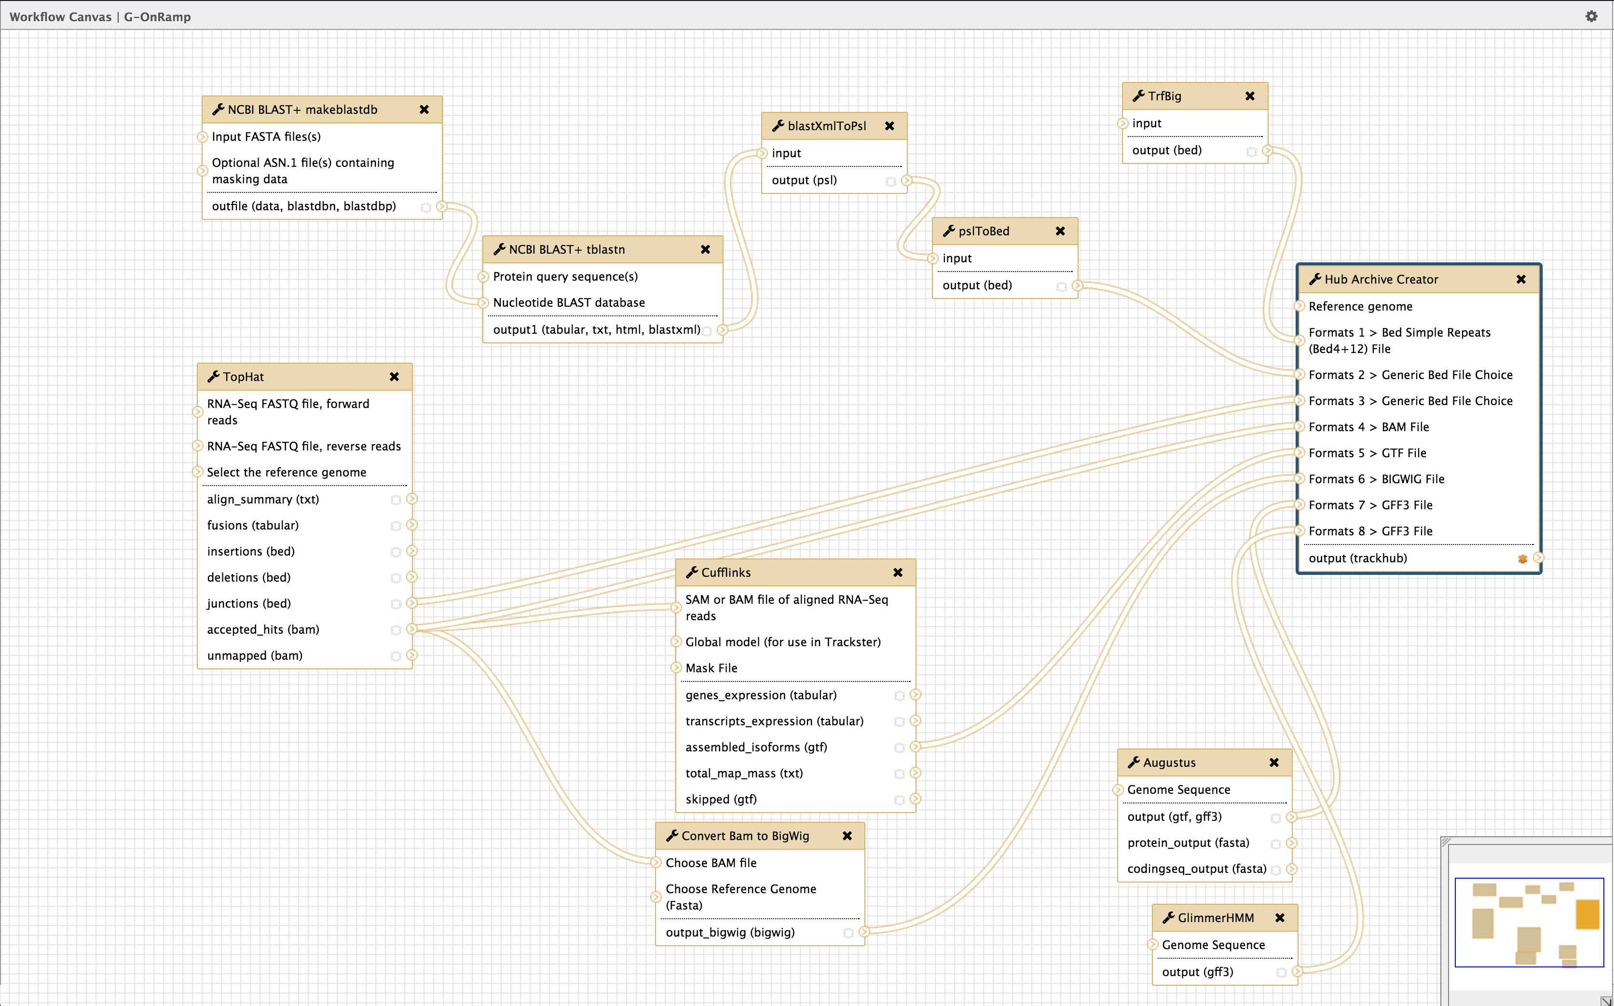
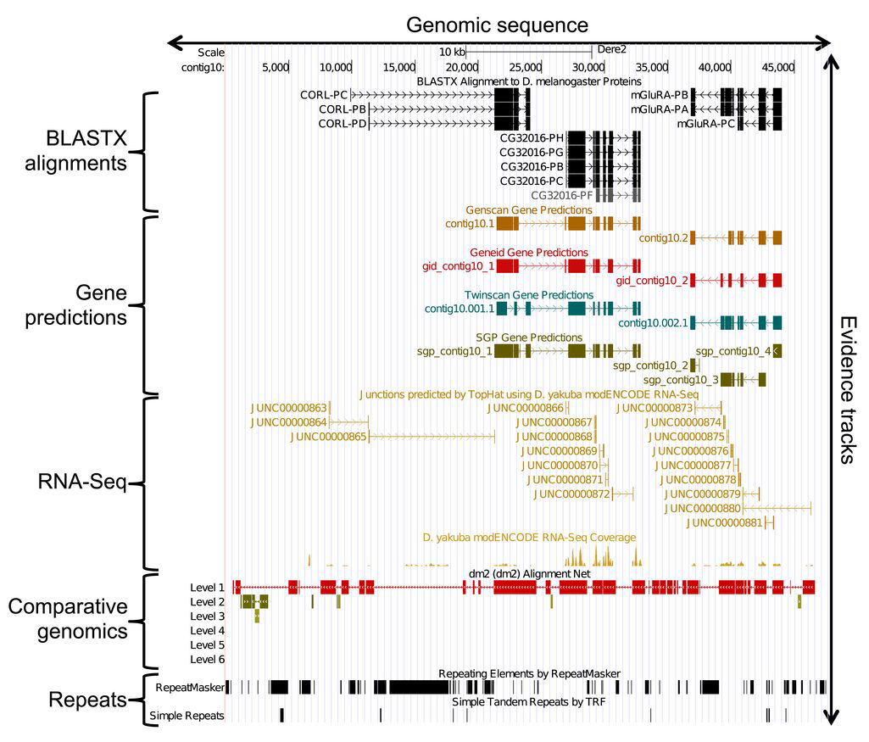






Engaging Biologists with Big Data Using Interactive Genome Annotation
Remi Marenco¹, Wilson Leung², Sarah C.R. Elgin² and Jeremy Goecks¹
¹George Washington University and ²Washington University in St. Louis
Project goal: combine two successful and long-running projects—the Genomics Education Partnership and the Galaxy Project—to create an integrated, Web-based, and scalable environment (G-OnRamp) that will enable biologists to utilize large genomic datasets for interactive annotation of any genome, an activity that can serve as an introduction and training for “big data” biomedical analyses.
The Genomics Education Partnership (GEP)
http://gep.wustl.edu
Primary goals:
Incorporate genomics and bioinformatics into the undergraduate curriculum
Engage undergraduates in genomics research
Central organization:
Hosts training workshops for GEP faculty / TAs
Develops & maintains web framework for projects
Hosts shared curriculum & assessment
GEP challenges can be addressed by Galaxy
GEP provides an ideal use case for training scientists to work with big data, but there are several challenges that Galaxy can address and help to scale and improve GEP:
UCSC Track Hubs in Galaxy
Many datatypes supported: Bed, BigWig, Bam, Bed Simple Repeats, GFF3, GTF, and more coming soon
TrackHub Datatype in any Galaxy:
Give your data to Hub Archive Creator, and visualize them on the UCSC Track Hub
PR pending for Galaxy 16.07
Access your Track Hub files from anywhere:
Use the Hub Archive Creator in Galaxy
Download the Track Hub structure
Move it to any server you want, the way you want
G-OnRamp available today in Beta:
On our servers
Get the workflow, give your data and visualize in the UCSC Track Hub
Feedback welcome at https://github.com/goeckslab/hub-archive-creator
GEP Challenge | Galaxy Feature to Address Challenge
Difficult to set up and integrate GEP computational tools | Automated installation and configuration
Cannot be easily extended to organisms beyond Drosophila | Develop approach to work with any organism and with multiple organisms
Limited flexibility to add custom analyses and data into the curriculum | Supports completely customizable workflows and analyses
Difficult to collaborate on gene annotations and analysis workflows across physically distributed sites | Web-based collaboration framework for sharing all Galaxy objects
Student photos taken by GEP faculty Michael Rubin (University of Puerto Rico – Cayey) and Heather Eisler (University of the Cumberlands)
Current GEP members The Genomics Education Partnership (GEP) began in 2006 with 16 members, and has grown steadily. GEP members represent a very diverse group of schools, both public and private, large and small, with varying educational missions and diverse student populations.
Currently there are > 100 affiliated schools; > 70 faculty/year are engaged in GEP research, and > 1,000 undergraduates participate each year. Faculty generally join by attending a one-week workshop at WUSTL. Shared work (done in summer Alumni Workshops) is organized on the GEP website (curriculum development, publications, etc.).
We find that institutional characteristics have little correlation with student success, indicating that diverse students in diverse settings benefit from course-based research experiences of this type.
GEP + Galaxy = G-OnRamp
G-OnRamp Goals:
Create a custom Galaxy server to power interactive annotation of any genome
Provide an interactive, Web-based platform that can scale to support world-wide big data biomedical training through interactive genome annotation
Foster the growth of the GEP and other educational communities to increase the participation of undergraduates and the broader scientific community in genomics research
Workflows, tools, and visualizations will be agnostic to the organism:
  Facilitate the analyses and annotations of non-model organisms
  Ensure that G-OnRamp can reach as broad an audience as possible
Validating G-OnRamp using GEP:
GEP faculty will serve as beta testers to ensure that G-OnRamp meets real educational needs
Provide continuous feedback to help guide the development of G-OnRamp
Help test and revise curriculum and training materials during workshops
Year joined
 | 2006
 | 2007
 | 2008
 | 2009
 | 2010
 | 2011
 | 2012
 | 2013
 | 2014
 | 2015
 | 2016
Shaffer CD et al. 2014, CBE Life Sci Educ. 13(1):111-30
Workflow Faculty members have collaboratively developed a variety of ways to use the GEP approach in their teaching:
Short (∼10 hrs) modules in a genetics course
Longer modules within molecular biology laboratory courses
Stand-alone genomics lab courses
Independent research studies
Results produced by GEP students are reconciled and used in subsequent scientific publications [e.g., Leung et al. 2015, G3. 5(5):719-40].
Sequence Improvement
Annotation
GEP gene annotation workflow for Galaxy for *any* genome
We have developed a comprehensive Galaxy workflow that produces multiple complementary datasets to facilitate the annotation of any genome:
  Gene prediction models from several different predictors
  Expression data from RNA-Seq (i.e. read coverage, splice junctions, assembled transcripts)
  Homology results from BLAST
  Repetitive regions such as transposons, simple repeats, low complexity repeats, and tandem repeats
Public “draft” genomes
Evidence-based gene annotation
Future plans
Extend the G-OnRamp workflow for analysis of functional genomic data:
ChIP-seq for finding transcription factor binding sites
DNase-seq/ATAC-seq for finding open chromatin regions
Bisulfite sequencing to identify methylated sites
Develop integrated and interactive Web-based tools and visualizations for:
  Viewing annotation evidence
  Distributed and collaborative annotations, including reconciling annotations from multiple individuals
Make it easy for individuals to use and install G-OnRamp on:
  Public national cybercomputing infrastructure such as CyVerse, XSEDE, and JetStream
  Commercial cloud computing platforms such as Amazon
  Virtual machines on local computers using preinstalled packages
Divide into overlapping student projects (40-100 kb)
Optional evidence-based TSS and motif annotation
Sequence and assembly improvement
Collect projects, compare and confirm annotations
Optional wet bench experiment
PCR/sequencing of gaps
Reassemble into high quality annotated sequence
Collect projects, compare and
verify final consensus sequence
Analyze and publish results
Homology
Repeat Regions
Training benefits Students are challenged to analyze and evaluate available evidence (assembled on the GEP UCSC genome browser) to create optimal gene models, often in the face of contradictory evidence, & explore other genomic features (right). GEP students report substantial learning gains, which improve significantly with more time invested (bottom).
RNA-seq
Acknowledgements
G-OnRamp supported by NIH Grant HG008843-01. GEP supported by HHMI grant #52005780, NSF grant #1431407 and WUSTL. Galaxy supported by NIH grant HG006620-04 and GWU.
Contacts
Jeremy Goecks
jgoecks@gwu.edu
Sarah CR Elgin
selgin@wustl.edu
Understanding the research process
Ability to analyze data
Independence
Gene Predictions
Mean scores
Q1 (1-10 hrs.)
Q4 (>36 hrs.)
Learning gain items in the SURE survey
SURE (Summer Research)

